Slide 1

Team Building
MK 341: Special Topics in Marketing 1
Marketing Leadership Development and Cross-cultural Management
By Ajarn Suwalya K.

Slide 2
What we plan to achieve
The Importance of Effective teams
Activities
Good and Bad Teamwork
Why Trust and a Respect are Important
Feedback
Giving Feedback: Good, Better,Best

Slide 3
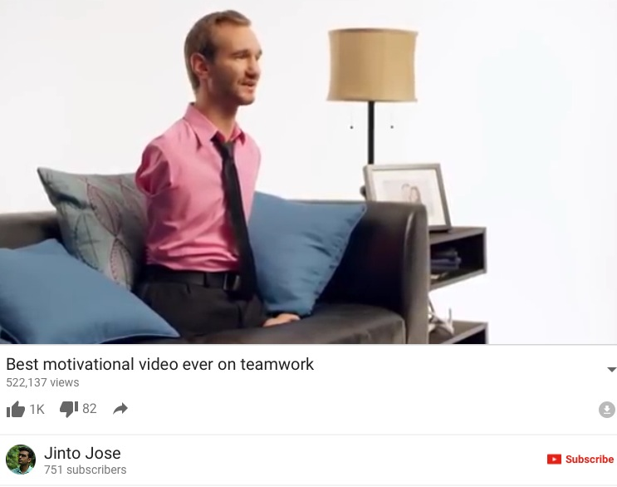


Slide 4
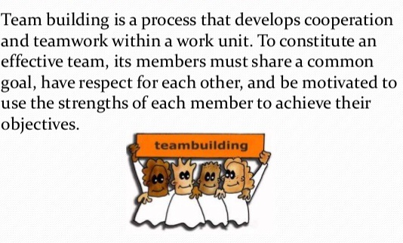
What is Team Building

Slide 5
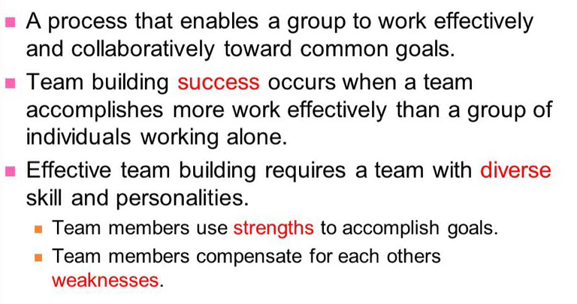
What is Team Building

Slide 6
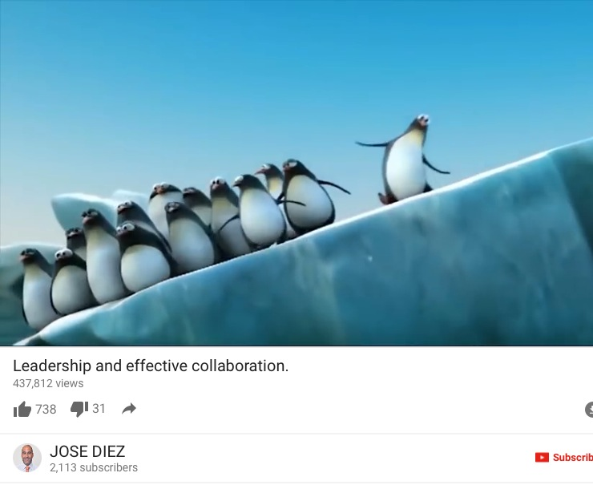

Slide 7
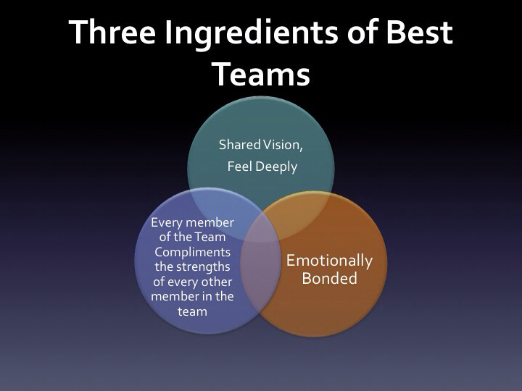

Slide 8
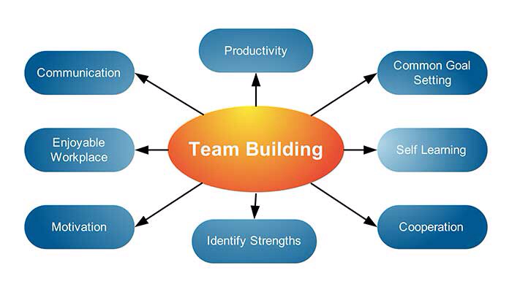
Team Building Creates

Slide 9
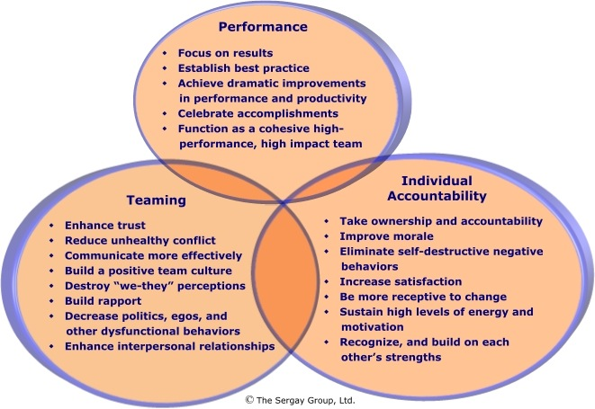
Good Team work reflects….

Slide 10
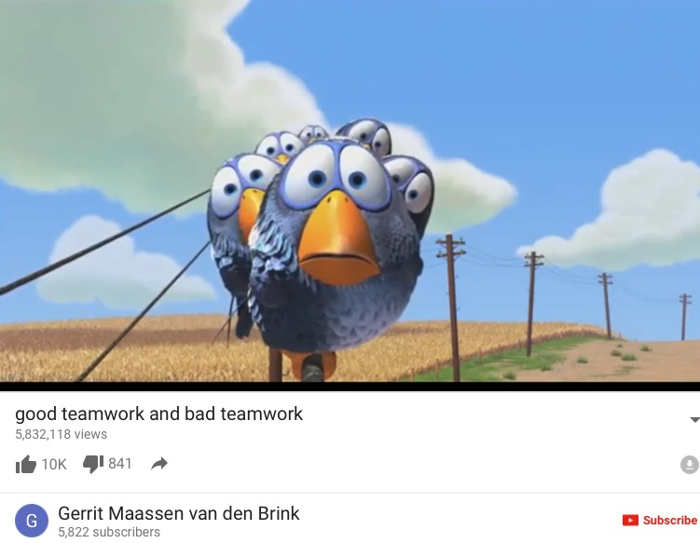

Slide 11
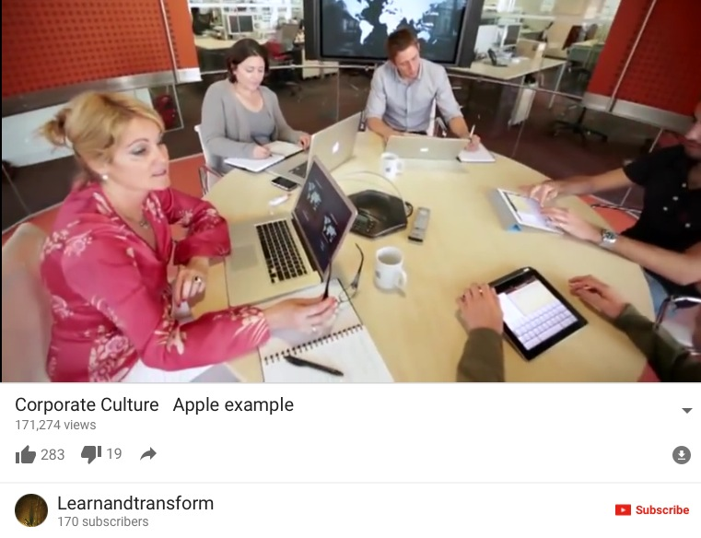

Slide 12
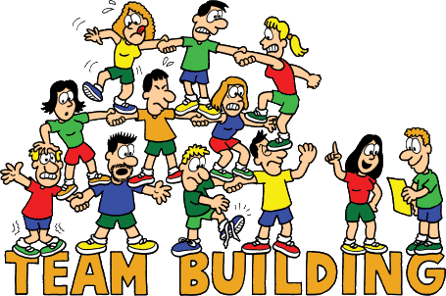
A team consists of….

Slide 13
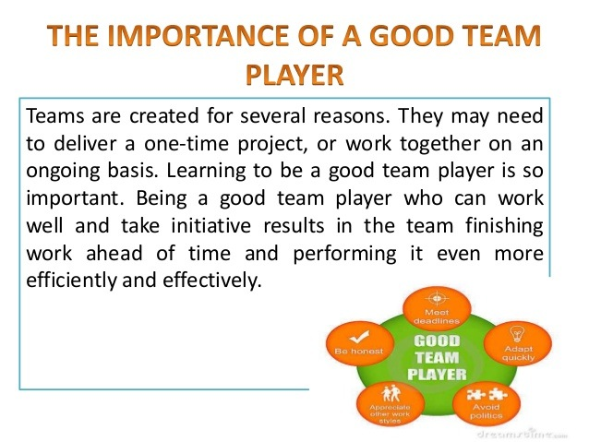

Slide 14
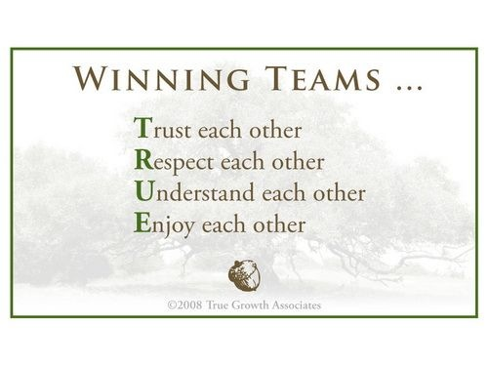
Trust and Respect

Slide 15
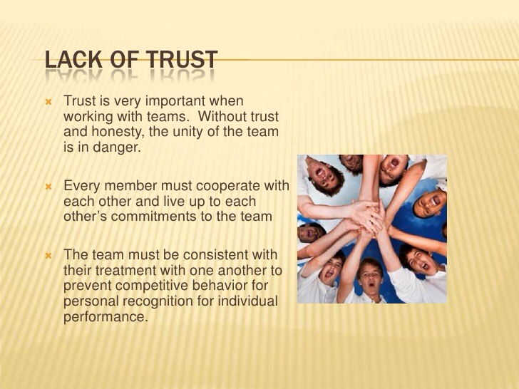

Slide 16

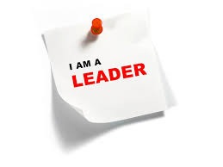

Exercise 1:Paper Doll

Slide 17
Discuss
How do you feel when you made her/him?
How did you feel when you rip her/him?
How did you feel when you had to mend her/him?
Lessons learned

Slide 18
Feedback

Slide 19
Feedback
"Give feedback often. Feedback works best when it's a continual process rather than a formal session once or twice a year. In fact, experts agree that the yearly performance appraisal is the worst time to surprise an employee with negative feedback. You're nervous, and so is the employee."
Feedback That Works - Harvard Business Review

Slide 20
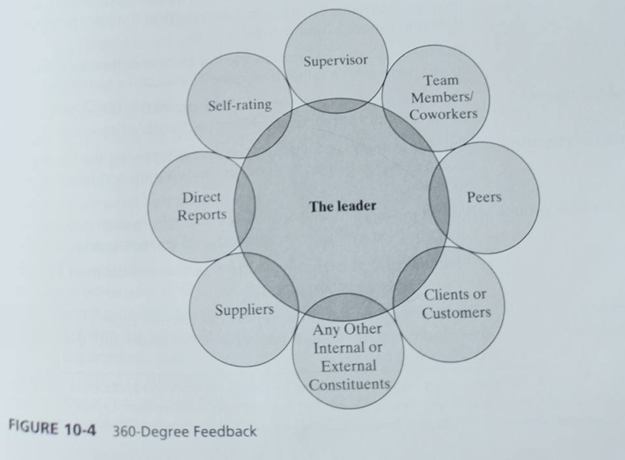
Feedback

Slide 21
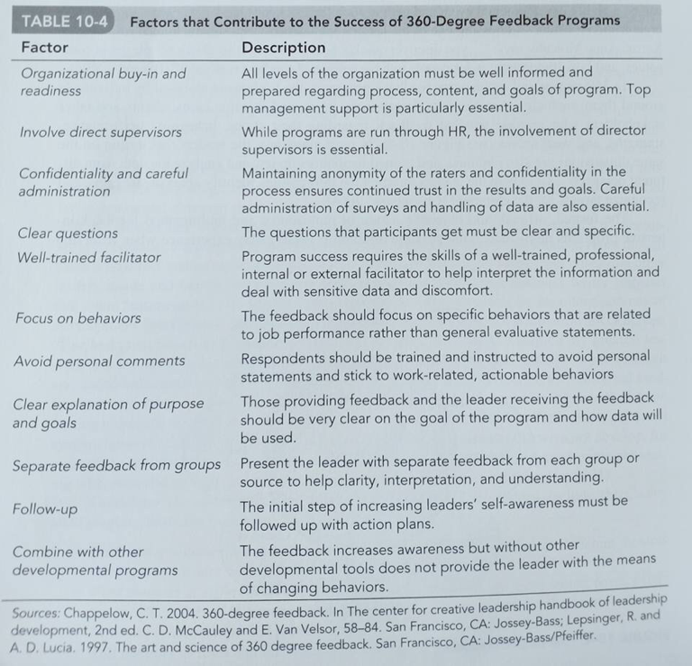
Feedback

Slide 22
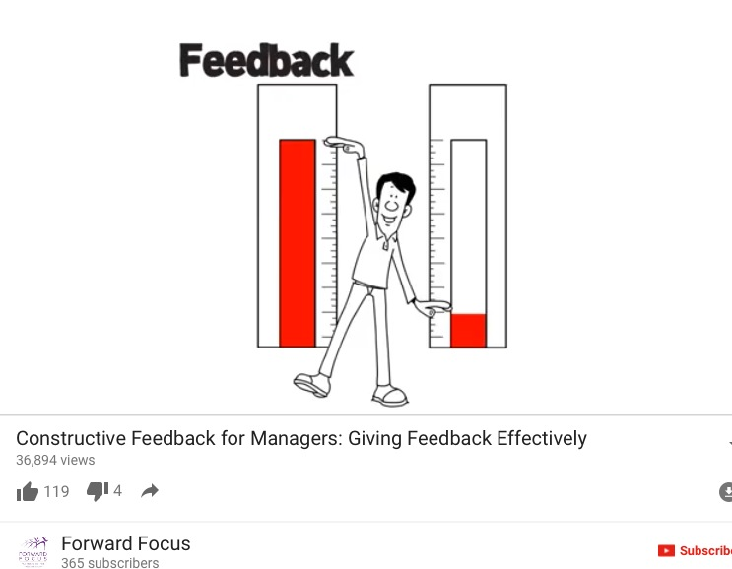

Slide 23
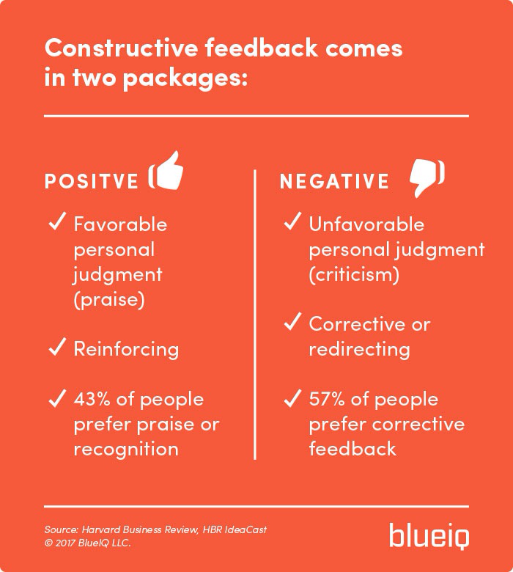
Feedback

Slide 24
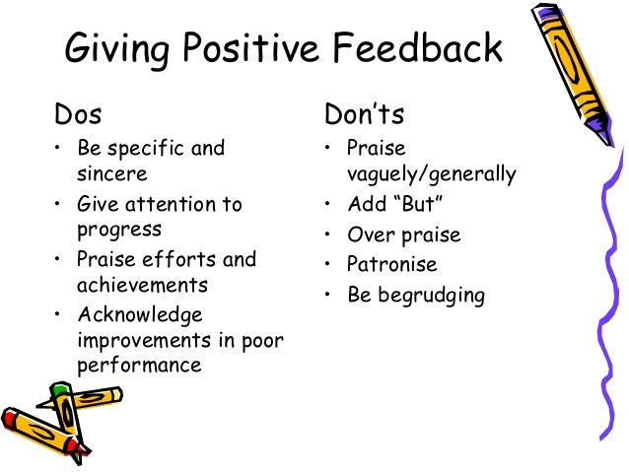

Slide 25
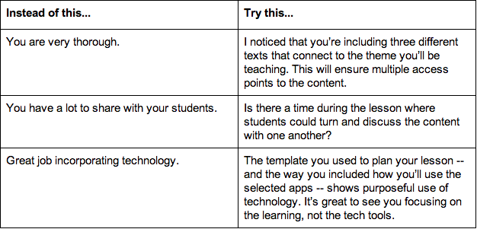
Feedback

Slide 26

Feedback

Slide 27
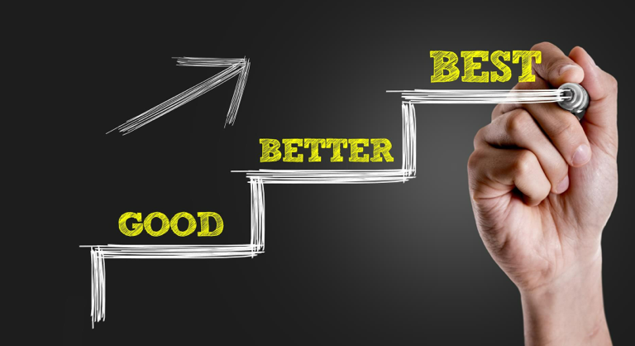
Feedback

Slide 28
Exercise 2: Feedback
Good…Better… Best
Briefing
Share in Class

Slide 29
What we accomplished
The Importance of Effective teams
Activities
Good and Bad Teamwork
Why Trust and a Respect are Important
Feedback
Giving Feedback: Good, Better,Best

Slide 30


