Slide 1

Chapter 1
Chapter 1
Introduction
MK 312 Marketing Management
By Aj.Suwalya

Slide 2
Ch. 1 - Learning objectives
After studying this chapter you should be able to:
■ understand why marketing planning is so important
■ explain the difference between marketing planning
and a marketing plan
■ explain the difference between goals and objectives
■ explore and explain the different stages in
developing a marketing plan.

Slide 3

Definition of Marketing planning
Marketing planning can be defined as the structured process of
researching and analyzing marketing situations,
developing and documenting marketing objectives, strategies and programs,
and implementing, evaluating and controlling activities to achieve the objectives.

Slide 4

Outcome of the marketing planning process
The outcome of this structured process is the marketing plan,
a document that summarizes
what the marketer has learned about the marketplace
and indicates how the firm plans to achieve its marketing objectives.

Slide 5
The marketing plan as a part of a more complex planning system
A marketing plan is one of several official planning documents created by a company.
These include the business plan, which outlines the organization’s overall financial and operational objectives and strategies, and the strategic plan, which discusses the organization’s general long-term strategic direction.

Slide 6

Marketing planning helps decision-making
Marketing planning is designed to assist the process of marketing decision-making under prevailing conditions of risk and uncertainty.

Slide 7

Marketing planning means change
Marketing planning means change. It is a process that involves deciding now what to do in the future,

Slide 8

Marketing planning means change
with a full appreciation of the resource position,
the need to set clear, communicable, measurable objectives, the development of alternative courses of action,
and a means of assessing the best route towards the achievement of specified objectives.

Slide 9
Benefits of marketing planning (1)
■ Consistency: the individual marketing action plan will be consistent with the overall corporate plan and with other departmental or functional plans. It should also be consistent with those of previous years, minimizing the risk of management ‘fire-fighting’
■ Responsibility: those who have responsibility for implementing the individual parts of the marketing plan will know what their responsibilities are. This enables a control system to be designed

Slide 10
Benefits of marketing planning (2)
■ Communication: those implementing the marketing plan will also know what the overall objectives are, the assumptions that lie behind them and the context for each of the detailed activities.
■ Commitment: assuming that the plan is agreed upon by those involved in its implementation, it should stimulate a group commitment to its implementation and ultimately lead to better decision-making.

Slide 11

Figure 1.1: The stages of building a
marketing plan

Slide 12
Step 1: mission, corporate goals and objectives
An organization’s mission is an expression of its purpose; it states what the organization hopes to accomplish and how it plans to achieve this goal. This expression of purpose provides management with a clear sense of direction.
A corporate mission statement requires detailed consideration by top management to establish the business the company is really in and to relate to its future business intentions.

Slide 13
Step 1: mission, corporate goals and objectives
A clear mission statement should include the customer groups to be served, the customer needs to be served, technologies to be utilized.
A general purpose expressed in the organization’s mission statement must be translated into more specific guidelines as to how these universal intentions will operate.

Slide 14


Step 1: mission, corporate goals and objectives
A goal is a general and qualitative expression of a desired outcome that provide general guidelines by which management can direct its actions.
Goals help identify, clarify and prioritize intended accomplishments, and help bridge the gap between the organization’s mission and its objectives by focusing the efforts of the strategic business unit (SBU) management team.

Slide 15

Step 1: mission, corporate goals and objectives
In contrast, an objective is a specific and quantitative expression of a desired outcome.
The corporate objectives of the organization are time dependent and determined to achieve shareholder expectations.
These should be derived from the mission statement to ensure integration within a corporate and marketing planning system.
If objectives specify what is to be done, then strategy lays down how it is to be done.

Slide 16

Step 2: assessing the current internal and external situation
This situation analysis attempts to address the question
“ Where is the organization now?”
It encompasses external and internal forces that shape market attractiveness, competitive position and current performance.

Slide 17

Step 3: SWOT analysis
Internal Environments -In assessing current situations, SWOT analysis attempts to identify one or more strategic relationships or match-ups between the SBU’s current strengths or weaknesses and its present or future opportunities and threats.
Strengths are the bases for building company competencies and ultimately competitiveness.
All businesses have weaknesses. Successful businesses try to minimize or conquer their shortcomings.

Slide 18

Step 3: SWOT analysis
External environments
Opportunities are unsatisfied customer needs that the organization has a good chance of meeting successfully.
Threats are hostile aspects of the external environment that could potentially injure the organization.

Slide 19

Step 3: SWOT analysis
The following actions suggested by the SWOT matrix are those that might be expected and provide the strategic marketing manager with some options:
  Match strengths and opportunities
  Convert weaknesses to strengths
  Convert threats to opportunities
  Minimize, if not avoid, weaknesses and threats

Slide 20

Step 4: segmentation, targeting, and positioning
In addition to analyzing the overall environment, marketers need to analyze their markets and their customer, whether consumers or businesses.
This means looking closely at market share trends, changing customer demographics, product demand and future projections, buying habits, needs and wants, customer attitudes and customer satisfaction.

Slide 21

Step 4: segmentation, targeting, and positioning
Marketers have to apply their knowledge of the market and customers – acquired through research –to determine which parts of the market, known as segments-should be targeted for marketing activities.

Slide 22

Step 4: segmentation, targeting, and positioning
Once the market has been segmented, the next set of decisions centers on targeting including whether to market to one segment, to several segments, or to the entire market and how to cover these segments.

Slide 23

Step 5: strategic market plan (marketing strategy)
At this point in the marketing planning process, the company has examined its current situation, looked at markets and customers, set objectives, and identified targeted segments and an appropriate positioning.

Slide 24

Step 5: strategic market plan (marketing strategy)
Now management can create the marketing strategies and tactics that will take the firm down the path towards its customers, working with the basic marketing mix tools of product, place (or distribution), price and promotions, enhanced by service strategies to build stronger customer relationships.

Slide 25

Step 5: strategic market plan (marketing strategy)
Marketing strategies are generally concerned with the 4Ps:
  Product strategies
    Developing new products, repositioning or relaunching existing ones and phasing out old ones
    Adding new features and benefits
    Balancing product portfolios
    Changing the design or packaging
  Pricing strategies
    Setting the price to skin or to penetrate
    Pricing for different products and market segments
    Deciding how to match competitive pricing

Slide 26


Step 5: strategic market plan (marketing strategy)
  Promotional strategies
    Specifying the communication platform and media
    Deciding the public relations brief
    Organizing the sales force to cover new products and services or markets
  Placement (distribution) strategies
    Choosing the channels
    Deciding levels of customer service

Slide 27

Exhibit 1.1 Global Marketing of Masterfoods M&M’s

Slide 28

Step 6: tactical marketing plan
The next step in the marketing planning process is the development of a tactical marketing plan to put the strategic market plan into effect.
Although the overall marketing strategy to protect, grow, reduce focus, harvest, enter or exit a market position is set by the strategic market plan, more specific tactical marketing strategies need to be developed for each of the key performance issues.

Slide 29
Step 6: tactical marketing plan
The firm’s overall marketing strategies need to be developed into detailed plans and programs.
The most important element is the detailed plans, which explain exactly what programs and individual activities will take place over the period of the plan (usually over the next year).
Without these specified – and preferably quantified-activities that plan cannot be monitored, even in terms of success in meeting its objectives.

Slide 30

Step 7: Marketing Budget
The classic quantification of a marketing plan appears in the form of budgets. The purpose of a marketing budget is to pull all the revenues and costs involved in marketing together into one comprehensive document.
It is a managerial tool that balances what need to be spent against what can be afforded, and helps in making choices about priorities; it is then used in monitoring the performance in practice.
The marketing budget is usually the most powerful tool with which the relationship between desired results and available means can be “thought through”

Slide 31
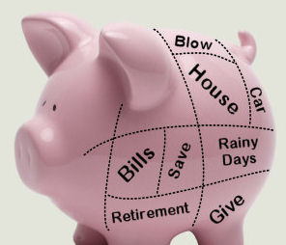
Step 8: implementation and performance evaluation
The best marketing plan is useless without effective implementation. Once strategies and plans are implemented, the ways to determine effectiveness by identifying company needs to formulate mechanisms and metrics that can be used to measure progress towards objectives.
Most companies use sales forecasts, budgets, schedules and other tools to set and record standards against which progress can be measured.
By comparing actual results against daily, weekly, monthly, quarterly and yearly projections, management can see where the firm is ahead, where it is behind and where it needs to make adjustments to get back on the right path.

Slide 32

Step 8: implementation and performance evaluation
There is 3 main marketing planning approaches in terms of involvement of the organization as a whole:
  1. Top-down planning
  2. Bottom-up planning
  3. Goals-down-plans-up planning

Slide 33



Case Study
Page 18

Slide 34

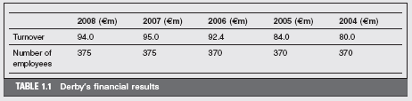

Slide 35
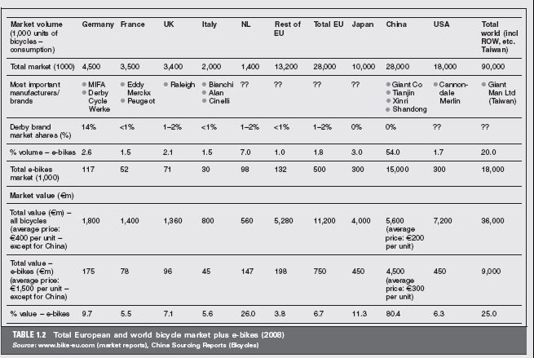

Slide 36


