Slide 1
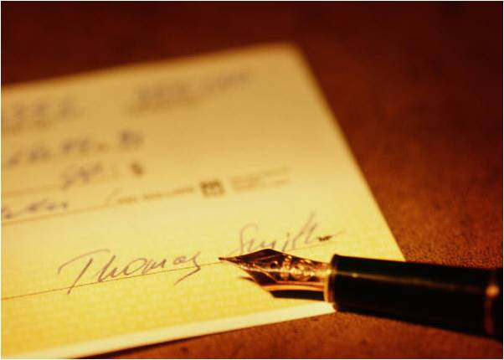
Cheques
Thawan Paruggamanont 5304641235
Isra Nandhakij ‎5304641433
Supakit Wongratvanich ‎5304641045
Pitraporn Chamsai 5304640732
Petchpimol Horpattraporn 5304640682

Slide 2
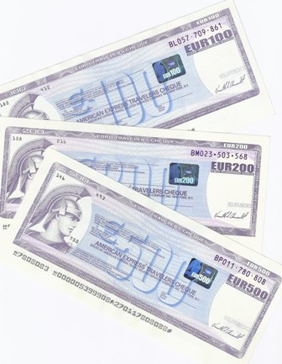
Traveler’s Cheque (T/C)
T/C is a bill of exchange designed specially for a business or vacation traveler, it is actually a sight draft (payable when presented) with the security equal to that of a letter of credit. T/C’s are issued by major financial service firms (such as American Express and Thomas Cook) and sold through banks and other outlets. T/Cs are available in several fixed denominations in all major currencies. They are readily accepted as cash by most banks, hotels, merchants, etc., and are insured by the issuer against damage, destruction, loss, or theft.
T/C’s were generally used by people on vacation instead of cash as many businesses used to accept traveller's cheques as currency. If a traveler's cheque were lost or stolen, they could be replaced by the issuing financial institution. Their use has been in decline since the 1990s as alternatives, such as credit cards, debit cards and automated teller machines became more widely available and were easier and more convenient for travelers.

Slide 3
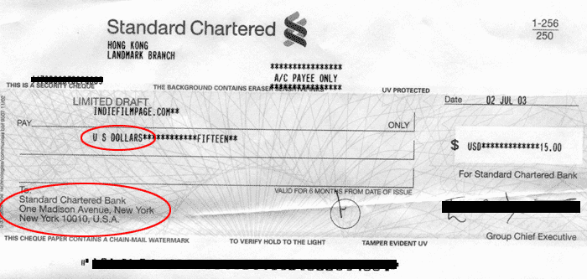
Bank Draft
A Bank Draft is type of check where the payment is guaranteed to be available by issuing bank. Typically, banks will review the bank draft requester's account to see if sufficient funds are available for the check to clear. Once it has been confirmed that sufficient funds are available, the bank effectively sets aside the funds from the person's account to be given out when the bank draft is used.
Bank drafts are normally involved in transactions involving large sums of money and/or situations where trust can be an issue.
Suppose you are purchasing a new car, showing up with a bank draft allows the dealership the assurance that you have enough money to purchase the vehicle and that your check will not bounce.
A Bank Draft is more secure than a “normal cheque”, which can “bounce”.
This is an example of an acceptable bank draft from Hong Kong. The bank draft is issued in U.S. dollars and payable from a U.S. bank (as the areas circled in red indicate).

Slide 4
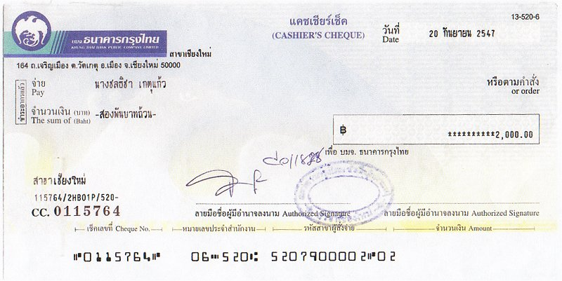
Cashier’s Cheque
A check written by a financial institution on its own funds. It is then signed by a representative of the financial institution and made payable to a third party. A customers who purchases a cashier's check pays for the full face value of the check and usually also pays a small premium for the service. These checks are secured by the funds of the issuer - usually a bank - and include the name of a payee (the entity to which the check is payable), and the name of the remitter (the entity that paid for the check).
An individual could use a cashier's check instead of a personal check to guarantee that his or her funds for payment are available. A cashier's check is secured because the amount of the check must first be deposited by the individual into the issuing institution's own account. The person or entity to whom the check is made out is then guaranteed to receive the money when cashing the check.
Cashier's checks differ from certified checks (eg. Bank Draft) in that the funds owing on a cashier's check are taken from the issuer's account, while the funds owing on a certified check are taken from the remitter's account.

Slide 5
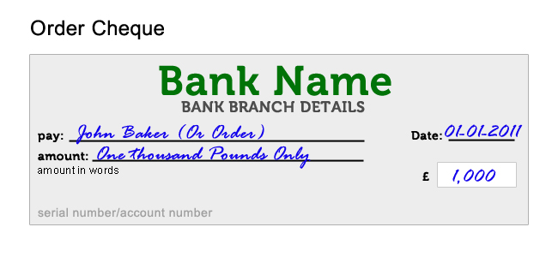
Order Cheque
A cheque which is paid to a named person with the words 'or order' after the payee's name, showing that he or she can endorse it and pass it to someone else if desired
Key Points: Like &co cheque, but the payee has to draw the money from local area (province) If you draw money from other areas (provinces), you will be subject to some fees, hence in the latter case, it is better to use “Pay to order”
Pay to Order
A check or draft that must be paid via endorsement and delivery. Pay-to-order instruments are negotiable checks or drafts that are generally written as "pay to X or order." These instruments stand in contrast to pay-to-bearer instruments, which do not require endorsement.
The Uniform Commercial Code outlines the rules pertaining to pay-to-order instruments. It specifies that ownership of this type of check can be transferred only via endorsement – someone who accepts a check must endorse it before transferring it somewhere else.
Key Points: Also like &co, but used for drawing money from other areas (provinces).

Slide 6
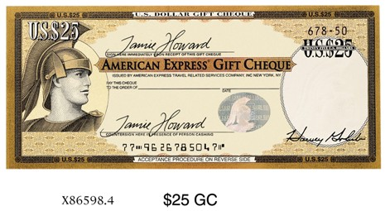
Gift Cheque
the check given to someone for the special occasion like Birthday and the giver can buy it by using cash. There are the different points and the regulation and condition for the reciever to get the cash are all like “cashier cheques”
Do I need to sign Gift Cheques before giving them to recipients?
No. Only the recipient should sign the Gift Cheque. Each Gift Cheque should be signed in the upper left corner immediately upon receipt. When the recipient cashes the Gift Cheque, a cashier should watch the recipient countersign the Cheque in the lower left corner. If accepting a Gift Cheque from another individual, you may only deposit it to your own bank account.
Is there a fee to purchase Gift Cheques?
There is usually a fee of $2.50 per Cheque, although exact fees may vary depending on establishment.
Where are American Express Gift Cheques accepted?
In the U.S. American Express Gift Cheques can be
used like cash at most retail locations, hotels, and
restaurants.
Do Gift Cheques ever expire?
No, they will never expire.

