Slide 1
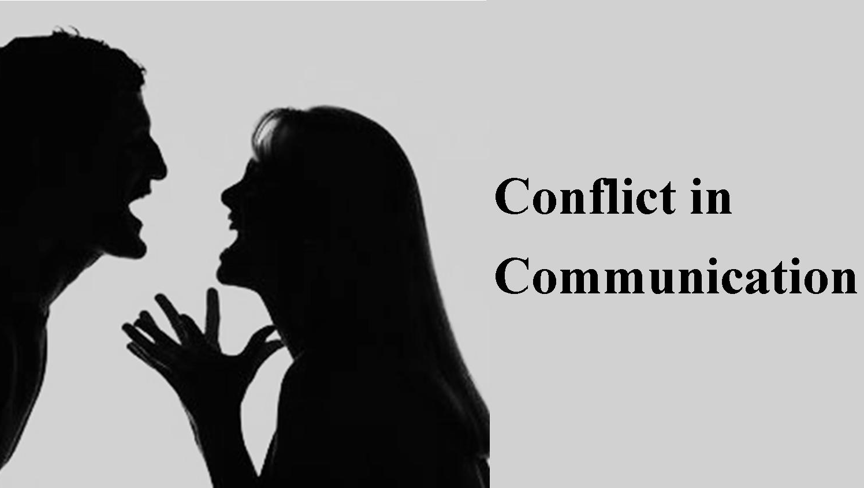

Slide 2
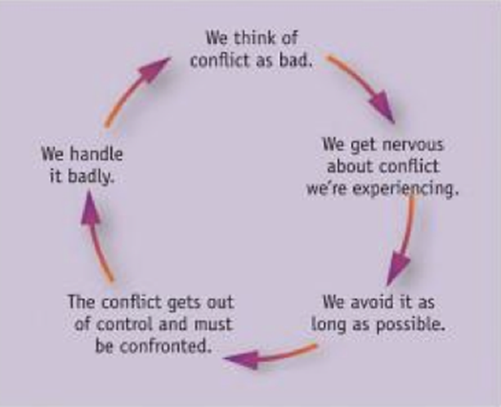
Beliefs About Conflicts

Slide 3

Beliefs About Conflicts
Conflict is neither inherently bad nor inherently good
Avoiding conflict can also be good sometimes
Collectivist cultures
  Often avoid conflict
Individualistic cultures
  Encourage direct confrontations

Slide 4
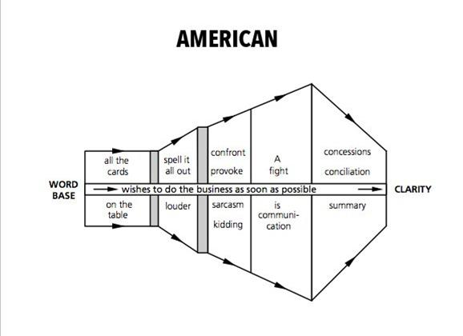
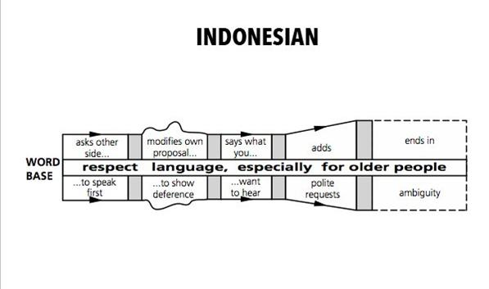
Beliefs About Conflicts
Collectivistic
Individualistic

Slide 5
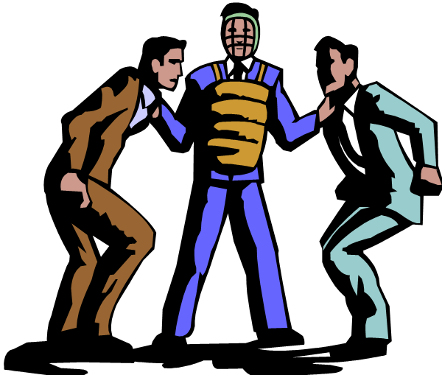
Causes of Conflicts
1. Conflicting resources:
Prioritize time and resources to avoid conflict
2. Conflicting Styles:
Consider personal styles when building team
3. Conflicting Perspectives:
Direct communication
4. Conflicting Goals:
Reconcile Goals from all parties

Slide 6

Causes of Conflicts (cont.)
5. Conflicting Pressure:
Reschedule tasks and deadlines
6. Conflicting Roles:
Respect one another’s area of responsibilities
7. Different Personal Views: (Conflicts with personal ethical standards)
Preserving Integrity

Slide 7
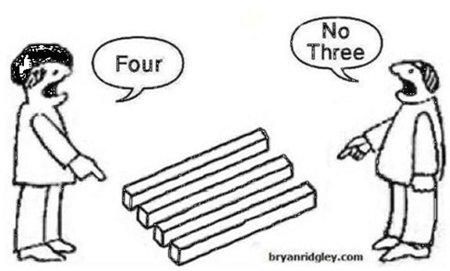
Different Personal Views

Slide 8
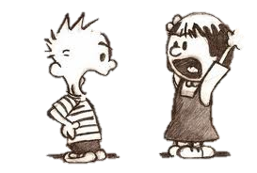
Causes of Conflicts (cont.)
8. Unpredictable Policies (Inconsistencies):
Clarifications
9. Power Conflicts: Tension
Negotiations
10. Barriers in Communication
11. Language of discrimination

Slide 9

Barriers to Effective Communication: Defensiveness
Excessive concern with protecting oneself from being hurt
Trigger:
Belief that others are evaluating/trying to control/manipulating them
When others act in a superior manner
Dogmatic people
self-fulfilling prophecy

Slide 10
Barriers to Effective Communication: Ambushing
Looking for opportunity to assail/harass the speaker after listening carefully to the message
  Arouse defensiveness
Trigger:
Desires to retrieve information to discredit/manipulate another person
Note: Can often be seen in politics and marriage divorces
Notes:
Note: Can often be seen in politics and marriage divorces

Slide 11

Barriers to Effective Communication: Motivational Distortion
Hearing what you want to hear rather than what is actually being said
  Produce emotional distress
Trigger:
Information that contradicts an individual’s own views
Selective attention
Reading unintended meanings/ Jump to erroneous conclusions

Slide 12
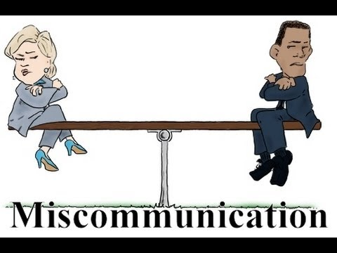
Barriers to Effective Communication: Motivational Distortion

Slide 13
Barriers to Effective Communication: Self-Preoccupation
People who are self-focused/ engaged in pseudolistening
  “That’s nothing. Listen to what happened to me!”
  Poor listener
  Mentally rehearsing their next comments
Arouse Negative Reactions:
  Their remarks are self-serving (offensive)
  Take up more than fair share of conversation time (listeners feel ignored)

Slide 14
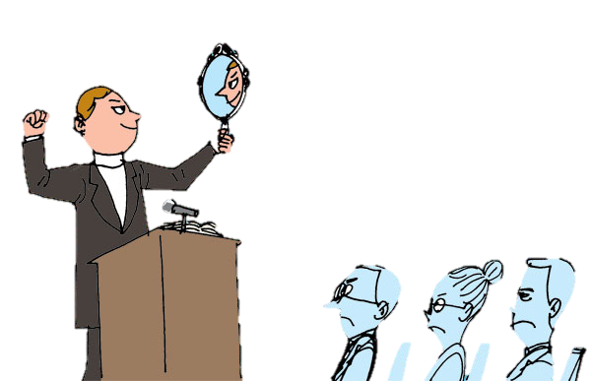
Barriers to Effective Communication: Self-Preoccupation (cont.)
Trigger:
Shyness
Personality Disorders
Self-consciousness

Slide 15
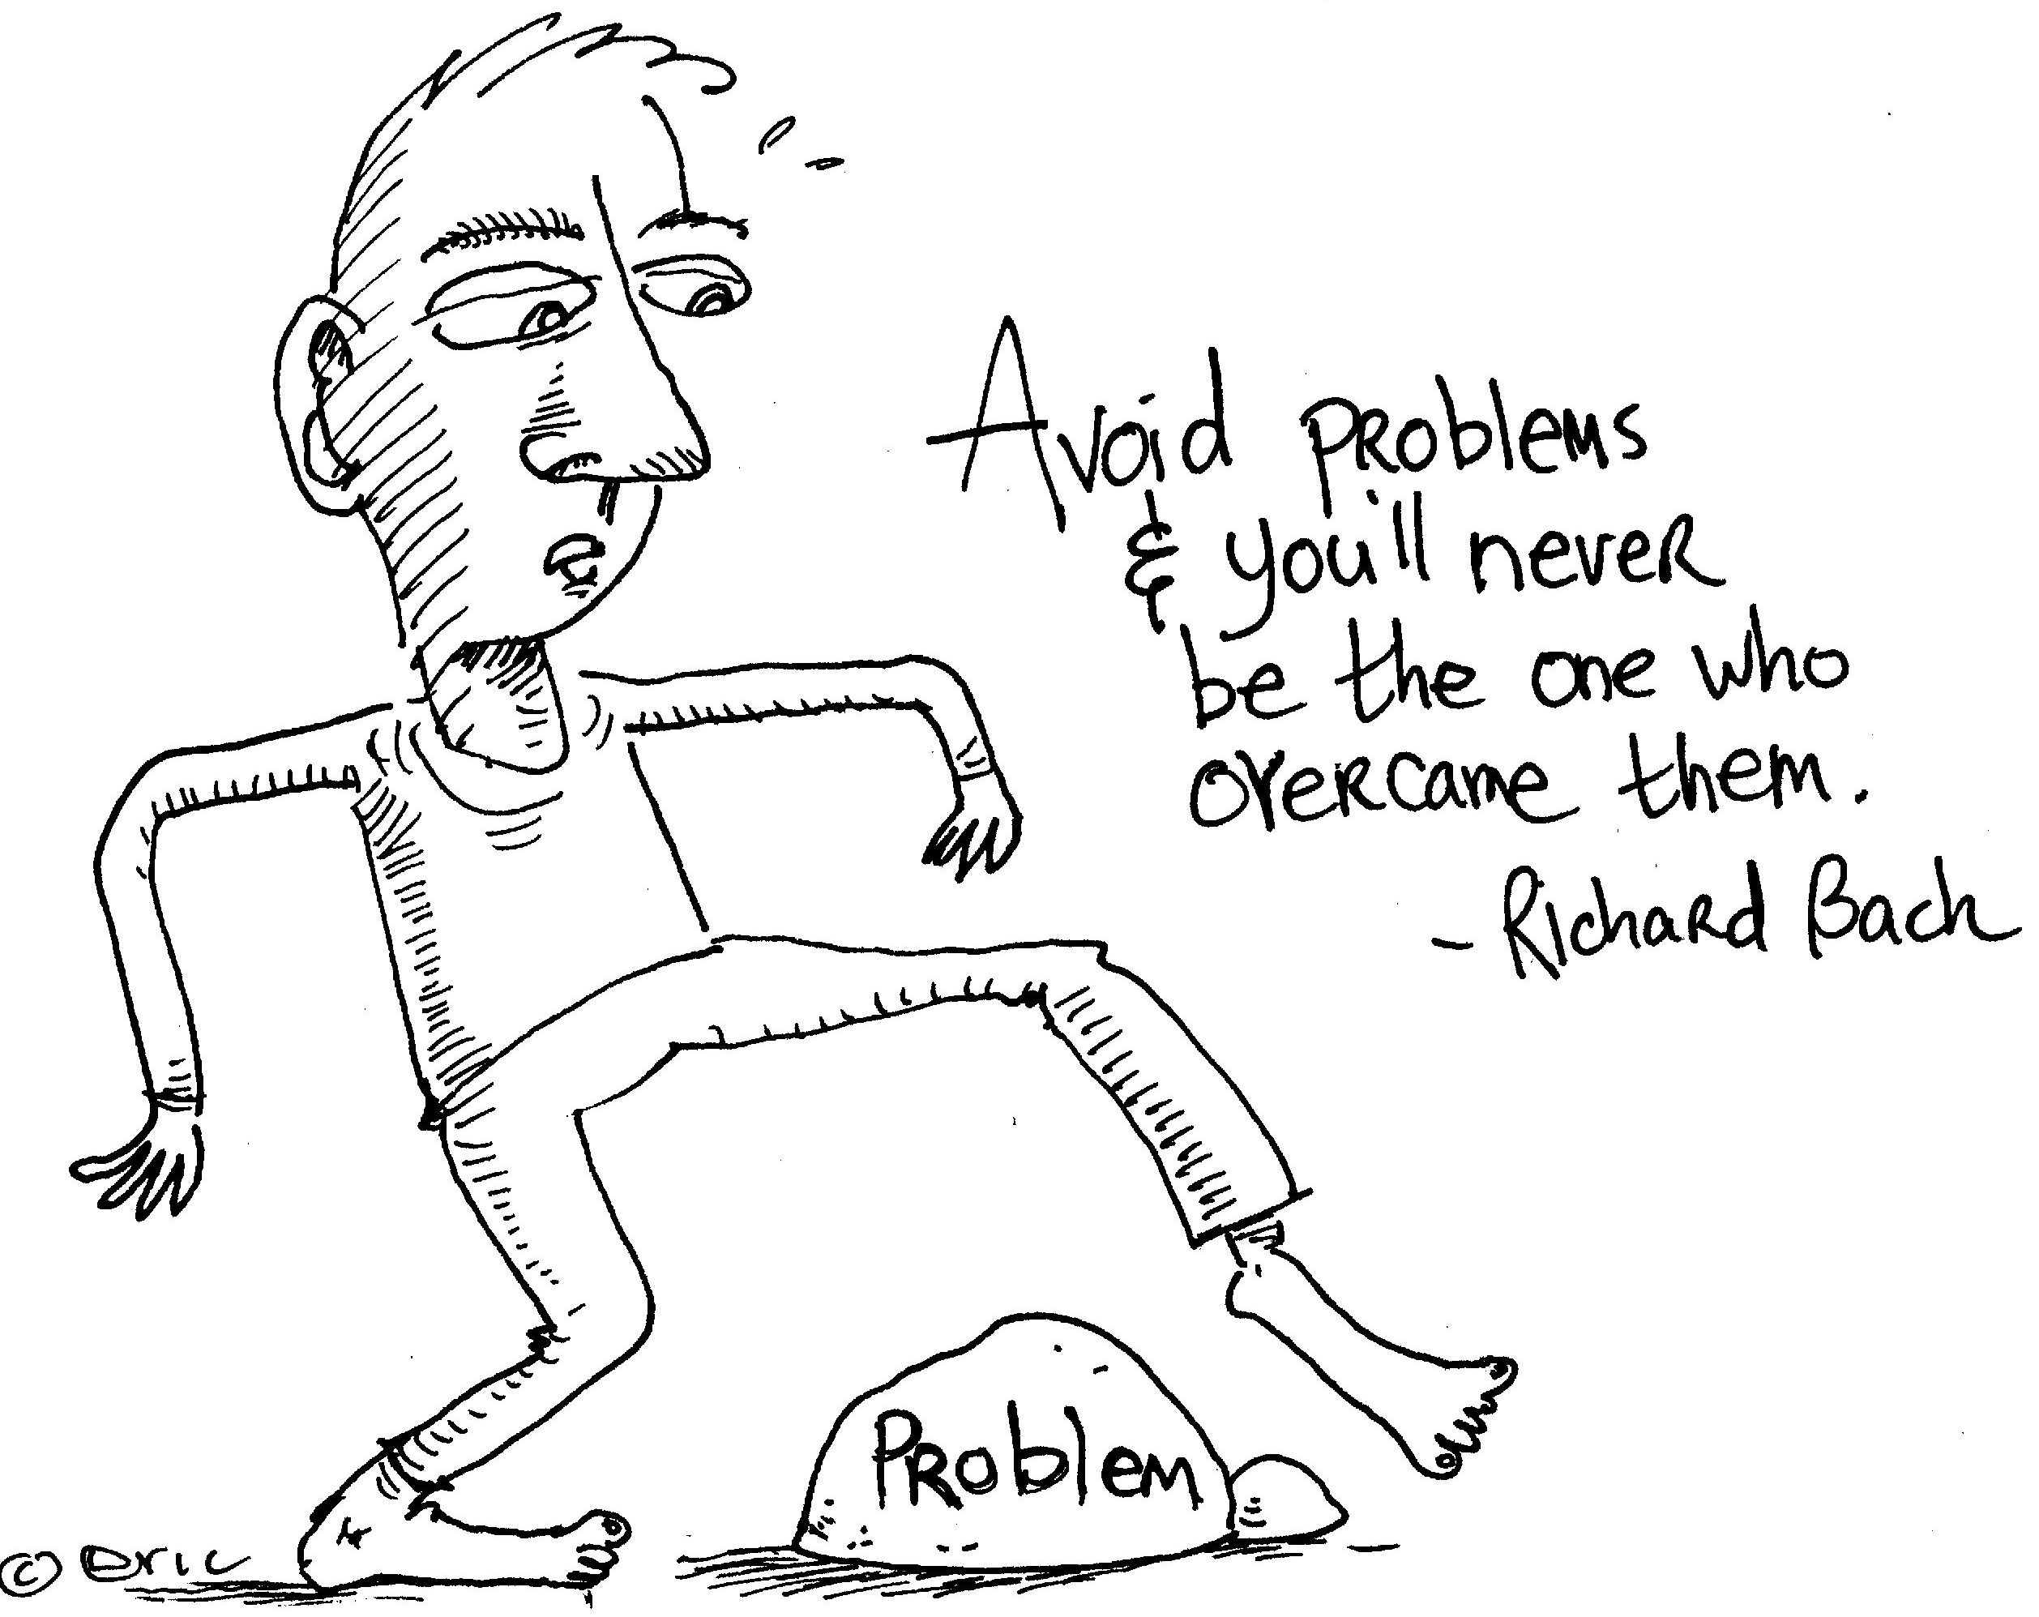
Conflict Resolution: 5 Distinct Patterns
Avoiding/Withdrawing:
  good for minor problems
  ineffective strategy for bigger problems
    Postponing Clash
Accommodating
  Giving in easily: surrender
  Does not generate creative thinking and effective solutions
  Occasionally appropriate: Cultural Context

Slide 16

Conflict Resolution: 5 Distinct Patterns (cont.)
Competing/Forcing
  view as win-lose situations
  lead to postconflict tension, resentment, hostility
  undesirable
Compromising(considering divergent needs of all parties)
  Pragmatic approach: halfway
  constructive for moderately important issues

Slide 17
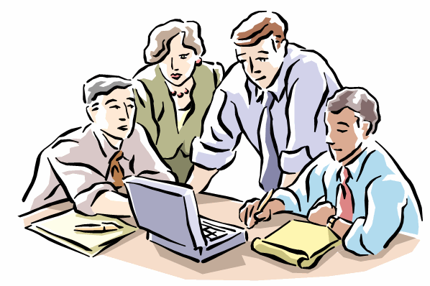
Conflict Resolution: 5 Distinct Patterns (cont.)
Collaborating
  find solutions to optimally satisfy both parties
  clarify differences and similarities to build on similarities
  produce trust

Slide 18

Constructive Resolution
Honesty
Use specific behavioral descriptions
    for a change
Avoid “loaded” words
    evoke negative emotions
Use of Grace
    show kindness without expecting compensation
Positive approach to help others
    Save face

Slide 19
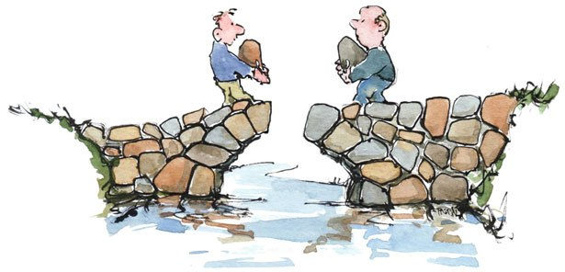
Constructive Resolution (cont.)
Limit Complaints
    may bring up old resentments
Be responsible for your own feelings
Use of Assertive communication styles
    opposed to submissive or aggressive
    collectivist societies: avoid both assertiveness and aggressiveness
    Individualistic societies: more assertive approaches
Defusing Technique
Empathy

Slide 20
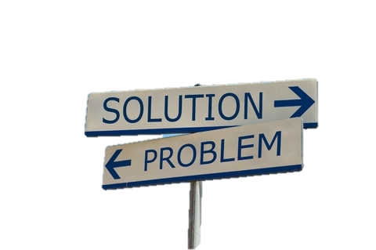
Rational Way of Resolving conflicts
Identify Problem
Brainstorm possible solutions
Evaluate alternative Solutions
Decide on Best solution
Implementation
Continue to evaluate solutions

Slide 21
General Principles for resolving conflicts
Consider all sides of the story before making assumptions
Approach the other party as an equal
Cooperation
Gradually work on the problem
Be Flexible

