Slide 1


MK 333/326 International Marketing
Group Assignment 7
In- Class Group Simulation: Global Trading
By Ajarn Suwalya K.

Slide 2

MK 333/326 International Marketing
Global Trade In-class Simulation….Let’s Trade!
By Ajarn Suwalya K.
Online Session March 18,2021

Slide 3
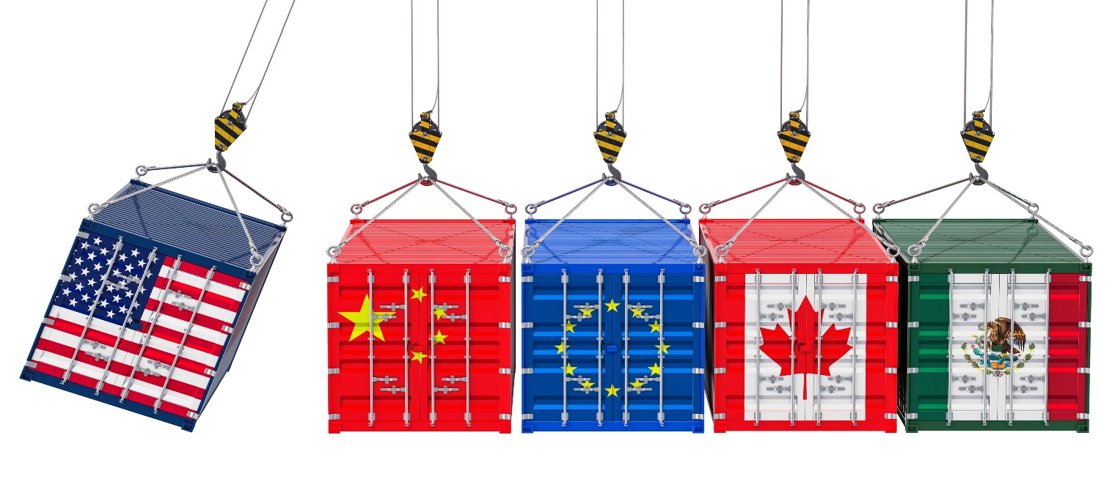
AGENDA
VDO clip on Global Trading
Briefing
Team Break –up (pairing)

Slide 4
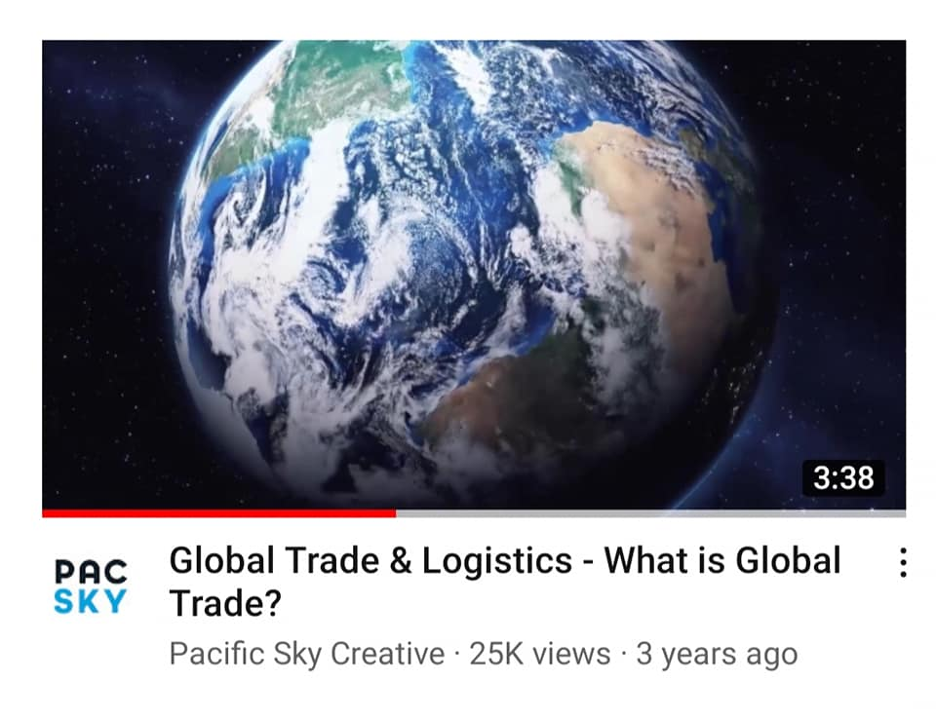


Slide 5
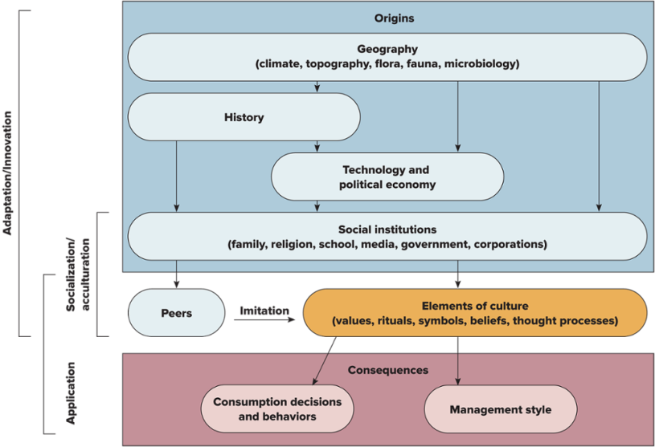
In Class Simulation-
Let’s Trade
1. Please pair up to be one team ( 3 people per country)
2. Each team will work in break out room. Must turn on camera/microphone ( I will be going to each room to observe , photo cap and consult)
3. Each pair to trade at least 3 products for import/export basing on the cultural info on your project country ( no industrial goods/commodities)
4. Results to be created -> 1 cover page + 2 ppt slides to submitted by 4:50 pm in CEO Group line.. Again please feel free to be creative and colorful ☺
Process: Negotiate
Each country has to share info.
Know consumers for each country
What are needs and wants
What is the STP for that product?
How large and substantial is the target market? Quantifiable
How much sales and profit will you make for each product (financial estimation)
Best Country Pair (s) will present next week… extra for individual participation score.
Exhibit 4.4 Origins, Elements, and Consequences of Culture

Slide 6
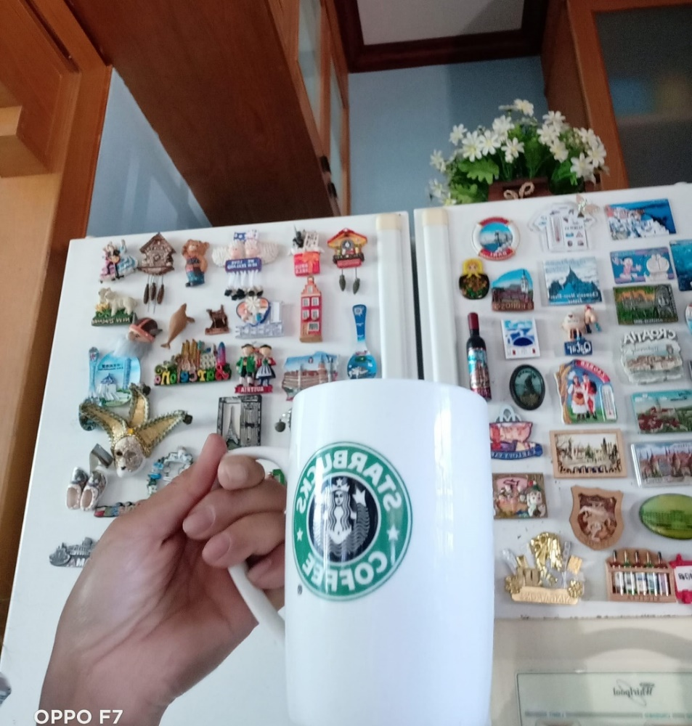
11 Countries for MK 333/326
Sequence
1.Germany
2.India
3.New Zealand
4.Switzerland
5.Spain
6.France
7.Sweden
8.Russia
9.Italy
10.Portugal
11.Canada

Slide 7


Slide 8
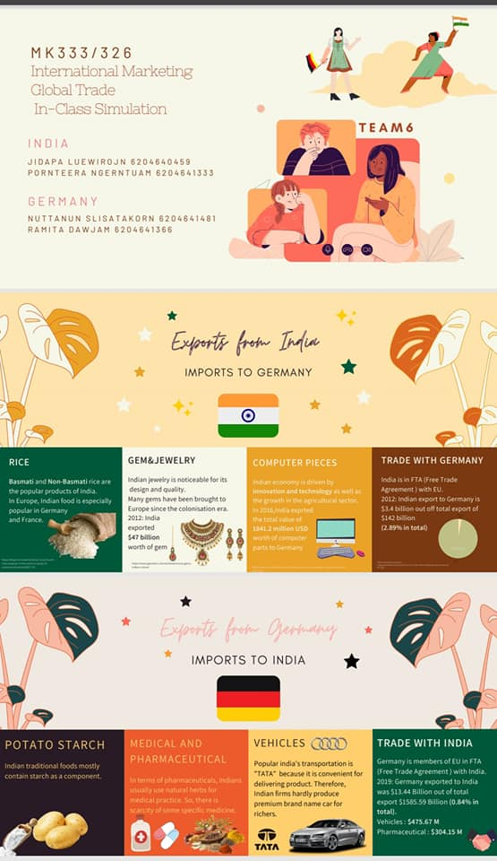

Slide 9
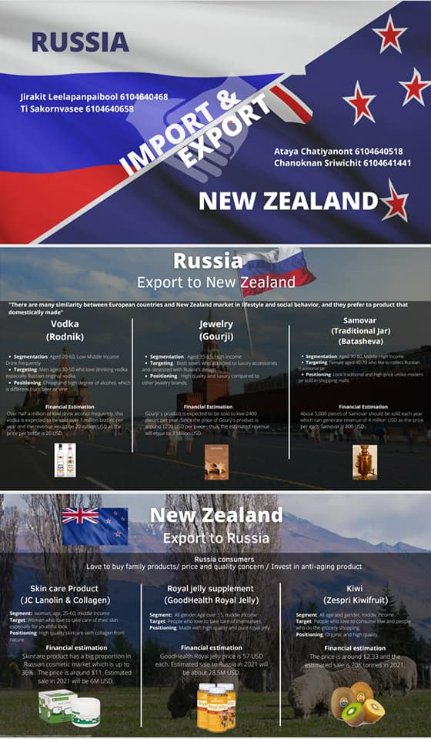

Slide 10
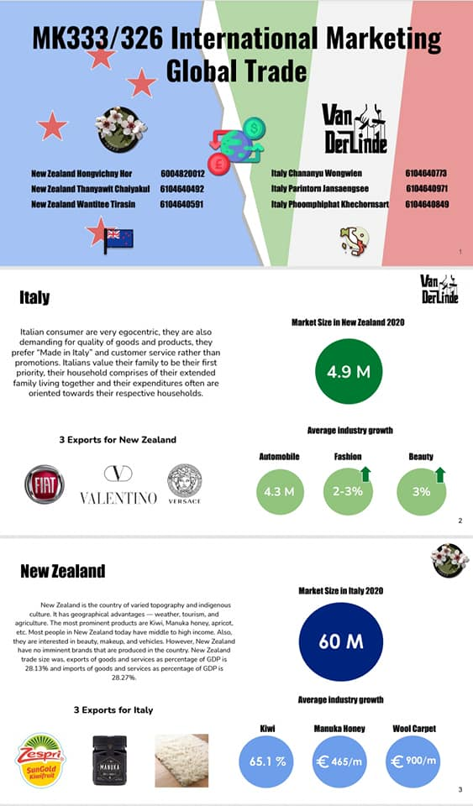

Slide 11
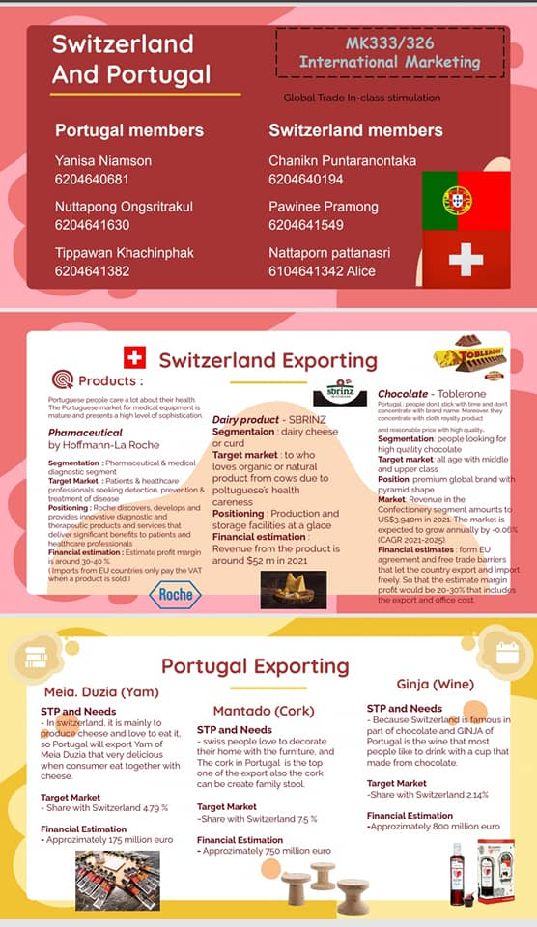

Slide 12
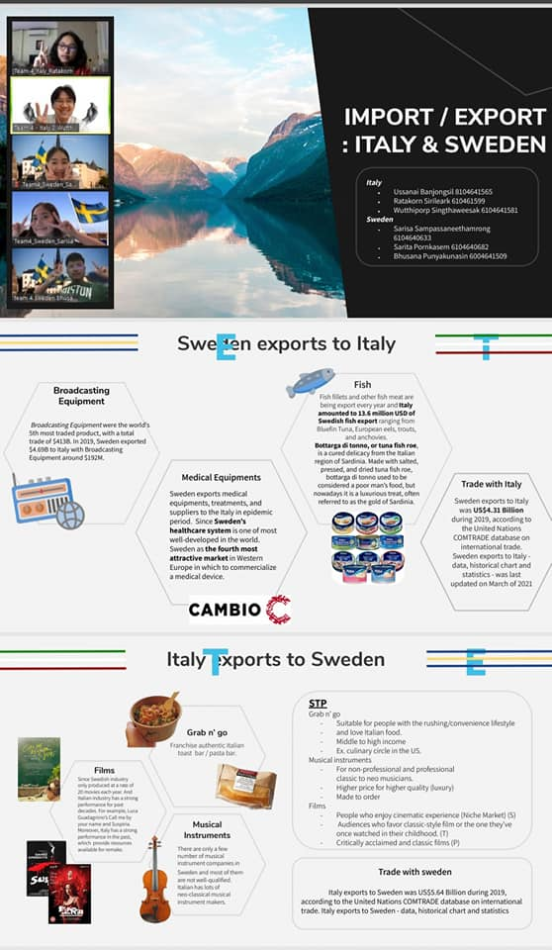

Slide 13


Slide 14
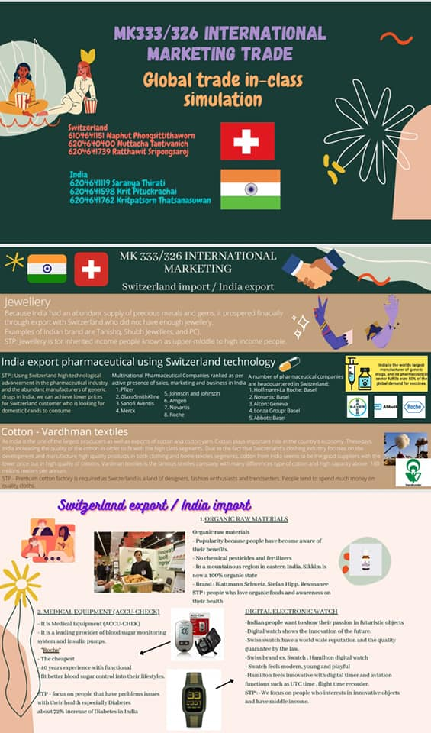

Slide 15
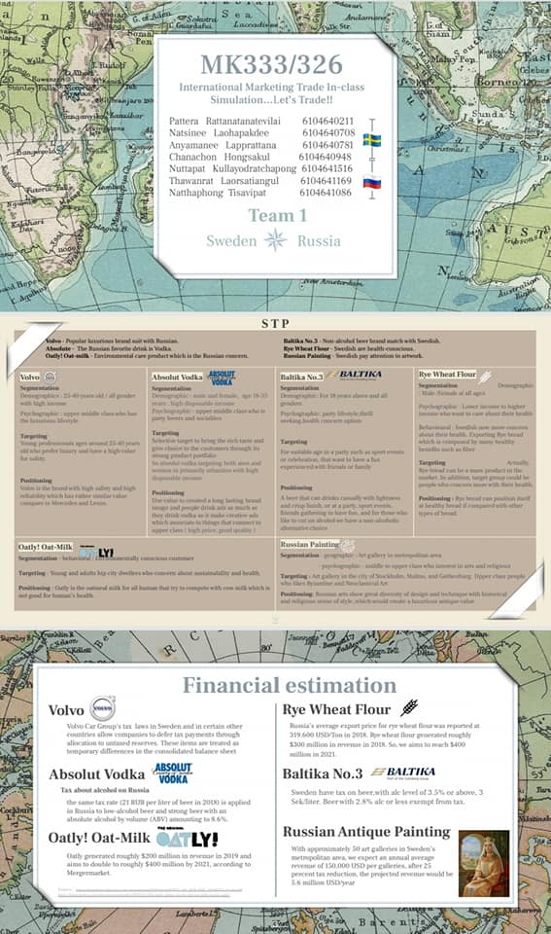

Slide 16
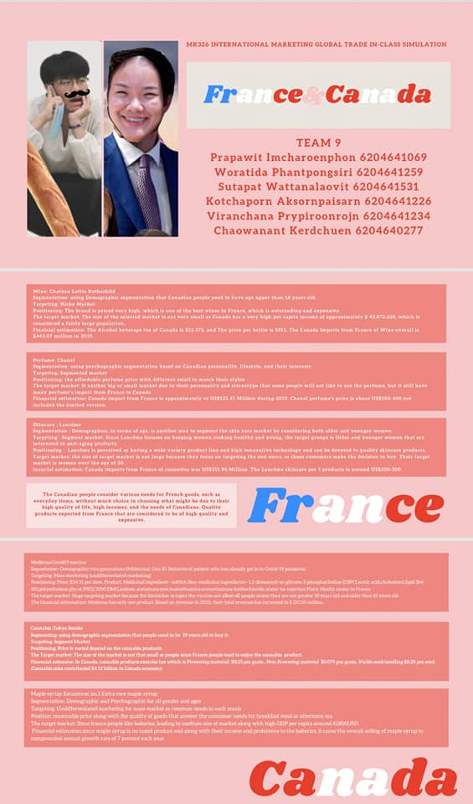

Slide 17
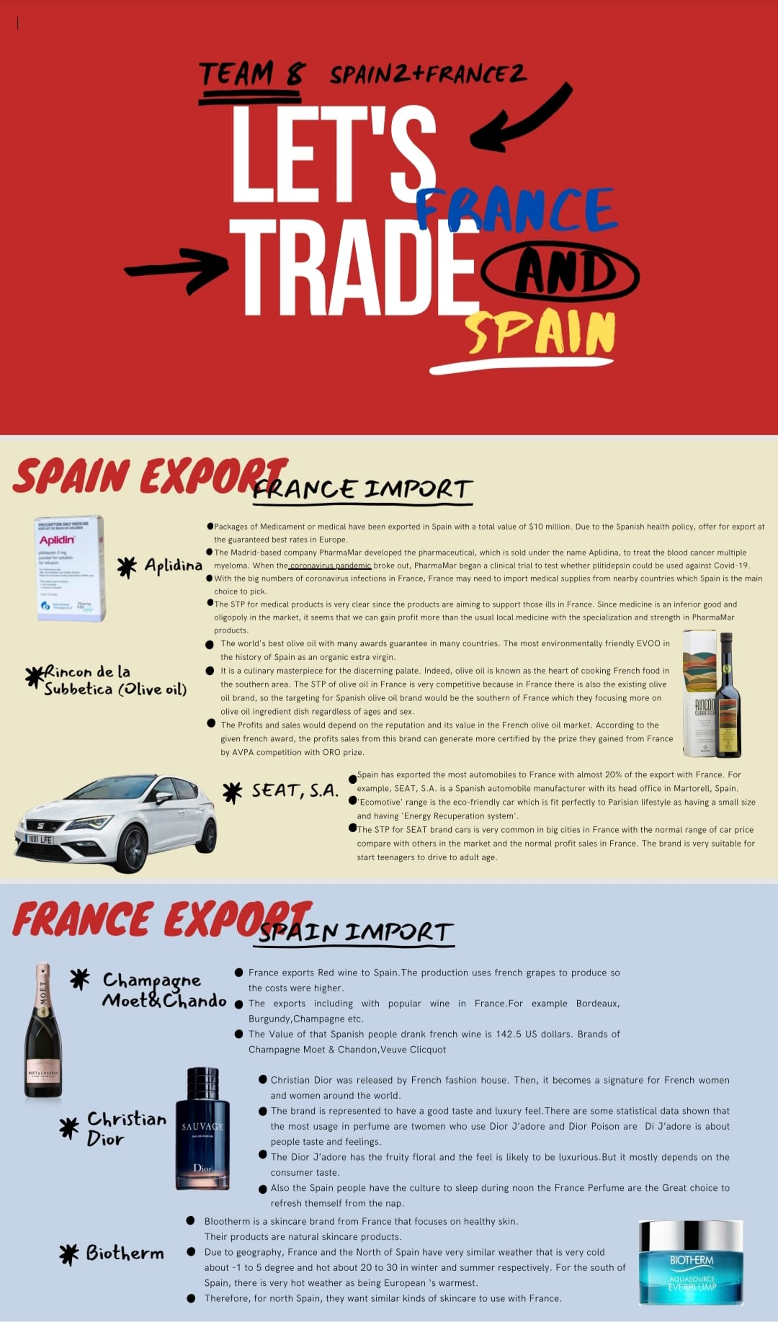

Slide 18


