Slide 1
Corruption
Effects, Causes, and Solutions
Thorn Pitidol
EE468

Slide 2
Topics
Corruption: Effects on Economics Development
Understanding Corruption
What can/should be done?
“Defining, understanding, and dealing with corruption are not simple”

Slide 3
Corruption
Definition: “The abuse of public office for private gain”
  But this does not include
    Corruption within the private sector
    Political corruption – affecting allocation of political power, not economic resources
  In addition, perception on the misuses (or immoral uses) of political power can vary depending on contexts
    Overuses of public funds?
  Most importantly, this is a modern perception

Slide 4
Corruption
Types
  Bribery
    Payments to public officials to influence their decisions
    Size vary from small to very large
  Theft of public asset
    By public officials or public/private collusion
    Wide scope: tax evasion, diversion of public funds, etc.
  Patronage/preferential treatment
    Preferential treatment regarding government rules/contracts/payments
    Granting “special favours”
  Others?

Slide 5
Most corrupted government units (Thailand)
According to surveys conducted in 1998 (Pasuk et al. and UTCC)
  Most corrupted according to business sector
    Custom Department, Police, Revenue Department
  Highest “special payment” per annual
    Custom Department, Revenue Department
  Highest frequencies of request for bribes
    Office of the Department of Land, Custom Department, Police

Slide 6
Effects on Economics Development
How (and whether) corruption affects economic growth?
  Difficult to assess the causality
On the roles of the government
  Allowing rules to be bypassed
    Seen as raising efficiency if rules are excessive (red-tape)
    Example: custom rules
  But also leads to missing roles in engaging with market failures

Slide 7
Effects on Economics Development
On public investment
  Potential distortion on the selection of bidders of projects?
    Depending on the relationship between ability to bribe/ability to perform
  Potential distortion on types of spending
    Also depending on whether different types accept different bribes
  Distorting the quality of services
On private investment
  Raising the cost of investment – but this depends more on uncertainties
  Potential risk of breaking contracts

Slide 8

Effects on Economics Development
On competitiveness of markets
  Firms competing for “rent” rather than profits
  Private resources divert to rent-seeking/corrupt activities
    Investment to find legal loopholes & gain favouritism
    Investment in connection building
      Ex. Special executive course

Slide 9
Effects on Economics Development
On inequality
  Putting the poor at disadvantages in the economy, judicial system, political system
  Economic inequality ⬄ political inequality

Slide 10
Understanding Corruption
Economics Perspective
  Corruption as reaction to excessive bureaucraticism
    Greasing the wheel hypothesis
  Corruption as occurring from the availability of “rent”
    Rent-seeking activities resulting from “licensing regime”
    The more discretion belonging to the government, the more corruption?
    Endogeneity: rent -> corruption -> more rent -> more corruption
  Inequality leading to the concentration & abuse of political power

Slide 11
Understanding Corruption
Political Perspective
  Corruption the symptoms of society under transformation
    Persisting features of “pre-modern” societies (in times of modernity)
    The struggle of the emerging/dominant classes to gain/sustain advantage
    Under-institutionalized politics and incomplete democratization
  State under influence of patrimonialism
    Patrimonialism = a form of governance in which all power flows directly from the leader. This constitutes essentially the blending of the public and private sector.
    In contrast to the state with strong modernized bureaucracy

Slide 12
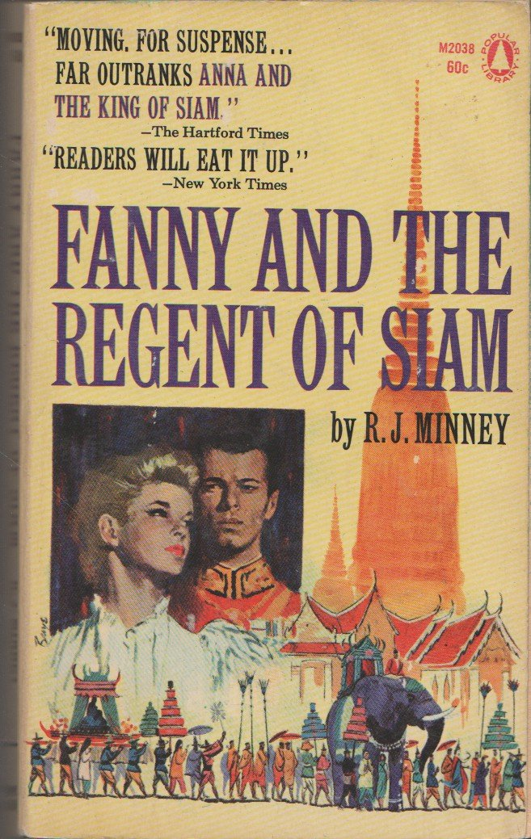
Patrimonialism and Corruption
Corruption in Thai history
  Thai for corruption in the past = ฉ้อ “ราช” บังหลวง (stealing from the King and the royalties)
  Serving as provincial rulers = กินเมือง (devouring cities)
  Persisting traits of patrimonialism in Thailand?

Slide 13
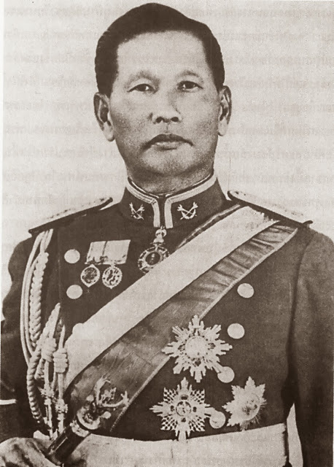
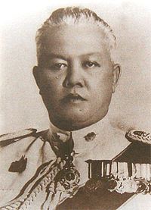
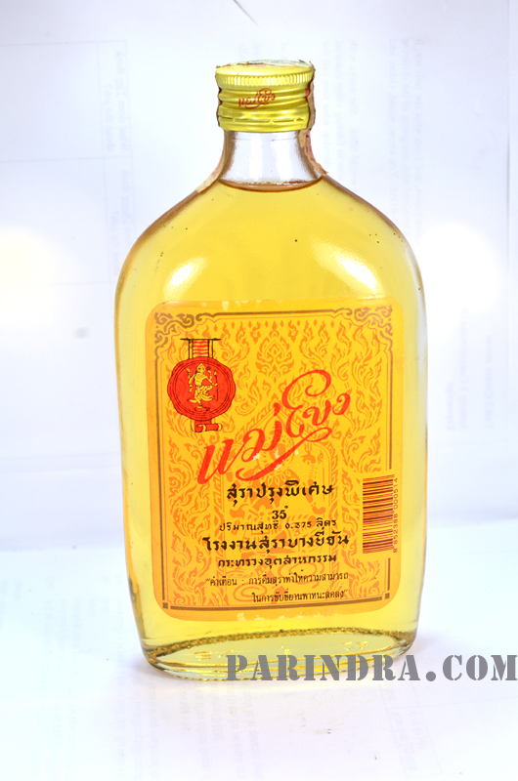
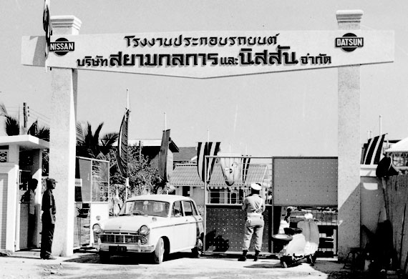


Corruption and the Struggle of Emerging Classes
Emergence of Thai capitalists under Sarit’s “licensing regime”

Slide 14
What can/should be done?
Areas to strengthen?
  Education
  Bureaucracy
  Independent organization/judiciary
  Civil society
Promoting social justice VS promoting individual morality
Should democracy be part of the solution?

