Slide 1
Trade Finance
Group2

Slide 2
Outline
-Definition & Necessity
-Instruments
-Examples

Slide 3
Importer’s
Exporter’s
Letter of Credit (L/C)
Bills for Collection (B/C)
Trust Receipt (T/R)
Shipping Guarantee
Outward Remittance
L/C Confirmation
Export Collection under B/C
Packing Credit
Inward Remittance

Slide 4
What is Trade Finance?

Slide 5
Trade Finance
Trade finance is related to international trade
A seller (the exporter) can require the purchaser (an importer) to prepay for goods shipped, the purchaser (importer) may wish to reduce risk by requiring the seller to document the goods that have been shipped
Allows very low risk payment advances to exporters to be made, while preserving the importers normal payment credit terms and without burdening the importers balance sheet

Slide 6
Letter of Credit (L/C)
The document issued by FI assuring payment to a seller of goods and/or services after certain documents have been presented to the bank.
  Documents that prove that the seller has performed the duties under an underlying contract (e.g., sale of goods contract) and the goods (or services) have been supplied as agreed
Beneficiary receives payment from the financial institution that issued the letter of credit
Guarantee to the seller that it will be paid regardless of whether the buyer ultimately fails to pay
Risk that the buyer will fail to pay is transferred from the seller to the letter of credit's issuer.
Can also be used to ensure that all the agreed upon standards and quality of goods are met by the supplier

Slide 7
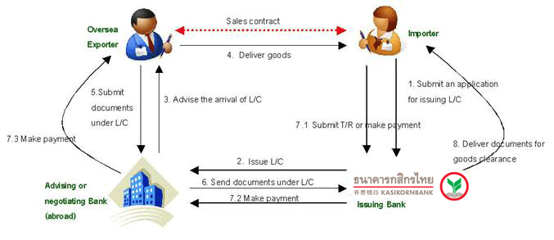

Slide 8
For the beneficiary (sellers)
Export L/C Advise
L/C Confirmation

Slide 9
Bills for Collection
Import Bills for Collection
Export Bills for Collection

Slide 10
Import Bills for Collection
Bank acts as a mediator in collecting payment for goods and services from domestic buyers or importers to pay oversea sellers.
The payment of this Import Payment under Bills for Collection has 3 conditions as the following:
  (1) Deliver Document against Payment (D/P): The Bank will submit the document to buyer when the buyer has fully paid the Bank.
  (2) Deliver Document against Acceptance (D/A): The Bank will submit the document to buyer after having accepted the D/A to the Bank. This guarantees the repayment to the Bank in the future under agreement.
  (3) Deliver Document under other Terms and Conditions: The Bank will submit the document to buyer under other terms and conditions. For instance, the document will be submitted to the buyer against a Letter of Undertaking or Letter of Indemnity to pay in the future date, etc.

Slide 11
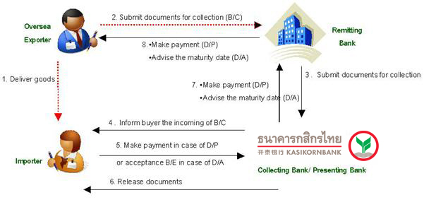
Import Bills for Collection

Slide 12
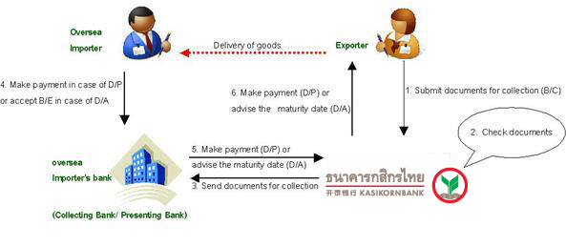
Export Bills for Collection

Slide 13
Credits
Trust Receipt
Packing Credit

Slide 14
Trust Receipt (T/R)
Short-term credit
Legal document written when a person borrows money from the bank. The money will be used in buying goods for sale only
Issuing bank have ownership over the goods but the borrower can hold the goods.
Bank’s interest in the goods is protected.
Bank have the right to reprocess the goods.

Slide 15
Packing Credit
PACKING CREDIT is any loan or advance granted or any other credit provided by a bank to an exporter
Finances the purchase, processing, manufacturing or packing of goods
2 types of Packing Credit
  Pre-Shipment
  Post-Shipment

Slide 16
Shipping Guarantee
Used in the situation that the imported good shipping via sea freight has arrived before the bank receive Bill of Lading;
  B/L is a receipt of shipment when the good is delivered to the predetermined destination.
Allows importer to receive goods at the port without Bill of lading
When the bank has receive Bill of lading, importer will use this B/L to redeem shipping guarantee from the sea freight company
Importer returns the shipping guarantee to the bank and bank provides Letter of indemnity for importer to cover against specific loss or damage of shipped goods.

Slide 17
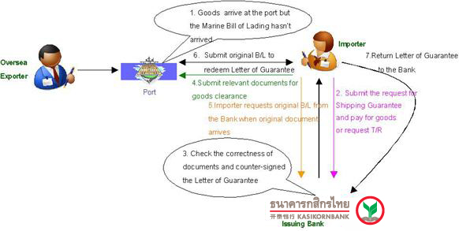

Slide 18
Outward remittance
Transfer of FUND to other countries through bank.
Used by those who need to transfer money aboard such as foreign tuition fee, investment aboard, payment for goods or etc.
Bank uses either the current exchange spot rate or the forward rate depending on the contract the customer have with the bank.
Bank might perform outward remittance through SWIFT.
  SWIFT (Society for Worldwide Interbank Financial Telecommunication) provides a network that enables financial institutions worldwide to send and receive information about financial transactions in a secure, standardized and reliable environment.
    The majority of international interbank messages use the SWIFT network. As of September 2010, SWIFT linked more than 9,000 financial institutions in 209 countries and territories, who were exchanging an average of over 15 million messages per day.
    SWIFT does not facilitate fund transfer, it only transfer financial messages to bank within SWIFT.
Inward remittance is the other way around.

Slide 19
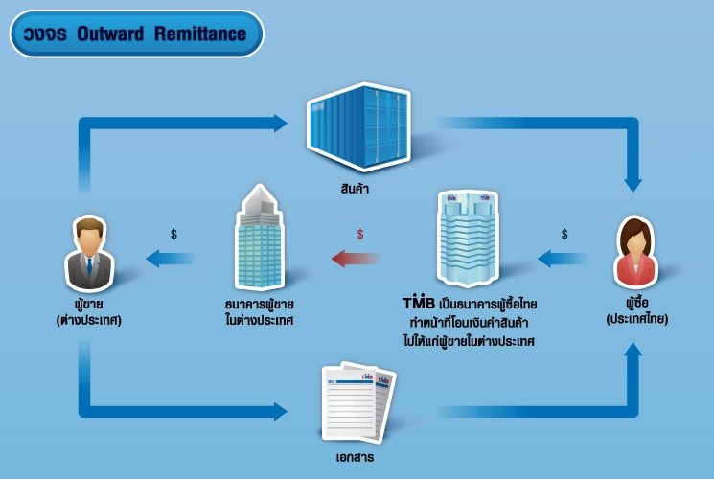

Slide 20
Reference
http://www.ventureline.com/accounting-glossary/P/p
http://en.wikipedia.org/wiki/Trade_financeacking-credit-definition/
http://www.kasikornbank.com/EN/SME/ProductAndService/InternationalTransaction/TradeTransactions/Pages/InternationalTradeTransactions.aspx
http://govisa.wordpress.com/tag/swift-%E0%B8%84%E0%B8%B7%E0%B8%AD%E0%B8%AD%E0%B8%B0%E0%B9%84%E0%B8%A3/
http://www.scb.co.th/en/business-banking/trade-finance-and-remittance
https://www.scbtradenet.com/tradenet/

Slide 21
Thank you☺

