Slide 1
Understanding Technology Development
Sanjaya Lall
03/12/14

Slide 2
Introduction
NIEs surpassed even global standard in given industry technologies.
  Hybrid car, Camera sensor and lenses.
Technological Capabilities
  Skill, technique, management, and institution
Industrial technology Development(ITD)

Slide 3

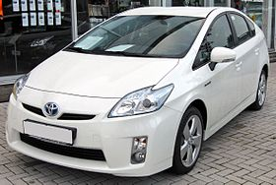


Slide 4
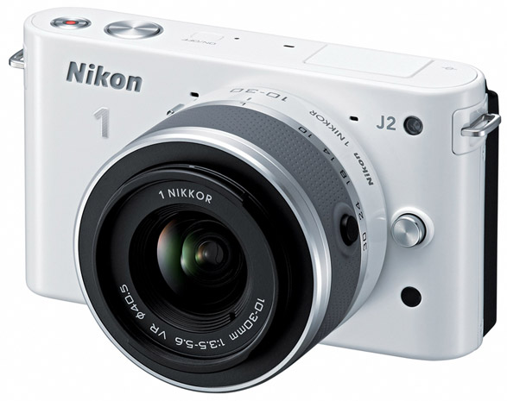
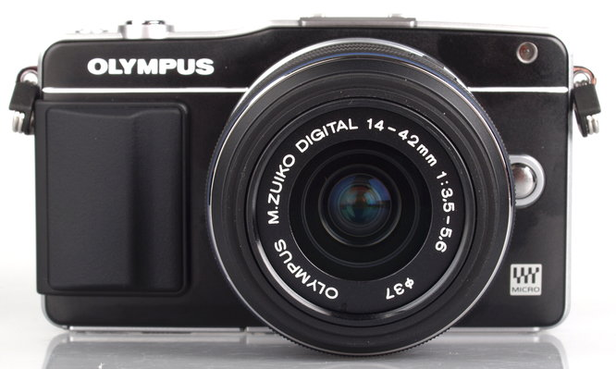
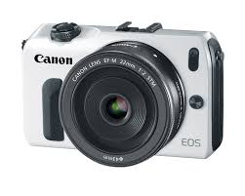




Slide 5
Technology Market
Prolonged process
Learning
Tacit or even non-existed
Non-exclusive and Non-rivalry
Market Failure
  Finance
  Skills
  Information

Slide 6
Technological Capabilities Characteristics
Education and Training: getting the bug out
Learning process is long and uncertain
Investment has to be conscious and purposive
Investment highly depends on incentive enviroment, especially at the firm level.
No predictable learning curve down the stretch.

Slide 7
Technological Capabilities Characteristics
Growth of TC can take place at any point in time and space.
Complexity leads to higher costs and risks.
TCs come from both networking and in-house.
Evolutionary but individual path

Slide 8
Textbook or Not?
No perfect information
Innovation is not cheap: time, and other resources.
Learning to learn problem.
Linkage exists between firms.
No perfect financial and marketing foresight as well as HR.
No comparative advantage.
Government Failures

Slide 9
Determinants of Technological Development
Incentives
Skills
Technical Information and Support Services
Finance
Technology Policies

Slide 10
Incentives
Macroeconomic Policies
Trade regime
Sectoral Bias and domestic competition
Deepening or linkage
Upgrading Infant Industry
  Infant to reach world-class
  Only few infants at a time
  Strong pressure to export

Slide 11
Skills
Preschool
Primary and Secondary
Pre-employment education
On-the-job training
Problems of developing country
  Don’t know the lack of skill
  Know the deficiency and can not do anything
  Afraid of labor movement

Slide 12
Technical Information and Support Services
Infrastructural Services
Government Sciences and Technologies Institutions
Universities and R&D centers

Slide 13
Finance
Market Failures
Traditional
Non-traditional

Slide 14
Technology Policies
Import Technology
FDI
Adoption
BOI

Slide 15
Market Failures and Policy Need for ITD
Nature of Market Failures from each determinant.
Government Capability and Failure
Notes:
Show the paper Table

