Slide 1

World’s Top Global Mega Trends To 2025 and Implications to Business, Society and Cultures
Frost & Sullivan

Slide 2
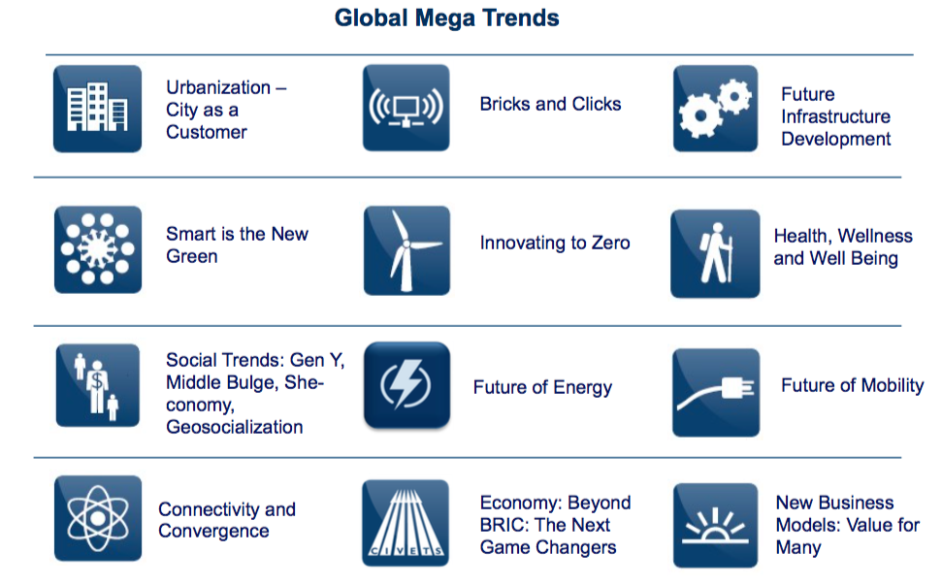
Definition of Mega Trends That Frost & Sullivan Tracks
Mega Trends are transformative, global forces that define the future world with their far reaching impacts on businesses, societies, economies, cultures, and personal lives.

Slide 3
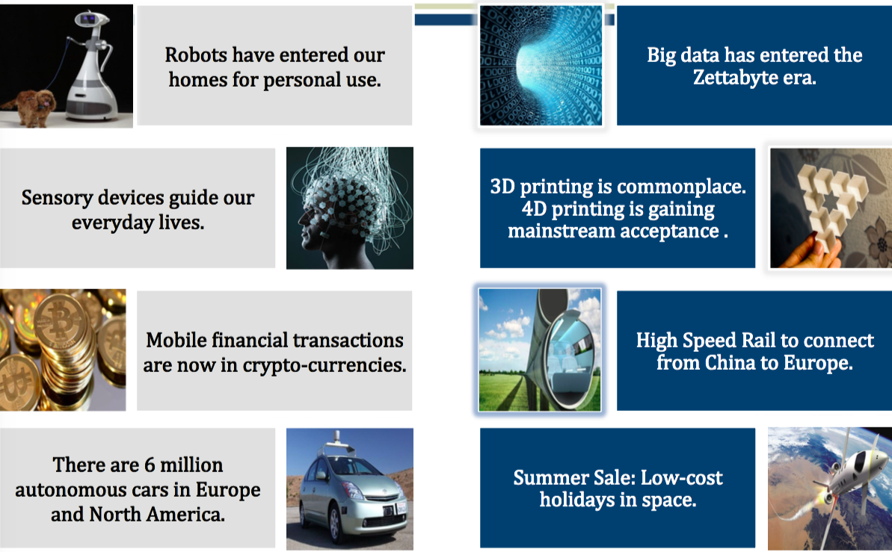
News Headlines in 2025

Slide 4
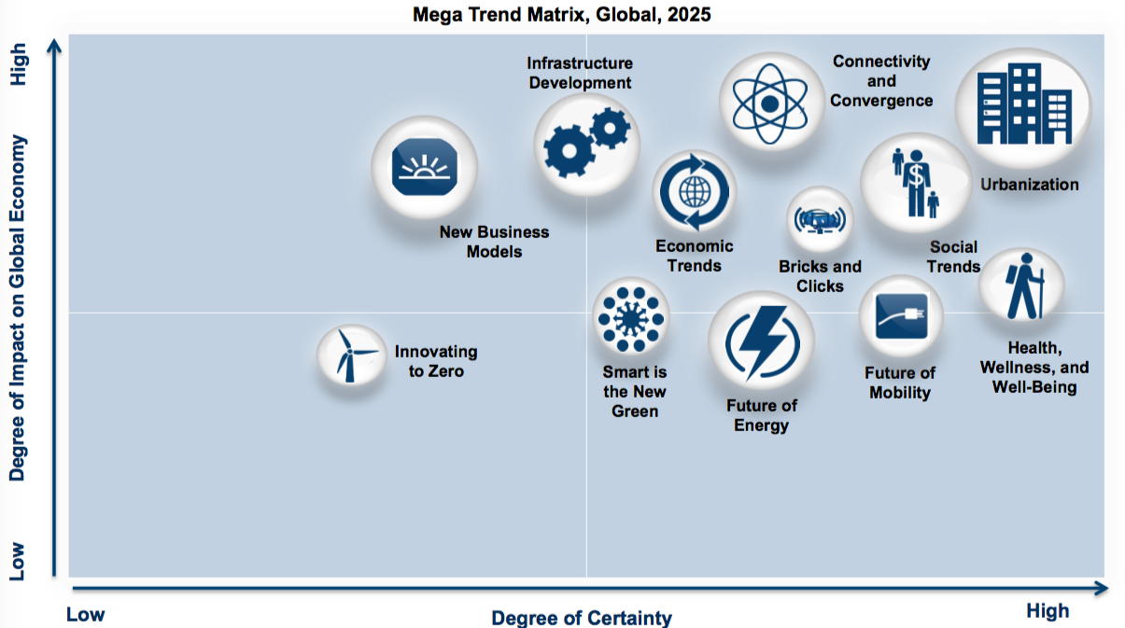
Mega Trend Matrix
Understanding Implications of Key Mega Trends on Global Economy

Slide 5
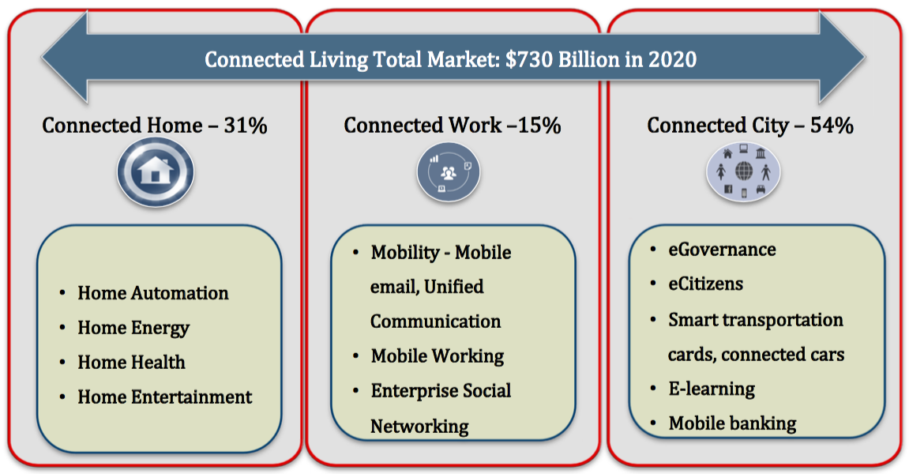
Future Connected Living Ecosystem
Connected life contains three important aspects of connected home, connected city, and connected work
Connected Living describes a world in which consumers use many different devices to experience compelling new services that integrate video, voice, and data services to provide access and ubiquitous connectivity anytime and anywhere

Slide 6
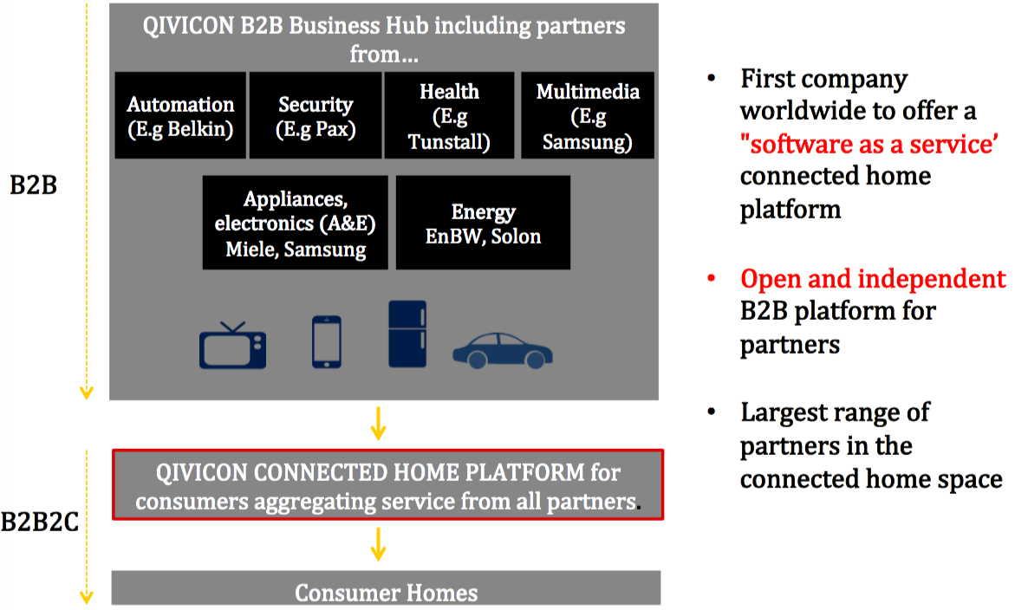
Case Study: Connected Home’s B2B Platform Of Deutsche Telekom A platform-based approach that brings together leading companies

Slide 7
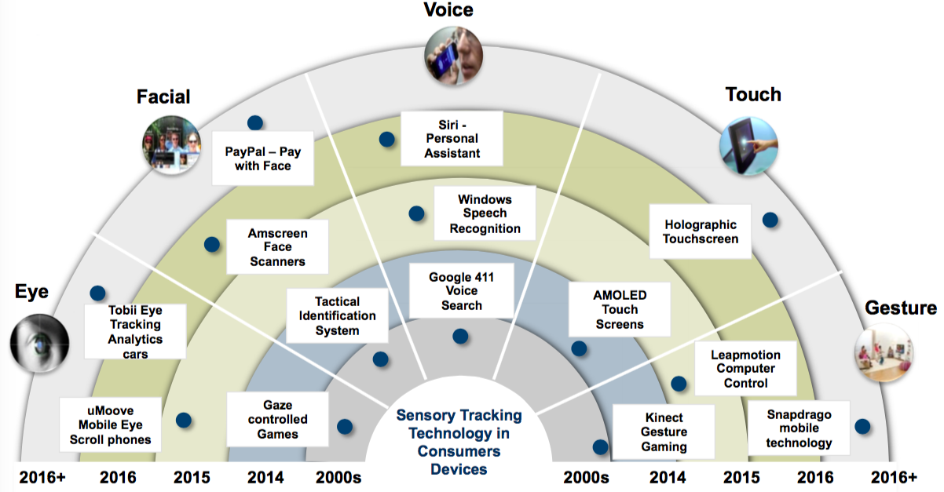
Sensorization of Things
Multi-Factor sensory-based trackers revolutionise the field of personal devices
The radial timeline diagram depicts which products are impacted in the next decade by sensory tracking technology in consumer electronics

Slide 8
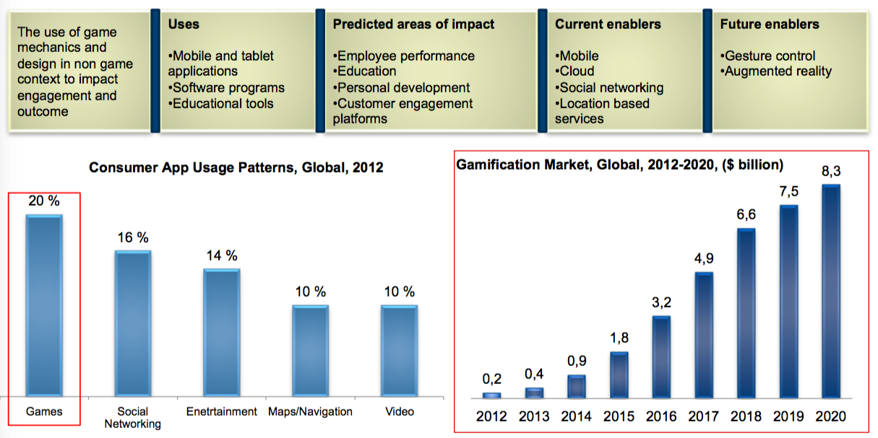
Gamification - solutions to generate $8 billion globally within a decade, driven by increasing need for consumer engagement
Gamification – a customer interaction approach to design behaviours, develop skills and engage customers

Slide 9
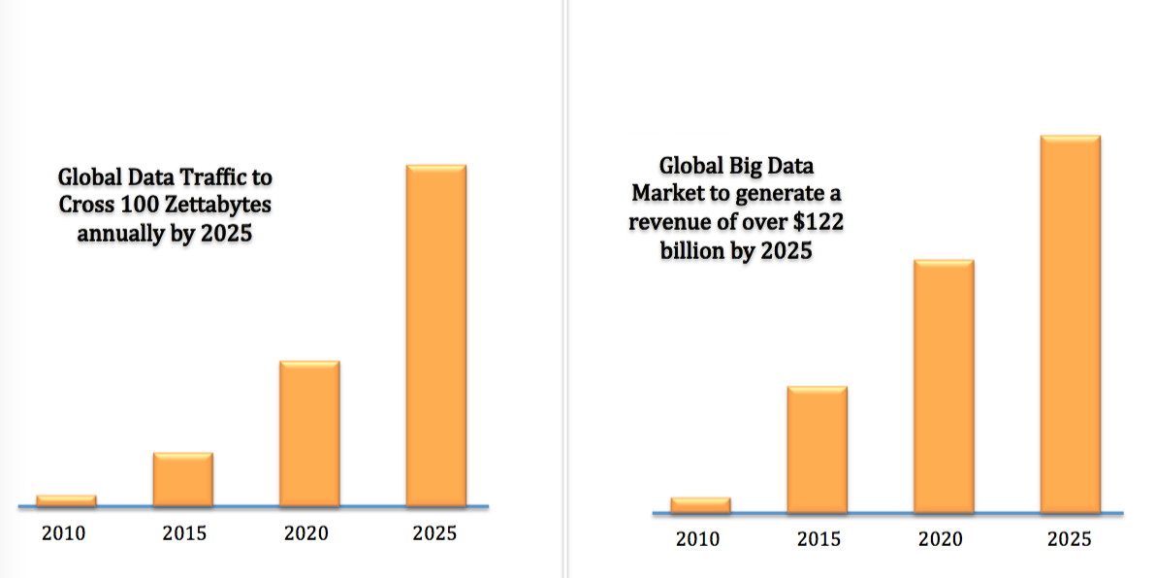
Sub Trend: Big Data Analytics
90% of the data in the world has been created in the last two years alone

Slide 10
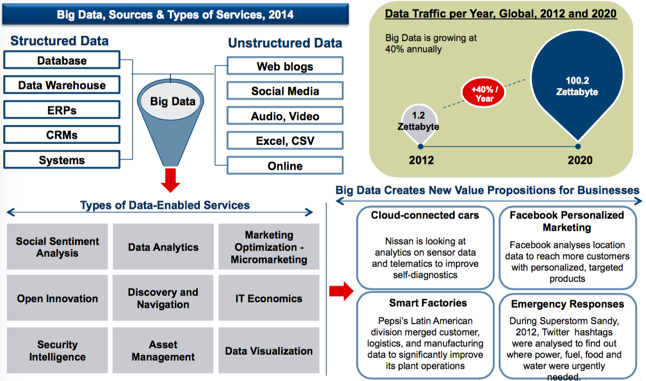
Big Data Deluge
Digital content is doubling every 18 months

Slide 11
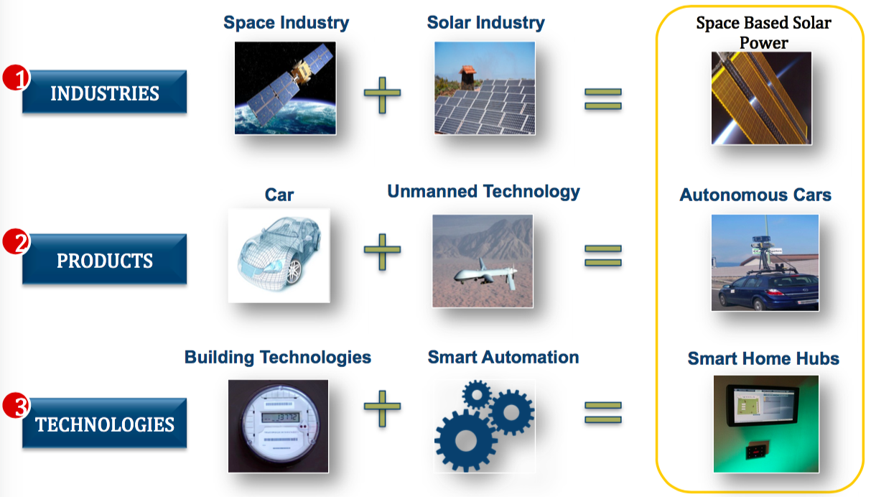
Implication: Connectivity Is Pushing Convergence
Connectivity will Accelerate Convergence of Industries, Products, Technologies and Competition

Slide 12
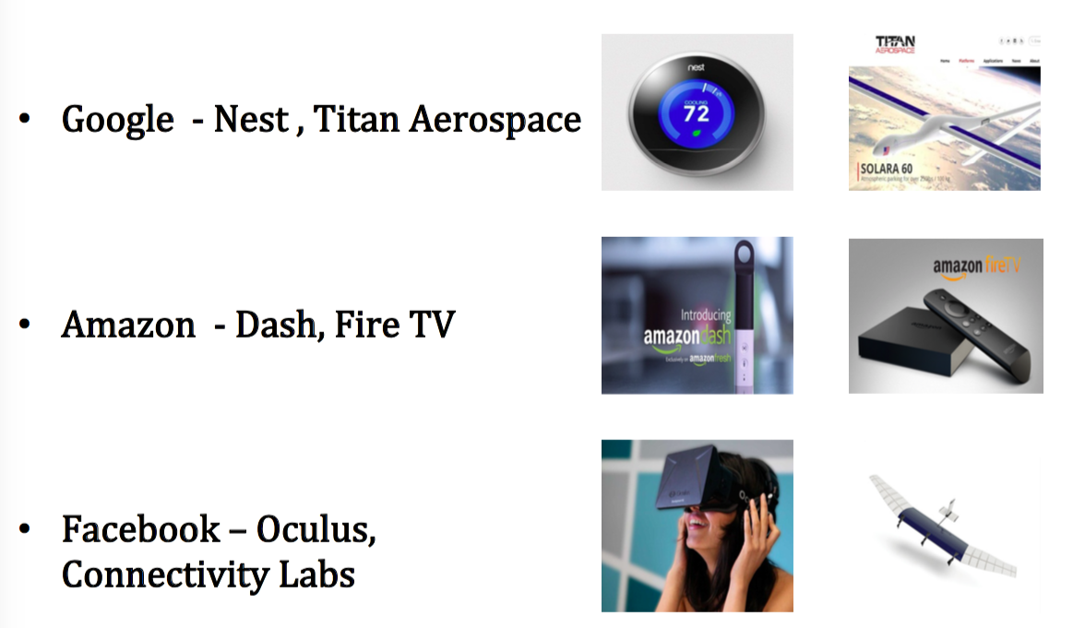
Implication: Connectivity Is Pushing Convergence
Convergence is Driving Unconventional Players to Contest for New Markets!

Slide 13
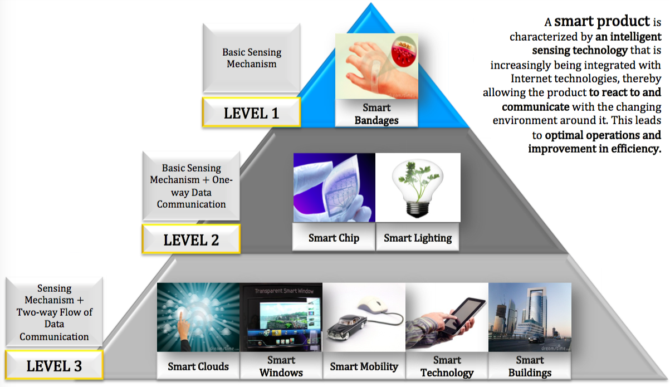
Smart is the New Green
3 Levels of Smart Products and Technologies

Slide 14
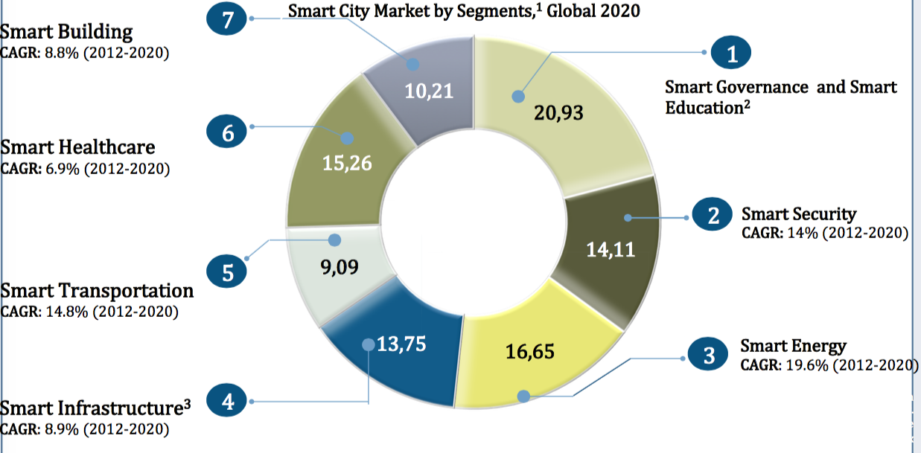
Smart is the New Green
Smart cities To Create Huge Business Opportunities With A Market Value Of $1.5 Trillion By 2020

Slide 15
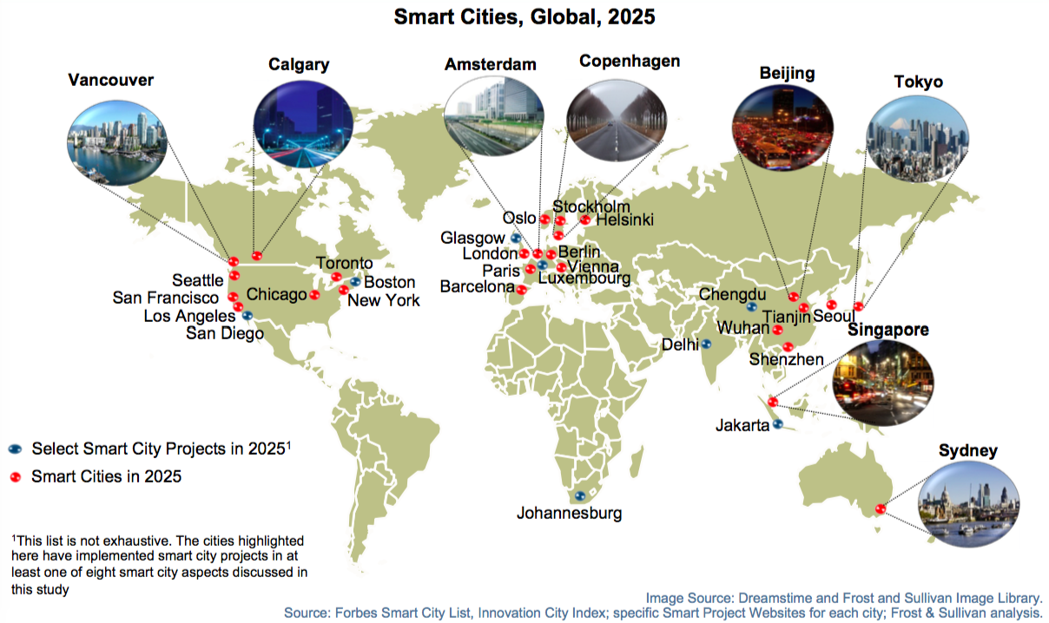
Global Smart Cities in 2025
More than 26 global cities will be Smart Cities in 2025, and more than 50% of which will be from Europe and North America

Slide 16
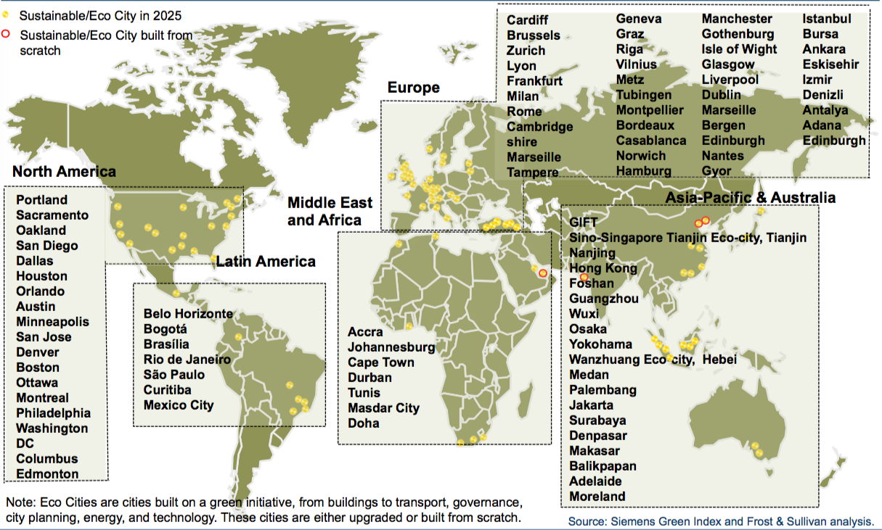
Sustainable/Eco Cities in 2025
Global Snapshot of Sustainable/Eco Cities in 2025

Slide 17
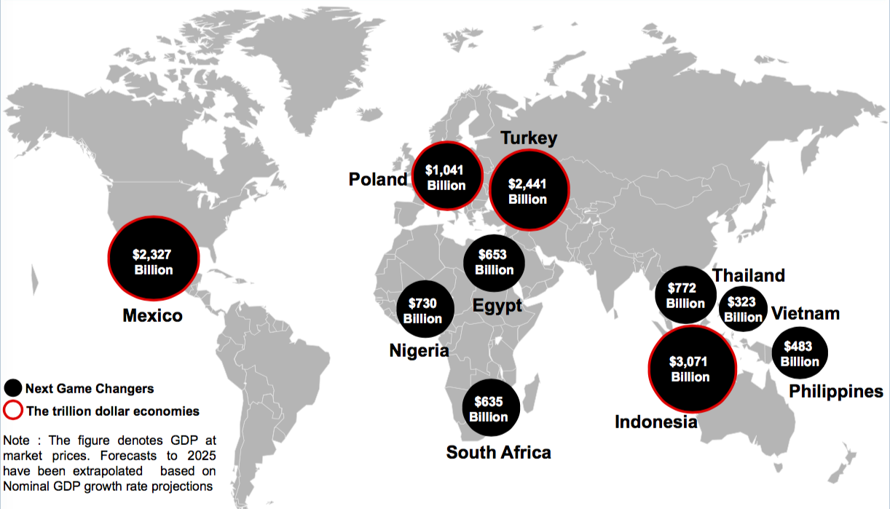
The Next Game Changers in 2025 (Beyond BRICSs)
High GDP growth, improved FDIs, and rapid industrialization to give rise to a new lot of emerging countries, beyond BRIC nations, that contend to become next decade’s economic leaders

Slide 18
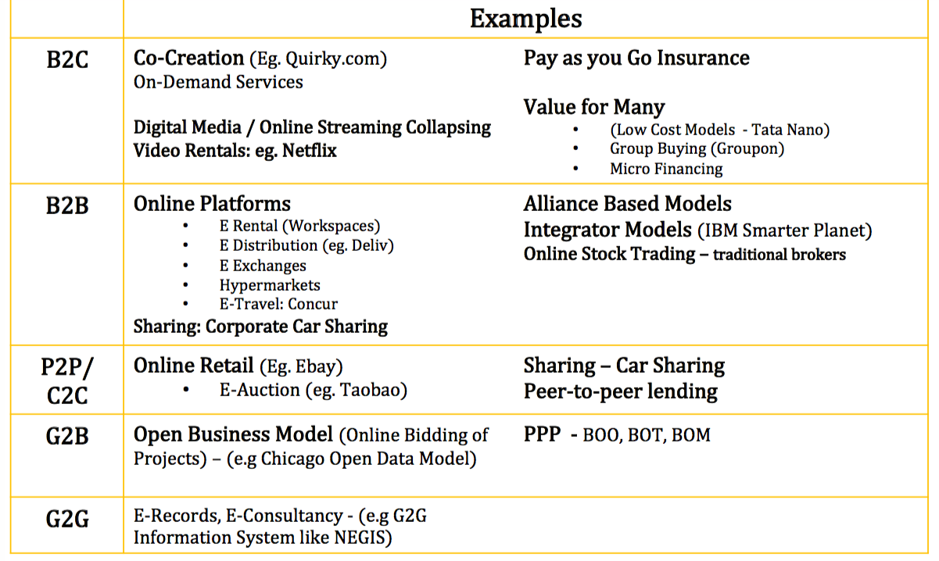
New Business Models

Slide 19
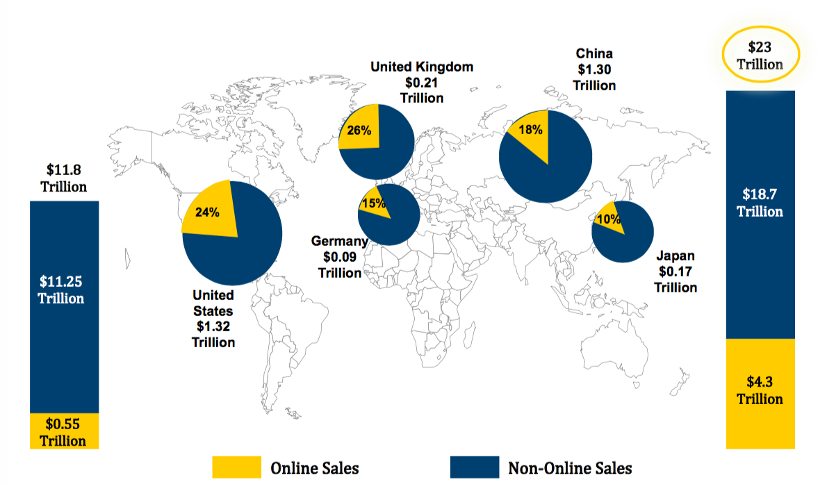
Future of Clicks in Retail Industry
Global Online Retail Sales To Reach $4.3 Trillion By 2025 Accounting for 19% of Total Retail

Slide 20
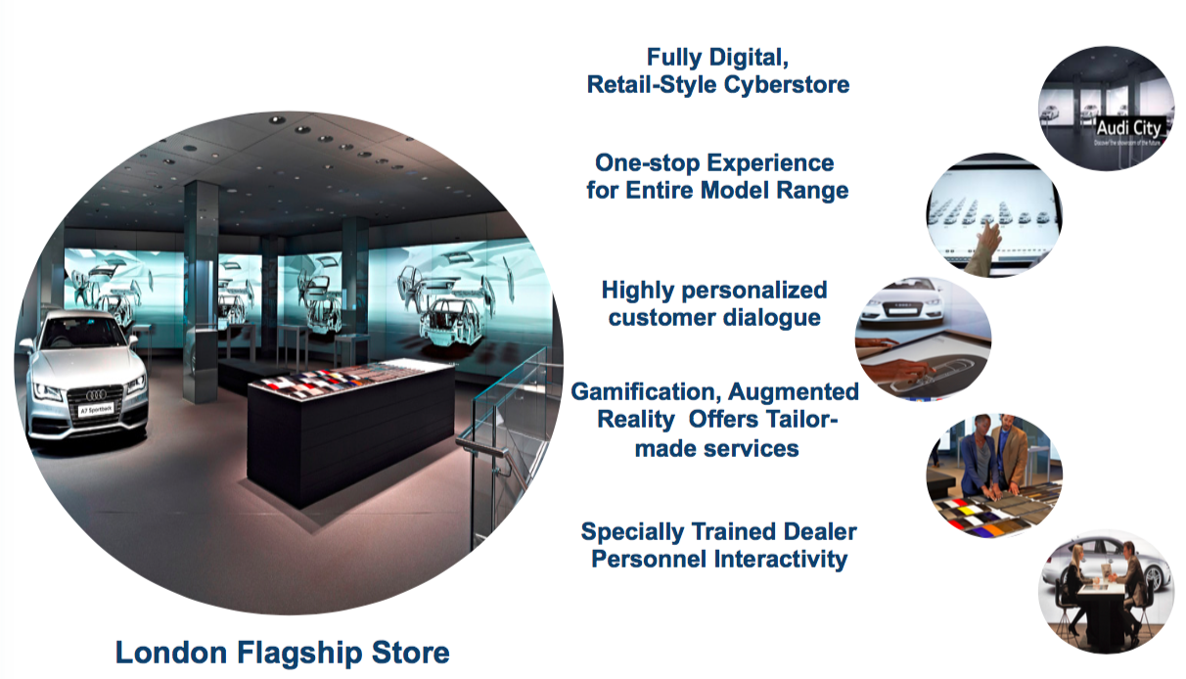
Case Study: Audi City London - First Digital Car Showroom
Example of Future Digital Car Showrooms that will be “Unlimited”, Personalised, Socially Connected and Digitally Integrated

Slide 21
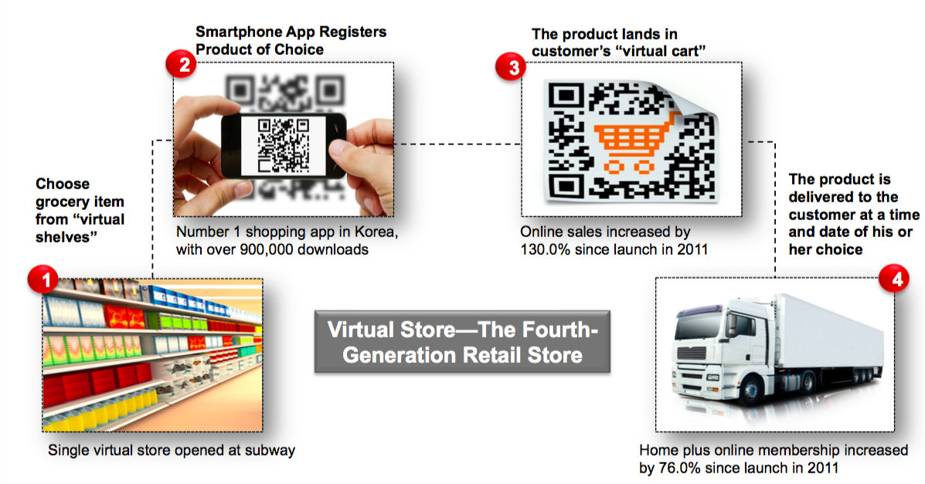
Virtual Stores—New Generation of Grocery Shopping
Virtual stores are simulated brick and mortar stores that offer interactive shopping in public places by creating virtual products, which buyers can buy and order using their Smartphones

Slide 22
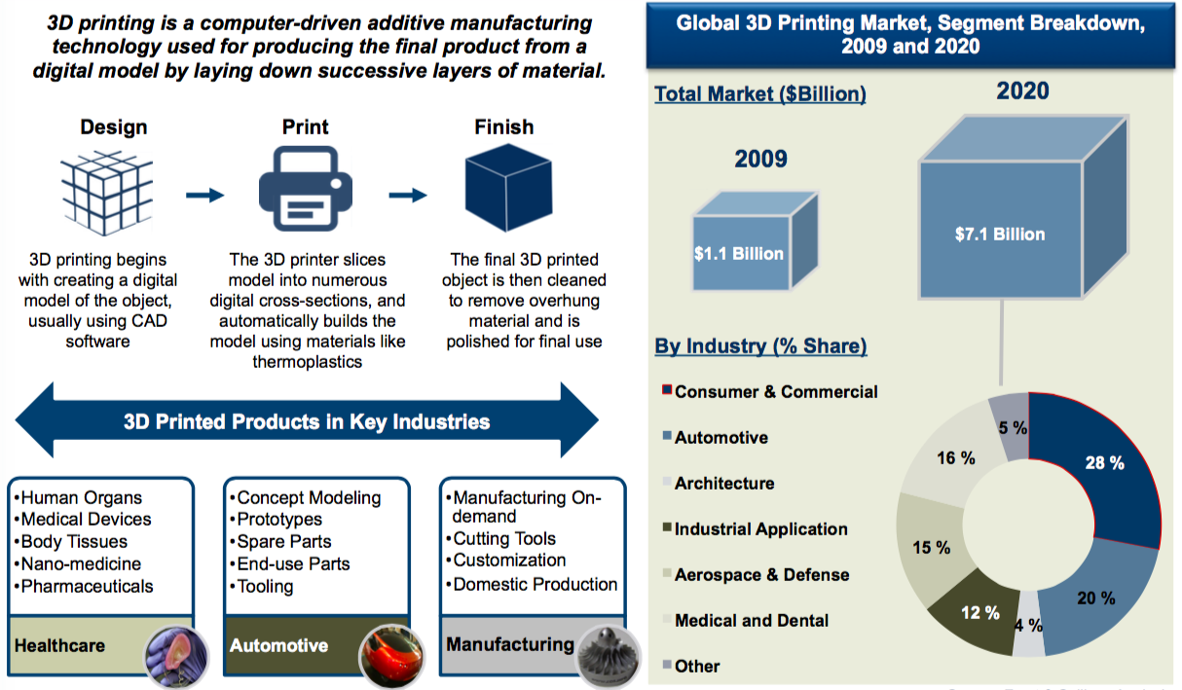
3D Printing
The consumer and commercial products are expected to account for 28% of 3D printing revenues by 2020

Slide 23
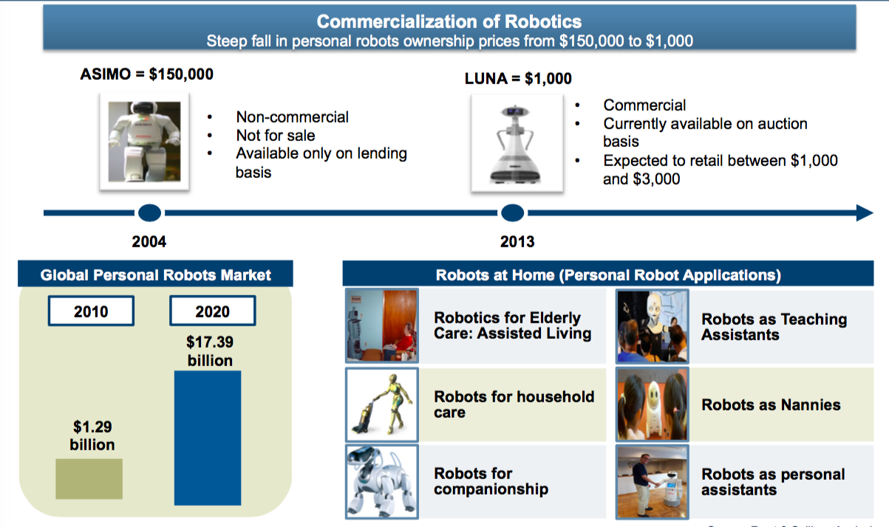
Rise of the Robots
Robots priced between $1,566 and $4,699 could enter our personal lives commercializing the personal robots market by 2020

Slide 24
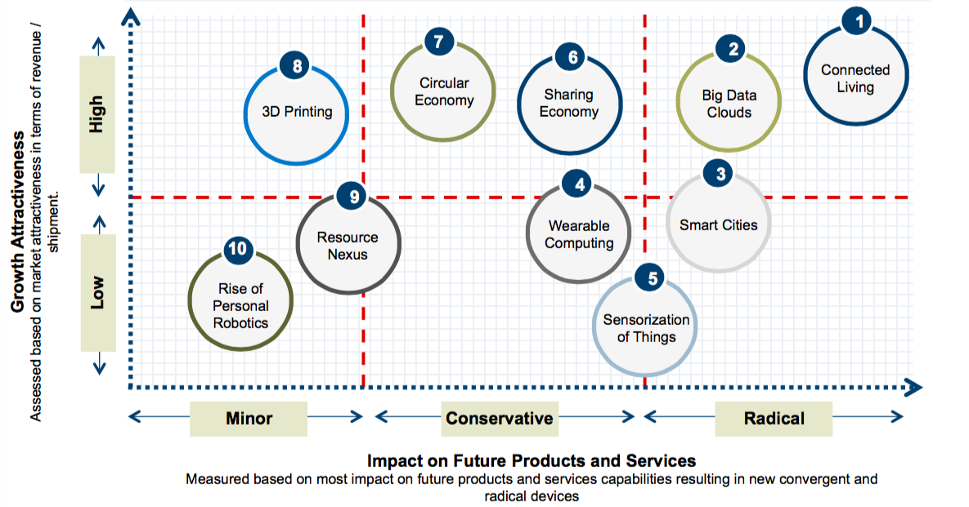
Executive Summary – Top Ten Transformational Shifts by 2020
While all Mega Trends are important, the selection and raking of these trends indicate which seismic shifts will have particular relevance in shaping the landscape in which the world will evolve this decade

Slide 25
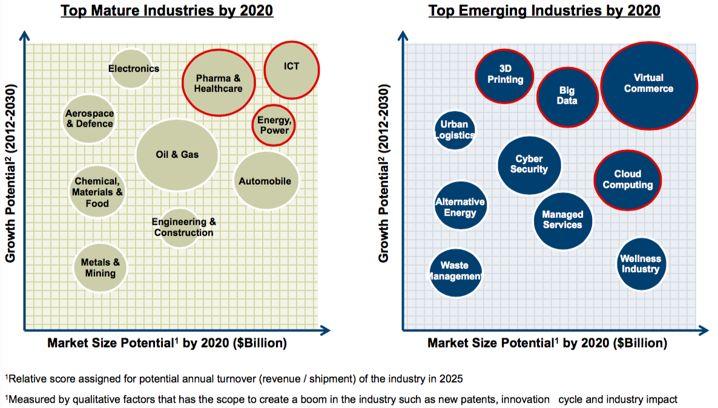
Top Industries of the Future

Slide 26
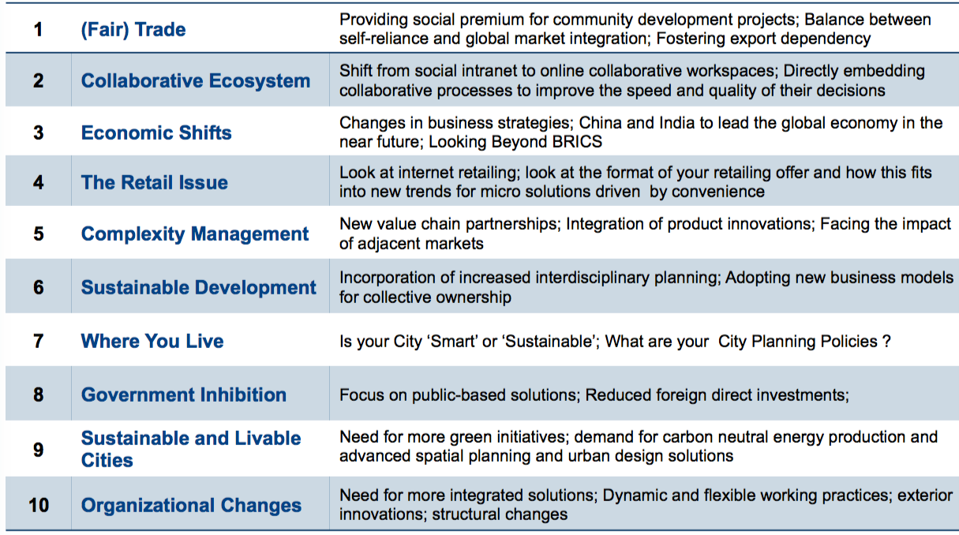
Some Key Strategic Challenges

Slide 27
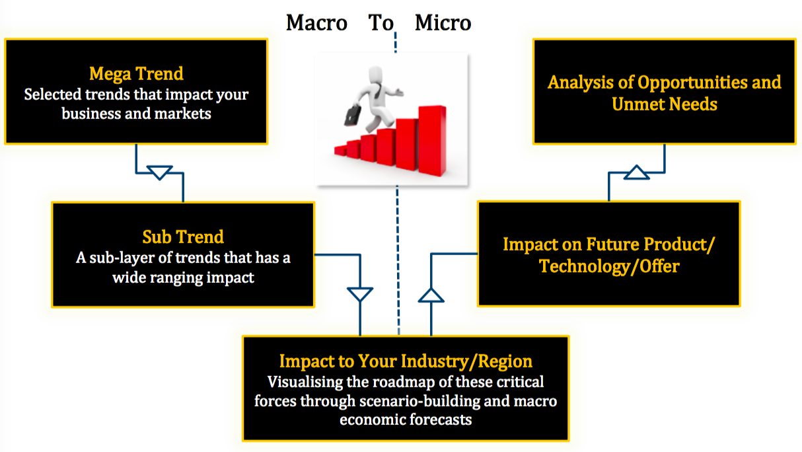
From Macro to Micro: Taking Mega Trends from Information to Strategy Implementation

