Slide 1
Diversification
A diversification growth opportunity is one in which a retailer introduces a new retail format directed toward a market segment that is not currently served by retailer
Related vs Unrelated Diversification
Vertical Integration describes diversification by retailing into wholesaling or manufacturing
Examples – CP?
Notes:
1

Slide 2
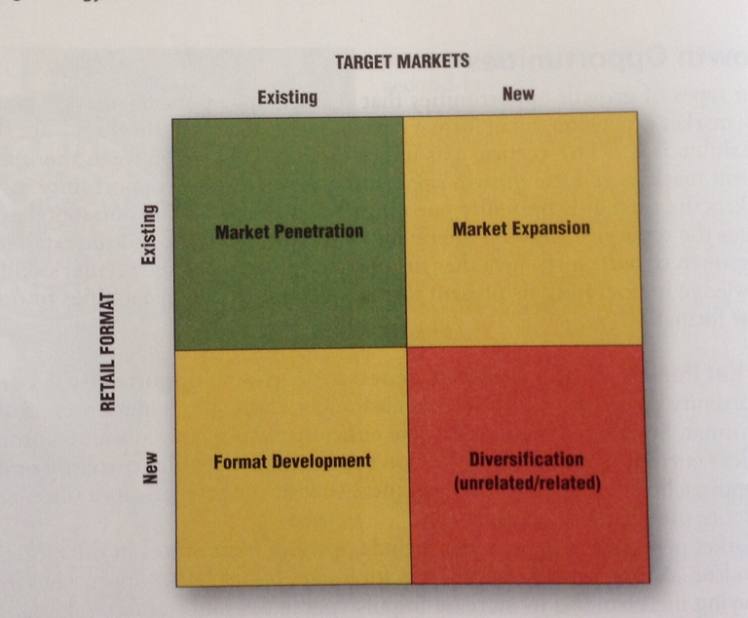
Diversification
Notes:
1

Slide 3
MK 322 Group Homework
Please present only 1 page for next session
You are required to Develop a new “Retail Diversification Strategy”(related) for your new business
Please find out the Corporate Mission/Vision for your focal company
Please suggest a new target group and a new business format meets your market target needs.
Your new retail format has to create a sustainable competitive advantage- creative, unique, differentiating, wow your target consumers
Then you are only allowed to create one page presentation to be added in next week’s store visit presentation
This presentation does not have to be detailed, it should be a direction of your new business
GOOD Luck!!

Slide 4
Group Exercise- Brainstorming session for Diversification Strategy
You are to brainstorming how many different Retail formats you could expend and list at least 10 down
You are to brainstorm how how many different target groups you want to expand to and list at least 10 down
Please base your assumptions on your previous fact finding work. Have fun

