Slide 1
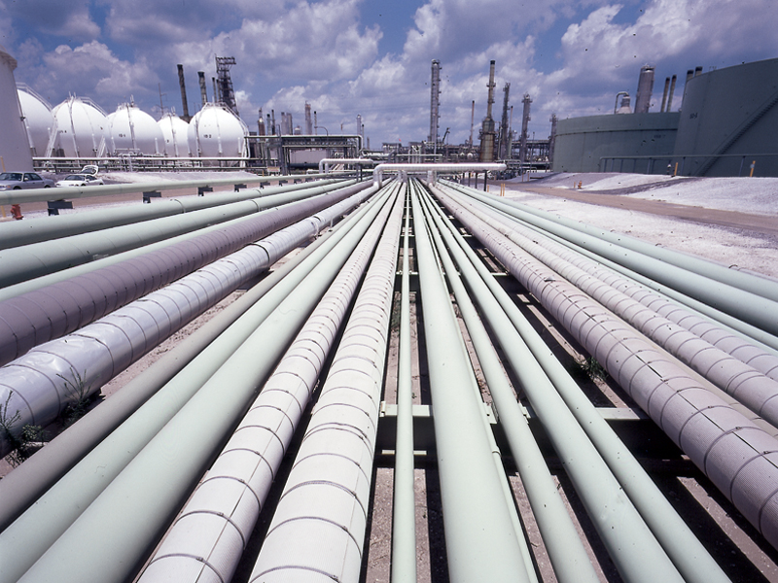
Pipeline
Economics of transportation

Slide 2
Group members
Athiphat Nithiwongwuttikul 5504640110
Ekkasit Sitthirotchanawan 5504640276
Pruthaporn Yai-aroon 5504641373
Thanawin Chuenchomlada 5504641936

Slide 3
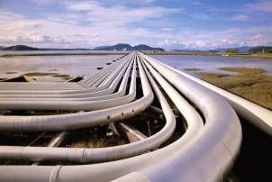
What is pipeline ?
Pipeline transport is the transportation of goods through a pipe. Most commonly, liquids and gases are sent, but pneumatic tubes using compressed air can also transport solid capsules.

Slide 4
What is pipeline ?
As for gases and liquids, any chemically stable substance can be sent through a pipeline. Therefore sewage, slurry, water, or even beer pipelines exist; but arguably the most valuable are those transporting crude petroleum and refined petroleum product including fuels: oil ,natural gas (gas grid), and biofuels.

Slide 5
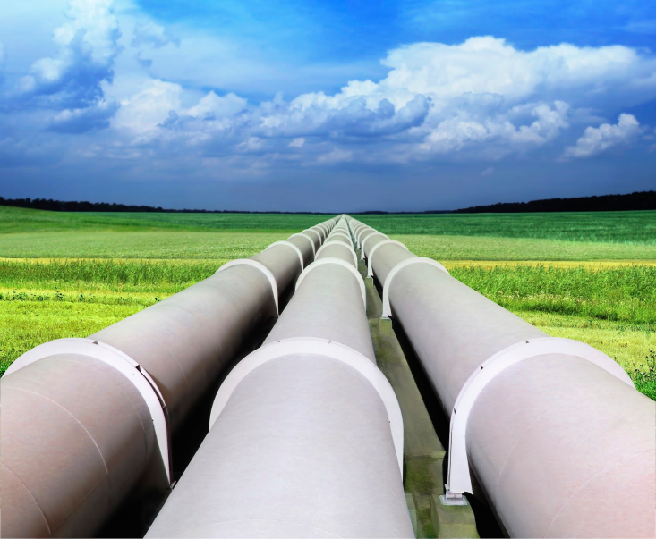
Types of pipeline
1 For oil or natural gas
2 For ammonia
3 For biofuels (ethanol and biobutanol)
4 For coal and ore
5 For hydrogen
6 For water
7 For beer
8 For other uses

Slide 6
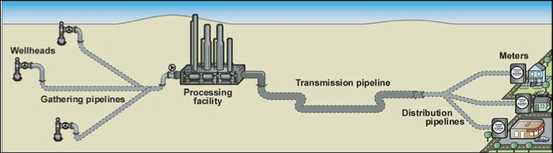
Function of pipeline
Gathering pipelines
  Group of smaller interconnected pipelines forming complex networks with the purpose of bringing crude oil or natural gas from several nearby wells to a treatment plant or processing facility.

Slide 7
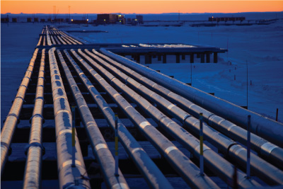
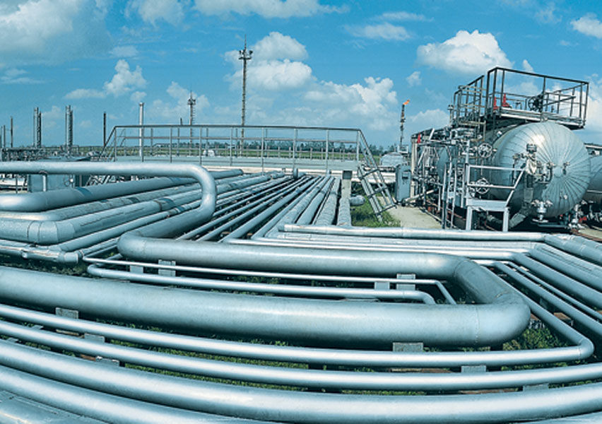
Transportation pipelines
  Mainly long pipes with large diameters, moving products (oil, gas, refined products) between cities, countries and even continents. These transportation networks include several compressor stations in gas lines or pump stations for crude and multiproduct pipelines.

Slide 8
Distribution pipelines
Composed of several interconnected pipelines with small diameters, used to take the products to the final consumer. Feeder lines to distribute gas to homes and businesses downstream. Pipelines at terminals for distributing products to tanks and storage facilities are included in this group.

Slide 9
Advantage
1.Cost and time saving.
2.Can be transported in any climate.
3. Unlimited time and quantities in transportation.
4. Highly secure from loss or theft.
5. Clear schedule in transportation.
6. Cheap labor cost because using less manpower.

Slide 10
Disadvantage
1.Can transport only liquid and gasses.
2. The cost of the initial investment is high.
3. Difficult to check for weak spot.
4. Cannot move or change the way of transportation.
5. Not suitable for transport in the country with frequent earthquakes.

Slide 11
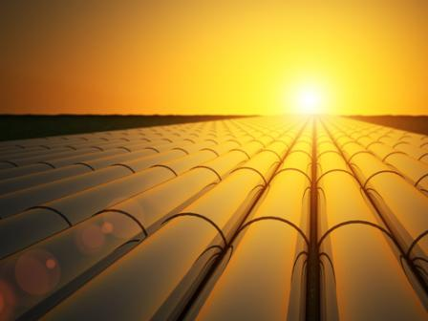
Summary
This mode of transportation after initial construction have fixed in place and move product in high volume, can protect product from contamination and it is most economical form of transportation with lower cost per ton of any mode. It has some drawbacks that must considered and be carefully in operation.

Slide 12
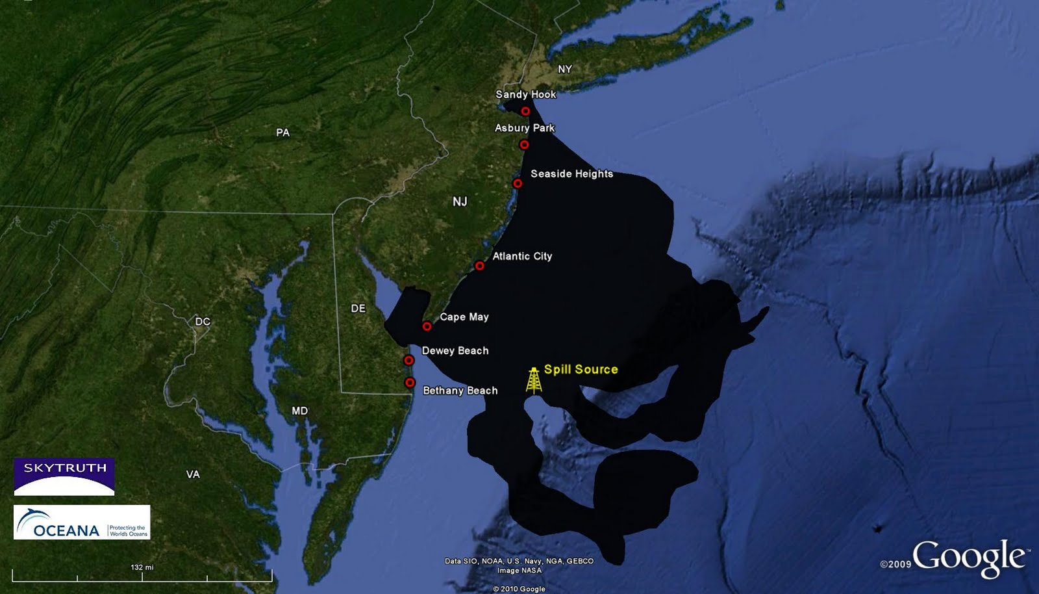
Recent news
In 2009, PTTEP Australasia, a PTT subsidiary, was involved in an oil spill considered one of Australia's worst oil disasters, in the Montara oil field in the Timor Sea of the northern coast of Western Australia.

Slide 13
In Thailand
July 29, Oil from a leaking pipeline has washed up on resort island in Thailand.
The spill occurred early Saturday when the pipeline operated by PTT Global Chemistry, a subsidiary of Thai state-owned oil and gas PTT Public Co. Ltd., sprung a leak about 12 miles off the coast of mainland Rayong province, The Nation newspaper reports.
About 13,000 gallons of oil leaked into the sea, the company said. By Sunday night, the oil slick had reached the western side of Samet Island, covering about 2,000 feet of beachfront, China's state-run Xinhua News Agency reports.

Slide 14
Effect on economy
The spill had caused severe damage to Rayong's environment and that it would take at least six months for its tourism sector to recover.
Even though the oil spill only hit Prao Bay on the island, many bookings at hotels on other beaches and even on Rayong’s mainland have been cancelled, Mr. Chairat said. He added that the number of day-trip visitors who usually come to taste seafood at restaurants has also dropped by about 80%.

Slide 15
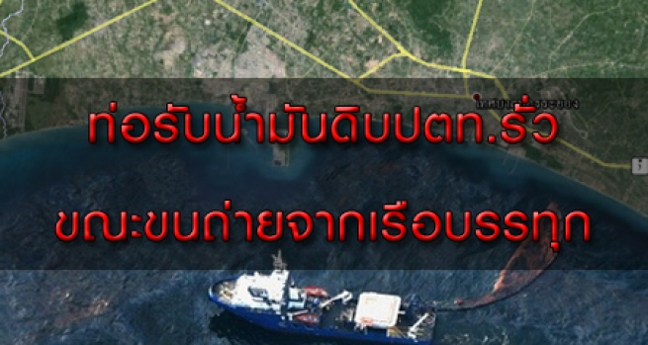
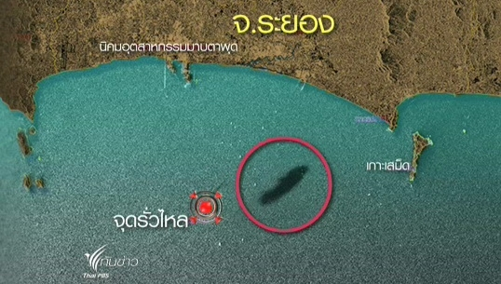
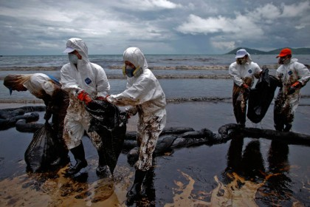
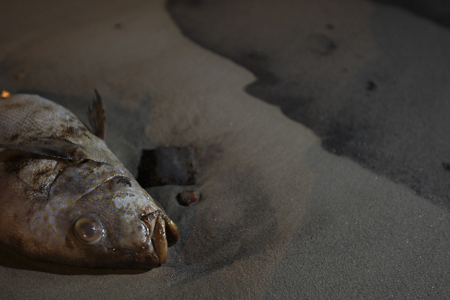

Slide 16
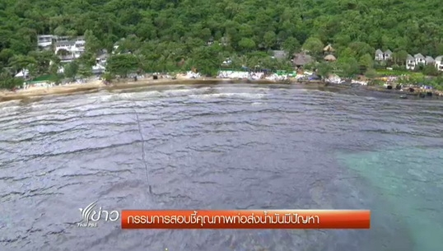
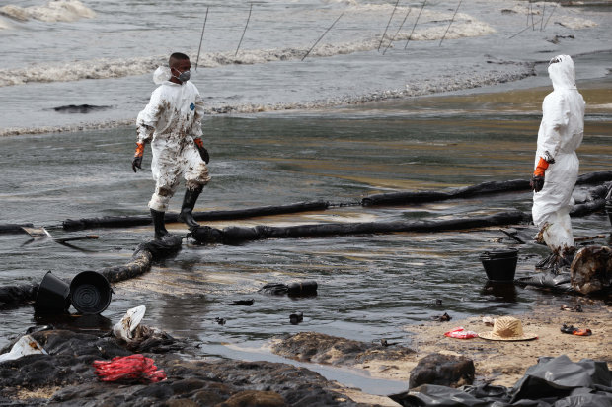
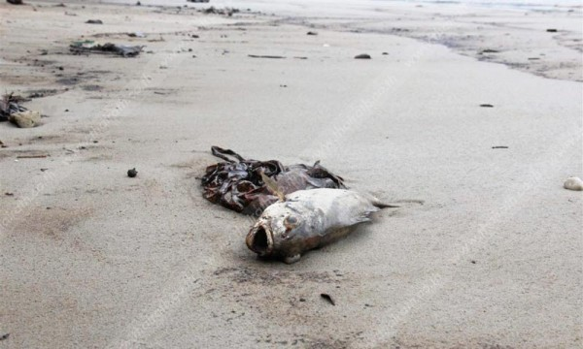
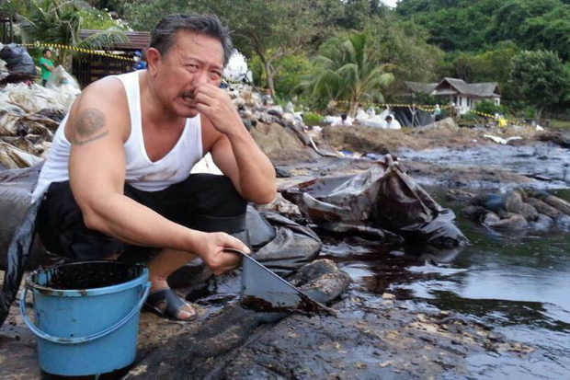

Slide 17
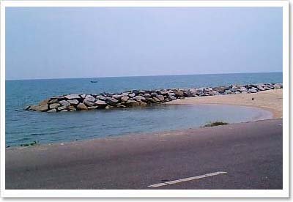
Thank you

