Slide 1

What is Disruptive Innovation?
HBR
December 2015

Slide 2
Story
Disruption describes a process whereby a smaller company with fewer resources is able to successfully challenge established incumbent businesses. Specifically, as incumbents focus on improving their products and services for their most demanding customers., they exceed the needs of some segments and ignore the needs of others.
Entrants that prove disruptive begin by successfully targeting those overlooked segments, gaining a foothold by delivering more suitable functionality frequently at a lower price.

Slide 3
Incumbents, chasing higher profitability in more-demanding segments, tend not to response vigorously.
Entrants then move upmarket, delivering the performance that incumbents’ mainstream customers require, while preserving the advantages that drove their early success.
When mainstream customers start adoping the entrants’ offerings in volume, disruption has occurred.

Slide 4
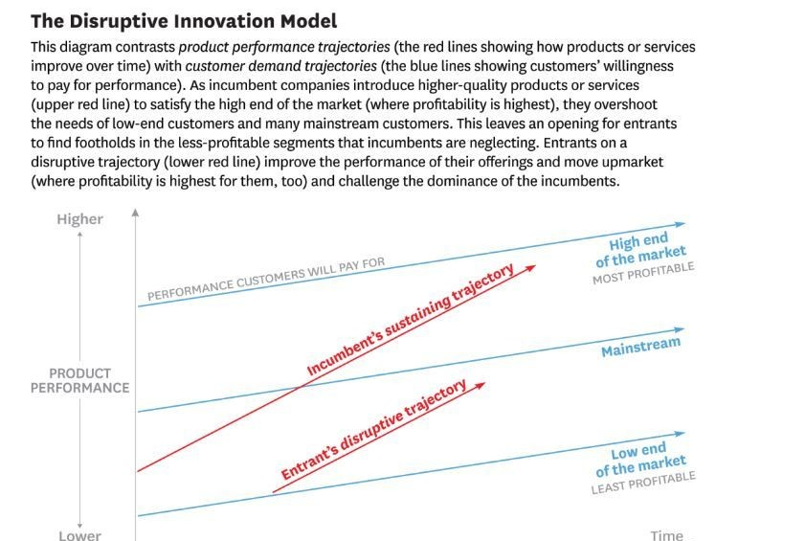
Disruptive Innovation Model

Slide 5
Explain the model
As incumbent companies introduce higher-quality products to satisfy the high end of the market, they overshoot the needs of low-end customers and many mainstream customer.
This leaves an opening for entrants to find footholds in the less-profitable segments that incumbents are neglecting.
Entrants on a disruptive trajectory improve the performance of their offerings and move upmarket where profitability is highest for them, and challenge tha dominance of the incumbents.

Slide 6

Is Uber a Disruptive Innovation?

Slide 7

UBER
Uber is the transportation company whose mobile application connects consumers who need rides with drivers who are wiing to provide them, founded in 2009.
It has spawned a slew of imitators.(WAYGO)

Slide 8

The answer is No
1. Disruptive innovations are made possible because they get started in two types of markets that incumbents overlook.
Low-end footholds exist because incumbents typically try to provide their most profitable and demanding customers with ever-improving products and services, and they pay less attention to less-demanding customers.

Slide 9


2. Disruptors create a new market.
They find the way to turn noncustomers into customers
Xerox targeted large corporations and charged high prices in order to provide the performance that those customers required.
School librarians made do with mimeograph machine.
Then in the late 1970s, new challengers introduced personal copiers, offering an affordable solution to individuals and small organizations, and new market was created.
From this relatively modest beginning personal photocopier makers gradually built a major position n the mainstream photocopier market that Xerox valued.

Slide 10
UBER is not disruptive innovation
A disruptive innovation, by definition, starts from one of those two footholds.
Uber did not originate in either one.

Slide 11
Conclusion
Disrupters start by appealing to low-end or unserved consumers and then migrate to the mainstream market.

Slide 12
Disruptive innovation and sustaining innovation
Sustaining innovations make products better in the eyes of an incumbent’s existing customers.
Disruptive innovations are initially considered inferior by most of an incumbent’s customers. Typically, customers re not willing to switch to the new offering merely because it is less expensive. Instead, they wait until its quality rises enough to satisfy them. Once that is happened, they adopt the new product and happily accept its lower price.
Disruption drives prices down in a market.

Slide 13


E-Spring and Fountain

Slide 14
1. Disruption is a process
Disruption is a process of the evolution of products over time.
Most of disruption begins as a small-scale of experiment.
Disrupters tend to focus on getting business model, rather than merely the product.
Netflix launched in 1997 and its initial service, delivery to the US mail and online interface, was not appealing to most of Blockbuster’s customers. Two companies filled very different needs for their different customers. as new technology allowed Netflix to shift to streaming video over the internet, the company did eventually appealing to Blockbuster’s core customers, offering a wider selection of content with an all-you-can-watch, on demand, low price, high quality, highly convenient approach.

Slide 15
2. Disrupters often build business models that are vey different from those of incumbents
Apple’s iPhone debuted in 2007, was a sustaining innovation in the smart phone market.
The iPhone created disruption in the laptop market by building facilitated network connecting application developers with phone users. The iPhone created a new market for internet access and eventually was able to challenge laptops as mainstream users’s device of choice for going online,

Slide 16
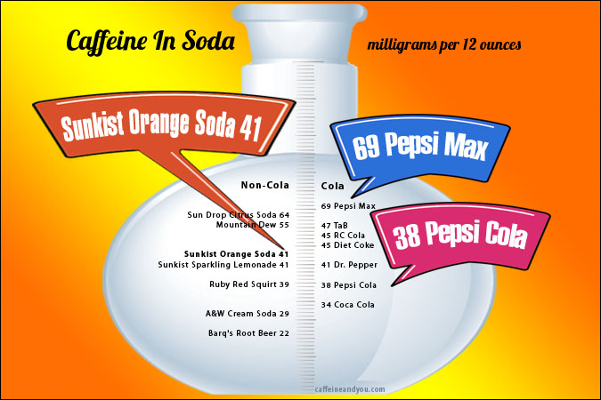
3. Some disruptive innovations succeed; some don’t

Slide 17
4. The mantra disrupt or be disrupted can misguide us.
Incumbent companies do need to respond to disruption if it is occurring, but tey should not overreact by dismantling a still-profitable business. Instead, they should continue to strengthen relationships with core customers by investing in sustaining innovations.
The success of the enterprise depends on keeping it separate from the core business. That means that for some time, incumbent will find themselves managing two very different operations.

Slide 18


Slide 19

R1
Disruption theory does not dictate what managers should do. Instead, it helps them make a strategic choice between taking a sustaining path or taking a disruptive one.

Slide 20
R2
The theory of disruption predicts that when an entrant tackles incumbent competitors head-on, offering better products, the incumbents will accelerate their innovations to defend their business. They will either offering even better products or comparable prices.
The entrants pursue a sustaining strategy for stand-alone business will face steep odds. In disk drive industry, only 6% of sustaining entrants managed to succeed.
Empirical findings showed that incumbents outperformed entrants in a sustaining innovation context but underperformed in a disruptive innovation context.

Slide 21
R3
Low-end disrupters come in at the bottom of the market and take hold within an existing value network and take hold within an existing value network before moving upmarket and attacking that stratum.
New market disruptions take hold in a completely new value network and appeal to customers who have previously gone without the product. Transistor pocket radio were aimed at non-consumers of tabletop tube radio.

Slide 22
R4
Disruptive theory does not, and never will, explain everything about innovation specially or business success generally. But empirical tests show that using disruptive theory makes us measurably and significantly more accurate in our predictions of which fledgling businesses will succeed.

Slide 23
Question
Provide the real life case study that explains the disruptive theory.

