Slide 1
EE401 Political Economy
Chapter 5 Marxian Political Economy and Socialism
Part i: Marxian Concept of Social Changes
and Revolution
Ploy Thammapiranon 2/2017
BE, Thammasat University

Slide 2
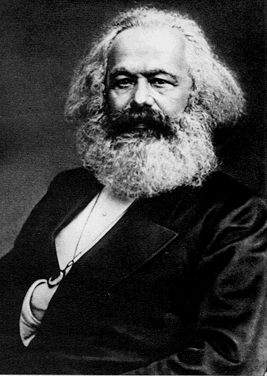
Marxian political economy and socialism
Introduction to Socialism
Branches of Socialism
Marxian Political Economy
Criticisms of Marx
Soviet and Mao’s Socialism
Rebuttal from Marxists

Slide 3
1. Introduction to Socialism
1.1 The rise of Socialism
Socialism is the response to bad living conditions of the masses.
  Struggling to survive.
  Huge income distribution.
Aiming at changing the unfair system.
  Alleviating living conditions of typical persons and sharing wealth.
Disagreeing with classical and neo-classical.
  The market has invisible hand.

Slide 4
1. Introduction to Socialism
1.2 Key Socialist ideas:
a) Against private property
Private property is the root of all social evils.
  Self-interest, competition and profit-seeking is harmful to society.
Rejection of capitalism.
  Periodic crises and general gluts.
Social reform to abolish private property.

Slide 5
1. Introduction to Socialism
1.2 Key Socialist ideas:
b) Collective ownerships and decisions
Public and collective ownerships of productive resources and products.
  Collective decisions on production.
Distribution by non-market means.
Collective social and cultural life.
  ‘From each according to their ability,
  to each according to their needs’.

Slide 6
1. Introduction to Socialism
1.2 Key Socialist ideas:
c) Social Engineering
Human nature is determined by environment.
‘We’ can change humans by changing their environment.
‘Selfish capitalistic persons’ can be changed to ‘socialist ones’.

Slide 7
2. Branches of Socialism
Utopian Socialism: idealistic view of future
  Perfect social arrangement with universal brotherly love.
  Reorganized the commune without class struggle.
  Workers are unaware of latent power.
Anarchism
  Abolition of the government.
  Society is capable of self-governing.
  Support collective ownership by group.
  Ideal community where there is specialization and trade between groups.

Slide 8
2. Branches of Socialism
Syndicalism
  Anti-parliamentarian, anti-militarists.
  Workers need to overthrow capitalism and replace with workers firms – ‘Syndicates’.
  Every firms hire people with the same wages.
Marxist Socialism
  Based on Smith and added theory of exploitation.
General tone
Workers were exploited.
Overthrow Capitalism and create new system where workers have better power and living conditions.

Slide 9
3. Marxian Political Economy
3.1 Karl Heinrich Marx (1818-1883)
Completed Ph.D. on Greek philosophy.
Moved to Paris, met Frederick Engels (1820-95).
‘The Communist Manifesto’ with Engels.
‘A Contribution to the Critique of Political Economy’.
‘Capital Volume I’.
1841
1843
1848
1859
1867
9
9

Slide 10
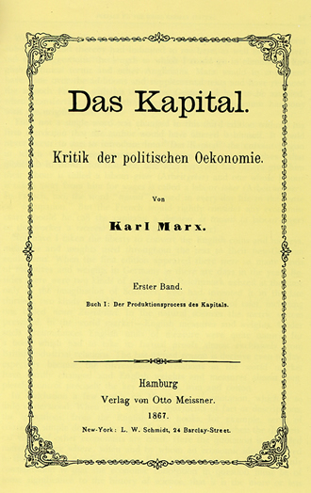
3. Marxian Political Economy
3.1 Karl Heinrich Marx (1818-1883)
Huge piles of manuscripts left to Engels.
Series of Marx’s works published until 1980s.
Manuscripts and letters in Germany sent to be preserved in Moscow as Nazism rose.
10
10

Slide 11
3. Marxian Political Economy
3.2 The Materialist Conception of History
Superstructure
Social consciousness
Mode of Production
Productive forces
Production relations
Economic base
Production activity determines social structures and social consciousness – ‘Social Formation’
11
11

Slide 12
3. Marxian Political Economy
3.2 The Materialist Conception of History
Any mode of production is the result of a specific relations of two factors
Productive forces
  Means of production, laborers and skills.
  Dynamic.
Production relations
  Relations between owners of factors of production and products → Affect the distribution of wealth.
  Class relation: exploiting vs exploited classes.
  Static and rigid.
‘Mode of production forms the basis of all social consciousness’
12
12

Slide 13
3. Marxian Political Economy
3.3 Social changes and revolution
Advancing productive forces are obstructed by rigid production relations.
Superstructure
Social consciousness
Mode of Production
Productive forces
Production relations
Economic base
✓✓
✕✕
13
13

Slide 14
3. Marxian Political Economy
3.3 Social changes and revolution
Economic and social crisis: class conflict and struggle.
Social revolution to a higher stage of society.
CONFLICTS!!!
Superstructure
Social consciousness
Existing mode of production is replaced by new mode of production
✕✕✕
Productive forces
Production relations
14
14

Slide 15
3. Marxian Political Economy
3.3 Social changes and revolution
New production relations develop
  Changes in the state power with the new ruling class and
Corresponding changes in social consciousness.
  Progress in productive forces resumes.
Human society passes to higher stages over time
15
15

Slide 16
3. Marxian Political Economy
3.3 Social changes and revolution
Primitive Communism
  Group activities for survival.
  No classes, common ownership.
  Low efficiency and little surplus → exploitation is impossible.
2) Slavery
  Surplus develops → hire slaves.
  A barrier to further progress because the lack of motivation.
  Exploitation and class conflict.
  → The new system keeps slaves, but fools them into thinking that they are free.
16
16

Slide 17
3. Marxian Political Economy
3.3 Social changes and revolution
3) Feudalism
  Lies between Slavery and Capitalism.
  Work ½ day for lords, work ½ day for themselves.
  Lords adjusted the time workers for themselves → earn only subsistence level.
4) Capitalism
  Fools workers into working and keeping all output for themselves.
  Hidden exploitation which leads them to the subsistence.
  Oppression of workers → class struggles → the overthrown of capitalism.
17
17

Slide 18
3. Marxian Political Economy
3.3 Social changes and revolution
5) Socialism
  Capital and land are publicly owned.
  Planned production replaces price system and profit-oriented production.
6) Communism
  So productive that the goods are available for everyone.
  People are motivated by interests for all.
  No state.
18
18

Slide 19
3. Marxian Political Economy
3.4 Labour Theory of Value
A commodity is produced for the purpose of exchange.
Use-value vs. Exchange-value: different commodities are exchangeable due to a common property called value.
Value is determined by the socially-necessary labor-time needed to produce it.
  Average labor-time, skills, hardship used to produce a commodity.
  Simple labor is unskilled, homogenous.
19
19

Slide 20
3. Marxian Political Economy
3.4 Labour Theory of Value
Price = value
Ex: one hour of labor = 1 unit of A
= 2 units of B
= 1 ounce of gold.
If one ounce of gold is dubbed ‘one dollar’:
  One hour of labor has value of $1;
  Price of A = $1;
  Price of B = $0.50.
20
20

