Slide 1
Ayutthaya’s Fall and Thonburi
EE/EC301
Thorn Pitidol

Slide 2
Topics
Changes before Ayutthaya’s fall
Ayutthaya’s Fall
Thonburi’s natural governments

Slide 3
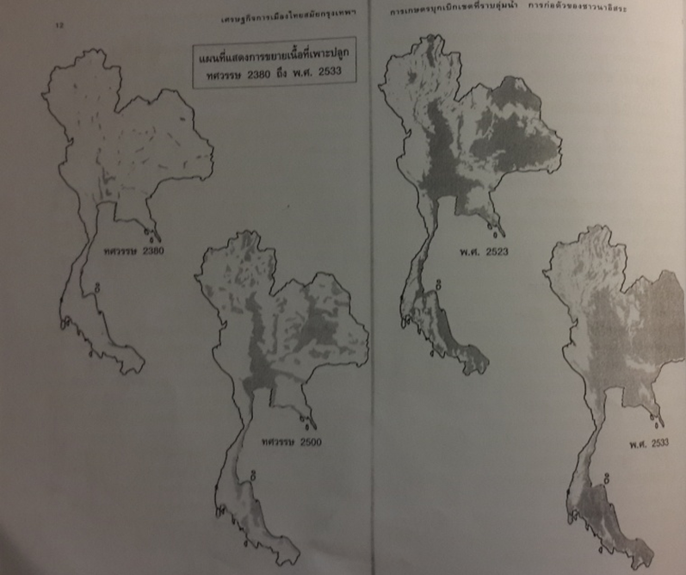
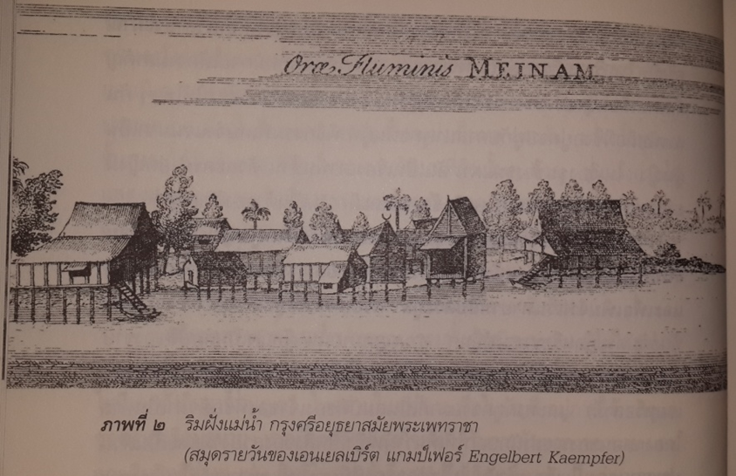

Slide 4
Ayutthaya: Geography-Society
2 geographic areas of Siam
  Low land Basin
  Forest hinterland
2 crucial form of productions
  Rice production
  Collection of forest products
Societal system organized around the control of labour to facilitate productions

Slide 5
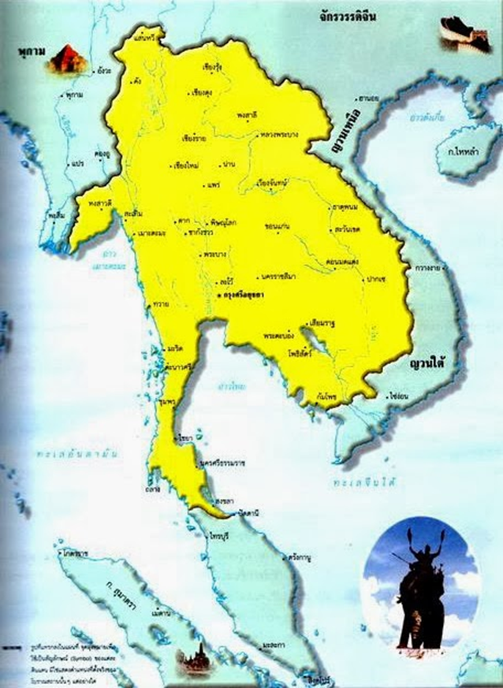
Ayutthaya: Trade and War
Trade of forest product crucial to wealth of rulers
  Key to Kingdon’s power was the ability to control trade
    Control of trade routs
    Tributary relationships
Other than to gain more labour, the function of war was to control trade routes
Usual misunderstanding – wars as territory gaining

Slide 6
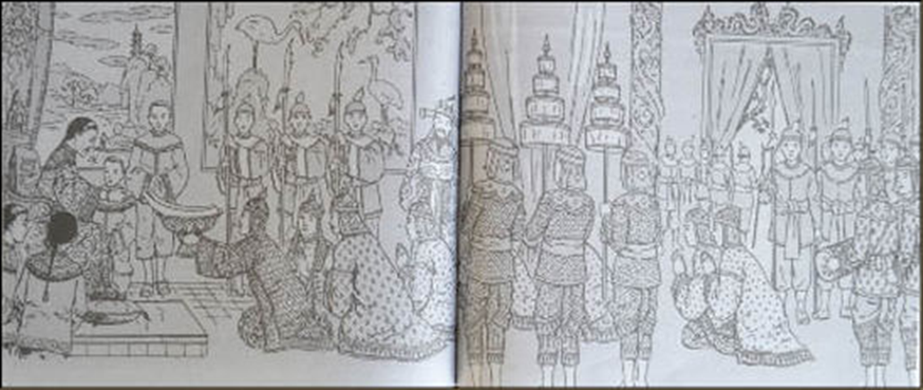
Tributary relations with China

Slide 7
Changes before the falling of Ayutthaya
As the result of almost a century of peace and commerce, Ayutthaya went through significant changes
  Rise of China and Chinese
  Struggles over force labour
  Rise of nobility

Slide 8
The rise of China and Chinese
After 1688, French and British led the scene. The Moors expanded dominance, joined by the Chinese.
  Importance of Chinese rose rapidly through trade and settlements.
  They also became one of the most important in Royal court.

Slide 9
The rise of China and Chinese
China trade
Trade between Siam and China boomed as a result of (1) Emperor's policy and (2) demand for food product
  Both trade in tributary structure and private trade
Chinese settlements
Influx of Chinese around 1700, from around 3,000 in 1720 to 20,000 in 1730.
  Emperor accepted "Chinese manning junks to China had lived in Siam"
  Signified in rises of places Chinese markets, Chinese villages, and Chinese Gate.
  Settlements also expanded to other areas – Chonburi, Chantaburi

Slide 10
The struggles over forced labour
As economy grew, demand for labour rose, there were more competition for labour control.
But the labour also made it difficult by fleeing the system
  Self-selling
  Monkhood
  And simply becoming "runaway Phrai" by moving to new rice tracts.
Nobles also competed to gain more control over labour.
  Stealing Phrai and slave.

Slide 11
The rise of nobility
With prosperity, the nobles became richer and more assertive. Their position became more stable. More prominent class of noble families emerged.
  Four important lineage of Ayutthaya's nobles
    Moors, Brahmans, Chinese, and Mon
      Bunnag, Siriwatthana, Ong’s lineage, Kosapan’s lineage
  More open in accumulating power and wealth
  Through their own restropective account, nobles now "made" Kings

Slide 12
Some responses to changes
Law addressing important challenges of the time
  Controlling labour, bandits, corruptions
  Signs of a much more complex social settings.
Buddhism
  Basis for social order and responsible Kingship

Slide 13
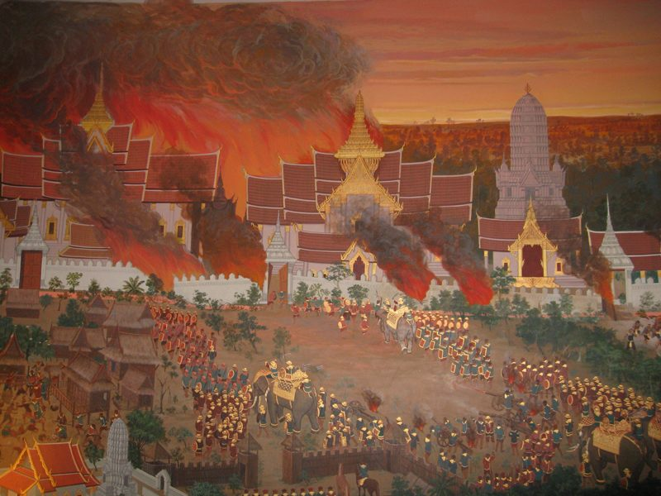
The Fall of Ayutthaya

Slide 14
The Fall of Ayutthaya
"The fall of the city was due not so much to internal conflict or dynastic decline but to a failure to manage the social and political consequence of prosperity“
  Baker and Phongpaichit, 2017

Slide 15
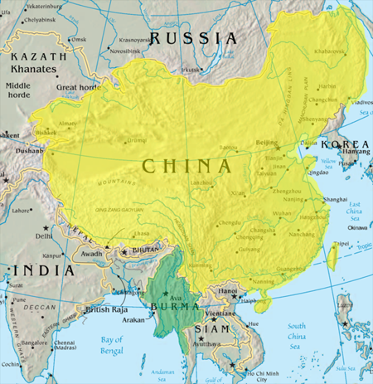
The Fall of Ayutthaya
New period of Burmese aggression in 1760
  Until then, more than 150 years of no significant threat
  Ayutthaya ability to waged war diminished. Best defense became natural monsoon.
Burmese siege of Ayutthaya lasted years

Slide 16
The Fall of Ayutthaya
"What is striking about 1767 us how few seemed motivated to defend the city which some thought 'deserve more praise than heaven high'.
  Few provincial lords brought their forces
  Many Siamese joined Burmese forces.
What does this shows about Ayutthaya’s fall?

Slide 17
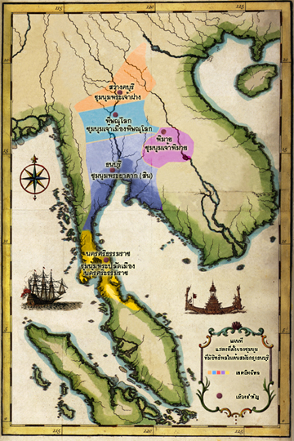
Thonburi period
Siam after Ayutthaya downfall
  “Chum-num” or “Natural government”
    A more natural state of society during the lack of development in ruling system
  What perhaps set Taksin’s Chumnum apart from others?

Slide 18
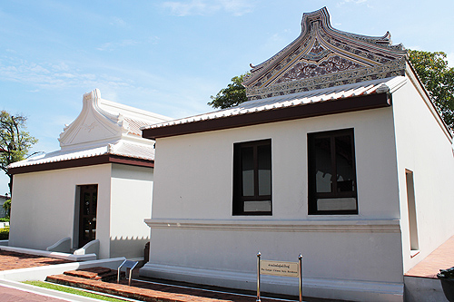
Taksin – the Chinese King
Taksin was a son of Teo-chew chinese merchant
He was likely to be born in Ayutthaya, but built himself as a merchant who travelled to trade in Tak.

Slide 19
The challenges of Thonburi
The strength of Taksin was in military skills. A fierce and ruthless leaders, he excelled at being a leader of a chumnum.
But he faced a totally different challenges as the King of a newly revived Siam.

Slide 20
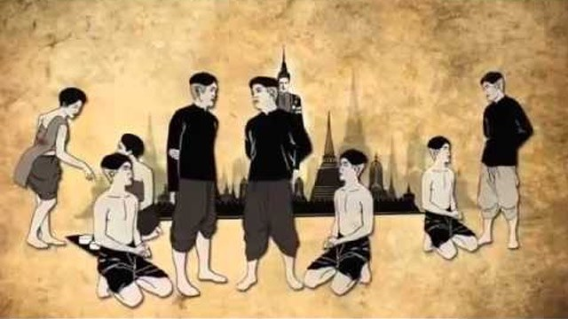
The challenges of Thonburi
Reviving the ruling system
Reviving the economy and re-establishing trade routes.

Slide 21
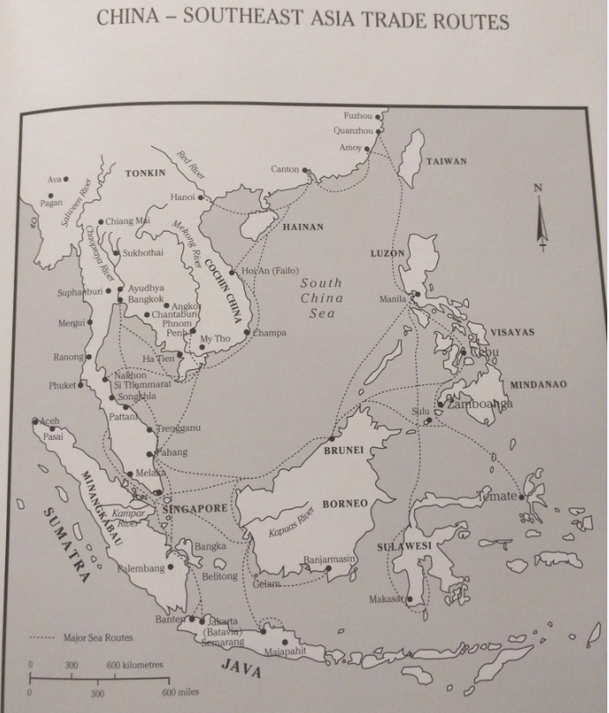
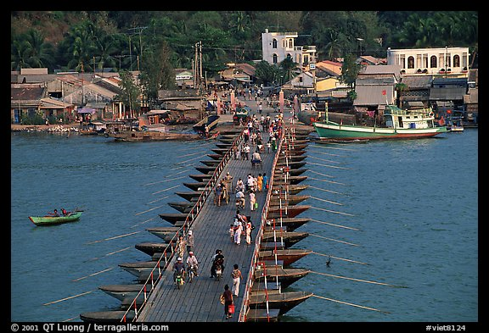
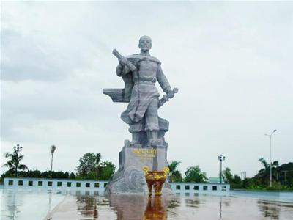
The challenges of Thonburi
Geo-politcs of trade with China
  Chantabun VS Ha-tien, Teochew VS Cantonese.

Slide 22
The fall of Thonburi
As the ruling system was rebuilt, Taksin’s position was destabilised by the system he tried to revived.
  The Chinese King VS Ayutthaya’s nobles?
Taksin’s obsession with Buddhism did not give him legitimacy as expected

Slide 23
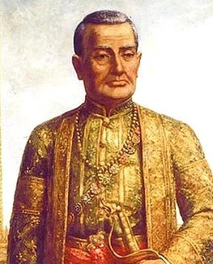
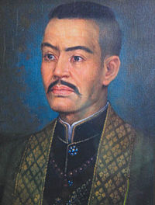
The fall of Thonburi
The new center of power for Thonburi’s Ayutthaya nobles “Phudee Gao”

Slide 24
Reflections from Thonburi Era
The rougher state of political economy
  A more natural form of politics (with no mafia state)
The basic challenges
  Scarcity of labour
  Expanding trade
  Rebuilding the society
  Reviving the royal court

Slide 25
Thailand | World
Rama I 1782-1809 (2325-2352 BE) | Industrial revolution started in 1760 Adam Smith died 1790 Napolean became the emperor of France 1804
Rama IV 1851-1868 (2394-2411 BE) | Britain imperial century started1815 First Anglo-Burmese War 1824
Rama V 1868-1910 (2411-2453 BE) | Beginning of Meiji Era 1868 First light bulb by Edison 1879 Titanic sank 1912 WWI 1914
Rama VII 1925-1933 (2468-2476 BE) | Great Depression started 1929 Adolf Hitler rose to power 1933
Rama IX 1946-present (2489-present) | Bombing of Hiroshima 1945 General Nevin coup in Burma 1962 Fall of Berlin Wall 1989

