Slide 1

Group Assignment 2
Retail Entrepreneurial Opportunities

Slide 2

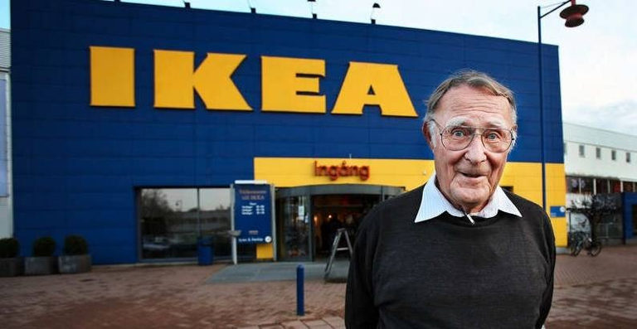

Entrepreneurial opportunities
Group Assignment:
What do they have in common?
What differences do they have?
What vision did each one have?
What makes their retail businesses so successful?
Please create one page ppt. slide to be due next Tuesday Feb.9th. Please design the one page by using graphs, charts, visuals to make one page interesting ka.
Notes:
1

Slide 3
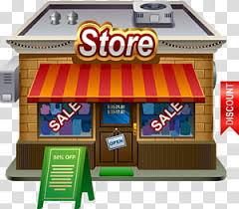
6 Retailers for MK 322
Sequence
Pekaboo
Black white
Rainbow (bookstore)
JJ+
Savage
BLACKCARD

Slide 4

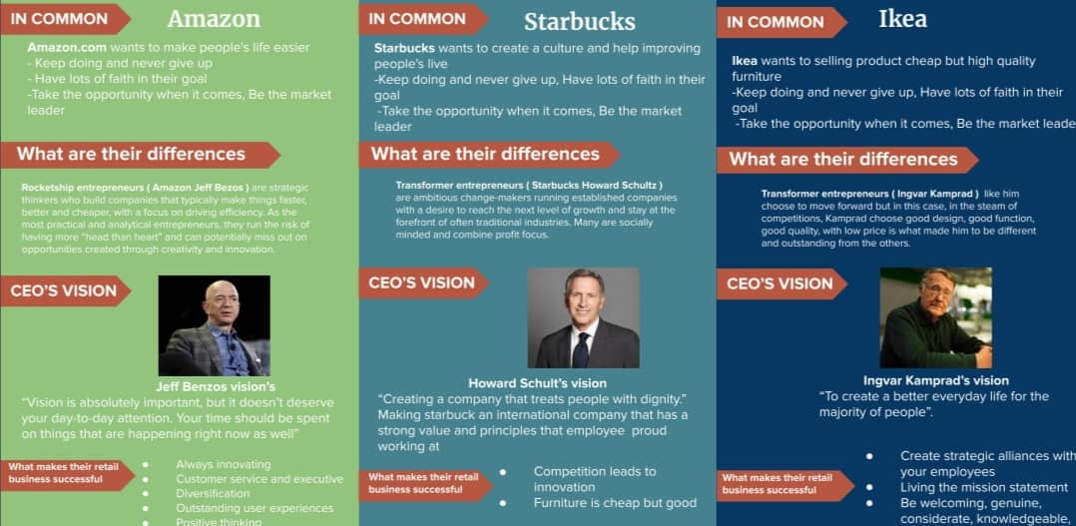
Pekaboo

Slide 5

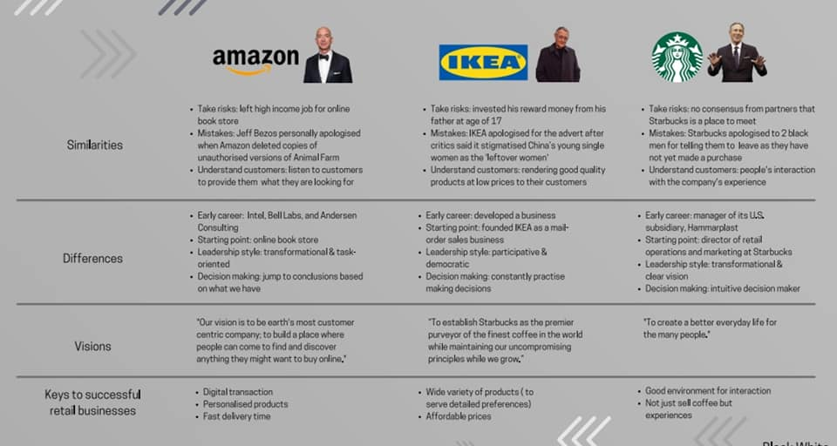
Black White

Slide 6

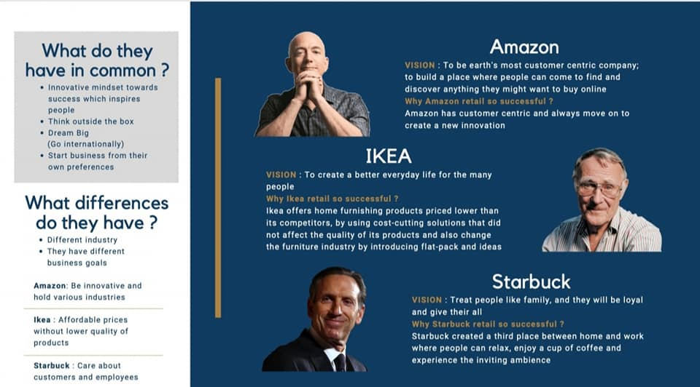
Rainbow

Slide 7

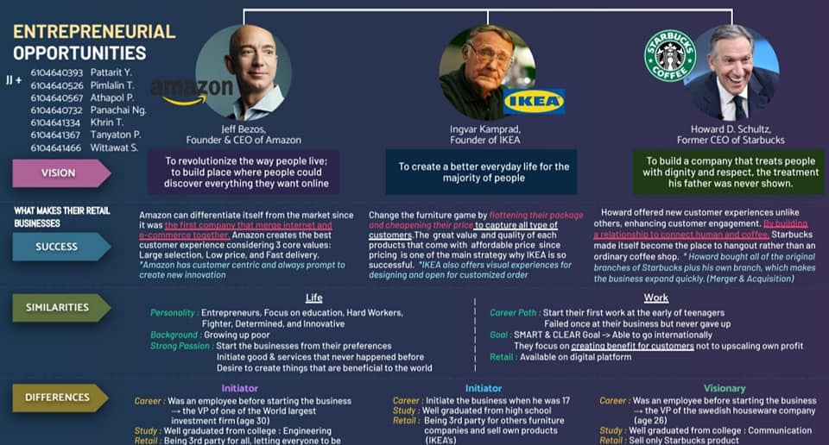
JJ+

Slide 8

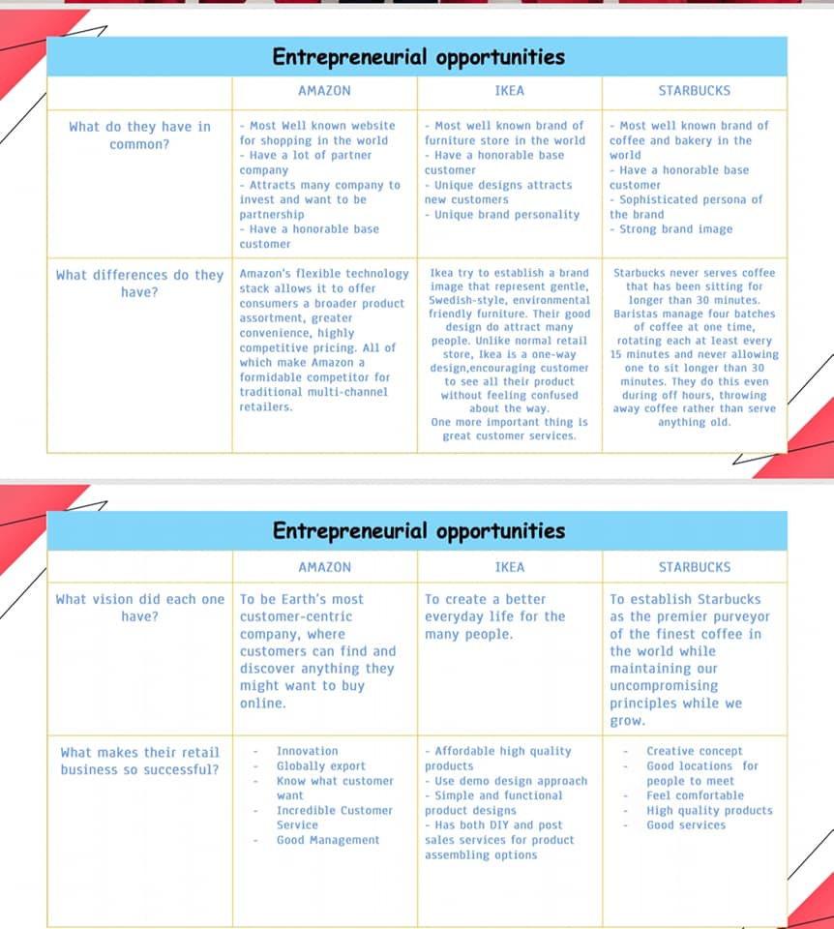
Savage

Slide 9
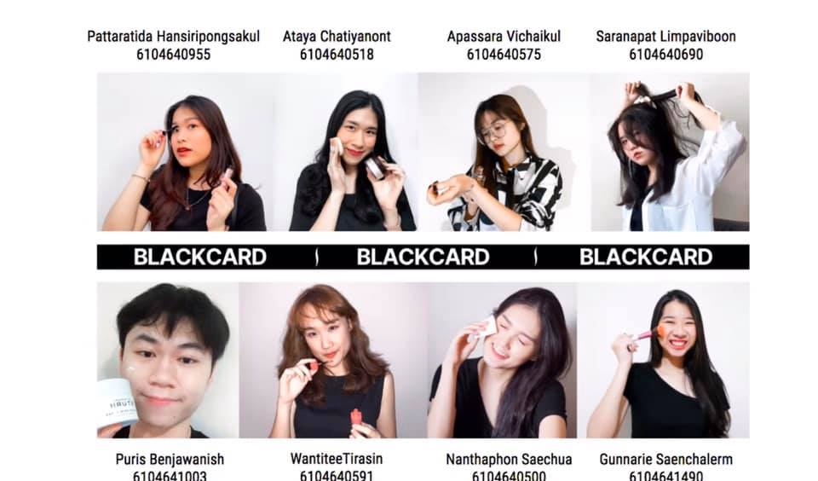
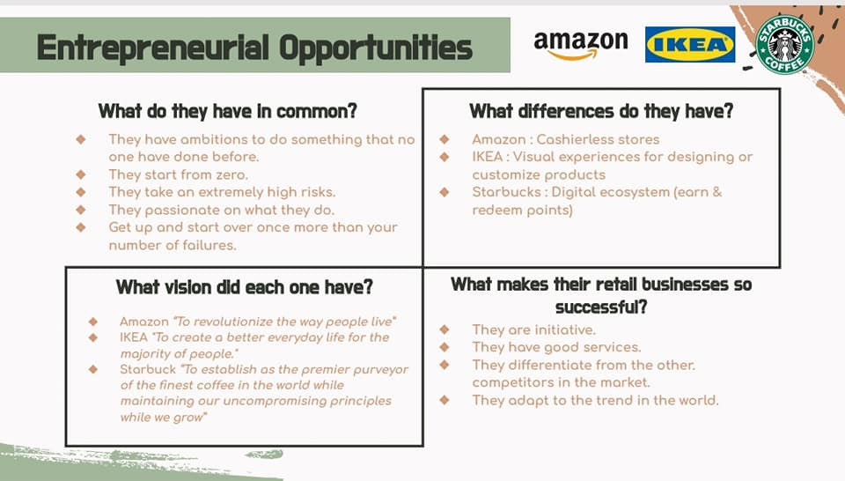
BLACKCARD

Slide 10


