Slide 1

MK 322 Retail Management
Chapter 6: Financial Strategy
By Ajarn Suwalya K.

Slide 2
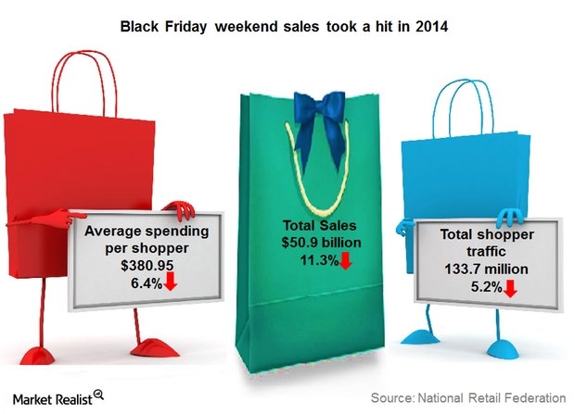
Objectives and Goals

Slide 3

Objectives and Goals
Three types of objectives that a retailer might
have are
Financial
Societal
Personal
Notes:
1

Slide 4
Financial Objectives
When assessing the financial performance of a firm, most people focus on profits
What were the retailer's profits or profit as a percentage of sales last year, and what will they be this year and into the future?
For retail, appropriate Financial measure is not profits but return on assets
Return on assets(ROA) is the profit generated by the assets possessed by the firm
Notes:
1

Slide 5
Societal Objectives
Societal Objectives are related to broader issues that make a world a better place to live.
Societal Objectives are more difficult to measure
But explicit societal goals can be set such as specific reductions in energy usage, excess packaging, increased use in renewable energy and support for United Way, Habitat for Humanity which are non profit organizations
For example providing employment opportunity for minority, disables, or environmentally friendly products
Notes:
1

Slide 6

Societal Objectives
Notes:
1

Slide 7

Personal Objectives
Many retailers, particularly owners of small, independent business, have personal objectives including self gratificaton, status and respect
By operating a popular store, a retailer might become recognized as a well-respected business leader in a community
Notes:
1

Slide 8

Strategic Profit Model

Slide 9
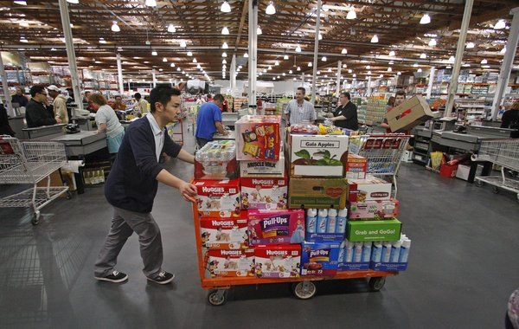
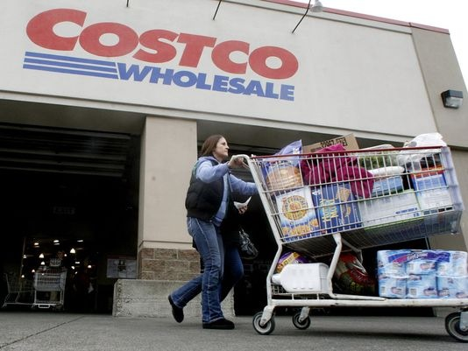
Costco
Notes:
1

Slide 10
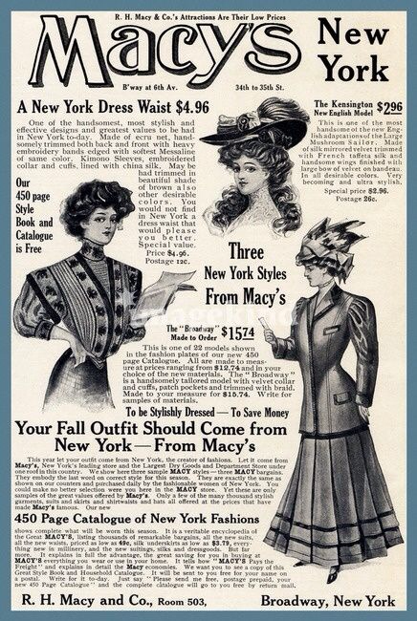
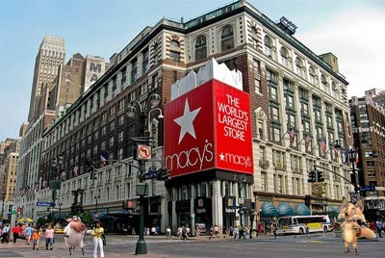
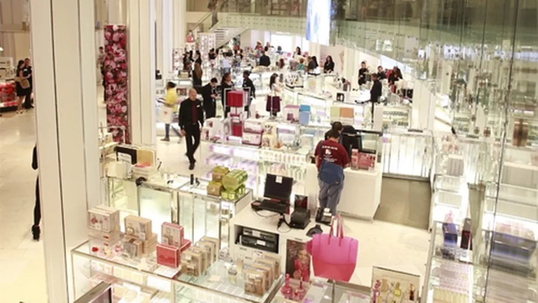
Macy's
Notes:
1

Slide 11
Strategic Profit Model
The strategic profit model is a method for summarizing the factors that affect the firm's financial performance
The operating profit margin also called earnings before interest, taxes, and depreciation (EBITDA) is a measure of the profitability from continuing operations if a retailer and is useful predictor if the retailer's profitability in the future
Asset turnover is the retailer's net sales divided by the assets
Notes:
1

Slide 12
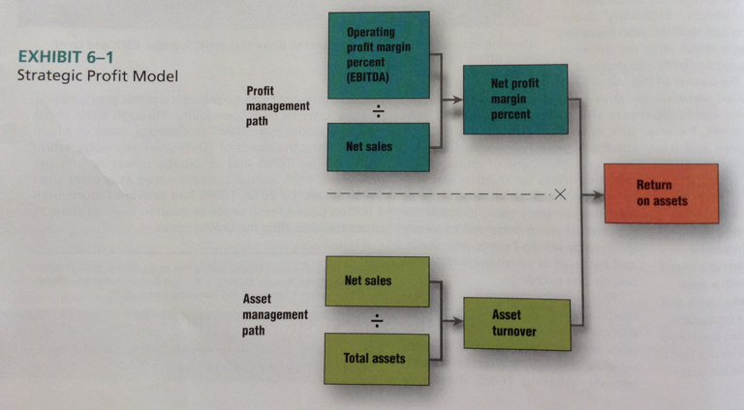
Strategic Profit Model
Notes:
1

Slide 13
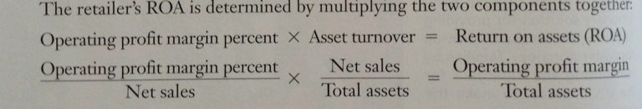
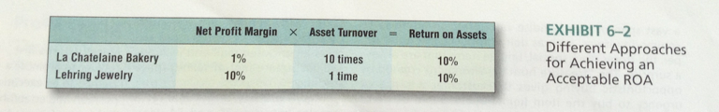
Strategic Profit Model
Notes:
1

Slide 14
Profit Margin Management Path
The information used to examine comes from the retailer's income statement or called statement if operations
The income statement summarizes a firm's financial performance over a period of time, typically a quarter (three months) or a year
To capture all the sales, gift card purchases, and returns from the holiday season, Macy's like many retailers, sets its fiscal year as beginning on February first and ending January 31
Notes:
1

Slide 15
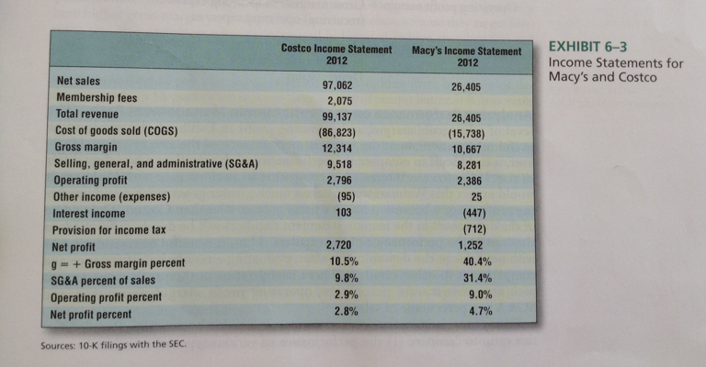
Profit Margin Management Path
Notes:
1

Slide 16
Profit Margin Management Path
Some retailers have additional revenue sources related to merchandise sales, such as payments to vendors
For example retailers often charge vendors for space in their stores known as slotting fee or slotting allowance
Retailers may also require that vendors pay a fee, known as chargeback fee when the merchandise bought from vendor does not meet all terms of the purchase agreement, such as those regarding delivery
Notes:
1

Slide 17

Profit Margin Management Path
Slotting Fees for placing products on shelves
Notes:
1

Slide 18
Profit Margin Management Path
Gross margin percentage is gross margin divided by net sales
Retailers use this ratio to compare
The performance of various types of merchandise and
Their with that of other retailers with higher or lower levels of sales
Notes:
1

Slide 19
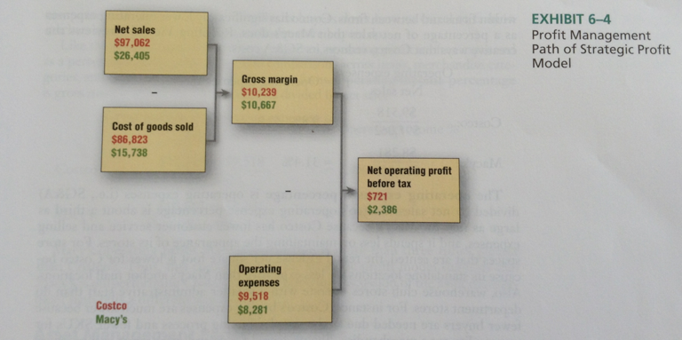
Profit Margin Management Path
Notes:
1

Slide 20
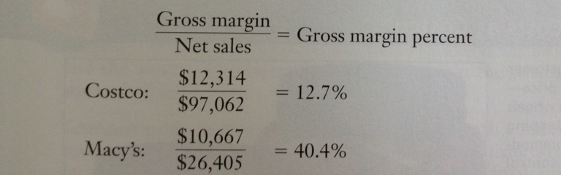
Profit Margin Management Path
Department stores like Macy's often have higher gross margins than warehouse clubs because they target less-price sensitive customers who are interested in branded fashion merchandise and personal service and are willing to pay for it.
Notes:
1

Slide 21
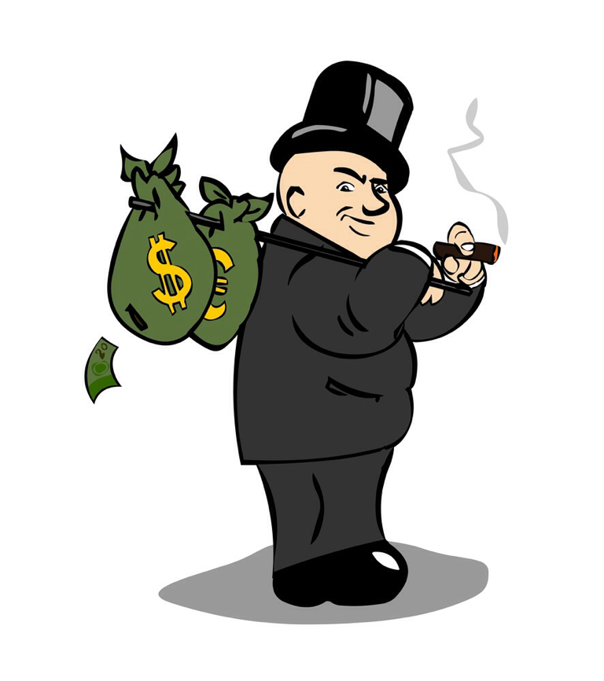
Asset Management Path
This information used to analyze a retailer's asset management path primarily comes from a retailer's balance sheet
Notes:
1

Slide 22
Asset Management Path
Assets are economic resources (eg.inventory,buildings, computer, store fixtures) owned or controlled by the firm
Current assets are assets that can normally be converted to cash within one year. For retailers, current assets are primarily cash, accounts receivable, and merchandise inventory
Fixed Assets are assets that require more than one year to convert to cash. The fixed assets are building (if store property is owned by retailer than leased).Distribution centers, fixtures (e.g. Display racks) and equipment (e,g. Computers, delivery trucks)
Notes:
1

Slide 23
Asset Management Path
Merchandising Inventory is a critical retailer asset that provides benefits to customers.
It enables customers to get the right merchandise at the right time and right place
Stocking more merchandise increases sales because it increases the chances that customers will find something they want
But by increasing inventory= increase amount of investment
Notes:
1

Slide 24
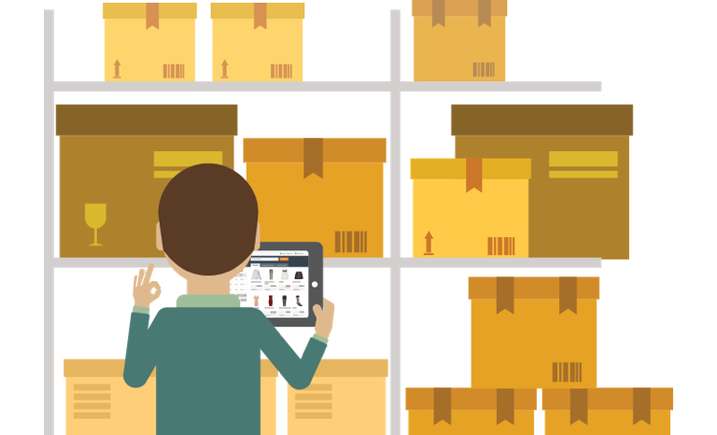
Asset Management Path
Inventory turnover is COGS during that time period, typically a year, divided by the average level of inventory (expressed at cost) during the time period
Notes:
1

Slide 25
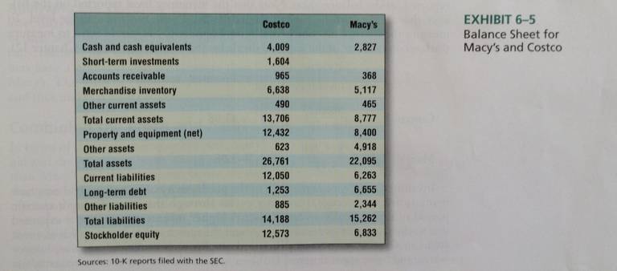
Asset Management Path
Notes:
1

Slide 26
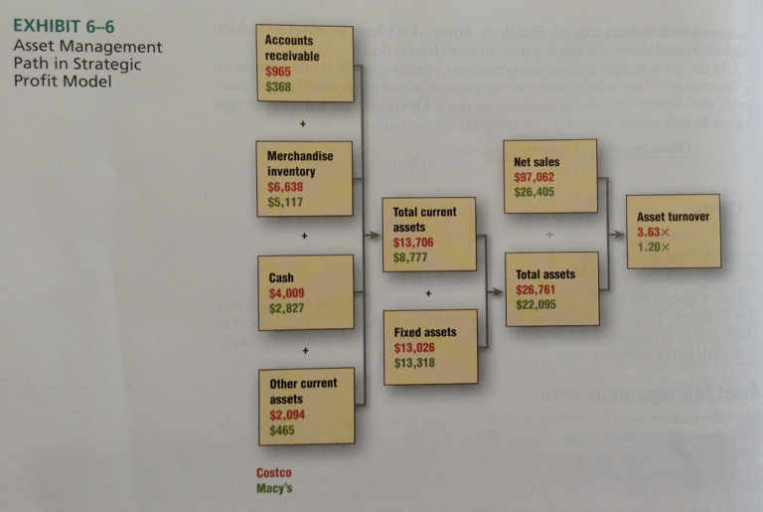
Asset Management Path
Notes:
1

Slide 27
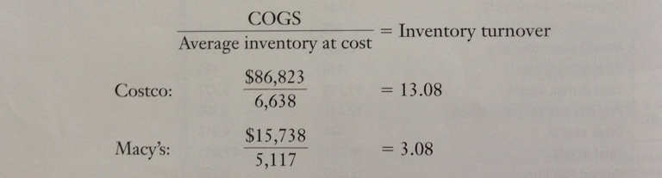
Asset Management Path
Costco's higher inventory turnover is due to the nature of its retail strategy and merchandise it sells.Most of Costco's are commodities and staples such as food, batteries, housewares, and basic apparel items. These staples can replenish rapidly as it has 4,000 SKUs incl, for example 2 sizes of Ketchup.
Notes:
1

Slide 28
Combining Profit and Asset Management Path
In terms if profit management path, Macy's has higher operating profit margin and thus performs better than Cosco
Costo performs better on higher asset management path
Although this type of performance is expected, given their overall strategy and retail formats, both retailers strive to increase their performance on these key ratios
Notes:
1

Slide 29
Combining Profit and Asset Management Path
For example Macy's department store develop supply chains and buying systems that allow less merchandise to be delivered more often- more closely matching supply and demand
This lowers average inventory and in turn, total assets, while at the same time may actually increase sales, resulting in higher inventory and asset turnovers
Notes:
1

Slide 30
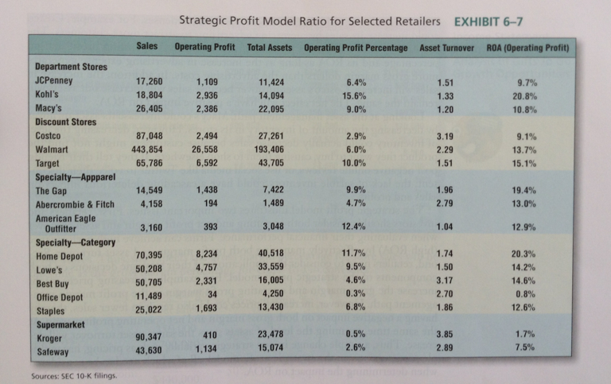
Combining Profit and Asset Management Path
Notes:
1

Slide 31

Combining Profit and Asset Management Path
Notes:
1

Slide 32


