Slide 1
2.4 Extension of the classical trade model
The classical model in monetary term
Multiple commodities case

Slide 2
The classical model in monetary term ----Example 3
Country | Wage for 1 unit of labor | Shirt (good X) |  | Watch (good Y)
 |  | Unit of labor required | Cost of labor | Unit of labor required | Cost of labor
Thailand (A) | 200 Baht | 4 |  | 10
USA (B) | 40 $ | 3 |  | 6
Exchange rate: 40 Baht per 1 dollar
1 Baht = (1/40) dollar = 0.025

Slide 3
The classical model in monetary term ----Example 3
Country | Wage for 1 unit of labor | Shirt (good X) |  | Watch (good Y)
 |  | Unit of labor required | Cost of labor | Unit of labor required | Cost of labor
Thailand (A) | 200 Baht | 4 |  | 10
USA (B) | 40 $ | 3 |  | 6
800 Baht
2,000 Baht
= 800*0.025 =20 $
= 2,000*0.025 = 50 $
120 $
240 $
Exchange rate: 40 Baht per 1 dollar
1 Baht = (1/40) dollar = 0.025
Export condition under monetary unit
Cost of producing good X in A (Cost X_{A}) VS Cost of producing good X in B (Cost X_{B})
Cost of producing good Y in A (Cost Y_{A}) VS Cost of producing good Y in B (Cost Y_{B})
Cost X_{A} < Cost X_{B}
Cost Y_{A} > Cost Y_{B}

Slide 4
The classical model in monetary term ----Example 3
If
W_{A} = wage rate in A
W_{B} =wage rate in B
Labor X_{A} = Unit of labor used to produce good X in A
Labor X_{B} = Unit of labor used to produce good X in B
e_{A,B} = Exchange rate of 1 unit of currency in A = ….unit of currency in B
In this case 1 Baht = ….dollars
Therefore, factors affecting export include

Slide 5
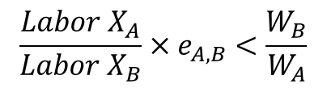
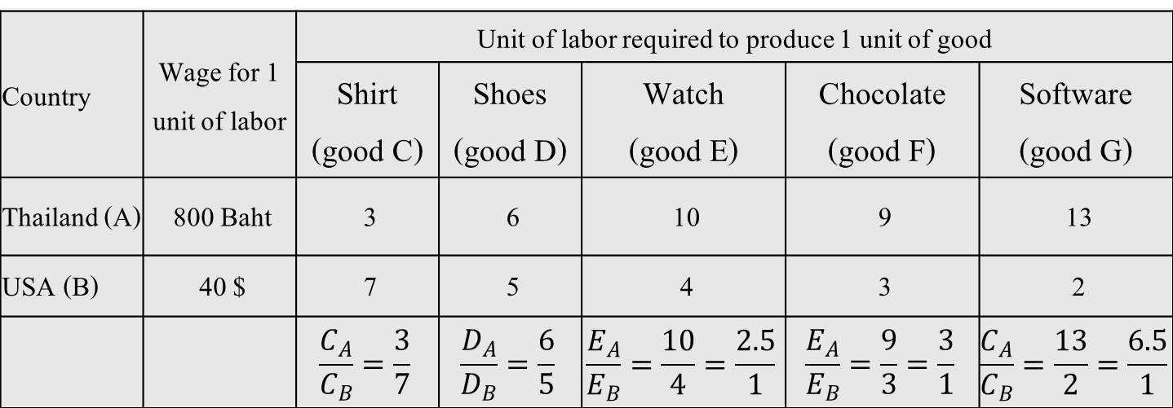
The classical model in multiple commodities case----Example 4
Country | Wage for 1 unit of labor | Unit of labor required to produce 1 unit of good
 |  | Shirt (good C) | Shoes (good D) | Watch (good E) | Chocolate (good F) | Software (good G)
Thailand (A) | 800 Baht | 3 | 6 | 10 | 9 | 13
USA (B) | 40 $ | 7 | 5 | 4 | 3 | 2
 |  | $$\frac{C_{A}}{C_{B}}=\frac{3}{7}$$ | $$\frac{D_{A}}{D_{B}}=\frac{6}{5}$$ | $$\frac{E_{A}}{E_{B}}=\frac{10}{4}=\frac{2.5}{1}$$ | $$\frac{E_{A}}{E_{B}}=\frac{9}{3}=\frac{3}{1}$$ | $$\frac{C_{A}}{C_{B}}=\frac{13}{2}=\frac{6.5}{1}$$
Exchange rate: 40 Baht per 1 dollar
1 Baht = (1/40) dollar = 0.025
Export condition under monetary unit
$$\frac{Labor X_{A}}{Labor X_{B}}×e_{A,B}<\frac{W_{B}}{W_{A}}$$
Country A should export Good X

Slide 6
2.5 Test of classical trade model
G.D.A. MacDougall (1951) in an article “British and American Exports: A Study Suggested by the Theory of Comparative Costs”
Employed 1937 data on US and UK export of 25 commodities to other countries

Slide 7
MacDougall’s classical trade model test
Suppose we consider 1 product: Good X
U.S. has advantage on the production of good X
Note:
represents 1 US$ = … UK £

Slide 8
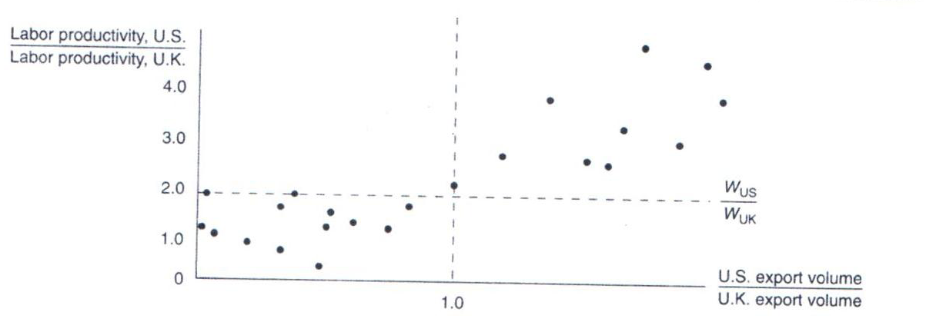
MacDougall’s classical trade model test
Empirical results support Classical Trade Theory prediction
Stern (1962), Balassa (1963), Golub (1996) and many other studies try to test Classical Trade Theory

Slide 9
2.6 Explanation of Classical trade model by Neo-Classic tools
Concept of Opportunity cost and Production possibility frontier
In each country economy, the increase in production of one product imply the decrease in the production of another product.
Classic assumes constant opportunity cost

Slide 10
2.6.1 Example 3 (Principle of Comparative Advantage) --- Table 4
Unit of labor used to produce 1 unit of good
shirt (good X)
watch, (good Y)
Thailand (country A)
3
XA
6
YA
USA (country B)
8
XB
2
YB
Compared to USA (Country B), Thailand (Country A) has relative units of labor used in the production of Shirt (Good X) less than Watch (Good Y)
__________has comparative advantage in _______ production
__________has comparative advantage in _______ production
Thailand exports shirt and USA exports watch

Slide 11
2.6.1 Example 3 (Principle of Comparative Advantage) --- Table 4
Unit of labor used to produce 1 unit of good
shirt (good X)
watch, (good Y)
Thailand (country A)
3
XA
6
YA
USA (country B)
8
XB
2
YB
Opportunity cost of production of shirt (X) in Thailand (A) = _____ unit of Y
Opportunity cost of production of shirt (X) in USA (B) = _____ unit of Y
Opportunity cost of production of shirt (X) in Thailand (A) ______ than USA
__________has comparative advantage in _______ production
__________has comparative advantage in _______ production

Slide 12
2.6.1 Example 3 (Principle of Comparative Advantage) --- Table 4
Unit of labor used to produce 1 unit of good
shirt (good X)
watch, (good Y)
Thailand (country A)
3
XA
6
YA
USA (country B)
8
XB
2
YB
Opportunity cost of production of watch (Y) in Thailand (A) = _____ unit of X
Opportunity cost of production of watch (Y) in USA (B) = _________unit of X
Opportunity cost of production of watch (Y) in Thailand (A) ______ than USA
__________has comparative advantage in _______ production
__________has comparative advantage in _______ production

Slide 13
2.6.2 PPC and Relative Price --- under constant opportunity cost case
Concept of Opportunity cost and Production possibility frontier (PPC)
In each country economy, the increase in production of one product imply the decrease in the production of another product.
Classic assumes constant opportunity cost

Slide 14
Review PPC under constant opportunity cost case ----- production side
Good Y
Good X

Slide 15
Review Indifference Curve (IC) and budget line---Consumption side
Good Y
Good X

Slide 16
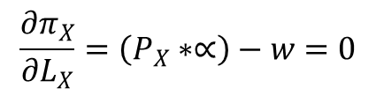
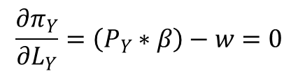











If production functions of good X and good Y are
$$X=∝L_{X}$$
$$Y=βL_{Y}$$
$$∝={MP}_{L}^{X}=Marginal Product of Labor to produce good X$$
$$β={MP}_{L}^{Y}=Marginal Product of Labor to produce good Y$$
$$π_{X}=(P_{X}∗X)−(w∗L_{X})$$
$$π_{Y}=(P_{Y}∗{βL}_{Y})−(w∗L_{Y})$$
$$π_{X}=(P_{X}∗∝L_{X})−(w∗L_{X})$$
$$π_{Y}=(P_{Y}∗{βL}_{Y})−(w∗L_{Y})$$
$$\frac{{∂π}_{X}}{∂L_{X}}=\left(P_{X}∗∝\right)−w=0$$
$$\frac{{∂π}_{Y}}{∂L_{Y}}=\left(P_{Y}∗β\right)−w=0$$
$$\left(P_{X}∗∝\right)=w$$
$$\left(P_{Y}∗β\right)=w$$
$$P_{X}∗{MP}_{L}^{X}=w$$
$$P_{Y}∗{MP}_{L}^{Y}=w$$
$$P_{X}∗{MP}_{L}^{X}=w=P_{Y}∗{MP}_{L}^{Y}$$

Slide 17



If production functions of good X and good Y are
$$X=∝L_{X}$$
$$Y=βL_{Y}$$
$$∝={MP}_{L}^{X}=Marginal Product of Labor to produce good X$$
$$β={MP}_{L}^{Y}=Marginal Product of Labor to produce good Y$$
$$P_{X}∗{MP}_{L}^{X}=w=P_{Y}∗{MP}_{L}^{Y}$$

Slide 18
2.6.3 Gains from trade under constant cost case
watch (Y)
watch (Y)
16
12
8
6
4
4
0
0
3
J
12
4
8
16
shirt (X)
shirt (X)
Thailand (A)
USA (B)
From Example 3, Table 4
If the endowment of labor in Thailand = 36 units
the endowment of labor in USA = 32 units

Slide 19
2.6.3 Gains from trade under constant cost case
shirt (X)
12
3
OB
16
12
watch (Y)
watch (Y)
16
OA
12
shirt (X)

Slide 20
Homework ---- Table 5
Unit of labor used to produce 1 unit of good
good X
good Y
Country A)
18
XA
12
YA
Country B)
3
XB
4
YB
Suppose
The endowment of labor in country A = 180 units
The endowment of labor in country A = 144 units
Before trade
country A consumes X = 6 units
country B consumes X = 24 units
Terms of trade is 1X : 1Y
After trade
country A consumes X = 22 units
Question: From the above situation, use neo-classical tools to explain
Source of comparative advantage and pattern of trade
Gains from trade

