Slide 1
Vietnam
EE551/561

Slide 2
Questions
What do you think about Vietnam or Vietnamese people?
What is your picture about Vietnam?

Slide 3
Getting to know about vietnam
https://www.youtube.com/watch?v=tWL44tLlisQ
https://www.youtube.com/watch?v=8UyvPcGb9EQ
https://www.youtube.com/watch?v=Zv8ZLgDbjwM
From what you expected and from what you saw from clips, what are the differences?

Slide 4
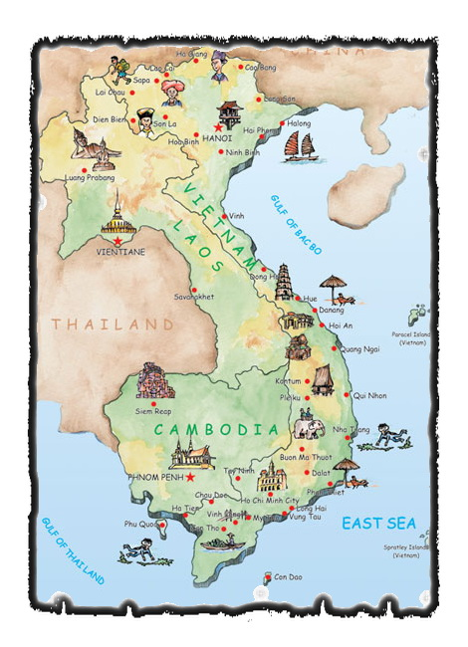

Slide 5
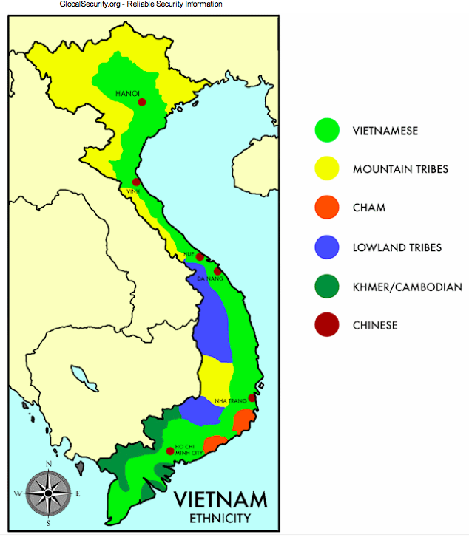

Slide 6
Vietnam economy
http://globaledge.msu.edu/countries/vietnam/economy
https://www.youtube.com/watch?v=qv5vjR6eXDo
Part1 >> https://www.youtube.com/watch?v=Ys1pavMdI5w
Part2 >> https://www.youtube.com/watch?v=yFytTxRtDqs

Slide 7
Vietnam economy
What are opportunities and threats of Vietnam economy?
(HSBC view: https://www.youtube.com/watch?v=D4Ei9unN56c)

Slide 8
Vietnam War infographic summary
http://thevietnamwar.info/vietnam-war-summary-infographic/

