Slide 1

D
BI 201/ BA291 – Business Model and Business Plan
by Parichat Jantori

Slide 2


Slide 3


Slide 4
Some key words:
การเสนอคุณค่า Value proposition
คุณค่า Value

Slide 5
Task 1:
Form up a group of 7 students
Brain storming with friends in your group to answer the question
„How would you create value for this product?“
Present your results to your classmates

Slide 6
Key Takeaway
Value:
The extent to which a good or service is perceived by its customer to meet his or her needs or wants, measured by customer's willingness to pay for it
Summarization of why a consumer should buy a product or use a service
customer's perception of the worth of the product than on its intrinsic value
A business model describes the rational of how an organization creates, delivers, and capture value

Slide 7
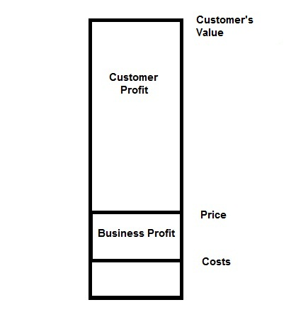
Key Takeaway

Slide 8

Key Takeaway
“Value creation vs. Value addition”

Slide 9
Key Takeaway
Value comes from
Newness: There was no similar offering. It is often, but not always technology related.
Performance: Improving product or service performance – PC, Mobile Phone, Car
Customization: Tailoring products and services to the specific needs of individual customer
Getting the job done: Helping a customer get certain job done ; Rolls-Royce, Recall, Audit-firms
Design: A product may standout because of superior design,
Brand/ status: Brand could signify status, personality and life-style
Price: Offering similar value at a lower price is a common way to satisfy the need of price-sensitive customers
Cost reduction: Helping customer to reduce cost is an important way to create value (Software, Internet platform)
Risk reduction : Product guarantee reduces risk of post-purchase breakdown and repairs (return and guarantee policy)
Accessibility: Making product and services available to customers who previously lacked access to them (Mutual fund, Netjets, Alibaba)
Convenience/ usability: Making things more convenient or easier to use (iPhone)

Slide 10
Task 2:
Describe the following business by using “Business Model Canvas”
What is the pro/ con of each business model?

Slide 11
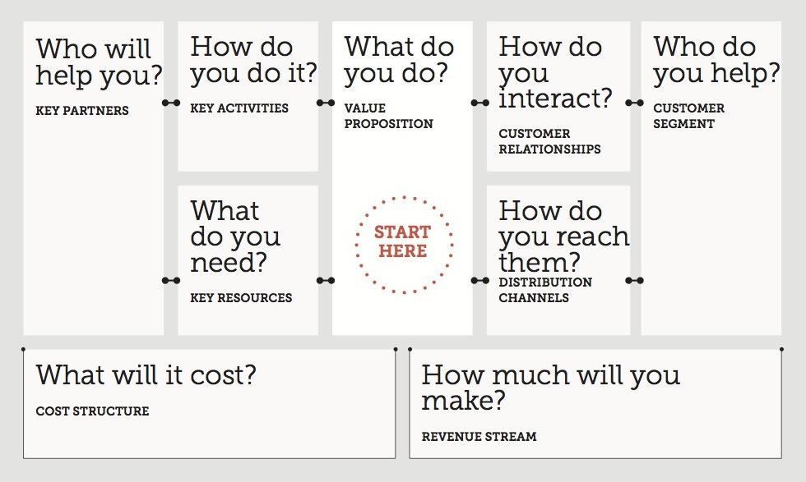

Slide 12
Key Takeaway
Different patterns of business model
Multi-sided: Bringing together two or more groups of customers
Free/ Freemuim: Basic services for free, paid for premium
Bait & Hook: inexpensive or free initial offer that encourage continuing future purchase
Low cost: Reduce cost to offer lower price
Subscription: customer must pay a subscription price to have access to the product/service
Auction: Ebay!
Open business model: Systematic collaborating with outside partners
Long Tail: Focus on offering a large number of niche products. Small number of bestsellers account for most revenues.

Slide 13
Task 3: Reviewing the given business plan.
What is business plan for you. Create your own definition. Why do we need it.
List all the common things you see from each plan
Pick up one favorite business plan. Why you like it?

Slide 14
Key Takeaway
The key elements of business plan
Executive summery
Company description
Management and organization
Industry and market analysis
Competitor analysis
Product and services (operational issues)
Marketing strategy
Financial plan

Slide 15
Characters of effective business plan
Business plan
communicate
commercial
competitive
Correct
clear

Slide 16
Check your business plan
Is your business concept solid and feasible?
Is your management experience and capable?
Does your product or service create value to the customer?
Does a real market exist?
What are your target markets and are they large enough to support your business plan?
Have you thoroughly and honestly evaluate your business and your competitors?
Are your goals focused and are your strategy competitive?
Is your financial plan realistic?
How and when will the investors get their investment back?

Slide 17
Task 4: Fix versus Variable cost
If you have a car, owner of restaurant, online seller, organizer of sport or concert event, what is fix and variable cost for you?
Make a list of all the cost.

Slide 18
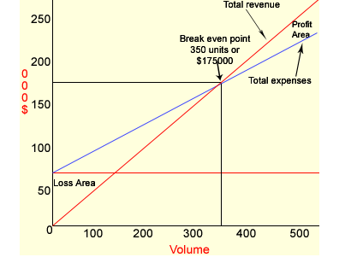
Break-even Point
B.E. is the level of sales at which profit is zero. At break -even point total sales are equal to total cost (variable + fixed).
If a firm cannot manage sales to cover variable as well as fixed costs it will have to bear losses. The following is the further explanation of this concept:

Slide 19
Break-even Point
Example:
Sales price per unit = $500
variable cost per unit = $300
Total fixed expenses = $70,000
At Break Even point, Revenues – Total cost = 0
In this example, quantity at break even point is ........Unit.

Slide 20
Break-even Point
Sales Break – Even Point
The break-even point in sales dollars can be calculated by dividing a company's fixed expenses by the company's contribution margin ratio.
The contribution margin is sales minus variable expenses. When the contribution margin is expressed as a percentage of sales it is referred to as the contribution margin ratio.
Break-even Sales = [Fixed Cost / 1 – (Variable Cost / Sales)]

Slide 21
Break-even Point
Example: A company has fixed expenses of $100,000 per year. Its variable expenses are approximately 80% of sales. (This means that the contribution margin ratio is 20%)
Therefore, break even point in sales is 100,000 / 0.2 = 50,000 $
Let’s check the answer:
Sales – total cost = 0
500,000 – (100,000+400,000) = 0

Slide 22
Break-even Point
Example:
- A travel agency is organizing weekend trips to different cities. The package includes the transfer by coach and the overnight stay in a B&B. It is offered for 99 € per person. The coach costs 500 € per weekend, fuel 300 €, the driver 350 € per weekend; administration is charged at 100 € per weekend trip. The B&B costs 55 € per person, the salespersons get a commission of 10 € per passenger.
a. Calculate the fixed and the variable costs of a trip.
b. How many passengers will the agency have to find in order to break even?
c. The target profit per trip is 100 €. What happens to the break-even-point?
d. If the travel agency expects 45 passengers. What are the margins of safety?

Slide 23
Break-even Point
Example:
A company producing felt-tip pen estimates its monthly sales at 30,000 pens. Its fix cost is 250,000 baht/month. Its variable cost is 3.70 baht per pen.
a. If the sales price is 10 baht/pen. How many pens this company should sell in order to reach break-even point?
b. If this company wants to achieve 150,000 baht profit. How many pens should this company sell to its customer?

Slide 24
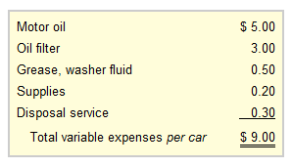
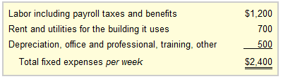
Break-even Point
Example:
At Oil Change Co. The fix and variable cost is shown as follow:
Oil Change Co. charges one flat fee of $24 for performing the oil change service.
How many car this company has to service in order to reach break-even point? Or how much is the sales break-even?

Slide 25
Payback Period
A period of time required for the return on an investment to “repay” the sum of the original investment.
Example 1: a 1000$ investment which returned 500$ per year. The pay back period would be 2 years.
Example 2: a project cost 100,000 and it is expected to return 20,000 annually, the payback period will be ………………… years.

Slide 26
Payback Period
Example 3: A project requires an investment of 200,000$ and it generates cash as follows:
1st year 20,000$, 2nd year 60,000$, 3rd year 80,000$, 4th year 100,000$ and 70,000 in the 5th year.
What is the payback period?
(20,000+60,000+80,000 = 160,000 in the first three years, 40,000/100,00 in the fourth year, therefore payback period 3.4.

Slide 27
Payback Period
Example 4: A project requires an investment of 20,000 Bath. and it generates cash as follows:
1st year 10,000$, 2nd year 8,000$, 3rd year 6,000$, 4th year 2,000$ .
What is the payback period?

Slide 28
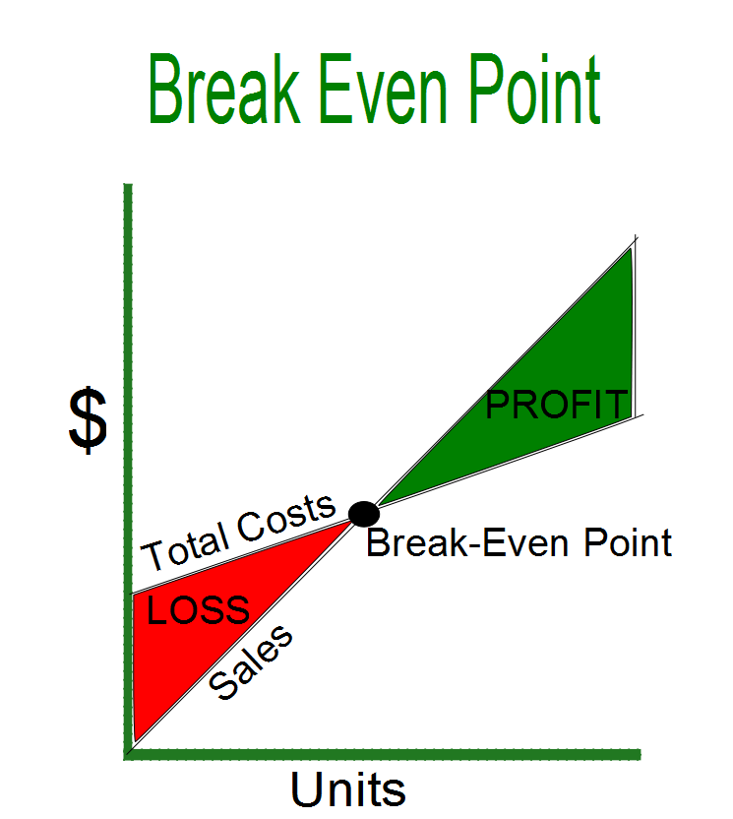
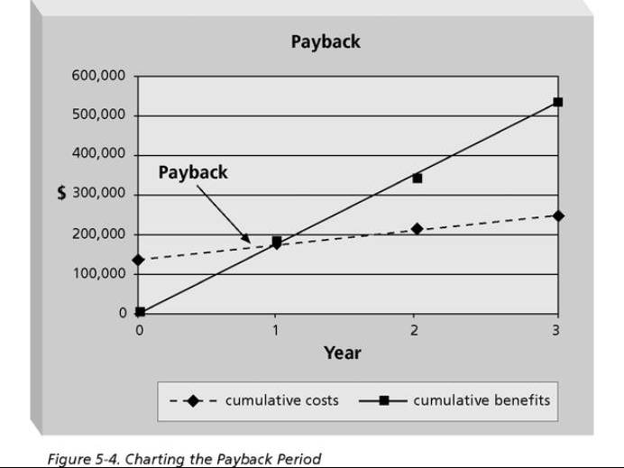
Key Takeaway

Slide 29
Key Takeaway
Would you prefer “longer or shorter” payback period?
Would you prefer “higher or lower” quantity at Break-even points?
Implications (cost structure, payback period, breakeven point)

Slide 30


Slide 31

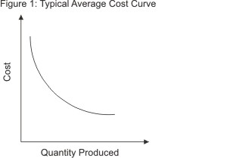

Economies of scale, Economies of scope, Economy of Speed
Notes:
http://roustabout-investor.blogspot.com/2013/01/003-economy-of-scale-economy-of-speed.html

Slide 32
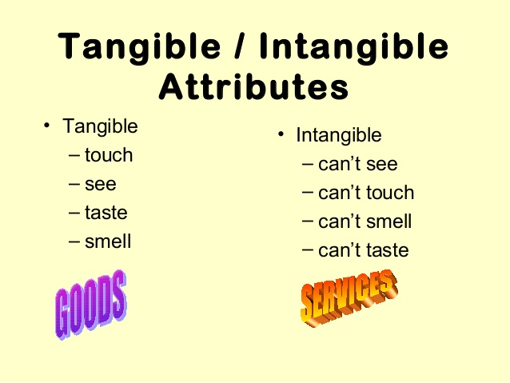
Tangible vs Intangible goods
A good or service with tangible and intangible characteristics that provide satisfaction and benefits.

Slide 33
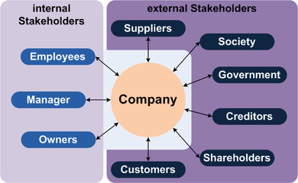
Stakeholders
A person, group, organization, or system who affects or can be affected by an organization's actions

Slide 34
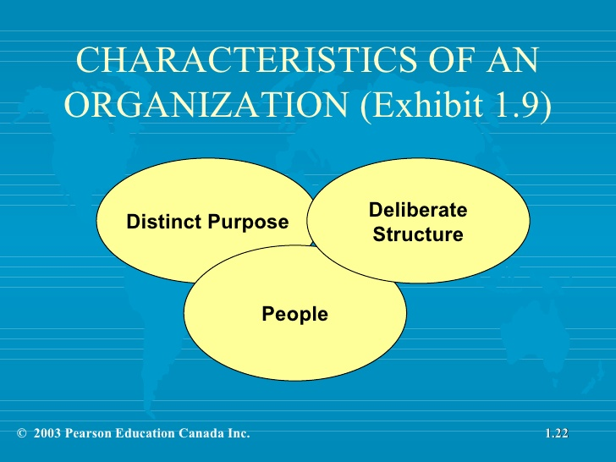
Organization
A deliberate arrangement of people to accomplish some specific purposes

Slide 35
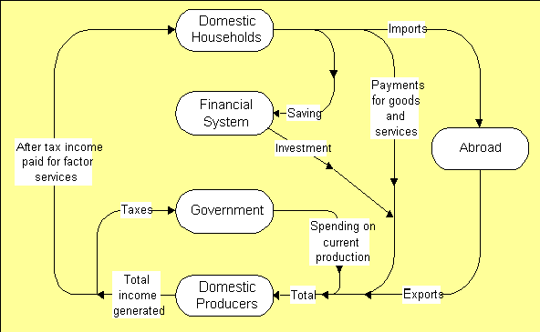
Macro and Microeconomics

Slide 36
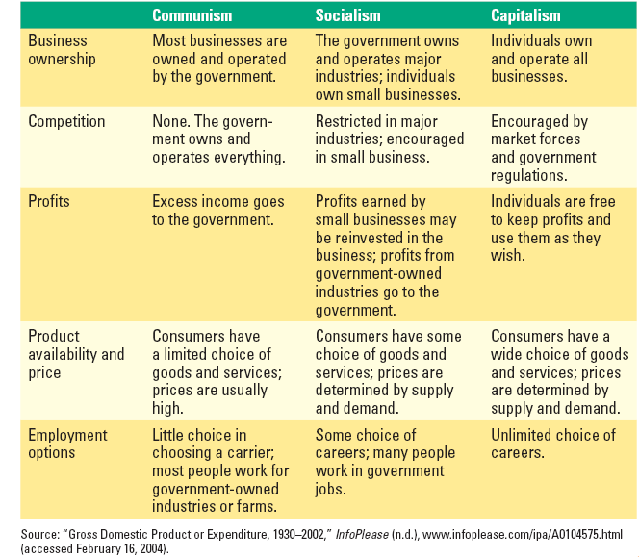
Economic System

Slide 37
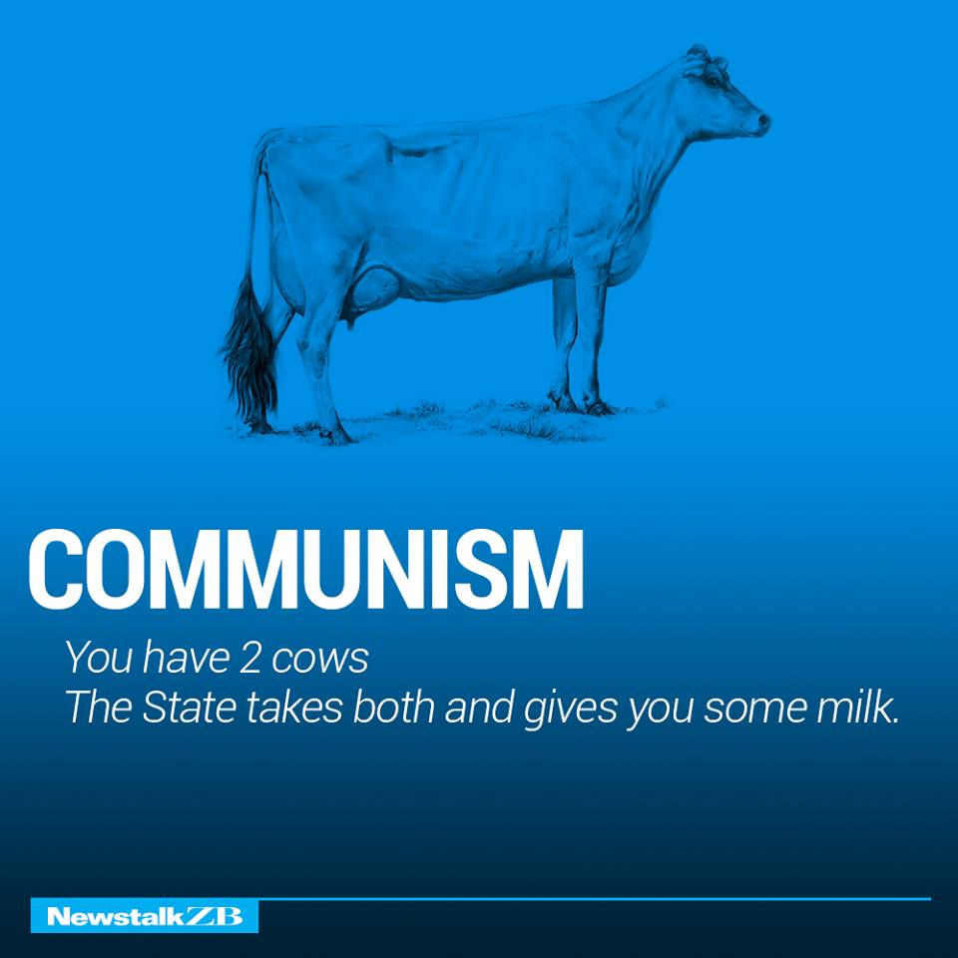
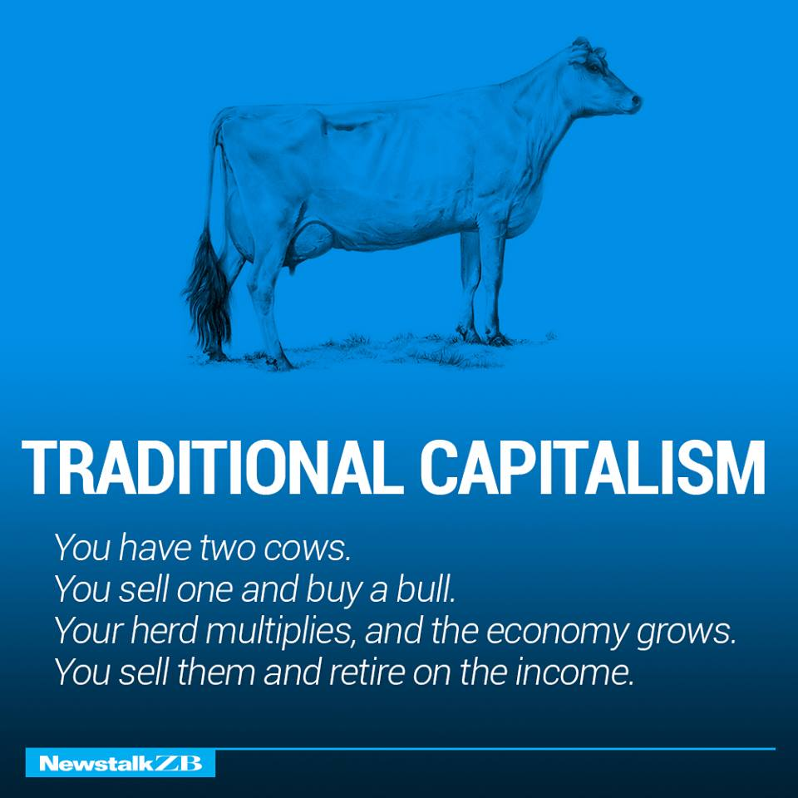
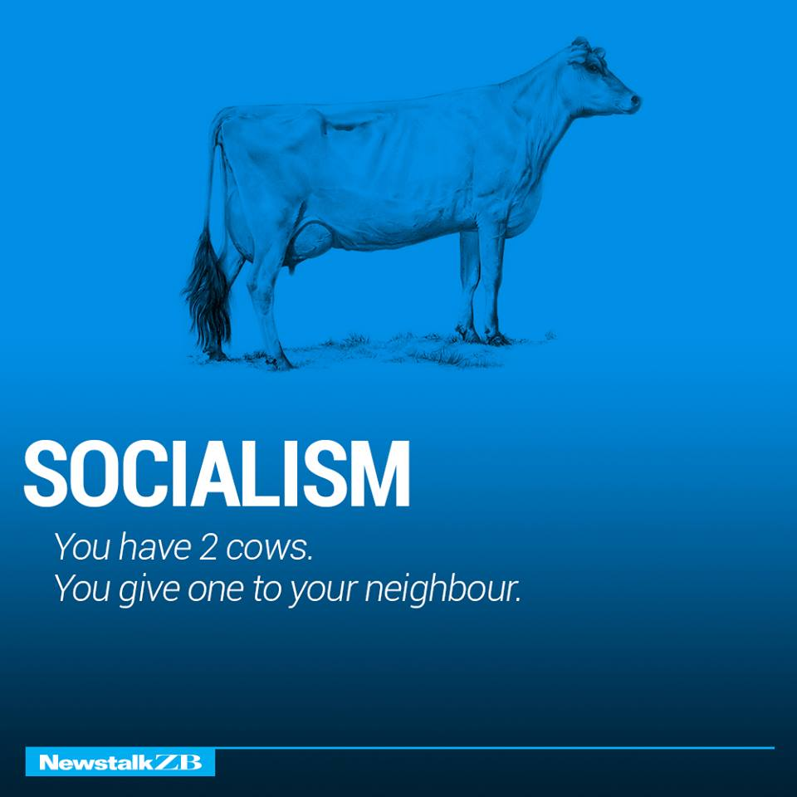
Notes:
http://news.bitofnews.com/the-world-economy-explained-with-just-two-cows/

Slide 38
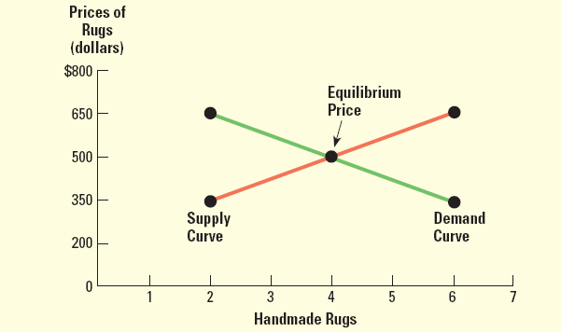
Demand & Supply
Demand -- number of goods/services consumers buy at given price at a specific time
ปริมาณความต้องการซื้อสินค้าใดสินค้าหนึ่งที่ผู้บริโภคมีความต้องการซื้อ ณ. ระดับราคาต่างๆ เมื่อปัจจัยอื่นๆ อยู่คงที่
Supply -- number of products businesses will sell at different prices at a specific time
ปริมาณสินค้าที่ผู้ผลิตเต็มใจทำการผลิต และเสนอขาย ณ ระดับราคาต่างๆ โดยมีเป้าหมายเพื่อให้ได้กำไรสูงสุด

Slide 39
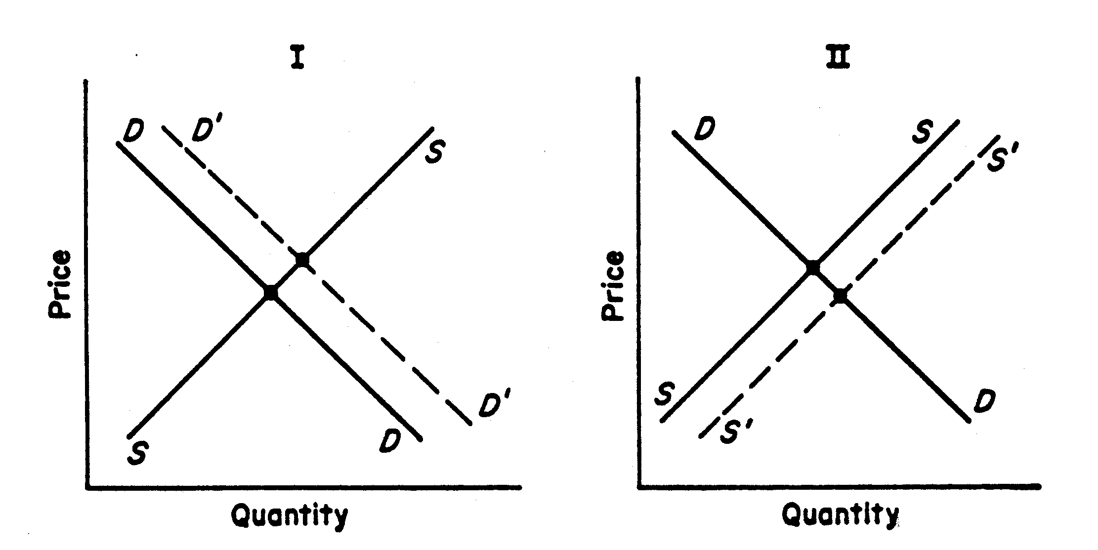
Shifting Demand/ Supply Curve

Slide 40
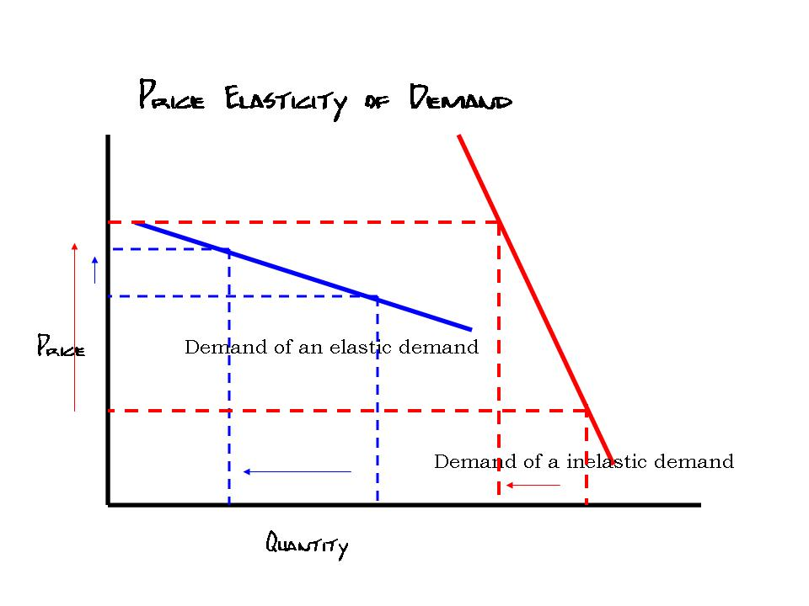
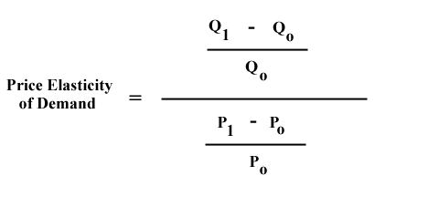
Price Elasticity of Demand

Slide 41
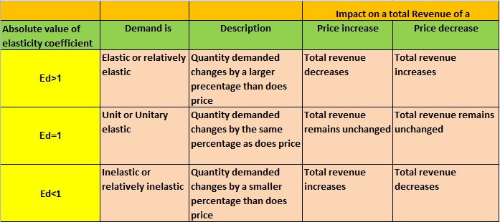
Price Elasticity of Demand

