Slide 1

Trade Finance

Slide 2
What is Trade Finance?

Slide 3
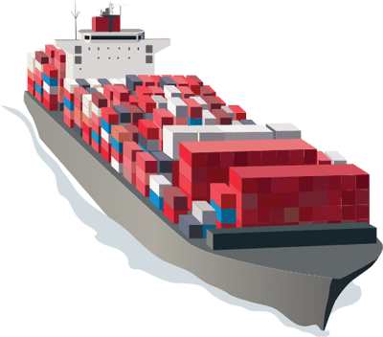
What is trade finance?
Trade finance is the financing of international trade for the primary purpose of reducing risks involved in cross-border trade transactions which would otherwise be born by importers and exporters. Trade finance professionals use a range of financing methods and tools to facilitate the payment for goods to exporters, who require payment for the goods and services they sell from importers, who insist on receiving the right merchandise and is in good condition. Global Trade Funding and other trade finance professionals provide the platform and financial infrastructure to minimize risk for importers and exporters.

Slide 4

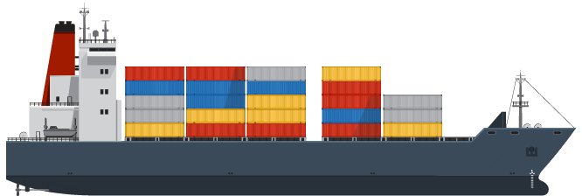
Type of Trade Finance

Slide 5

Type of trade finance
IMPORT SERVICES
Import/Export financing is a specialized segment of trade finance that exclusively provides financing for imports/exports
EXPORT SERVICES
A type of finance that fills the funding gap between receiving goods and sending payment for importers and exporters.
INTERNATIONAL
GUARANTEE
A simple and practical way of ensuring that a business or its trading partner receives compensation in the event of breach of contract.

Slide 6
How it work?

Slide 7
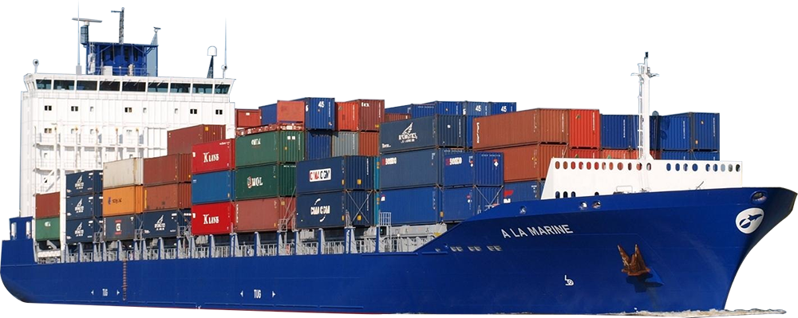
How does import finance work?
How does export finance differ?
Much trade is done on trust between the buyer and seller; however as trade and companies expand and there is a lack of trust between jurisdictions and new buyers or sellers, trade instruments are used more frequently. Letters of credit or other trade instruments are used as a type of import finance to bring in more goods to a country, with the ability to trade with a foreign entity that is not trusted.
Export finance conversely works on the basis that goods are financed and usually exported cross border. This can use trade finance lines including letters of credit or other alternative financing structures. Many funders will only release capital when title has passed and certain documents are delivered. This will include whether shipment has happened and the goods have been loaded.

Slide 8


How International guarantee work ?
Guarantee is work when a lending institution promises to cover a loss if a borrower defaults on a loan. The guarantee lets a company buy what it otherwise could not, helping business growth and promoting entrepreneurial activity.

Slide 9
Examples

Slide 10

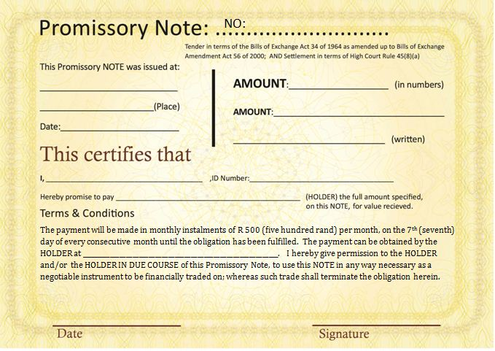

Import Service
Short Term Loan P/N Against Trade Documents

Slide 11
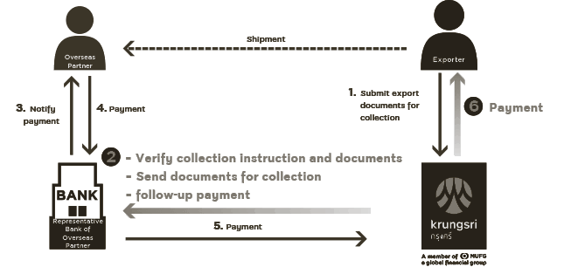
Export Service
Outward Bill for Collection

Slide 12

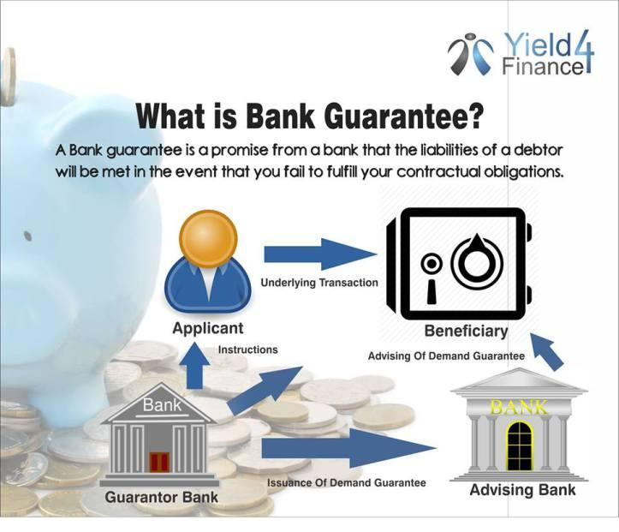

Guarantee
Bank Guarantee

Slide 13
Benefits

Slide 14

Advantages of Trade Finance
Trade finance reduces payment risks.
It helps business to focus on growth activities.
Protect against international trade's unique inherent risks.
Various trade finance products and services.
Factoring in trade finance.
Bank guarantee requires less number of documents

Slide 15
References
https://www.investopedia.com/terms/t/tradefinance.asp
https://tradefinanceanalytics.com/what-is-trade-finance
https://www.krungsri.com/bank/en/Corporate/Trade/Export/Bill-Collection.html
https://www.bangkokbank.com/en/Business-Banking/My-International-Trade/AEC-Trade-Express
https://www.cimbthai.com/en/business/products/trade-finance/export-trades-at-cimb/outward-bill-for-collection.html

Slide 16
Members
Montita Yongmarlwong 5904640280
Arinchaya wannasarnmetha 5904640769
Sireedhorn Lertviseschai 5904641569
Sirichat Kattiyapirak 5904641775

Slide 17

Thank you

