Slide 1

CHINA’s
SHADOW
BANKING

Slide 2
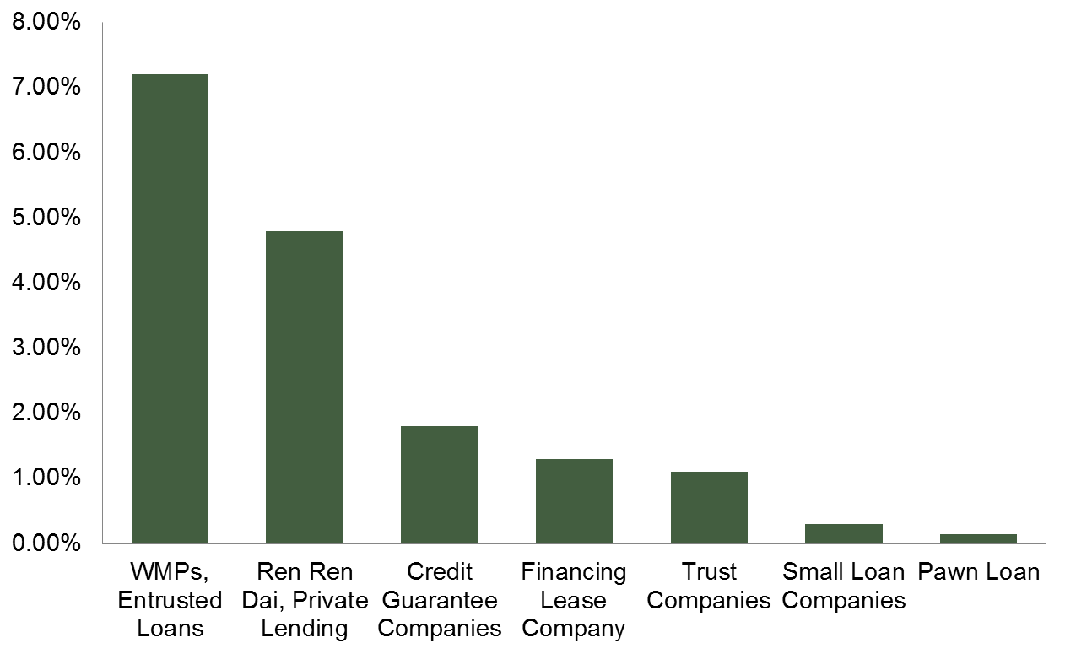
Q.1
OVERVIEW
Shadow Banks are unregulated non-banks which take into many forms
Definition:
“Credit intermediation involving entities and activities outside the regular banking system”
Shadow Banking Activities
Wealth Management Products (WMPs)
Local Government Financial Vehicles (LGFV)
Undiscounted Banker’s Acceptances
Asset-backed Bonds
Entrusted Loans
Collective Trust Programs
Estimated loan size from different types of Shadow Banking as % of total gross loans of Chinese Banks

Slide 3



Q.1
OVERVIEW
Shadow Banking System in China
Sponsor
Shadow Banks
(Trust, WMPs, etc.)
Lend
Banks lend money out to shadow banks instead of keeping it as deposit.
Banks are required to set aside high required reserve ratio.
Investors turn to shadow banks for higher return without knowing where the money is invested.
Local Government, Unsecured developers, and Small business who are unable to raise capital through regular banks

Slide 4
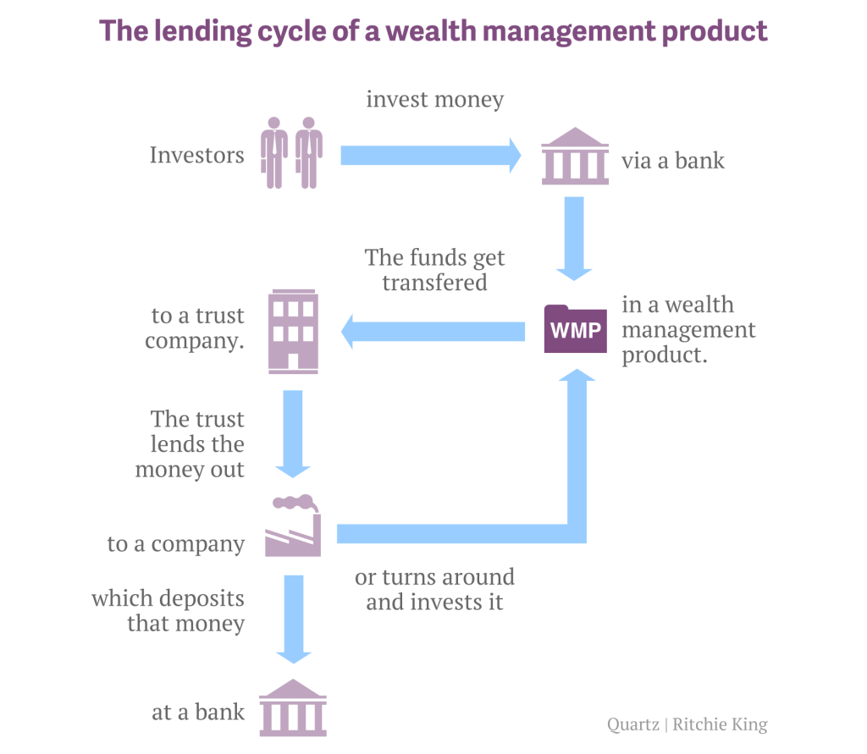
Q.2
KEY ISSUES
WMPs is the area which government concerns the most.
The off-balance sheet Wealth Management Product Market
The main products of Shadow banking
- In 2013, it reached ¥ 10 trillion
Issue to moment-pop retail investors
9% yield and above, represent loan to risky company
Big impact if fail
Non-principle-guarantee product
End-investors bear high risk
The off-balance sheet Wealth management product market are hard to control and predict.
The shadow banking makes debt per capita skyrocket.

Slide 5
Q.2
KEY ISSUES
2 main problems are the poor quality debt and maturity mismatch.
One-thirds are backed by truly risky loan
Approximately 500 billions US dollars of loss
Example, Local government financing vehicle (LGFV) which worth about 30% of Chinese GDP
Poor quality of debt
Most of WMPs are short-term instruments.
Need to be rollover because funding money are used in long-term project.
Maturity mismatch
In addition, there are problems of
lacking transparency and insufficient disclosed information .
From these problems, they may lead to the big financial crisis as US’s subprime mortgage boom by packing project that never pay-off. Government needs to do something about it but they need to very careful about the consequences of their action.

Slide 6
Q.3
CAUSE OF PROBLEM
Shadow banking stems from tight regulation from Chinese Government
RMB 4 trillion stimulus package following the global financial crisis
  Expansion of bank lending and concern of credit quality
  Require the local government to borrow; however, by law, China’s local governments are not allowed to borrow from the regulated banks
Tightening regulation and supervision of commercial banks
  Credit limit
  Reserve requirement
  Upper bound on deposits rate → 3 percent which is lower than the target for inflation
  Encourage large bank to give credit only to the government supported business

Slide 7
Q.3
CAUSE OF PROBLEM
Shadow banking stems from tight regulation from Chinese Government
Inaccessibility of credit by small risky and some overinvestment business due to the tightened regulation (90 percent of small businesses are unable to get bank loans)
Incentive of large banks to avoid the regulation
  Use of large business as a channel in lending to small business.
  Sell loan to the trust company who then issues the wealth management product.
Liquidity and maturity mismatch problem

Slide 8
Q.4
ACTIONS DONE SO FAR
Overview
Methods against rapid growth in debt and expansion of shadow banking
Loan quotes
Specific restrictions on certain types of loan
Qualitative measures
Draining liquidity
Increasing interest rates
Quantitative measure
Money market intervention
Reduce credit creation
Increase reserve requirements
Notes:
http://www.economonitor.com/blog/2014/04/chinas-shadow-banking-system/#sthash.tEumtqt9.dpuf
In recent years, policy makers have taken steps to slow the rapid growth in debt and the expansion of the shadow banking system.

Slide 9
Q.4
ACTIONS DONE SO FAR
Recent reformation imposes rules for shadow banks
BANKS
Banks are required to
Set up separate accounts for WM businesses
Set aside provision for losses and capital for outstanding WMPs
WEALTH MANAGEMENT
In 2013, CBRC issued new guidelines to control exposure of LGFV loans including …
Requiring banks to report their aggregate exposure to LGFVs
Forbidding banks from providing guarantee for LGFV bond issuance
Limiting (yet, not forbid) banks’ purchases of LGFV bonds
Instructing banks to keep the level of LGFV loans below the level at the end of 2011 and the ratio of LGFV loan to total loans should not exceed the level seen at the end of 2012
LOCAL GOVERNMENT LOANS
Notes:
Source: Bloomberg – China’s Cabinet Imposes New Rules in Shadow Banking Fight
Reuters – China issues rules to limit bond investment by shadow bank products
JPMorgan - China: CBRC’s guideline regarding local government loans
http://asianbankingandfinance.net/lending-credit/exclusive/how-will-cbrcs-new-guideline-lgfv-loans-change-banking-landscape-in-china

Slide 10
Q.4
ACTIONS DONE SO FAR
Recent reformation imposes rules for shadow banks
TRUST COMPANIES
Credit Equal Gold No.1 (2012)
It is a Trust product
issued by ‘China Credit Trust’
Marketed through ‘Industrial and Commercial Bank of China’ branches
To make loan to a coal company
Later collapse after the coal company’s owner got arrested
Got bailed-out by the government (worth $500 million) to prevent run or panic in the banking system raise while concerns about Moral Hazard are raised.
IN THE NEWS
CBRC
Hold officers personally accountable for irresponsible lending
Requires shareholders to inject capital and liquidity when necessary
Trust companies are required to
Maintain net capital at no less than 40% of its net assets
Maintain net capital at no less than 100% of the sum of all risk capital
Trusts companies are banned from
Pooling deposits from more than one product
Invest in non-tradable assets
REGULATIONS IMPOSED
Notes:
Source: Bloomberg – China’s Cabinet Imposes New Rules in Shadow Banking Fight
Reuters – China issues rules to limit bond investment by shadow bank products
http://www.chinalawandpractice.com/Article/2736393/Channel/7576/CBRC-Measures-establish-trust-company-risk-control.html
Trust → purpose is to ensure that the net capital of trust companies can cover risk capital of the various businesses
Net Capital = Total assets (deduct assets not easily convert into cash) – total liabilities
Or = liquid assets (cash and cash equi)
Previously, funds a trust collected from investors buying different products were packaged into loans for a property developer or other borrower

Slide 11
Q.5
CRITICISM of ACTIONS DONE
There are reasons for shadow banks to stay.
Benefits
Acts as alternative to traditional bank deposit whose interest rates are capped be the central bank
Provides funding for SMEs
which might lead to economic expansion and better employment rate of the country
Costs
Subject to risk exposures (i.e. market risk, credit risk and liquidity risk) but without safety nets (e.g. Deposit insurance) for investors
Threaten financial system’s stability due to linkage between regulated traditional banks and shadow banks
Regulators need to establish a system that closes regulatory loopholes, and
balances between keeping benefits and avoiding potential risks of shadow bank system.
Notes:
Now you might question why Chinese government don’t just prohibit and punish all the shadow banking activities.
To answer this, we should analyze the costs and benefits of having shadow banking in the economy.
For benefit side
Shadow banks’ products offer investors opportunities to earn return on their money
with an attractive rate higher than inflation which is obviously higher than traditional bank deposits
Shadow bank provided source of finance for small and medium sized businesses
which are main contributor to the economic growth of China
On the other side,
Cost associated with shadow banking includes risk such as market risk, credit risk and liquidity risk.
However, investors do not have safety net like in the regulated banks such as deposit insurance or capital adequacy ratio
Consequently, Shadow banks can cause a buildup of systemic risk because
they are interrelated with the traditional banking system
meaning that problems in this unregulated system can easily spread to the traditional banking system. (wiki)
Now that we see both cost and benefit of shadow banking
We can see why the regulators still let them exist
Further more, the analysis implies that what they need now is balance between keeping the benefit of fueling growth to the economy
And avoiding the excessive risk involved
Moreover, we think that they also need a system or rules that can close possible regulatory loopholes. Otherwise, regulators will never get ahead and cannot catch up with these innovation from financial institutions

Slide 12
Q.5
CRITICISM of ACTIONS DONE
Chinese regulators are moving towards an agreeable direction
OUR EVALUATION
It starts to deliver expected results
    Loan extended by trust companies fell by RMB 100 billion
It enhances regulator’s monitoring and control on shadow banking activities
WHAT WE LIKE
Bailout encourage moral hazard for trust companies and create misperception about risk
Lack of coordination between regulators (i.e., PBoC, CBRC, CSRC, CIRC) might allow discovery of new regulatory loopholes
WHAT WE ARE WORRIED ABOUT
Notes:
From the costs and benefits analysis
For the upside as goal of regulators is to slow debt growth in the economy.
we think that the regulations imposed are effective because it is reported that shadow banking portion of total financing shrunk because of the fall of loans extended by trust companies and also bank's acceptance.
Next the regulation also helps to mitigate risk
for example, there is a policy that require banks to move some of their off-balance sheet financing businesses back to their books. We think that it help enhanced transparency and investors can better evaluate the risk.
For the downside,
The regulators have mentioned that they will not bail out shadow banks
But it is contradict to past action of bailing out trust product credit equal gold no.1 which raise concerns
Of Moral hazard and investor may misunderstand that government will guarantee these products which is not true.
The other issue that we concern is the lack of coordination between regulators
As shadow banking activities encompasses very wide range. It covers banks, trusts companies, securities companies and so on.
I mentioned that they need to close regulatory loopholes.
To do that, regulators need to work together or maybe they can set up a separate regulatory body to specifically deal
With shadow banking.

Slide 13
Q.6
ROOM FOR IMPROVEMENT
Possible policy implementations to solve the problem
Restriction on Wealth Management Products
Setting the limit of mismatch ratio
Restrict the use of short-term WMPs to fund long-term investment
Requirement of detail information about investment projects
Provide government guarantee to a qualify WMPs
Reform of Interest Rate Liberalization
To maintain market level of interest rate
Reduction of net interest margin from shadow bank
Reform the Banking regulations
Lowering the level of restriction on traditional bank loans
To shift the risk from shadow bank to traditional bank
More regulation on off-balance-sheet activities

Slide 14
Q.6
ROOM FOR IMPROVEMENT
Possible policy implementations to solve the problem
Provision of Fund-raising Platforms to SMEs
Liberalize financial market to enhance more source of funds for SMEs and attract new investment and financial technology
Relax restriction on SMEs’ preferred stock issuance
Stress testing on Banks
To analyze bank potentials and its resilience on the downturn of economy
Set up standardize method for stress test to match with international standard
Increase the frequency of stress test revising to keep up with the most recent situation
Allow public to access to this information for the purpose of transparency and preparation to future problem

Slide 15
Thank you
Q
A
&
Team members
5402640311 | Ms. Chosita Ploychankul
5402640816 | Ms. Onmanee Floro
5402640824 | Ms. Panatsaya Kaewphap
5404640632 | Ms. Nutnaree Jurukul
5404640731 | Ms. Pattamaporn Rewprasong
5404640954 | Ms. Sakulrat Bovornsantisuth

Slide 16
A
Appendix
Coordination among different regulators is needed.
Shadow banking encompasses a wide-range of activities conducted in various types of financial institutions which are subjected to different regulators.
Regulators
Abbreviation
Full name
Regulating …
PBoC
People’s Bank of China
(Central Bank)
Overall Financial Institutions
1
CBRC
China Banking
Regulatory Commission
Trust Companies
2
CSRC
China Securities
Regulatory Commission
Securities Companies
3
CIRC
China Insurance
Regulatory Commission
Insurance Companies
4
Notes:
Source: http://www.euromoney.com/Article/3228047/Taming-of-China-shadow-banks-crimped-by-archaic-regulatory-structure.html
Coordination among different regulators is needed.
The agency responsible for supervising the banking sector, including shadow banking, is the China Banking Regulatory Commission (CBRC). The agency has wide-reaching powers over the state-run banks, but when it comes to shadow financing its reach is more limited. For example, inter-company loans or peer-to-peer lending are difficult to detect, let alone regulate.
However, any joined-up approach to shadow financing is hampered by regulatory overlap with other agencies. The People’s Bank of China, for example, sets the all-important loan-to-capital ratio and controls liquidity.

