Slide 1
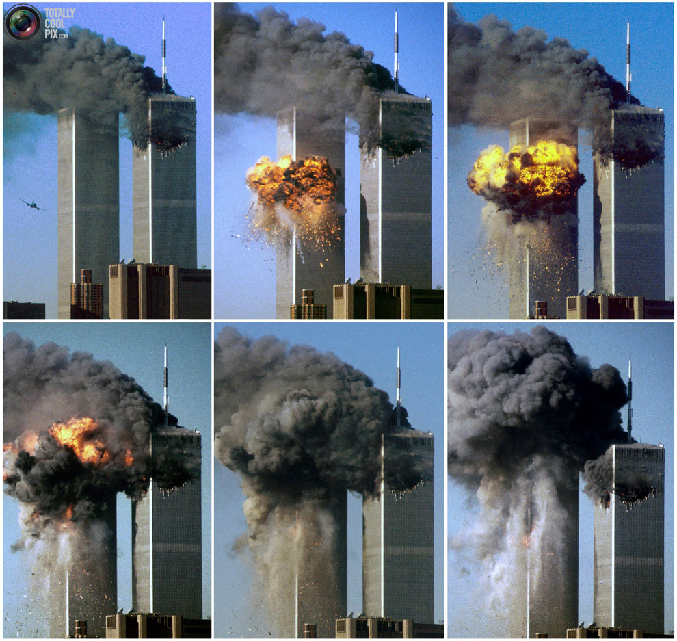

Slide 2
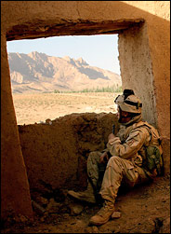
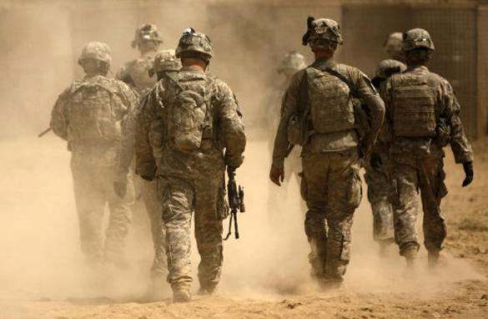

Slide 3
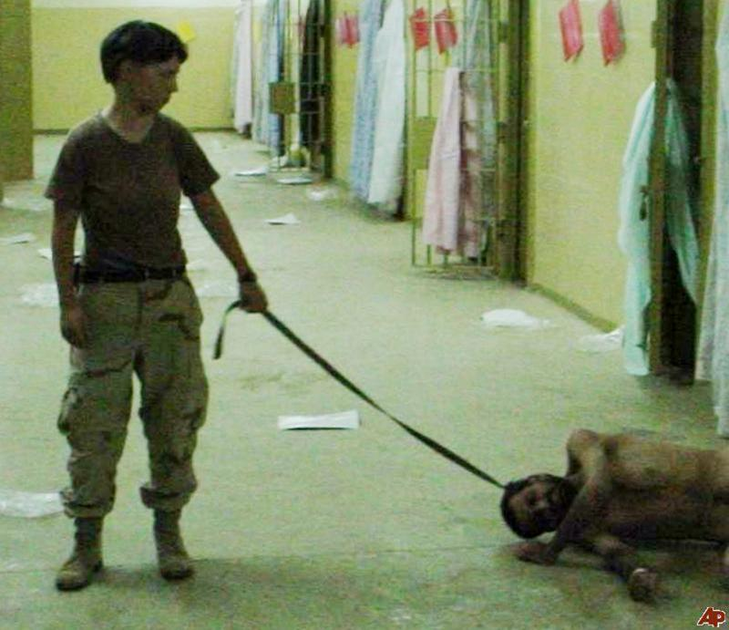
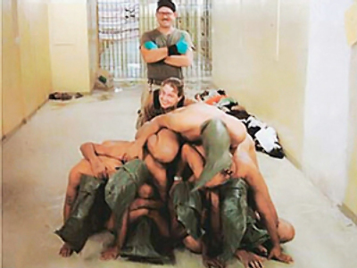
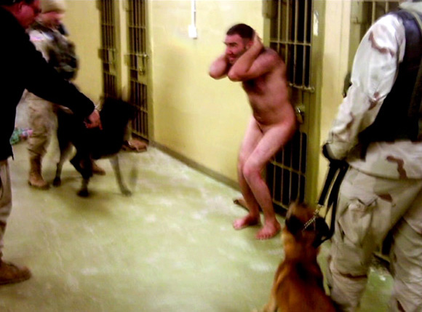
Notes:
Abu Graib

Slide 4
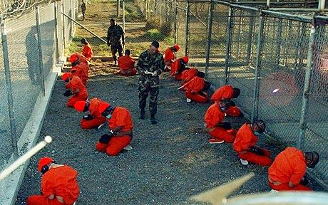
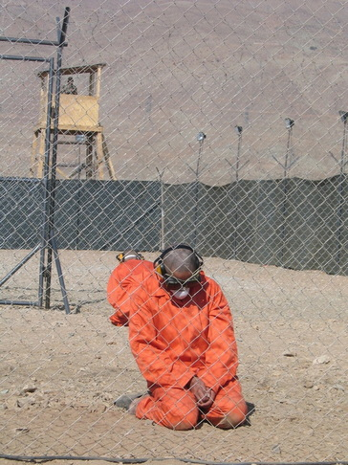
Notes:
Guantanamo

Slide 5
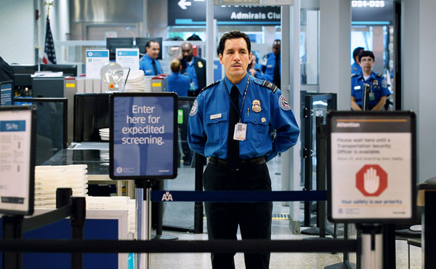
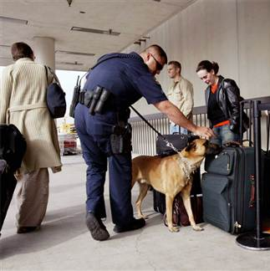
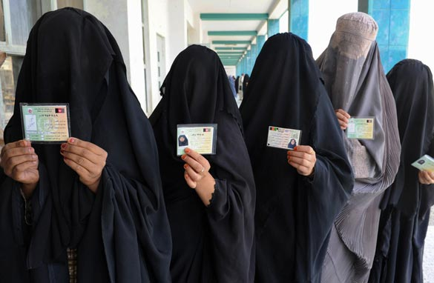
Border crossing: Biometric identification/ Muslim migrants = suspected terrorist?
Notes:
Film, “Reluctant Fundamentalist”

Slide 6
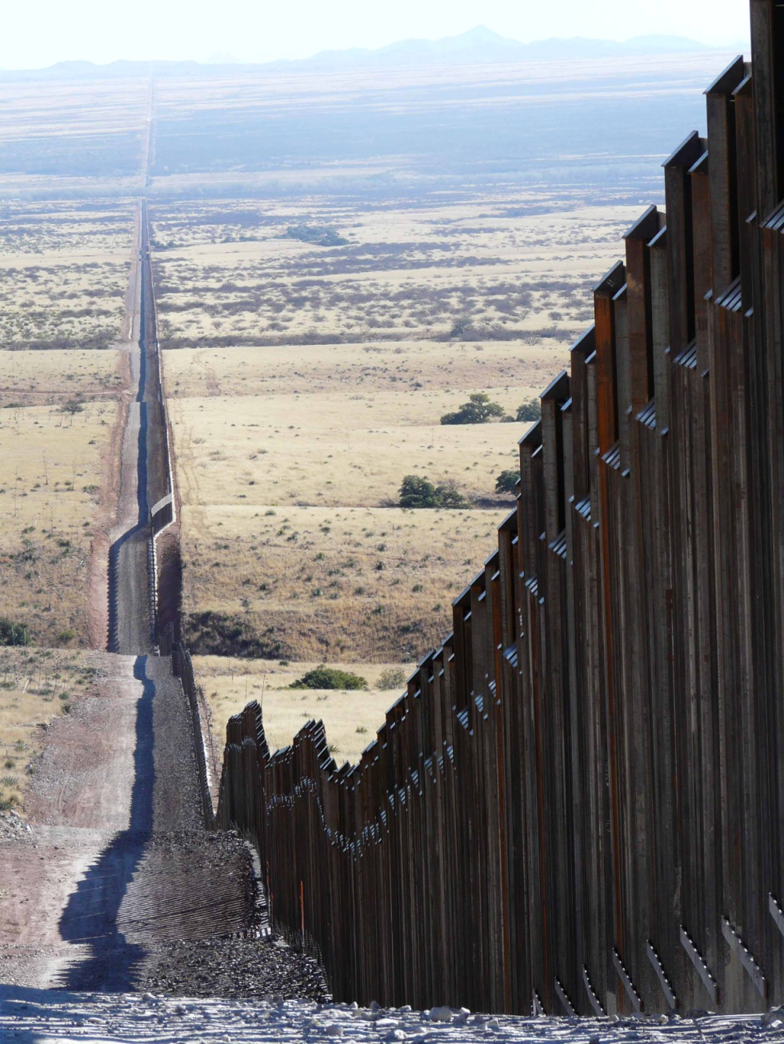
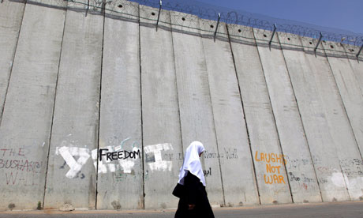
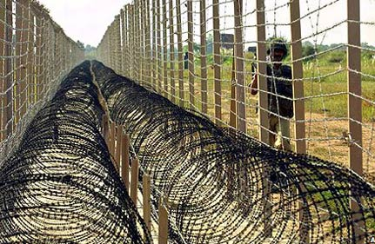
Border/ Walled States
Notes:
(1) US-Mexico border; (2) The Israel Wall in North Jerusalem; (3) India-Pakistan border fence

Slide 7
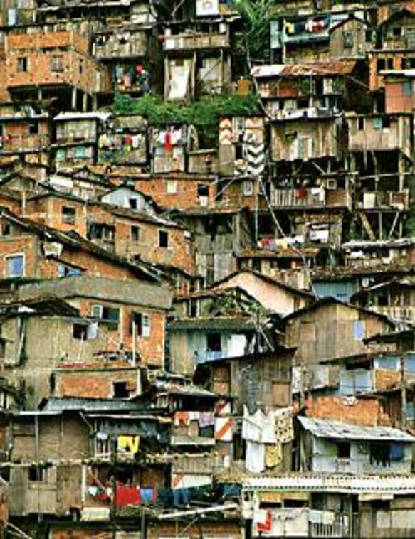
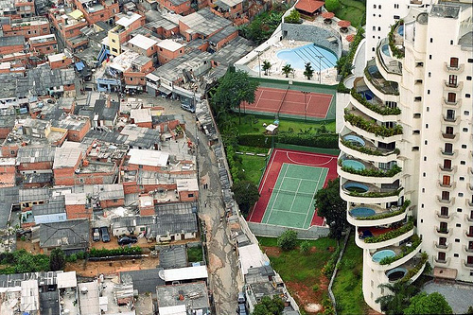
Slum dwellers

Slide 8
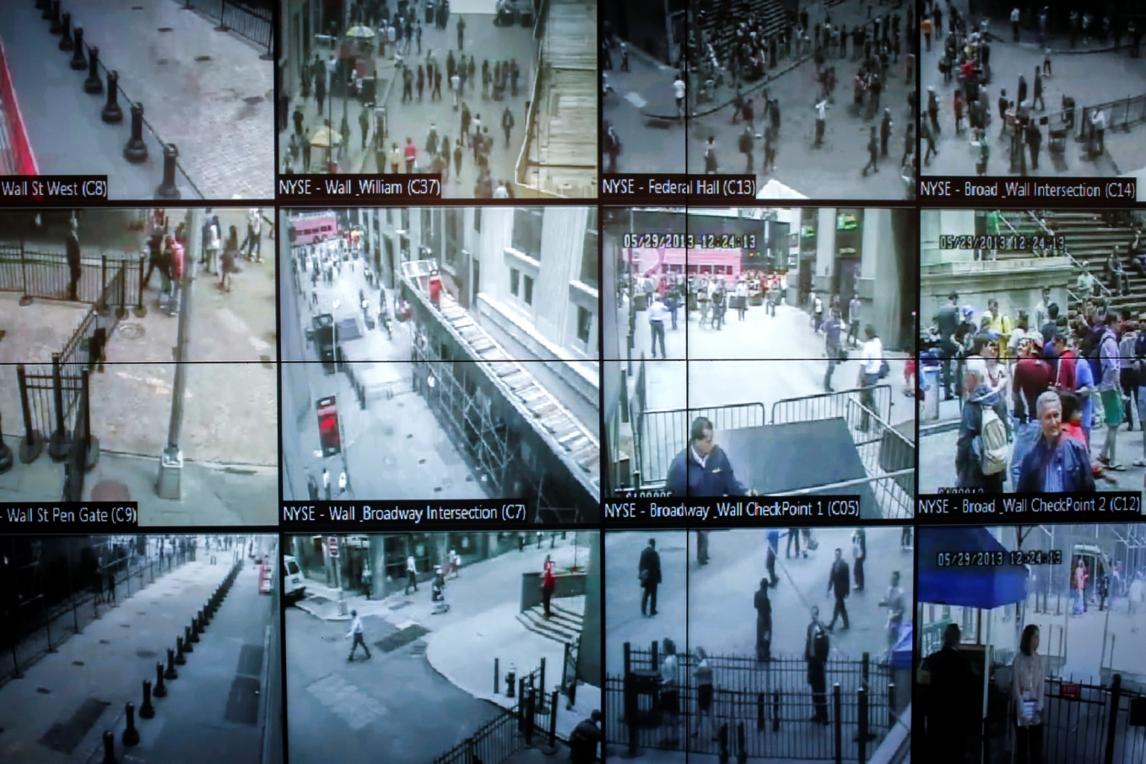
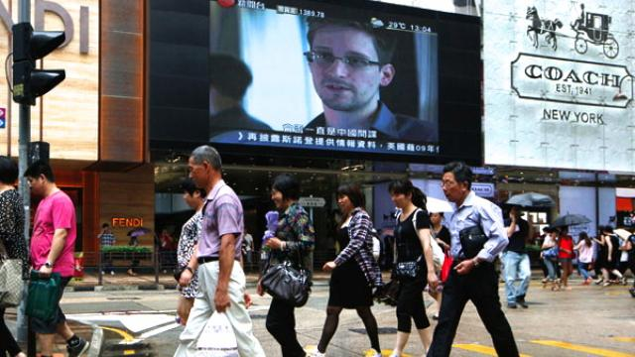
Surveillance State/Society: CCTV/ Drone

Slide 9
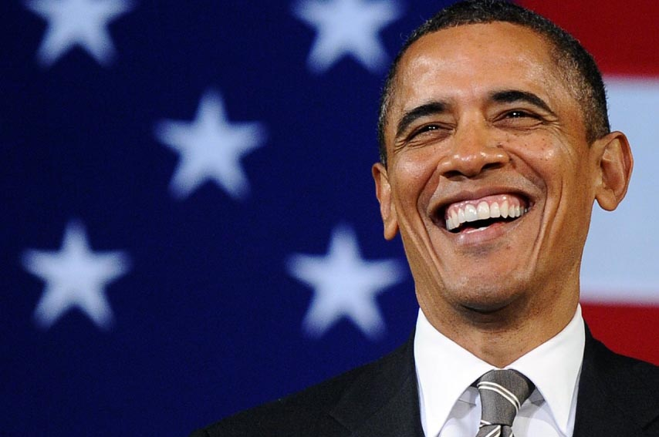
Obama’s Wars
Jittipat Poonkham
Faculty of Political Science
Thammasat University

Slide 10
On War
Does war still matter in IR?
Do we need to study war?
What kind of wars are they in contemporary global politics?

Slide 11
War Studies
Strategic Studies: War-centric
“New War” Studies (Mary Kaldor)
Security Studies: security/non-war-centric – nontraditional (human) security
  Critical Security Studies (i.e. Copenhagen School, Aberystwyth School, etc): securitization, emancipation, etc.
Critical War Studies: Bring “war” back in IR

Slide 12
What is New about “New War”?
Intrastate warfare
Identity conflict (ethnic, religious, etc)
The new decentralized global war economy
Private uses of force: militias, criminal organizations, terrorists, Private Military Companies (PMCs), etc.

Slide 13

“New War” (Mary Kaldor 1999)
Is the “New War” thesis theoretically helpful?
Is an Old War obsolete?

Slide 14
Obama’s Wars
How many wars is the US fighting today?

Slide 15
Obama’s Wars
5 wars
2 declared wars: Iraq and Afghanistan
At least 3 undeclared/ unannounced wars: Pakistan, Yemen and Somalia

Slide 16
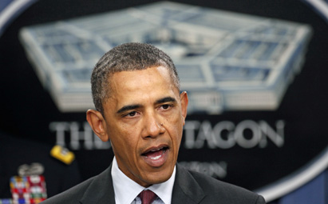
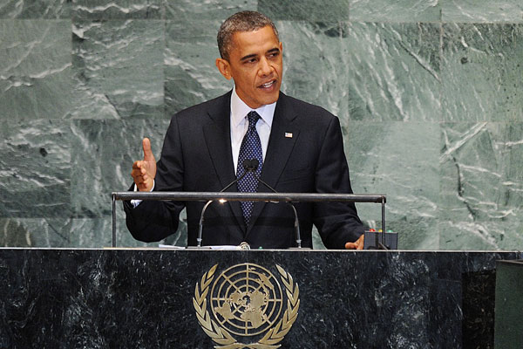
Obama’s Wars

Slide 17
Whose Speech?
“If we have to use force, it is because we are America. We are the indispensable nation. We stand tall. We see farther into the future”.
Notes:
Madeleine Albright

Slide 18
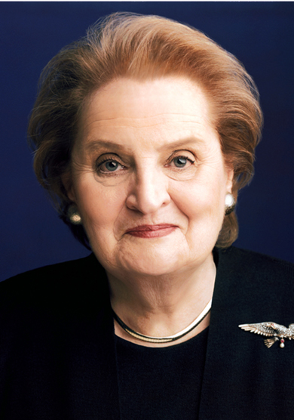
Whose Speech?
“If we have to use force, it is because we are America. We are the indispensable nation. We stand tall. We see farther into the future”.
Notes:
Madeleine Albright

Slide 19
Whose Speech?
“No president should ever hesitate to use force – unilaterally, if necessary – to protect ourselves and our vital interests when we are attacked or imminently threatened”.
Notes:
Barack Obama

Slide 20
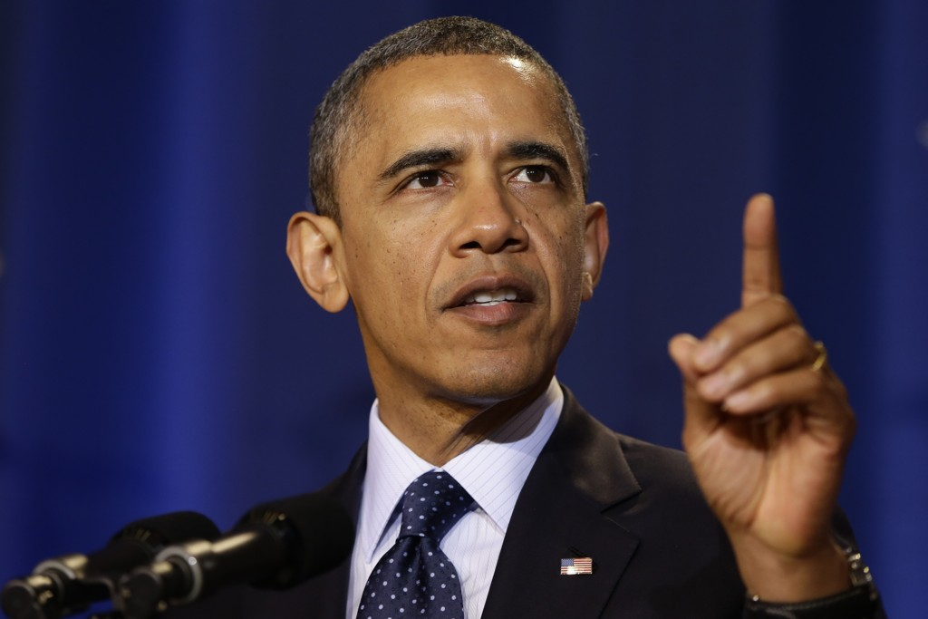
Whose Speech?
“No president should ever hesitate to use force – unilaterally, if necessary – to protect ourselves and our vital interests when we are attacked or imminently threatened”.
Notes:
Barack Obama

Slide 21
Whose Speech?
“When our national security interests are threatened, we will act with others when we can, but alone if we must. We will use diplomacy when we can, but force if we must”.
Notes:
Bill Clinton

Slide 22
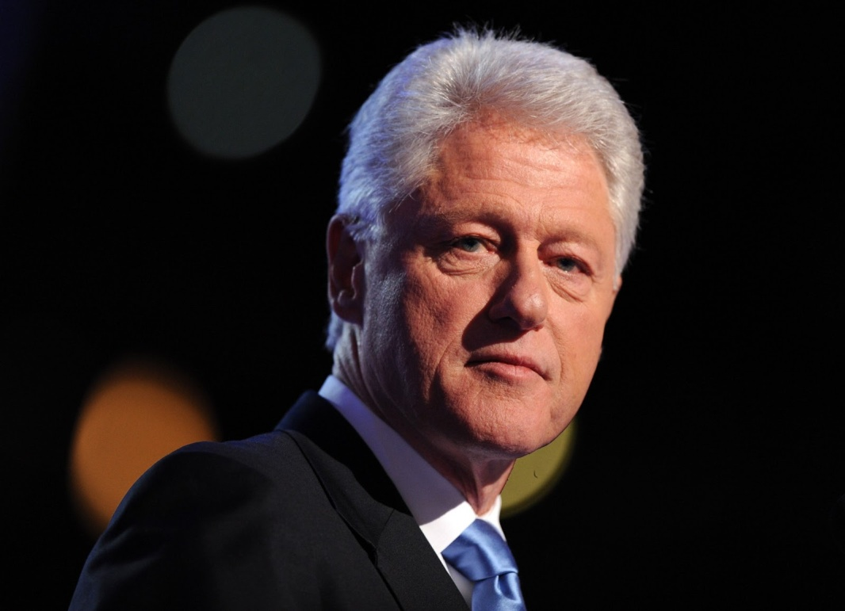
Whose Speech?
“When our national security interests are threatened, we will act with others when we can, but alone if we must. We will use diplomacy when we can, but force if we must”.
Notes:
Bill Clinton

Slide 23
Whose Speech?
  “Let me say it clearly: the United States can, must, and will lead in this new century”.
Notes:
Hillary Clinton

Slide 24
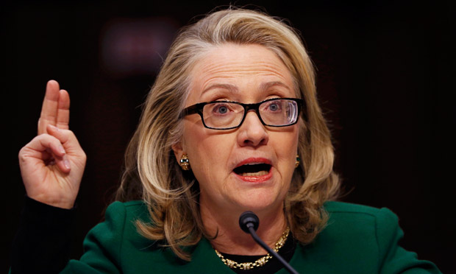
Whose Speech?
  “Let me say it clearly: the United States can, must, and will lead in this new century”.
Notes:
Hillary Clinton

Slide 25
Whose Speech?
  “We stand up for universal values because it is the right thing to do. But we also know from experience that those who defend these values from their people have been our closest friends and allies, while those who have denied these rights – whether terrorist groups or tyrannical governments – have chosen to be our adversaries”.
Notes:
Barack Obama

Slide 26
Obama’s Wars: Outline
The “Obama Doctrine”: “Change” or Continuity of the Bush administration?
Practices

Slide 27
The Nobel Peace Prize speech
(December 10, 2009)
“As a head of state sworn to protect and defend my nation, I cannot be guided by their [Gandhi’s or Martin Luther King’s] examples alone. I face the world as it is, and cannot stand idle in the face of threats to the American people. For make no mistake: Evil does exist in the world”.

Slide 28
The Nobel Peace Prize speech
(December 10, 2009)
“I am the commander in chief of the military of a nation in the midst of two wars. I am responsible for the deployment of thousands of young Americans to battle in a distant land. Some will kill, and some will be killed”.

Slide 29
The Nobel Peace Prize speech
(December 10, 2009)
“There will be times when nations – acting individually or in concert – will find the use of force not only necessary but morally justifiable”.
“The instrument of war do have a role to play in preserving the peace”.

Slide 30
The Nobel Peace Prize speech
(December 10, 2009)
America’s role in the world
“Whatever mistakes we have made, the plain fact is this: the United States of America has helped underwrite global security for more than six decades with the blood of our citizens and the strength of our arms”.
“We have borne this burden not because we seek to impose our will. We have done so out of enlightened self-interest”.

Slide 31
The Prague Speech (April 5, 2009)
“Nuclear Weapon Free World”
“Today, I state clearly and with conviction America’s commitment to seek the peace and security of a world without nuclear weapons”.
“I am not naïve. The goal [of a nuclear-weapon-free-world] will not be reached quickly – perhaps not in my lifetime. As long as these weapons exist, the United States will maintain a safe, secure, and effective arsenal to deter any adversary, and guarantee that defense to our allies”.

Slide 32
The “Obama Doctrine”
“I don’t oppose all wars. What I am opposed to is a dumb war”. – Barack Obama
Iraq War as “a dumb war. A rash war. A war based not on reason, but on passion, not on principle, but on politics. I know that an invasion of Iraq, without a clear rationale and without strong international support, will only fan the flames of the Middle East, and encourage the worst, rather than best, impulses of the Arab world, and strengthen the recruitment arm of al-Qaeda”. (October 2002)

Slide 33
The “Obama Doctrine”
The possibility of a smarter/ legitimate war
“I stand before you as someone who is not opposed to war in all circumstances”.
“I would willingly take up arms myself to prevent such tragedy [9/11] from happening again”. (October 2002)

Slide 34
The “Obama Doctrine”
“No president should ever hesitate to use force – unilaterally, if necessary – to protect ourselves and our vital interests when we are attacked or imminently threatened”. – Obama (April 2007)

Slide 35
The “Obama Doctrine”
Obama’s Wars in Afghanistan and Pakistan
“getting off the wrong battlefield in Iraq and taking the fight to the terrorists in Afghanistan and Pakistan” (August 1, 2007)
“to track down, capture or kill terrorists around the world”
“As president, I would deploy at least two additional brigades to Afghanistan. If we have actionable intelligence about high-value targets and President [Pervez] Musharraf won’t act, we will”.

Slide 36
The “Obama Doctrine”
Unilateralism
  A direct threat to the US: willing to use unilateral force, even if it violates sovereignty of other states, and even if it angers its allies (e.g. the Osama bin Laden raid, the drone strikes over Pakistan, etc.)
  Not a direct interests at stake: “Leading from behind”? (e.g. Libya, Syria, etc.)

Slide 37
The “Obama Doctrine”: Practices
“Pivot” to Asia: Managing the rise of China
“Reset” relations with Russia
The “Afpak” strategy: from counterinsurgency towards counterterrorism?
Drone warfare (the remote-control warfare)
Arab Spring: Democracy promotion in the Middle East?
“Congagement” with Iran and North Korea?

Slide 38
The New Old War?
Inter-/ trans-state warfare
Undeclared, covert warfare
Technology-driven warfare
  Drone warfare (the remote-control warfare)
  Cyber warfare
Low-risk warfare
Surveillance warfare
From geopolitics of warfare to biopolitics of warfare: a power over life

Slide 39
The New Old War: Context
The Revolution in Military Affairs (RMA)
  Technologization of weapon systems
  Network centric warfare
  Cyberwar/ Netwar
  Smaller special units (i.e. JSOC – Joint Special Operations Command)
9/11
  The Authorization for Use of Military Force (AUMF) (the US Congress, 14 September 2001) – the president broad authority to use force against terrorist groups linked to the 9/11 attacks

Slide 40
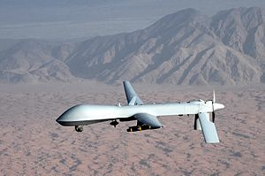

Slide 41
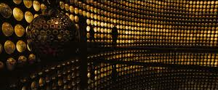
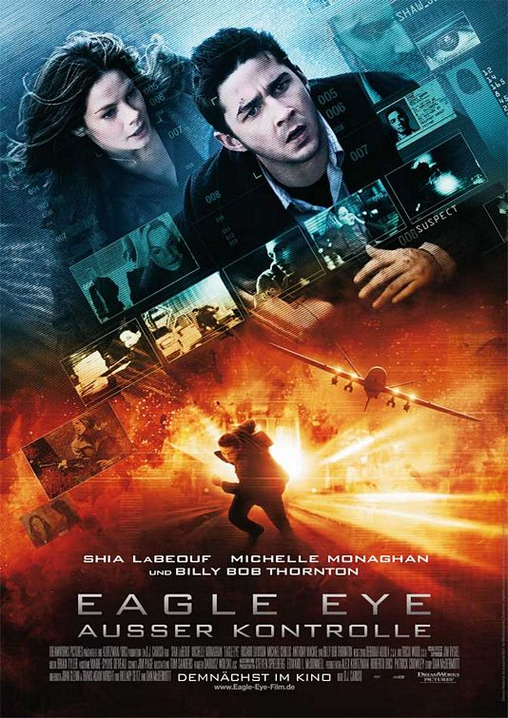

Slide 42
Discourse of Drone: A Joke
At the White House Correspondents Dinner on 2 May 2010, President Obama warned American boy band the Jonas Brothers to stay away from his daughters: “Boys, don’t get any ideas. Two words for you: Predator drones. You will never see it coming. You think I’m joking?”

Slide 43

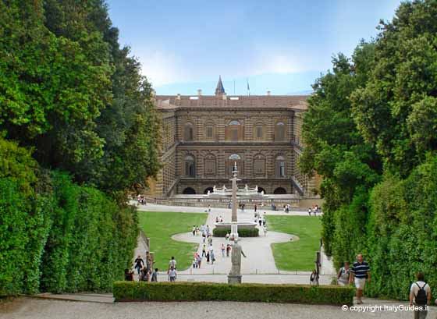

Slide 44
Drone Warfare
Drones or Unmanned Aerial Vehicles (UAVs)
  Surveillance and reconnaissance missions
  Combat missions
  Civilian missions (i.e. disaster and trauma reliefs such as the tsunami in Japan in 2011)
Two kinds: (Big) Predators and (small) Reapers
The remote-control warfare

Slide 45
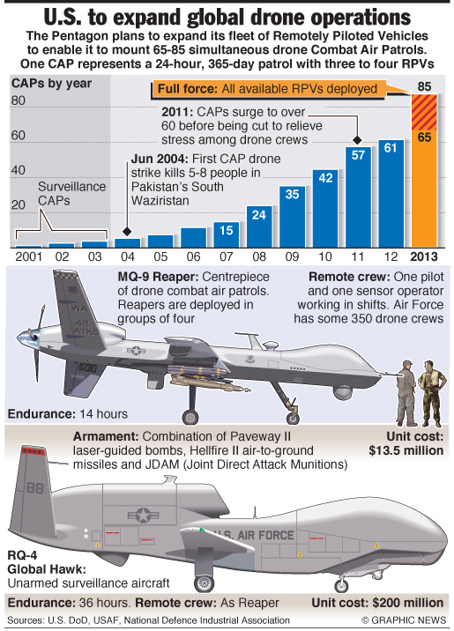
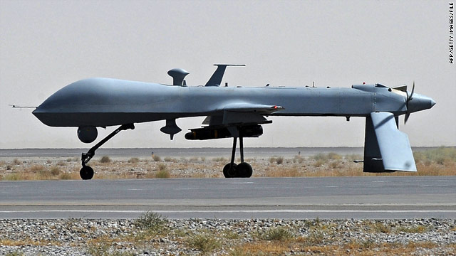

Slide 46
Drone Warfare
Drone operators in Nevada (a Ground Central Station at Creech Air Force Base) | Drones -- > missiles | Pakistan CIA Covert Operation
 | Air bases in Afghanistan/ Iraq

Slide 47
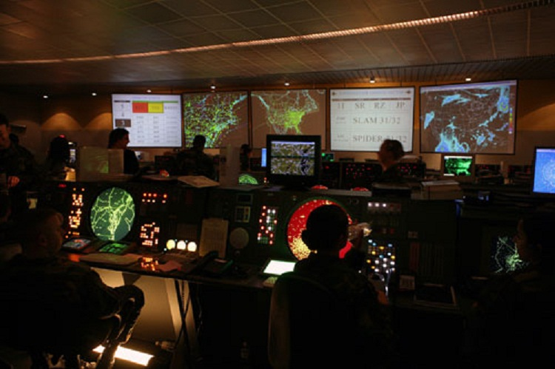

Slide 48
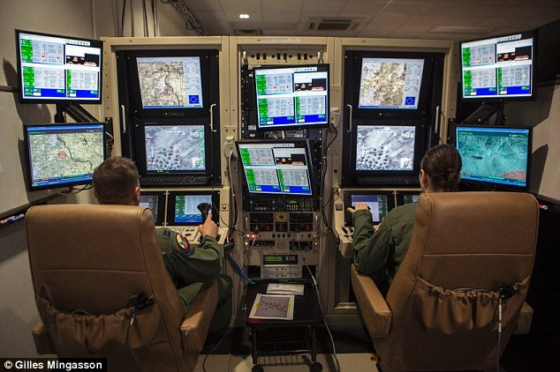

Slide 49
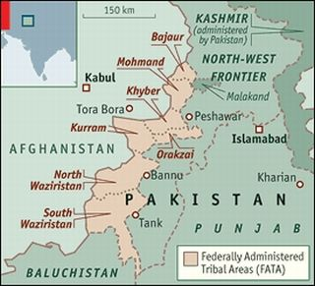

Slide 50
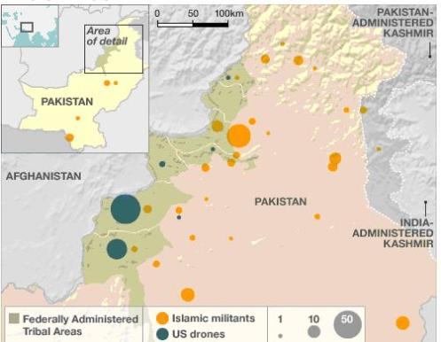

Slide 51
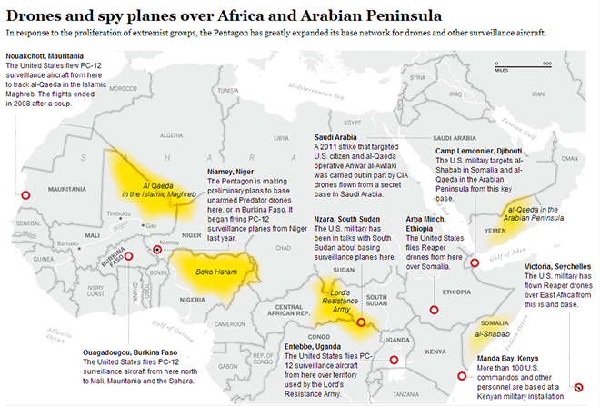

Slide 52
Obama’s War on Terror: Kill or capture?
Narrowed version of “global war on terror”
  America’s objectives were “narrowly defined as disrupting, dismantling and defeating al Qaeda and its extremist allies” (Obama).
  A war on al-Qaeda
  Not putting those four words together anymore while still preserving the concepts and using each of the words separately
  The US was “at war” with al-Qaeda.

Slide 53
Obama’s War on Terror: Kill or capture?
Drone operations (remote-control warfare)
  To “disrupt, dismantle, and defeat” al-Qaeda
  Targeted killing
  “We have had more success in eliminating al-Qaeda leaders in recent months than in recent years”. (May 22, 2010)
  Operations: “Is this a kill or is it a capture?”

Slide 55
Obama’s War on Terror: Kill or capture?
  3 Options: (a) bombing or missile attack; (b) the raid with ground forces; (c) a delay until the CIA had more intelligence and greater certainty that Bin Laden was inside the Abbottabad compound
  The Abbottabad operation (May 2, 2011)
  authorizing a Navy SEAL team to kill Osama Bin Laden in Pakistan, without telling any of Pakistan’s leaders in advance
  “Talk Your Way Out” or “Fight Your Way Out”?
  “Which law governs the execution of Bin Laden”?

Slide 56
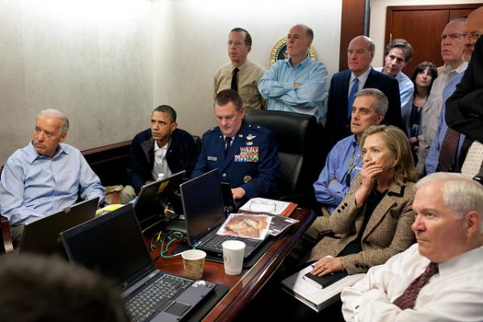

Slide 57
Drone Warfare: Pros and Cons
Pros:
Cons:

Slide 58
Obama’s Withdrawal from Iraq
A timetable for withdrawal from Iraq
  Bush’s agreement in 2008 to a broad status-of-forces agreement with the Iraqi government under which all American troops were to be taken out of Iraq by the end of 2011.
By the time Obama took office, the debate was not over whether to withdraw, but how quickly.
Obama’s shift from Iraq to “Afpak”: the other war?
  Iraq as a diversion from the “real” war against al-Qaeda in Afpak
August 30, 2010: the formal end of American combat operations in Iraq

Slide 59
Obama (2007)
If elected, he would send American troops into Pakistan “if we have actionable intelligence about high value targets”, such as al-Qaeda leaders.
Obama said, he would do so even without the assent of Pakistan’s top leaders.

Slide 60
Obama’s “Afpak” Strategy
Strategy of counterinsurgency (COIN)
  General David Petraeus (from commander in Iraq to Afghanistan)
  The Bruce Riedel report – The Search for al Qaeda (2008).
    To “disrupt, dismantle, and defeat” al-Qaeda
  winning “hearts and minds” – development task
  More time and more troops
  Ordering another 17,000 American troops to Afghanistan (February 2009)

Slide 61
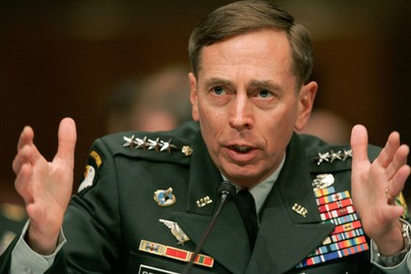
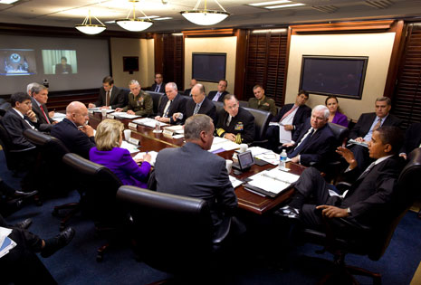

Slide 62
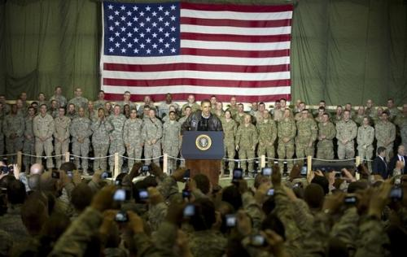
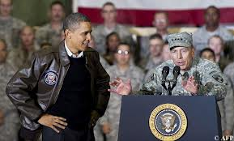

Slide 63
Obama’s “Afpak” Strategy
  “We have to ensure that neither Afghanistan nor Pakistan can serve as a safe haven for al-Qaeda”. – Obama (March 30, 2009)
  “As commander in chief, I will have no greater priority than taking out these terrorists who threaten America, and finishing the job against the Taliban. For years, I have called for more resources and more troops to finish the fight in Afghanistan”. – Obama (August 19, 2008)

Slide 64
Obama’s “Afpak” Strategy
  “This is not a war of choice. This is a war of necessity. Those who attacked America on 9/11 are plotting to do so again”. – Obama (August 17, 2009)
Notes:
In the photo, to the president’s left: outgoing National Security Advisor Jim Jones, Secretary of State Hillary Clinton, Director of National Intelligence James Clapper, Deputy Secretary of State Jack Lew, Special Representative to Afghanistan and Pakistan Richard Holbrooke and incoming U.S. Ambassador to Pakistan Cameron Munter. To Obama’s right: Defense Secretary Robert Gates, Chairman of the Joint Chiefs of Staff Adm. Mike Mullen, incoming National Security Advisor Tom Donilon, White House counterterrorism advisor John Brennan, Centcom Commander Gen. James Mattis, Deputy CIA Director Michael Morrel. Along the wall: NSC Afpak coordinator Douglas Lute, Undersecretary of Defense for Policy Michele Flournoy, Deputy Treasury Secretary Neal Wolin, Deputy Chairman of the Joint Chiefs of Staff Gen. James Cartwright, White House spokesman Robert Gibbs, (last two people unidentified). Vice President Joe Biden, U.S. Ambassador to the UN Susan Rice, U.S. Ambassador to Afghanistan Karl Eikenberry and ISAF Commander Gen. David Petraeus participated in today’s meeting by videoconference. Also participating in today’s meeting, USAID Chief Rajiv Shah, and White House Chief of Staff Pete Rouse.

Slide 65
Obama’s “Afpak” Strategy
A shift towards the counterterrorism strategy
  Joe Biden’s initial policy option: If the goal was to defeat al-Qaeda, then the answer was to step up the use of drones and special operations in Pakistan, instead of new deployment of ground forces.
  A greater reliance on drones and special forces (i.e. the US Special Operations Command) to kill terrorists
  Fewer troops than counterinsurgency strategy

Slide 66
Obama’s War on Terror: Continuity?
RDI [rendition, detention, and interrogation] as “an outrageous betrayal of our core values” – Obama (October 2007)
Preserving the counterterrorism programs, inherited from the Bush administration
  The CIA’s “enhanced interrogation techniques”?
  Accepting the practice of indefinite detention, without trial or sentencing, for those prisoners believed to be especially dangerous terrorists.
  The failure to close Guantanamo
Notes:
Rendition is a process that the CIA abducts alleged terrorists and moves them across international border to the “black sites” for interrogation.

Slide 67
Obama’s War on Terror: Continuity?
  “I am not going to release individuals who endanger the American people … Al-Qaeda terrorists and their affiliates are at war with the United States, and those that we capture – like other prisoners of war – must be prevented from attacking us again”. – Obama (May 21, 2009)
  “When threatened, we must respond with force. But when that force can be targeted, we need not deploy large armies overseas”. – Obama (June 22, 2011)

Slide 68
Obama’s Democracy Promotion?
The “Obamians” e.g. Denis McDonough, Samantha Power, Michael McFaul, Susan Rice – “We are all democrats now”.
The Arab Spring since 2011
  The Green Revolution (Green Movement) in Iran (2009) – Hossein Mousavi
  Tunisia (against Zine el Abidine Ben Ali)
  Egypt (against Hosni Mubarak)
Clinton’s call for “an orderly transition”
Obama: an orderly transition “must begin now”.

Slide 69
“Military Action” in Libya
(March 2011)
Imperial temptation?
  A campaign of air strikes in support of Libyan rebels against the government of Muammar Gaddafi
  “all necessary measures” against Libyan forces
Imperial presidency?
Carrying out military action Libya beyond the time limits set in the War Powers Resolution (1973)*
  *the law prohibiting a president from deploying American troops overseas for more than 60 days without the authorization of Congress

Slide 70
Military Intervention in Libya:
“Leading from behind”?
“America’s role would be limited; that we would not put ground troops into Libya; that we would focus our unique capabilities on the front end of the operation and that we would transfer responsibility to our allies and partners”. – Obama
NATO intervention in Libya (March-October 2011)
A retreat to “a supporting role” – “the risk and costs of this operation … will be reduced significantly”.
“To be blunt, we went down that road in Iraq … That is not something we can afford to repeat in Libya”. – Obama

Slide 71
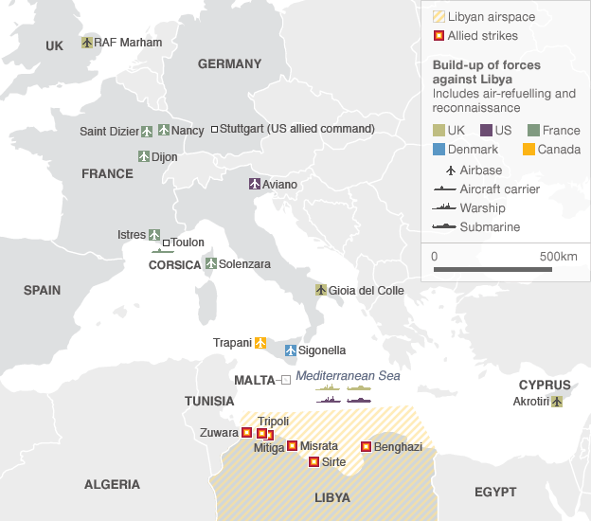

Slide 72
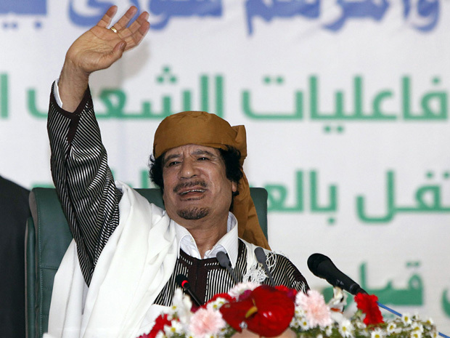
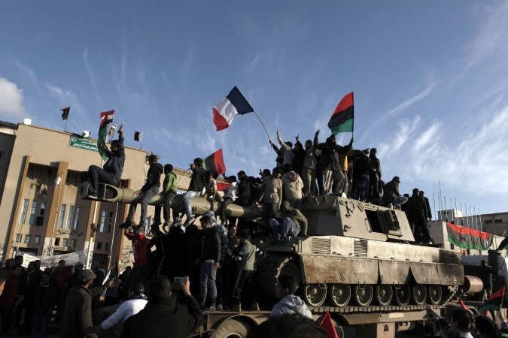

Slide 73
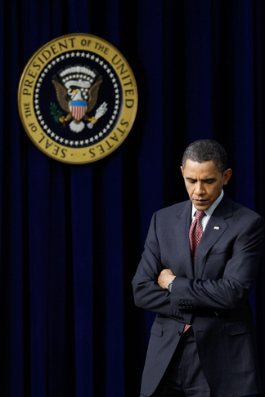
Conclusion

Slide 74
Obama’s Wars
  From the “long war” to permanent war?
  The expansion of transnational shadow wars
  Air power and drones: Risk averse; risk transfer
  From hierarchical to networked forms of organization: JSOC
  Disappearing violence (from media/ political accountability)?
  Proliferation of drones
  A society of control (surveillance)

Slide 75
Obama’s Wars
  “I want to make sure that people understand, actually, drones have not caused a huge number of civilian casualties. For the most part they have been very precise precision strikes against al-Qaeda and their affiliates. And we are very careful in terms of how it’s been applied. … This is a targeted, focused effort at people who are on a list of active terrorists”.
  – Obama

Slide 76
Obama’s Wars
  “I am not going to release individuals who endanger the American people … Al-Qaeda terrorists and their affiliates are at war with the United States, and those that we capture – like other prisoners of war – must be prevented from attacking us again”.
  – Obama (May 21, 2009)

Slide 77
Obama’s Wars
  “When threatened, we must respond with force. But when that force can be targeted, we need not deploy large armies overseas”.
  – Obama (June 22, 2011)

