Slide 1
The Integration of ASEAN
and the Role of Connectivity

Slide 2

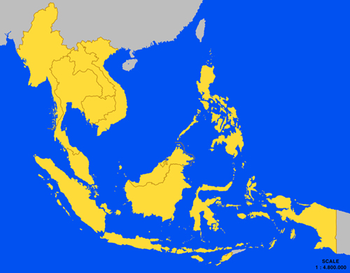
Background on ASEAN
ASEAN established in 1967 with Indonesia, Malaysia, Philippines, Singapore and Thailand
Joining later: Brunei Darussalam (1984), Viet Nam (1995), Lao PDR (1997), Myanmar (1997), and Cambodia (1999)
Home to 600 million with combined GDP of $2 trillion (8th largest economy in the world)
2015 marks the establishment of the ASEAN Economic Community.
Notes:
Let’s begin with a background of ASEAN.

Slide 3
ASEAN: opportunity for capturing $615 bn of global trade
A recent McKinsey report notes the following trends in ASEAN:
  Intra-regional trade at 24% of total trade in 2013
  Relatively low labor productivity, but opportunities as Chinese labor costs rise
  Combined GDP of $2.4 trillion was 25% higher than India’s economy in 2013

Slide 4
ASEAN incomes have doubled faster than the UK
McKinsey highlights how ASEAN has performed better than many developed economies

Slide 5
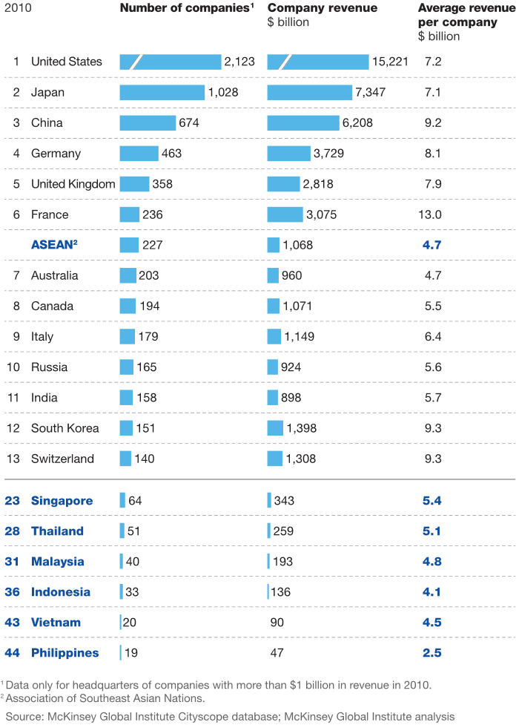
ASEAN is home to 227 of the world’s largest companies
Notes:
ASEAN is home to many globally competitive companies (49 companies in 2006 and 74 by 2013 – Global Forbes). The region has 227 of the world’s companies with more than $1 billion in revenues, or 3% of the global total.
ASEAN is attracting many multinationals. Foreign direct investment in ASEAN has boomed, surpassing its pre crisis levels. In fact, the ASEAN-5 (Indonesia, Malaysia, the Philippines, Singapore, and Thailand) attracted more foreign direct investment than China ($128 billion versus $117 billion) in 2013
ASEAN is the fourth-largest exporting region in the world, trailing only the European Union, North America, and China/Hong Kong. It accounts for 7 percent of global exports—and as its member states have developed more sophisticated manufacturing capabilities, their exports have diversified

Slide 6
What is the ASEAN Economic Community?
The ASEAN Economic Community 2015 is anchored on 4 pillars:
  Single market & production base;
  Competitive economic region;
  Equitable economic development; and
  Integration into the global economy
Notes:
Let’s begin with a background of ASEAN.

Slide 7
AEC’s 2015 Target: Reality or Vision?
Source: AEC Blueprint, the ASEAN Secretariat
Notes:
ASEAN’s diversity gives it great strength. The ASEAN Economic Community 2015 (AEC) offers the opportunity to capitalize on diverse resource endowments, comparative advantages of geography, factors of production, and distinct levels of human capital--both education- and demographic-based. While each member pursues its own national reform agenda, collectively they offer all the ingredients for an ASEAN Economic Community that benefits all.
The AEC is anchored on 4 pillars: (i) single market production base, (ii) competitive economic region, (iii) equitable economic development, and (iv) integration into the global economy. ASEAN has made significant strides in each.
The key objective is the transformation of ASEAN into a region with free movement of goods, services, investment, skilled labor, and freer flow of capital.
The AEC can potentially provide a bigger market for each individual ASEAN country goods and services, create more jobs, and encourage more investments, provided that the right policies and business environment are in place.
But with a bit more than a year remaining before the 31 December 2015 deadline, many are wondering – will the AEC become a reality in 2015, or will it remain essentially a vision statement?
Quote from former ASEAN Secretary General Rodolfo Severino: “regional economic integration becomes stuck in framework agreements, work programs and master plans, with little real movement on the ground” (2006)

Slide 8

AEC’s Remaining Challenges
Removing barriers to trade in sensitive areas like agriculture, steel and services.
Eliminating non-tariff barriers like anti-dumping regulations, or sanitary or phytosanitary rules.
Complete the ASEAN single window to improve efficiency of border administration.
Removing behind-the-border constraints related to logistics, transport, infrastructure problems, and weak institutions.
Notes:
So, which are the remaining challenges?
In creating a single market base, remaining challenges--the harder "second generation" ones--include removing barriers to trade in sensitive areas like agriculture, steel and in services.
Non-tariff barriers--like excessive red tape, antidumping, cumbersome licensing requirements or misuse of sanitary or phytosanitary rules on food--need to be fixed, as non-tariff barriers are replacing tariffs as protective measures.
Complete the ASEAN single window to improve efficiency of border administration is also a challenge
Finally, it is also important to remove behind-the-border constraints related to logistics, transport, infrastructure problems, and strenghen weak institutions that could facilitate trade.

Slide 9
The AEC and Connectivity
As the region prepares for the ASEAN Economic Community 2015, physical and “soft” aspects of connectivity need to be enhanced to strengthen economic and social integration.

Slide 10
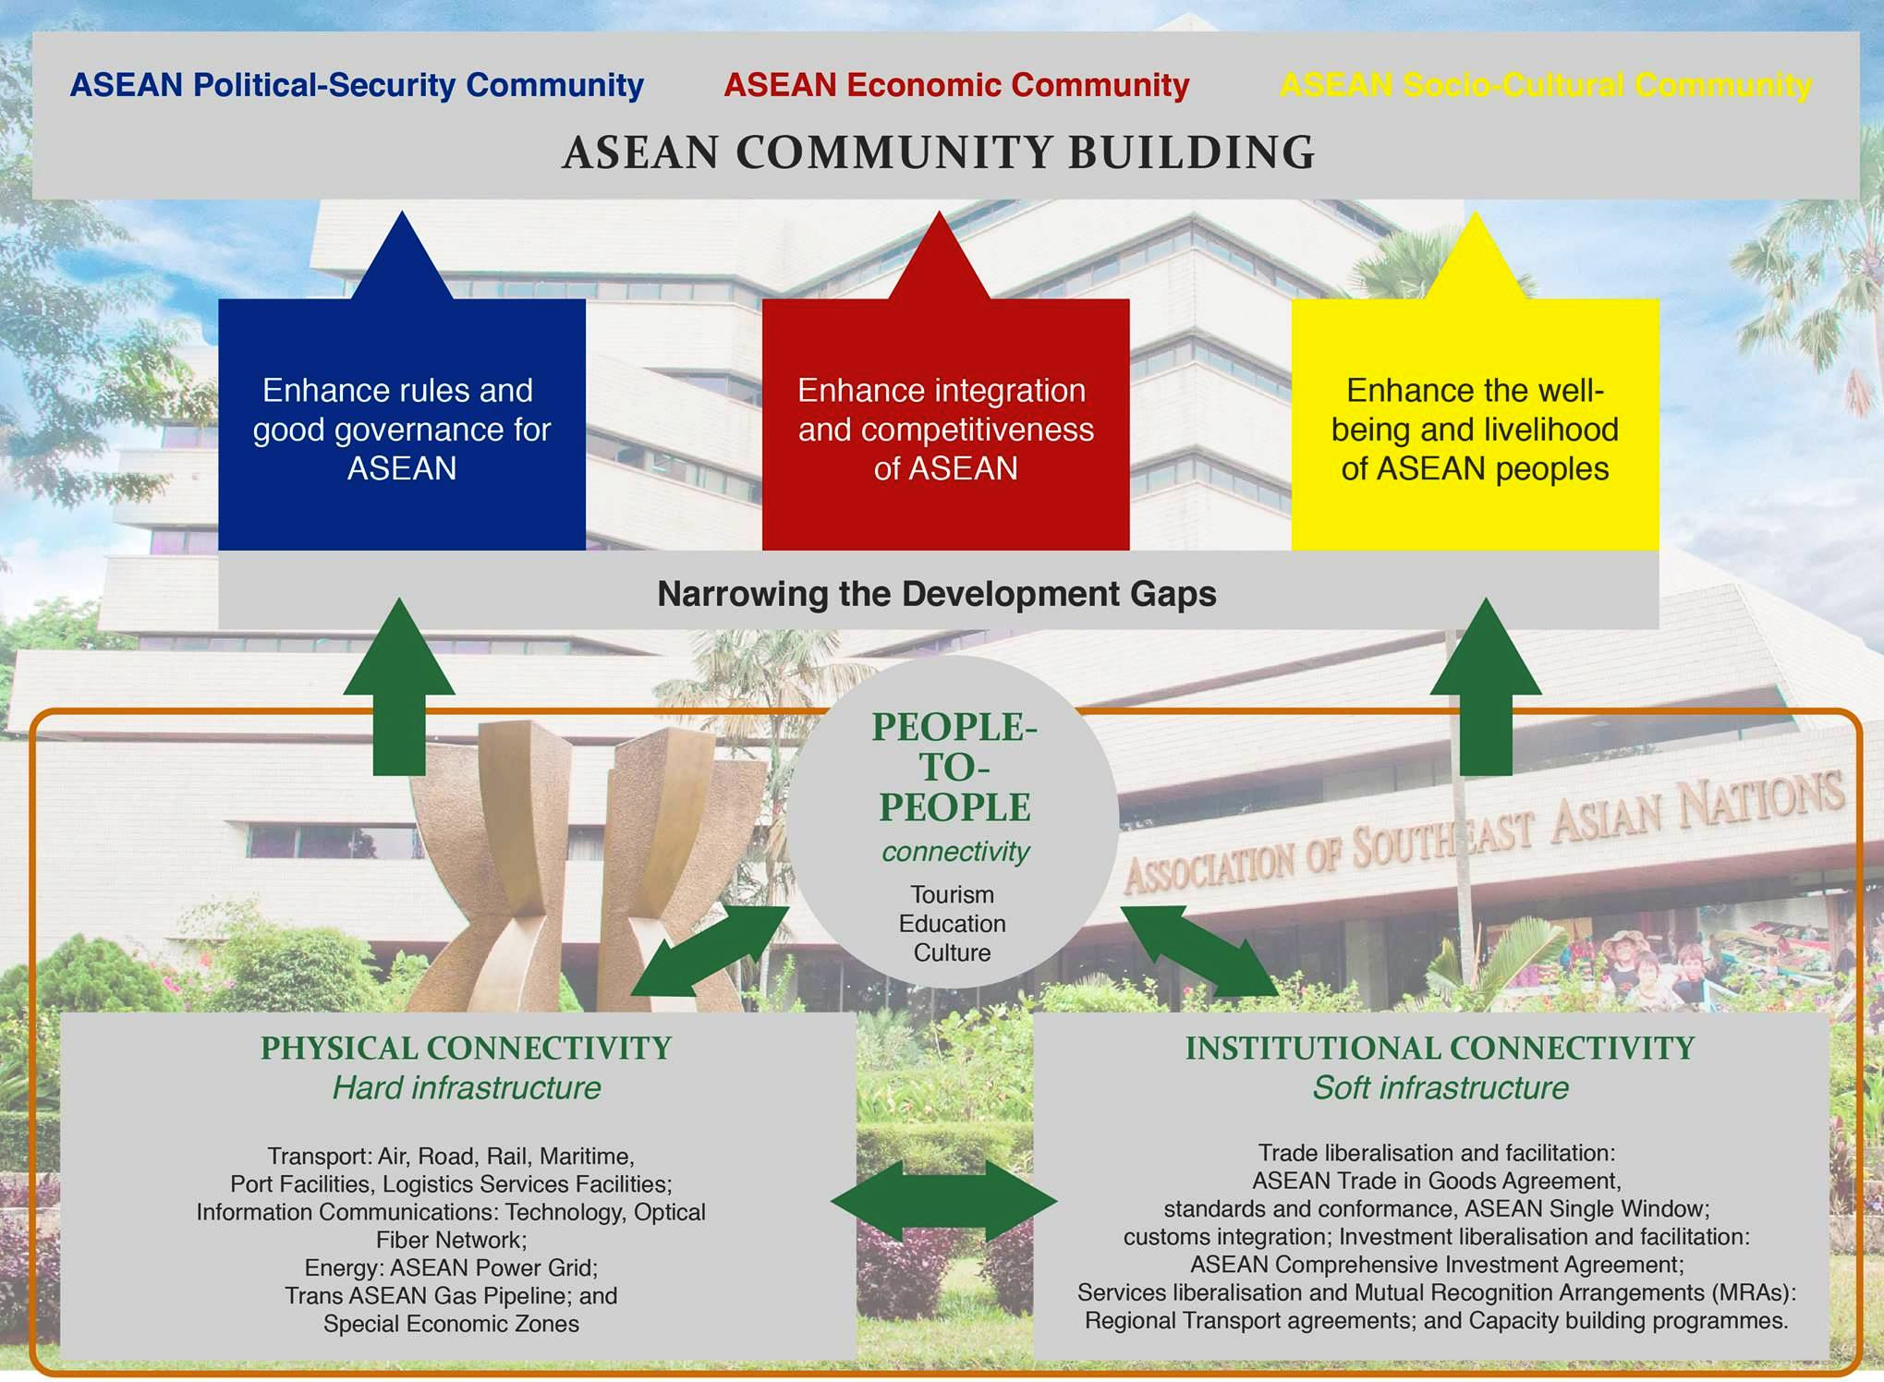
Master Plan for ASEAN Connectivity: Cornerstone for AEC

Slide 11
ASEAN physical connectivity is progressing
Despite lagging other regions and some internal disparities, ASEAN shows steady progress in physical connectivity
However, despite physical infrastructure investments, additional work in promoting “software” connectivity needed
Source: ASEAN-Japan Transport Partnership Information Center
http://www.ajtpweb.org

Slide 12
Physical & Software Connectivity Constraints
Account for Relatively High Logistics Costs in ASEAN
Source: World Bank, “State of Logistics in Indonesia” (2013).

Slide 13
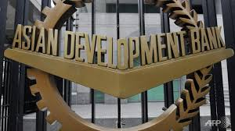

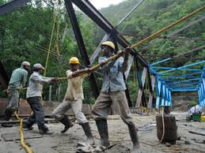
Connectivity Initiatives Supported by ADB
Physical Connectivity: ADB lends for infrastructure development. Of ADB’s $14.4 billion in lending in 2014, more than 50% was on infrastructure.
Innovative Financing: ADB is involved in new and innovative financing schemes, such as the ASEAN Infrastructure Fund.
Private Sector Participation: $4.5 billion in operations by ADB’s Private Sector Operations Department (2013). ADB is working to promote PPPs for physical and software connectivity projects.
Software Connectivity: Development partner for the GMS, BIMP-EAGA, IMT-GT programs promote software connectivity and integration: “bottom up” approach through technical assistance, knowledge sharing and capacity building.

Slide 14





ADB Support for Subregional Cooperation in Southeast Asia

Slide 15
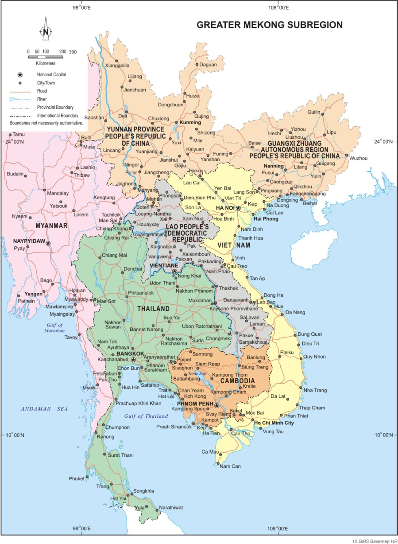
The GMS Program
Participating Countries: Cambodia, People’s Republic of China (Yunnan Province and Guangxi AR), Lao PDR, Myanmar, Thailand, and Viet Nam
Strategic Priorities:
  Vision – a more integrated, prosperous, and harmonious subregion
  “3Cs” – Connectivity, Competitiveness, Community
GMS projects: More than $17 billion in investment projects supported since 1992
Notes:
The GMS Economic Cooperation Program began in 1992, covering Cambodia, Lao PDR, Myanmar, Thailand, Viet Nam, and the People’s Republic of China (PRC) (then specifically the Yunnan province and later on, also the Guangxi autonomous region).
From its inception, the underlying strategy was to link the GMS countries through improvements in infrastructure, thus overcoming domestic constraints and promoting trade and investment to boost economic growth. The overall vision is of a more integrated, prosperous, and harmonious subregion. This vision can be summed up by the “3Cs”: enhanced connectivity, improved competitiveness, and a greater sense of community.
Connectivity through the development of subregional transport, power, and telecommunications infrastructure.
Competitiveness through transport and trade facilitation, development of logistics systems, regional power trade, harnessing of ICT, cross-border agricultural trade, and promotion of the GMS as a single tourist destination.
A sense of community through jointly addressing shared social and environmental concerns, such as the prevention and control of communicable diseases, and the protection of the subregion’s rich biodiversity and ecosystems.
As of the end of December 2013, 69 priority projects worth around $16.8 billion have either been completed or are being implemented. For these projects, ADB has provided loans/grants amounting to almost $6.1 billion, while GMS governments have provided around $4.6 billion. Contributions of cofinancing partners and the private sector amounted to $6.2 billion.
A total of $330 million of grant resources have been mobilized for 192 regional technical assistance (RETA) projects, of which $115.1 million has been provided by ADB, for project preparation, capacity development, policy advisory and studies on various areas of GMS cooperation. ADB has played the role of lead development partner, coordinator, and honest broker in the GMS Program.

Slide 16
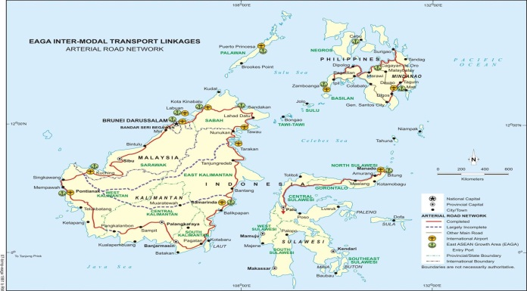
The BIMP-EAGA Program
Participating Countries: Brunei Darussalam, Indonesia, Malaysia and the Philippines
Strategic Priorities: Narrowing the development gap across and within EAGA member countries and the 6-ASEAN
BIMP-EAGA Priority Connectivity Projects under the BIMP-EAGA Implementation Blueprint exceed $1 billion
Notes:
The GMS Economic Cooperation Program began in 1992, covering Cambodia, Lao PDR, Myanmar, Thailand, Viet Nam, and the People’s Republic of China (PRC) (then specifically the Yunnan province and later on, also the Guangxi autonomous region).
From its inception, the underlying strategy was to link the GMS countries through improvements in infrastructure, thus overcoming domestic constraints and promoting trade and investment to boost economic growth. The overall vision is of a more integrated, prosperous, and harmonious subregion. This vision can be summed up by the “3Cs”: enhanced connectivity, improved competitiveness, and a greater sense of community.
Connectivity through the development of subregional transport, power, and telecommunications infrastructure.
Competitiveness through transport and trade facilitation, development of logistics systems, regional power trade, harnessing of ICT, cross-border agricultural trade, and promotion of the GMS as a single tourist destination.
A sense of community through jointly addressing shared social and environmental concerns, such as the prevention and control of communicable diseases, and the protection of the subregion’s rich biodiversity and ecosystems.
As of the end of December 2013, 69 priority projects worth around $16.8 billion have either been completed or are being implemented. For these projects, ADB has provided loans/grants amounting to almost $6.1 billion, while GMS governments have provided around $4.6 billion. Contributions of cofinancing partners and the private sector amounted to $6.2 billion.
A total of $330 million of grant resources have been mobilized for 192 regional technical assistance (RETA) projects, of which $115.1 million has been provided by ADB, for project preparation, capacity development, policy advisory and studies on various areas of GMS cooperation. ADB has played the role of lead development partner, coordinator, and honest broker in the GMS Program.

Slide 17
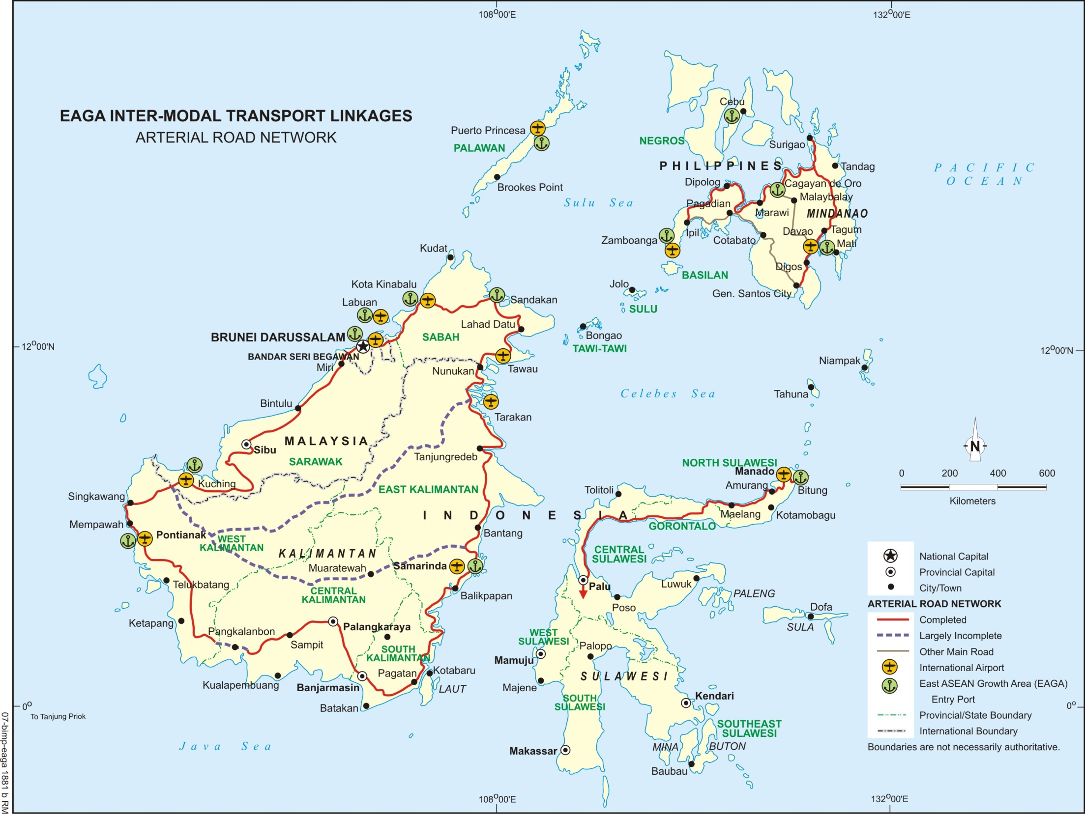
BIMP-EAGA Priority Connectivity Projects
Expansion of Mindanao Ports Programs
- Zamboanga
-Bongao and
Sitangkai
-Davao
General Santos
Glan
Palawan Ports Development Program
Puerto Princesa Port
Brooke’s Point Port
Pandaruan Bridge (completed)
Kuala Lurah Border Crossing
-Davao-General Santos Road
- Zamboanga-Pagadian Road
Manado-Bitung Link
-Manado Port Expansion
Tanjung Selor Border Road
3 port programs
3 road projects
1 border crossing
project
1 bridge project
Pontianak-Entikong Link
Rehabilitation of 150 km road
Notes:
17

Slide 18
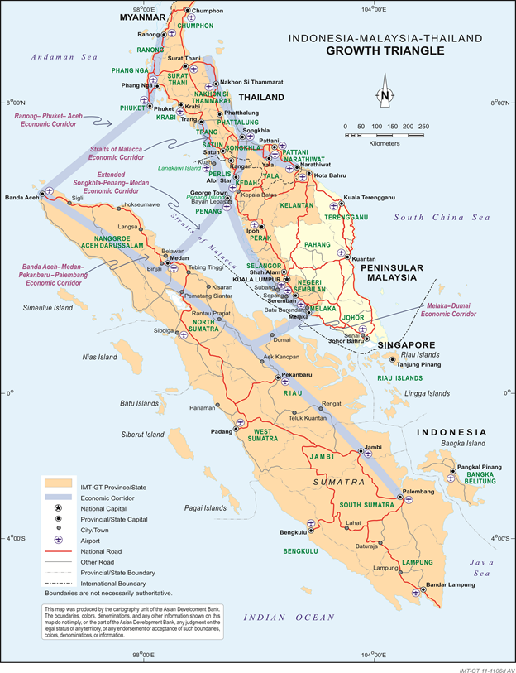
The IMT-GT Program
Participating Countries: Indonesia, Malaysia and Thailand
Strategic Priorities: A seamless, progressive, and peaceful subregion with improved quality of life
IMT-GT Priority Connectivity Projects under the IMT-GT Implementation Blueprint exceed $5.2 billion
Notes:
The GMS Economic Cooperation Program began in 1992, covering Cambodia, Lao PDR, Myanmar, Thailand, Viet Nam, and the People’s Republic of China (PRC) (then specifically the Yunnan province and later on, also the Guangxi autonomous region).
From its inception, the underlying strategy was to link the GMS countries through improvements in infrastructure, thus overcoming domestic constraints and promoting trade and investment to boost economic growth. The overall vision is of a more integrated, prosperous, and harmonious subregion. This vision can be summed up by the “3Cs”: enhanced connectivity, improved competitiveness, and a greater sense of community.
Connectivity through the development of subregional transport, power, and telecommunications infrastructure.
Competitiveness through transport and trade facilitation, development of logistics systems, regional power trade, harnessing of ICT, cross-border agricultural trade, and promotion of the GMS as a single tourist destination.
A sense of community through jointly addressing shared social and environmental concerns, such as the prevention and control of communicable diseases, and the protection of the subregion’s rich biodiversity and ecosystems.
As of the end of December 2013, 69 priority projects worth around $16.8 billion have either been completed or are being implemented. For these projects, ADB has provided loans/grants amounting to almost $6.1 billion, while GMS governments have provided around $4.6 billion. Contributions of cofinancing partners and the private sector amounted to $6.2 billion.
A total of $330 million of grant resources have been mobilized for 192 regional technical assistance (RETA) projects, of which $115.1 million has been provided by ADB, for project preparation, capacity development, policy advisory and studies on various areas of GMS cooperation. ADB has played the role of lead development partner, coordinator, and honest broker in the GMS Program.

Slide 19
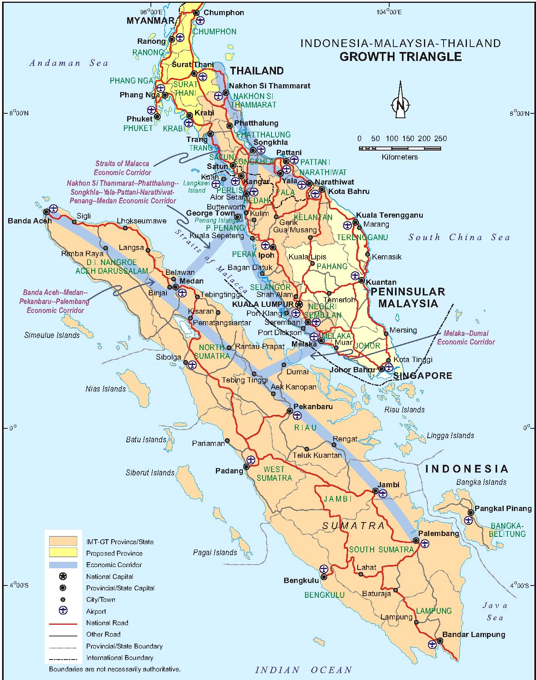
IMT-GT Priority Connectivity
Projects
Southern Thailand Ports Development Program
-Phuket Port
-Greenfield Development of Naklua Port
S. Region CDC Thungsong
ICQS Bukit Kayu Hitam
Hat Yai-Sadao Toll Road
Melaka-Pekanbaru Power Interconnection
Development of
Aceh Highway
Facilities
-Bandah Aceh-
K.Simpang
Melaka-Dumai Economic Corridor Multimodal Transport Project
-Dumai Port
Pekanbaru-Dumai Road
Sumatra Ports Development Project
-Ulee Lheue Port
Malahayati Port
Belawan Port
Kuala Enok Port
Sumatra Toll Roads Project
-Palembang and
Indralaja Toll Road
-Highway from Bandar
Lampung to Bakahuni
Notes:
The location of the eight priority IMT-GT connectivity projects are shown on the map.

Slide 20
Thank you

