Slide 1
Urban Economy in Sarit’s Era
Thai Economic History
Thorn Pitidol
1/2017

Slide 2
Topics
US Capitalism and Sarit's Development
Banks and Capital Mobilisation
Import-Substitution and Foreign Investment

Slide 3
US Capitalism
From 1950-1970, the world entered two decades of economic and trade boom
  Driven by the growth in US and Europe, world demand for primary produce expanded
  Capital became more internationally mobile
Rising international trade, capital inflows, and US intervention in SEA had dramatic impact on Thai economy

Slide 4
US Capitalism
US political intervention as context for economic intervention
  The best recipe for anti-communism is strong gov't and economic growth based on private capital
US pressed Thai military leaders to start econ.dev based on support for capitalism, and Thai military leaders responded enthusiastically
  They were already partners to local capital
  Facilitating the Thai economic adjustment was the US’s aids.

Slide 5
Sarit's Development
While Phibun was ambivalent in following the US, Sarit differed
  Sarit’s rise came from US support to the military.
  Sarit also involved in arms deals and in setting up his own businesses such as in shipping, construction, insurance, shipping, etc.

Slide 6
Sarit's Development
Sarit’s arguments
  Thailand needed a stable anti-communist regime to gain more US aid.
  Justified his coup as a preparation for launching a plan of "national development"
Under Sarit, the strategic interests of the US, the dictatorial aim of Thai military, and the business interests of Thai new entrepreneurs converged

Slide 7
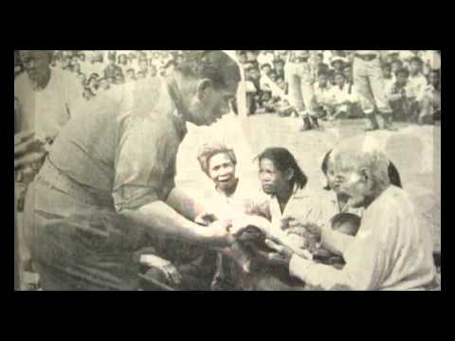
Sarit's Development
Sarit’s"our important task in this revolutionary era is development".
“งานคือเงิน เงินคืองาน บันดาลสุข”
“น้ำไหล ไฟสว่าง ทางดี”

Slide 8
Sarit's Development
Sarit started major restructuring of Thai economy
  The restructuring began with the World Bank's report
    SOEs collapsing, operating at losses or debt.
    The World Bank recommended the scaling down of SOEs, promoting manufacturing under private ownership by improving legal framework, infrastructure, and credit system, and by establishing institutional structure for econ.dev.
World Bank's recommendations were adopted. No more SOEs created except for public utilities.

Slide 9
Sarit's Development
Institutional and physical infrastructure
  Budget Bureau, National Statistical Office, NESDB, and BOI. These organisations staffed with US trained bureaucrats.
  World Bank also provided funding for building highways, irrigation, electricity, and education.
1st-3rd National Development Plan drafted with US advisers, prioritising growth driven by private sector.

Slide 10
A New Strategy for Growth
The shift to support foreign investment.
  Creation of BOI, and Investment Promotion Act, to provided tax and tariff incentives to promote local and foreign investors.
  Foreign firms gain more favourable treatment, allowed to repatriate profit and occupy land.
  Labour unions suppressed.

Slide 11
A New Strategy for Growth
Tariff protection to protect domestic manufacturers of consumer goods.
  Under the pressure from domestic capitals.
  Tariff on capital goods were set low, while tariff on consumer goods high.
  Wages were kept low to help domestic industries, facilitated by supply of labour from booming population.

Slide 12
A New Strategy for Growth
Technocrats in BOT and MOF prioritised economic stability with tradition of conservative fiscal management and support for open economy.
  External aid and loans helped fiscal deficit and limited inflation.
  Stable growth came at 6.6% without much inflation.
  The new strategy was successful in drawing in foreign investments.

Slide 13
A New Strategy for Growth
Impact of the new strategy
  Rising world's demand for primary goods caused boom in Thailand's export of primary commodities.
    From 1960-75, agri.exports rose 10% per year.
  Tariff regime, the end of econ.nationalism, and the better infrastructure, provided incentives for Thai capitals to expand in domestic markets, especially in the countryside.
  Foreign firms flew in but did not substitute local firms. Most chose instead to partner with local firms.

Slide 14
Banks and Capital Mobilisation
Banks formed in 1940s rose to dominance
  The rise based on the role in mobilising capitals for emerging businesses
  Chinese immigrants the main beneficiaries.
    For generations, had remained small business. Significant portion of money used to be sent back to China, small amount invested in pawnshops.
  The banks provided them with location for savings.
    Gov't restrictions and problems in China led to fallen remittance and channeled the saving to banks.
    Between 1962-81, total deposits in Thai Banks grew from 8 millions to 299 million bahts.

Slide 15
Banks and Capital Mobilisation
The rise of Thai banks also helped by other two factors
1) political connections
  From 1950s, all of Thai major banks had forged close links with Thai military leaders.
    Example: Bangkok Bank with Ratchakru group
  The connection led to laws made to prevent new entrants and foreign competitors in banking sector.
  Banks' cartel created and not challenged for 3 decades.

Slide 16
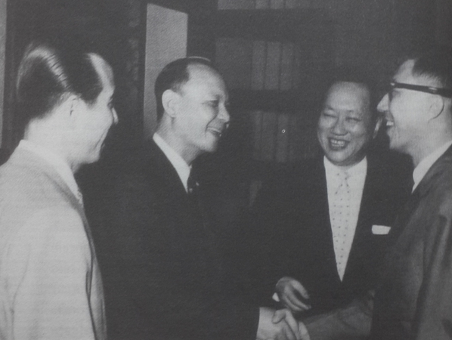

Slide 17
Banks and Capital Mobilisation
2) the extensive business networks.
  Successful banks had extensive connections within local and overseas business communities.
  The major banks came from dominant Teochiu group. They competed but also cooperated in the Chamber of commerce. They forged relations through marriage.
  Many had relatives in other Asia's business cities.
  Beyond providing funds, they also provided business services to client by helping them build business alliances, brokered deals, and found markets.

Slide 18
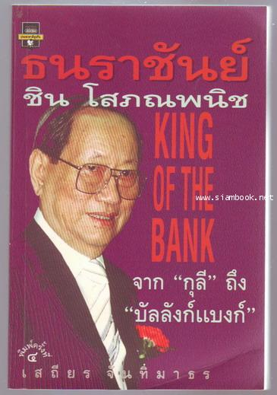
Chin Sophonphanich
Dominant role based on extensive network with Chinese communities through trading activities and from organising the sending of money back to China
Built Bangkok Bank overseas branches, and created network with leading Chinese entrepreneurs throughout the region

Slide 19
Banks and Capital Mobilisation
The banks dictate the economic expansion in Sarit's era, enabling hundreds of companies to emerge.
Bangkok Bank dominated the task of promoting new ventures.
  As the rice trade was released from gov't control, Bangkok Bank helped the rice trading familties with new opportunities such as in the textile industry.
  Bangkok Bank also facilitated the expansion of agribusiness, most notably that of CP.

Slide 20
Banks and Capital Mobilisation
Kasikorn Bank continued to play key role in crop exports. They expanded their business to joint venture with foreign firms such as Dole and Firestone.
  Other banks also expanded their own businesses into other sectors especially in manufacturing.
The number of firms that the banks were involved with grew significantly.
  In 1958, BKK Bank, K-Bank, Bank of Ayudhaya, and Union Bank involved in 51 firms. In 1973, the number became 173, and in 1979, 295.
  BKK Bank financed 42% of total export and 26% of imports.

Slide 21
Banks and Capital Mobilisation
The importance of connection with banks and military generals
  Sukree Potiratanangkun textile business strarted from securing contract as a military supplier.
  Thaworn Pornprapa's Nissan benefited from gov't decreed that taxis must be Nissan.
  Uthane gained monopoly in distilling whisky
  Kirati Srifuengfung glass making business started through connection with ratchakru group.
In return, the generals held positions in extensive amount of private firms.

Slide 22
Import-substitution
With growing domestic market, cheap labour, gov't assistance, and foreign investment, industry began to grow.
Major areas of expansion
  Agri-processing
  Basic manufacturing such as textile
  Variety of assembly industries supplying consumer goods to domestic market.

Slide 23
Import-substitution
The expansion of agri-business
  Rice business revived after freed from state's control, benefitting from better irrigation, high-yield seeds, and better cultivation system.
  The major rice trading families entered new crops such as cassava, and also new opportunities for processing such as silos and warehousing.
  Metro group started manufacturing fertilizer.

Slide 24
Import-substitution
Suger-milling and feed-mill.
  Big sugar milling firms -Thai Roong Ruang, Bangpong, Kwang Soon Lee, and Mitrphol- expanded rapidly and formed cartels.
    Export of suger increased more than ten times.
  With massive growth in production of maize and cassava, forms moved into feedmill business.
    Betragro and CP

Slide 25

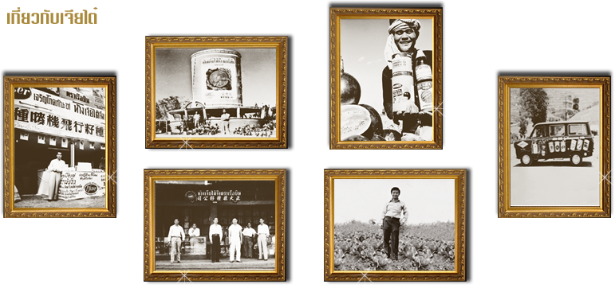
http://www.cpthailand.com/CPGROUP/History.aspx

Slide 26
Began as importers of seeds, fertilizers, and other agricultural inputs.
Later moved into feedmill and other livestock business
Joint venture with a US company to start a chicken industry.
As the Thai gov't ended its monopoly on slaughterhouse, CP created integrated chicken business. It used the contract farming system and expand its business to other animals.
CP set up range of associate companies covering all aspects of its agro-business and expand to other countries.

Slide 27
Import-substitution
New manufacturing industries founded in 1960s under tariff protection
  Glass factories, cement works, iron and steel plants, and paper manufacturing.
The most important was textile.
  By 1979, textile accounted for 19% of value added in manufacturing, and 6% of export.
For the entrepreneurs of the new industries
  Started from being trader and importers, then moved into manufacturing as a result of tariff protection and gov't incentives.

Slide 28
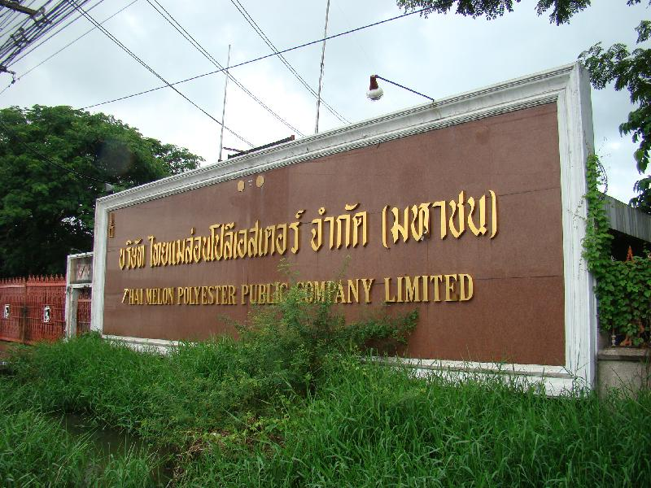
Sukree’s Textile
Sukree started textile business from being importer. He grew through joint venture of Japanese forms and once owned largest textile enterprise in SEA.

Slide 29
Import-substitution
The tariff structure levied high rates on finished goods while low rates on parts and components encouraged assembly business for domestic markets.
  Assembly operations for consumer goods such as household durables and automobiles.
  Firms joined with overseas supplier to manufacture products under tariff walls.
  Example: Pornprapa's Nissan "Siam Motors“ and other automobile joint venture such as Toyota, Mazda, Mitsubishi.

Slide 30
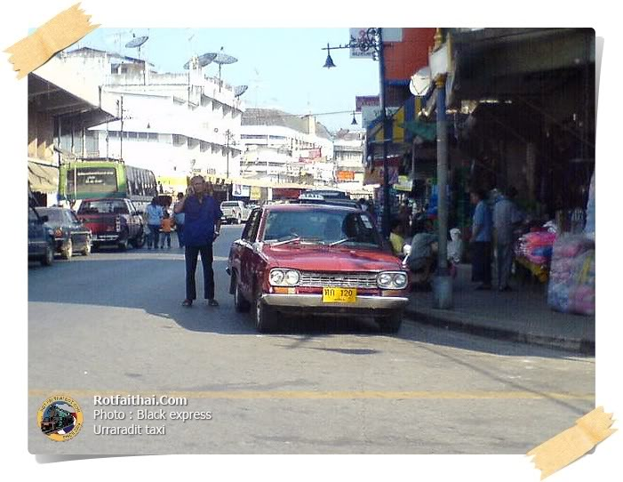
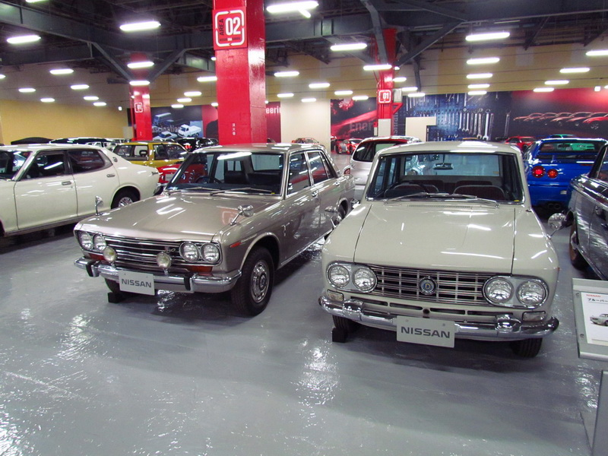
Pornprapa’s Nissan

Slide 31
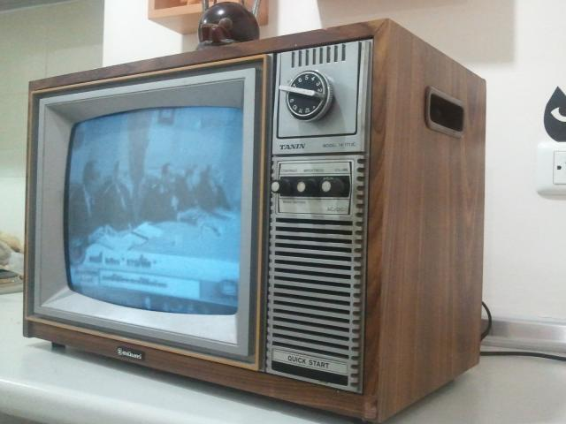
Import-substitution
Joint ventures between importers and foreign firms also emerged in assembly operation of consumer durables such as radios and TVs.
  Tanin

Slide 32
Foreign investment
The final aspect of Sarit's restructuring of Thai economy was foreign investment.
  Through investment promotion regulations, foreign investment flew in at 1 billion baht a year in late 1960s, and around 1.5 billions a year in 1970s.
  The first investors were from US, who invested in 100% ownership in areas such as petroleam and chemical businesses.
  Then Japanese investments started to grow in late 1960s, surpassing the US in 1973. Thailand's trade with Japan also rose significantly during the same time.

Slide 33
Foreign investment
At first, Japanese’s role in Thai economy provoked tension among technocrats and businessmen.
  Japanese gov't reduced tension by reducing duties on many Thai goods, increasing loans to Thai gov't
  Japanese gov’t also encouraged joint ventures between Japanese and Thai firms.
  Japan increased aids to Thailand. By 1980s, Japanese aids amounted to 2/3 of all aids Thailand received.

Slide 34
Foreign investment
Japanese investments in this period were of two types.
  First, tariff jumping assembly operations, mainly in the area of consumer products.
  Second, investment in manufacturing for exports, mainly back to Japan.
Japanese investments accelerated by the rising wage in Japan, causing Japanese to look for cheaper labour elsewhere.

Slide 35
Foreign investment
Japanese investments in Thailand started in textile businesss through joint venture.
In contrast to US investors, Japanese investors often choose the path of joint-venture.
  Partly due to them wanting to avoid political opposition. And also due to the gov't requiring foreign investors (other than US) to have a Thai majority partner.
  Also Japanese firms wanting to use domestic firms to gain access to knowledge about local market.
  Joint venture also helped Thai firms gained knowledge and technology transfers

Slide 36
In sum
Sarit’s development era came with business opportunities enabled by tariff protection, better raw material supply, foreign assistance and technological transfer, political connections, and capitals provided by banks.

