Slide 1
Trade and development
EE463 Globalization and international development
Faculty of economics
Thammasat university

Slide 2
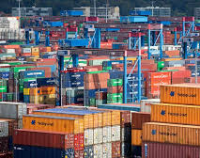
overview
World trade has increased four-fold during the past 30 years; open trade benefits developing countries, generating economic growth and reducing poverty
While trade provides opportunities for economic growth and many developing countries are expanding their trade, there are winners and losers in the process
Exporters may face risk of falling prices or other events beyond their control

Slide 3


overview
With cheap imports, firms and farmers producing at high prices for domestic consumers can be forced out of business
Weather occurrences affect trade: excess surplus drives commodity prices down; however when crops fail, prices go up
Multilateral trade is often biased against less developed countries, whereby rich countries protect their agricultural and textile producers while forcing developing countries to open their economies

Slide 4
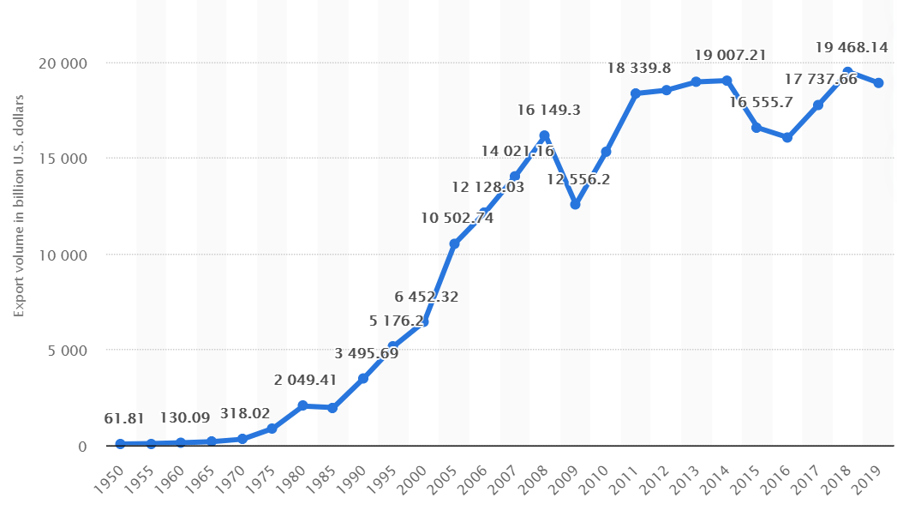
World trade: export volume, 1960-2019
World trade increased steadily since 1985 with collapse of the Soviet Union and various economic reforms undertaken worldwide
Increase in worldwide trade: $2 trillion in 1985 to $19.5 trillion in 2018

Slide 5

Trade trends and patterns
The bulk of world trade occurs among high income countries
Trade has moved beyond finished goods. For example, a single car contains around 30,000 components such as the car seats, glass, electrical parts, mechanical parts, and tires
There are more regulations governing trade; formation of WTO in 1995 broadened international rules for trade beyond goods and tariffs to regulations, services and intellectual property rights

Slide 6
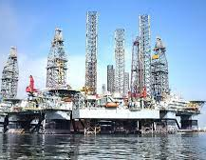
Trade trends and patterns
There has been a significant growth in exports from low- and middle-income countries:
China (late 70s), since its reversal policies towards outward-looking trade strategy
Korea, Taiwan, Hongkong and Singapore (early 60s): export orientation strategies
Mauritius: primary export was sugar cane (1975); manufacturing share of exports increased from 12% to 81% (2000)
As economies grow and trade increases, imports and exports tend to change as well

Slide 7
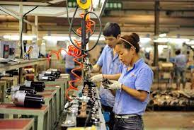
Trade trends and patterns
On imports: as incomes increase, countries typically import higher quality and sophisticated goods
On exports: workers gain new skills and increase productivity; composition of exports shift from primary commodities to manufacturing products and services
Over the past 30 years, East Asia, South Asia, and Latin America countries have replaced primary product exports with manufacturing

Slide 8
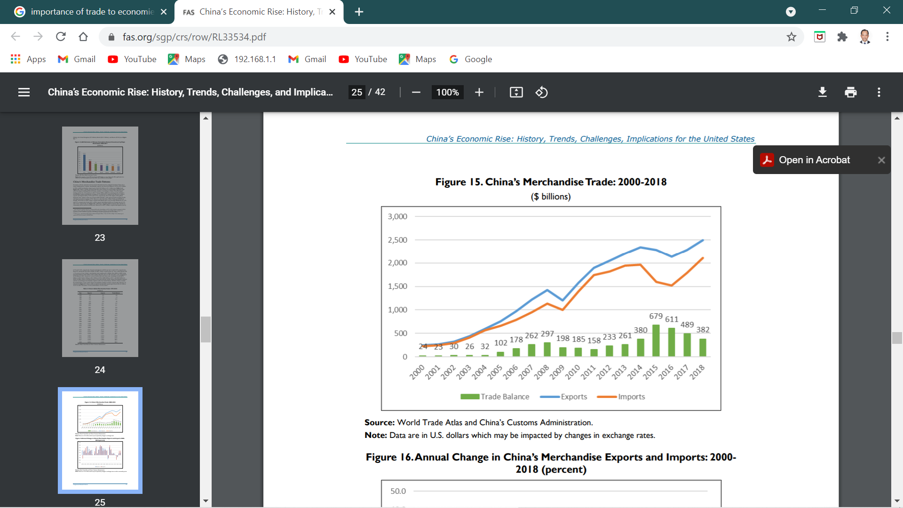
Trade patterns: PR China
Economic reforms and trade and investment liberalization have helped transform China into a major trading power; from 1979-2018 exports rose from $14 billion to $2.5 trillion, while imports grew from $18 billion to $2.1 trillion
From 2000 to 2008, the annual growth of China’s merchandise exports and imports averaged 25%
Due to the 2008 global financial crisis, annual growth of exports and imports fell by 15%

Slide 9
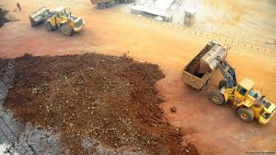
Trade patterns: PR China
In 2010 and 2011, trade recovered with export and import growth averaging 28% but fell to 5% thereafter, reflecting sluggish global economic growth due to a decline in commodity prices (oil, ores)
In 2012, China overtook the United States as world’s largest merchandise trading economy
China’s imports and exports began rising again since 2017;
China’s abundance of low-cost labor has made it internationally competitive in many low-cost, labor-intensive manufacturing

Slide 10
Trade policies
Import substitution: focuses on the production of goods and services that replace or substitute imports; increases national pride, however this may not be cost effective
Export orientation (export-led growth): focuses on production for exports or global markets; however it is sensitive to global economic/financial fluctuations

Slide 11
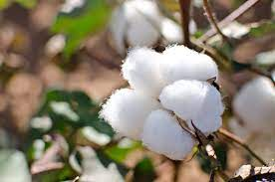


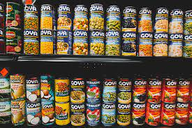


Export-led growth
Benefits of primary products export is the possibility of stimulating production in other, related sectors; exports would therefore lead to more broad-based economic growth
Backward linkage: the growth of one industry (e.g., textiles) stimulates domestic production of an upstream input (cotton)
Forward linkage: the growth of one industry stimulates the production of downstream industries (apparel, garment)
backward linkage
forward linkage

Slide 12
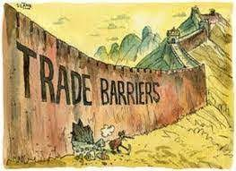
Trade barriers
Trade barriers are government-induced restrictions on international trade which decrease overall economic efficiency
Trade barriers are generally imposed to protect domestic industries; several forms of trade barriers are:
Tariff barriers: taxes on imported goods
Non-tariff barriers: import quotas, embargos, national regulations, involuntary export restraints, trade restrictions, and subsidies, and local content requirements

Slide 13




Comparative advantage
A country increases its welfare by trading because the world market provides opportunity to buy and sell goods at better prices
The smaller the economy, the greater the potential to be gained by trade
A country gains most by exporting commodities that it produces using abundant factors of production while importing goods whose production requires relatively scarcer factors of production

Slide 14

Benefits of trade
Trade exposes domestic firms to competition; in small economies, there are a limited number of producers which could exercise market/monopoly power and charging more for their goods; with international trade they have to compete and therefore prices will go down, society benefits
Trade enables transfer of technology and raise productivity, particularly when intermediate and advanced goods are involved

Slide 15

Benefits of trade
Trade increases not only the amount of goods a country can consume, but also the quality and variety of goods available; cell phones and computers are examples
Trade brings people into contact with one another; it may promote global understanding, democracy and prosperity

Slide 16

Winners and losers
Distributional aspects of trade: although every country can gain from trade in the aggregate, not all groups or individuals in a country stand to gain
Therefore there are winners and losers in the process of international trade
Winners: large companies, consumers
Losers: domestic producers, labor, middlemen

Slide 17
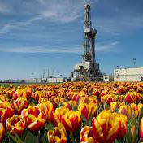
Dutch disease
A nation’s increased earnings from booming primary export prices which causes adverse effects on the economy
Netherlands, 1960s: discovery of reserves of natural gas fueled an oil boom, resulting in a large export boom and bringing in foreign exchange and economic surplus
Netherlands, 1970s: rising inflation, declining manufacturing exports, lower rate of economic growth and rising unemploymemt
Other countries experiencing Dutch disease: Mexico, Nigeria, Saudi Arabia (oil); coffee booms in Africa

Slide 18
summary
World trade has grown rapidly during the past three decades; trade among high income countries dominate world trade
The share of trade in GDP tends to be higher for smaller economies; as economies grow, the composition of trade tends to change, whereby exports shift from primary products towards manufactured goods
International trade encourages competition and reduces the market power of domestic firms, facilitates the adoption of new technologies, can facilitate investments and increase the quantity and quality of available goods
However trade is not without costs; there are both winners and losers. In the aggregate, however, countries benefit from trade

