Slide 1
National Account in Matrix Formats
Nattapong Puttanapong, Ph.D.
(for EE 459 – lecture #3, August 22nd 2012)

Slide 2
Classification of Matrix Accounting
Social Accounting Matrix (SAM)
Supply and Use Table
Input – Output Table (IO Table)

Slide 3
Circulation within the economy

Slide 4
Structure of SAM Table
 | AGR-A | NAGR-A | AGR-C | NAGR-C | LAB | CAP | U-HHD | R-HHD | TOTAL
AGR-A |  |  | 225 |  |  |  |  |  | 225
NAGR-A |  |  |  | 250 |  |  |  |  | 250
AGR-C | 60 | 40 |  |  |  |  | 50 | 75 | 225
NAGR-C | 40 | 60 |  |  |  |  | 100 | 50 | 250
LAB | 62 | 55 |  |  |  |  |  |  | 117
CAP | 63 | 95 |  |  |  |  |  |  | 158
U-HHD |  |  |  |  | 60 | 90 |  |  | 150
R-HHD |  |  |  |  | 57 | 68 |  |  | 125
TOTAL | 225 | 250 | 225 | 250 | 117 | 158 | 150 | 125
Production Outputs
Input – Output
Table
Consumption
Expenditures
Value Added
Factor Incomes

Slide 5
SAM Exercise : Income and Expenditure Tables
PRODUCTION (FIRMS)
CONSUMPTION (HOUSEHOLDS)
EXPENDITURE
EXPENDITURE
 | AGRI activity (AGR-A) | NON-AGRI activity (NAGR-A)
AGR-C | 60 | 40
NAGR-C | 40 | 60
LABOR | 62 | 55
CAPITAL | 63 | 95
TOTAL | 225 | 250
 | URBAN-HHD (U-HHD) | RURAL-HHD (R-HHD)
AGRI Commodity (AGR-C) | 50 | 75
Sales of NON- AGRI Commodity (NAGR-C) | 100 | 50
TOTAL | 150 | 125
INCOME
INCOME
 | AGR-A | NAGR-A
AGRI Commodity (AGR-C) | 225
NON- AGRI Commodity (NAGR-C) |  | 250
TOTAL | 225 | 250
 | URBAN-HHD (U-HHD) | RURAL-HHD (R-HHD)
LABOR | 60 | 57
CAPITAL | 90 | 68
TOTAL | 150 | 125

Slide 6
SAM Exercise : Completing SAM Table
 | AGR-A | NAGR-A | AGR-C | NAGR-C | LAB | CAP | U-HHD | R-HHD | TOTAL
AGR-A
NAGR-A
AGR-C
NAGR-C
LAB
CAP
U-HHD
R-HHD
TOTAL

Slide 7
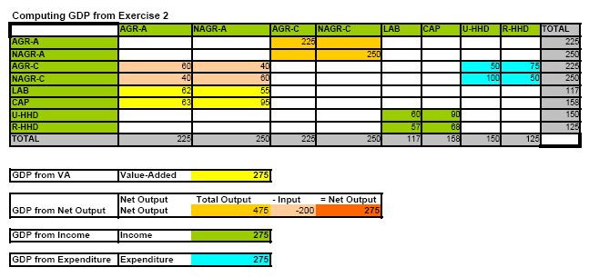

Slide 8
Gross Domestic Product
Gross Domestic Product
Main measure of economic activity and growth
Can be measured in three ways:
Output = Expenditure = Income or GDP(O) = GDP(E) = GDP(O)
Supply = Demand:
Domestic Production + Imports = Household Expenditure + Intermediate Consumption + Capital Formation + Exports + Change in Stocks
GDP(O) = GDP(E)
Domestic Production – Intermediate Consumption = Household Expenditure + Capital Formation + Change in Stocks + Exports - Imports
GDP(I) = wages and salaries + profits
Main measure of economic activity and growth
Can be measured in three ways:
Output = Expenditure = Income or GDP(O) = GDP(E) = GDP(O)
Supply = Demand:
Domestic Production + Imports = Household Expenditure + Intermediate Consumption + Capital Formation + Exports + Change in Stocks
GDP(O) = GDP(E)
Domestic Production – Intermediate Consumption = Household Expenditure + Capital Formation + Change in Stocks + Exports - Imports
GDP(I) = wages and salaries + profits

Slide 9
Compilation and Balancing in Matrix Format
  Each component can be measured separately, annually, quarterly or monthly
  Results in three different estimates of GDP
  Data confrontation exercise, known as ‘GDP balancing’ to reconcile these estimates
  Results in one ‘best’ estimate of GDP

Slide 10
2.Supply and Use Tables
Enables data reconciliation at a more disaggregated level:
  GDP(O) and GDP(E) by product
  GDP(O) and GDP(I) by industry

Slide 11
2. Format of Supply and Use Table

Slide 12
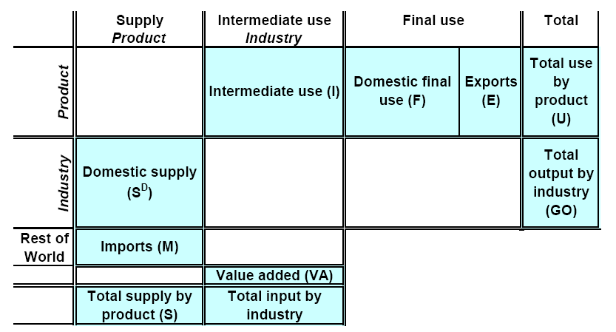
2. Format of Supply and Use Table

Slide 13
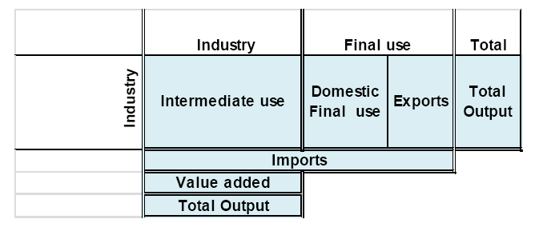
3.Format of Input – Output Table
One country format

Slide 14
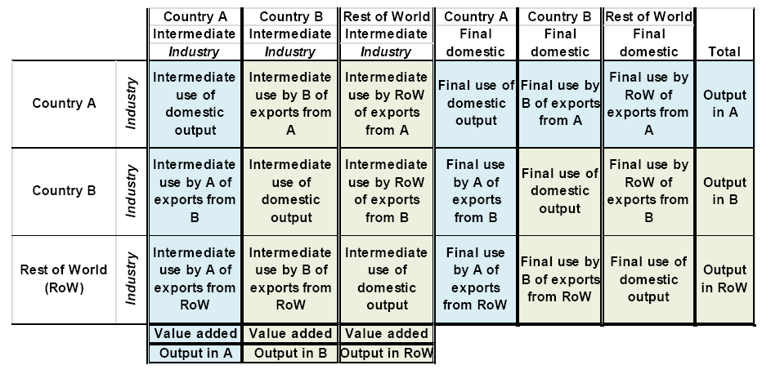
3.Format of Input – Output Table
Format of 3-coutry IO Table

Slide 15
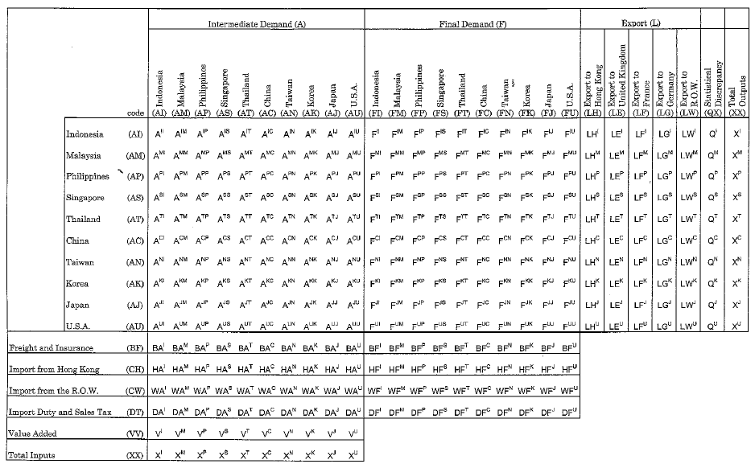
ASEAN+3 - Year 2000 IO Table – Intraregional analysis
Structure of Asian International Input-Output Table

Slide 16
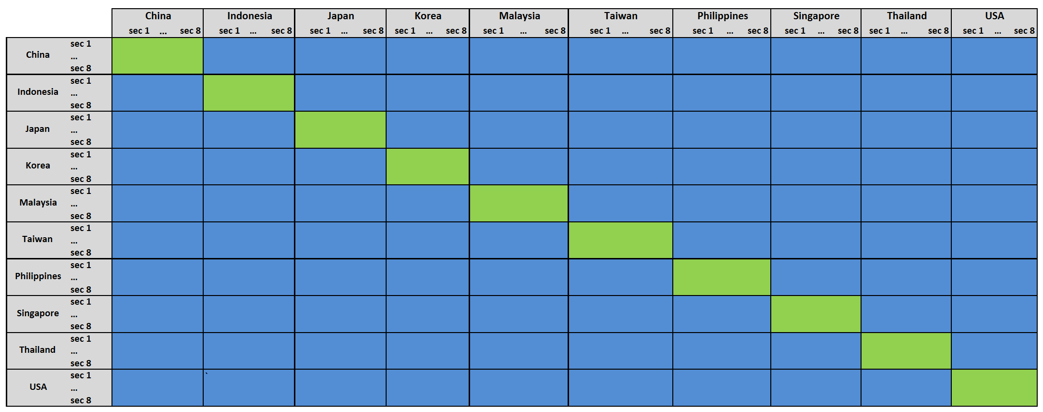
ASEAN+3 - Year 2000 IO Table – Intraregional analysis
Matrix and sub-matrices of multiregional Input-Output table
Multipliers of bilateral influence
Multipliers of domestic influence

