Slide 1
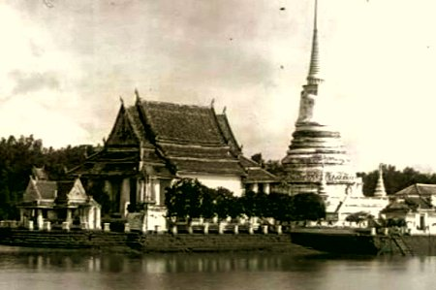
“Sukhothai and Ayudhaya”
TU111 Thai Civilization
Dr.Wankwan Polachan

Slide 2
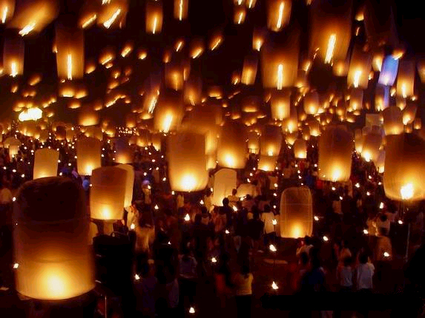
Sukhothai

Slide 3
Sukhothai
When Mengrai, Ngam Muang of Phayao, and Ramkhamhaeng of Sukhothai meet and concluded their alliance against Mongols in 1287
- Sukhothai had the land that equal of Mengrai’s Lanna in the north
Two elements critical to the history of the Tai in central Siam during the 13th century
- substantial population were established throughout the central Plain
- substantial exposure to the society, culture, politics of the old Angkorian Empire
Intermarriage with the indigenous ruling elite must have been an important means for Thai princes to rise to power (indigenous = Khmers, Mon)
- Ex. Khmer Empire period; Tai princes and local chiefs of the Chaophraya valley were subdued by Angkorian and given official titles and even brides to bind them to the empire

Slide 4
Sukhothai
Pha Muang (angkorian King conferred the title of Sri Indraditya) lord of the small principality of Muang Rat (near Uttaradit)
Later on (≈1240) gathered with troops, joined with a neighboring Siamese ruler, Bang Klang Hao of Muang Bang Yang (near sukhothai) who had not submitted to the Khmer.
- Marched on the main Khmer outpost in the region of Sukhothai
- The Khmer were defeated
- Pha Muang then entered the city and presided as King of Sukhothai
In his reign, Sukhothai remained only a local power on the fringes of the old imperial plain. He seems not to have been concerned with any threat from Angkor, but rather from other neighboring Tai princes, such as the ruler of Sot (Mae Sot)

Slide 5
Sukhothai
In Sot’s and Pha Muang’s battle, Sri Indraditya’s troop fled the battlefield in confusion, the king’s nineteen-year-old son Rama held the ground, pushed through the commander of the attacking forces and defeated him
- earning the epithet “the bold”
- thus, “Ramkhamhaeng” = Rama the bold
When Rankhamhaeng became king of Sukhothai in 1279, the kingdom was quite small (possibly = present-day Sukhothai, Uttaradit, Kamphaengphet, and Tak)
He got firm grip on power in Sukhothai
- his reputation in battle gave him some standing among the Tai neighborhood to the north
- He also had some standing to the south through his mother and by his marriage into the ruling families of the south

Slide 6
Sukhothai
The time was right for a young man with ambitions and connections
- Angkor was clearly diminished
- Mangrai was in the process of forming a major empire to the north
Ramkhamhaeng concentrated his efforts on the zone of greatest opportunity and avoided conflict with his Tai neighbors (to the north: Mangrai, Ngam Muang; and to the south: Nakhon Si Thammarat, Lopburi)
- An inscription of 1292 (ศิลาจารึก – p.54)
In this self-advertisement,
- he painted a picture of an idyllic kingdom free of constraints
- presided over by a just, benevolent and thoroughly accessible monarch beloved by his people
- he was a “Lord Father” as the social relationships connote a familial style
- there is an implicit contrast drawn between his paternal benevolence accessibility (Sukhothai) and rigid social hierarchy, arbitrary administration of justice, heavy taxation (Angkor)

Slide 7
Sukhothai
Ramkhahaeng seems to have been anxious to present an alternative form of government, one that was Tai.
He presents himself as one who respected animistic spirits that populated the supernatural world, as a devout Buddhist, promoted the cause of the religion and supported the monkhood
Sukhothai was then a Buddhist state, a monastic community
The people observed Buddhist precepts and celebrated the ceremonies of the religious calendar
On the throne, the king heard his subjects’ petitions and at the same time, he learned Dhamma of the Buddha from weekly learned monks’ preaching
- king and monks shared the same throne Buddhism and state were closely identified
The state was Buddhist, but the religion was also political

Slide 8
Sukhothai
Ramkhamhaeng built an extensive kingdom by a judicious combination of force and diplomacy
- He raided towns and villages, captured elephants, metals, and prisoners whom he did not kill, but encouraged to make their submission to him
The geographical extension 0f Sukhothai’s power, which was matched in later centuries by the Kingdom of Siam, Ramkhamhaeng certainly did not raise a massive army and march several thousands of miles (voluntary submission, rather than conquest)
Ramkhamhaeng’s power, compounded of military strength and moral prestige radiated outward from the capital, and those who recognized his leadership submitted to him

Slide 9
Sukhothai
Vassals, unlike Chinese system, political loyalties in the Tai world tended to be personal
- Ex. Ruler of Nakjon Sri Thammarat owed personal allegiance to the ruler of Phetburi, who owed it to the prince of Suphanburi, who himself submitted to Ramkhamhaeng
- means, all but the core of the kingdom remained separated into the small muang units, each with its own rulers, the relationships between local rulers and the king were defined by the relative power of the individuals concerned and confined to the duration of their lifetimes
Ramkhamhaeng’s Sukhothai is remembered as much for its art and ideas as for its political achievements
- Ex. Image of the Buddha bear the distinctive stamp of Tai physiognomy (waiting posture are cast with such a flowing grace that they seem to move before the observer’s eye)
- major monuments constructed remains ‘til present

Slide 10
Sukhothai
People of Sukhothai were uniquely creative. Remaining true to their own Tai traditions.
- Their art was strongly influenced by Ceylon and Nakhon Si Thammarat, and they imported potters from China who created brilliant works in celadon and the famous Sankhalok ceramics
Sukhothai art, like Sukhothai life, was a thing of its own, more than eclectic and distinctively Siamese
Sukhothai had transplanted from the upland valleys to the edge of the great Chaophraya plain
There was relatively little social and political differentiation
- the division between chao and commoners based firmly on “personal”
The environment in which Sukhothai was set, was a new one. There were considerable non-Tai populations, Mon and Khmer communities and posed political problems

Slide 11
Sukhothai
Ramkhamhaeng, thus, encouraged Siamese Tai, the language he claims have invented in 1283, to be the language of administration and prestige
- “a script that made the written, tonal tai language comprehensible to the speakers of non-tonal language”
Brahmanical religion was given court patronage
Court sculptors even fashioned bronze images of Vishnu and Shiva in a style similar to that expressed in Sukhothai’s Buddha images
Ramkhamhaeng did not centralize all powers, although his muangs held together by pyramided personal loyalties, he suggested in his inscription, his power rested upon his moral authority and leadership

Slide 12
Sukhothai
On his death in 1298, his son Lö Thai succeeded him, the vast empire rapidly disintegrated
a. Sukhothai’s dominion to thenorth of Uttaradit collapses almost immediately
b. Luang Prabang, Vietianne and the middle Mekong similarly slipped into independence
c. Mon no longer recognized Sukhothai’s suzerainty
d. Tak had fallen under the sway of Lanna
By about 1320, Sukhothai again become a small kingdom of local, rather than regional significance

Slide 13
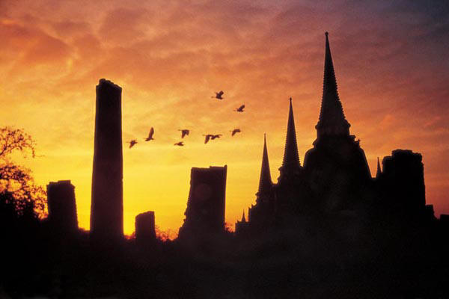
Ayudhaya

Slide 14
Ayudhaya
In the middle of the 14th century, Tai principalities now filled the map across the central and northern reaches of mainland S/E Asia but only “Lanna” at Chiang Mai could be dignified with the title Kingdom
In the next two centuries, one major Tai empire emerged, the Kingdom of Ayudhya, and it became a regional power of the first importance, Two Tai competitors challenged its ambitions to lead the Tai world
- a revived Kingdom of Lanna
- the new Lao Kingdom of Lan sang centered on Luang Prabang

Slide 15
Before Ayudhaya
The traditional Tai states:
- operated within limited horizons
- over restricted territories
- with a narrow range of political and military skills
- rulers were little concerned with the affairs of the non-Thai world
- the state consist of only a few muang, each with its few dozens of villagers scattered among the hills and valleys of upland S/E Asia
- ruled on a small and personal scale
- seldom troubled by incursions of the major empires: China, Vietnam
However, later on when the Tai rules assumed imperial pretensions and ambitions, they had to make a radical shifts in the ways of looking at and organizing their world, internally and externally
- “To gain recognition as great powers”

Slide 16
Before Ayudhaya
To accomplish, the new Tai empires had to create new identities for themselves, for the sake of internal cohesion and of external recognition
“They were confronted by international standards of behavioral and values that the outside world employed to distinguish between civilized and barbarian people, between states and tribes, between kings and chieftains
Unlike the Westernization and modernization of many century later, new standards could be viewed as foreign and inimical to Tai values: bureaucratic administration, codified, impersonal law, the state-organized and taxed economy; were all rejected as alien, as they had been by Ramkhamhaeng
They welcomed useful ideas – viewed as being no more than new and improved political administrative technology

Slide 17
Before Ayudhaya
Civilization was ultimately Indian in origin
Theravada Buddhism was becoming so popular in the region, like Buddhism, the new standard of civilization were hardly new to the region, having over several centuries been upheld by the classical empires and integrated into the live of the first immigrant Tai communities
Now Tai groups expressed their heightened ambitions in the strongest manner possible, by staking a claim to leadership within the new system
It was the moment for the Tais, the major wmpires were in some disarray
- Mongol in China was slipping into the decline that in 1368 would bring the Ming dynasty to power
- vast confederation of Ramkhamhaeng’s Sukhothai had disintegrated on his death
- Lanna (Chiang Mai) was in a state of confusion

Slide 18
Before Ayudhaya
In the mid of 14th century, a stable new order rapidly began to emerge out of this chaos
- Two international developments maybe of some importance:
1. an uprising in the movement of international trade on the long routes between India and China; lead to economic opportunities for S/E Asian rulers and to Chinese diplomatic initiatives in support of the creation of a stable political and economic order
2. a period of major religious and cultural change, the spread of a new and more vigorous form of Theravada Buddhism of the Singhalese persuasion, amenable to royal patronage and manipulation
To the extent the future development of the region was based upon international trade and communication

Slide 19
The Rise of Ayudhaya
The core of what was to become the Kingdom of Ayudhaya had in the 13th century been the western provinces of the Angkorian Empire in the region centered on Lopburi
Mid 13th century, Angkor’s control of the region had faded, owing to dynastic difficulties in Angkor
Tai people in the lower Chaophraya valley, whose population was rapidly growing, inspired by the example of Sukhothai’s successful bid for independence
Lopburi the old Angkorian cultural and administrative center of the eastern portion of the plain, have maintained its independence of both Sukhothai and Angkor

Slide 20
The Rise of Ayudhaya
Its culture represented an amalgam of
1. Mahayan
2. an older Burmese Hinayana Buddhism
3. Angkorian brahmanical religion
4. Indian arts and sciences
The population may have been predominantly Khmer, Mon and growing numbers of Tai
Tai of this region must have been linguistically distinct from the Sukhothai Tai
The west side of the Chaophraya plain was dominated in this period by the principality of Suphanburi
- this region was closely connected with Nakhon Si Thammarat
- this entire strip was subject to Ramkhamhaeng in the 1290s
- When Ramkhamhaeng’s hand was removed, Suphanburi quickly established its own independence and maintained influence over the south
Suphan was a Siamese, Theravada Buddhist state

Slide 21
The Rise of Ayudhaya
The 1340s, the Chaophraya plain still lacked political focus and leadership of the quality that Ramkhamhaeng and Angkor had provided
Although Lopburi and Suphan enjoyed some eminence as centers of power and influences, there was then still a multiplicity of small towns and principalities in the region
Inward-looking and preoccupied with their local concerns and the preservation of their own prerogatives, such alliances and confederations of states were fragile affairs, products of relationships among individual families, cemented by political marriages or forced by temporary military imbalances
The leadership that transformed this region in the mid 14th century was provided by “U Thong” (Prince Golden Cradle)

Slide 22
The Rise of Ayudhaya
U Thong was born in 1314 to a powerful Chinese merchant family, located in Phetburi
- he was married to a daughter of Suphanburi ruler
- he may also have married a princess connected to the ruling line of Lopburi
This combination of relationships to two powerful principalities and to a growing commercial community, represent the symbolic form of the fundamental strength which U Thong was to base and develop his political ambitions
Later on March 4, 1351 Ayudhaya was established
U Thong took the name of Ramathibodi
- he sent his queen’s elder brother to take charge of Suphan (his family’s traditional seat of power)
- he sent his eldest son Ramesuan to mount the royal throne in Lopburi

Slide 23
The Rise of Ayudhaya
With his own capital located at Ayudhaya, some distance from but within easy reach of both major cities by water, and being in a port city of some antiquity with a thriving international trade
Ramathibodi was in a position with strong natural advantages. Capitalizing upon them and upon his political and Kin connections with the leading peoples and principalities of the region, he constructed a kingdom that soon overwhelmed his rivals
The mixture of forces and interests that combined to Ayudhaya’s strength (1st centuries of its existence) is revealed in its internal politics:
- the fluctuation of its foreign policy
As tensions and conflict always emerge in the areas only creative and forceful leaderships could ease them

Slide 24
The Rise of Ayudhaya
Ramathibodi I politically was based upon an uneasy alliance between:
1. Tai labors from the western portion of the state: built their strength from the manpower (labor) of the regions under their chief’s control
2. Chinese: commercial power concentrated at the centre in the port-capital. As a resident alien community-they have had political influence > power (they attempted to exercise that influence by assisting various court factions to expand their wealth or to make diplomatic connections aboard
3. Lopburi people (Khmer prestige and statecraft); eastern region, formal government: here was skilled labor, functionaries, and specialists for a new and expanding kingdom
Three sources of strength represented by these elements: economic, military, and administrative
Political conflict in Ayudhaya centered on the succession to the throne, which passed back and forth between the Suphanburi and Lopburi

Slide 25
The Rise of Ayudhaya
Ramathibodi I
Ramesuan (his son from Lopburi); 1 year
Borommaracha (his wife’s brother from Suphanburi)
Thong Chan (Borommaracha’s son), after Borommaracha died
Ramesuan returned and killed Thong Chan (7 years)
Ramaracha (Ramesuan’s son)

Slide 26
The Rise of Ayudhaya
In 60 years after the foundation of the kingdom, Ayudhaya was already on the verse of beginning a major power in the interstate relations of mainland S/E Asia
- Ramathibodi I was preoccupied with the heartland of his kingdom and with securing its eastern frontier against the Khmer
- In the war, considerable numbers of people were rounded up and resettled in Ayudhaya’s domains
Boromracha I (63-year-old war-minded ruler) turned his attention to the north and viewed Sukhothai as his chief rival for paramountcy in the Thai world. He spent all his reign at war in the Sukhothai region. Later he was drawn into warfare with Lanna which he gained submission of Lampang then alliance with Lanna in 1386
In 1438 Sukhothai was incorporated as a province into the kingdom of Ayuadhaya, in th reign of King Borommaracha II (1424-1448)

Slide 27
The Rise of Ayudhaya
Borommaracha II who defeated the revived Angkor and make the heir of last Angkorian King fled to find a new kingdom in the reign of Phnom Pen far to the east
By the time Borommaracha died in 1448, his son, King Trailok was under pressure to systematize and strengthen the adminitration of the state as now the kingdom incorporated larger territories and engaged in full-scale warfare

Slide 28
The Beginning of Ayudhaya
Its core provinces had been very tightly organized and controlled. The state was constructed on the claimed of the ruling class to the labors in its territory
Freedom were obligated to render six month’s labor each year and could be employed on public works or in military service
It was organized by mun nai, territorial officers appointed by the government responsible for keeping track of freemen to produce them when they might be required
This bureaucratic control over labor was in sharp contrast to the traditional Tai patterns of freemen rendering service to personal patrons
The extending of bureaucratic control over labor immediately dependent on the capital was important new source of strength that gave Ayudhaya an advantage over its neighbors” “Innovation”

Slide 29
The Beginning of Ayudhaya
This reflect the Angkorian model (established in Lopburi) Ramathibodi must have recruited his personnel court Brahmans, scribes, jurists…from the Khmerized urban elite of Lopburi
- For them, a truly royal king must be raised above the level of his subjects; return of cults of Shiva
Now the capital and various ministries of government were separated from the personal clients they once had and their bureaucratic command over labor was held only at the king’s pleasure
Ramathibodi and his successors went beyond their contemporaries in their role of legislator, with Burmese, Cambodian, Javanese kings shared the belief in Dhamma (the natural law concerning the universe) known in S/E Asia through versions of the Dhammasastra Indian law text). While others simply rendered judicial decisions in accord with Dhamma

Slide 30
The Beginning of Ayudhaya
Kins of Ayudhaya issue real legislation formal codes of civil and criminal law: Law on Evidence, Law on Abduction, Law of Husband and Wife, Law of Offense against the People
In King’s Tailok (1448-1488), he undertook a major attempt to strengthen the administrative institutions of the kingdom
- issued Law of Civil Hierachy and the Law of the Military and Provincial Hierachy
(feudalism) the laws assigned to everyone a number of units of sakdina (field power) in term of rai (22 rai = 1 acre)
At first it was still symbolically represented measured rice field by the 15th century everyone for even Buddhist monks, housewives, slaves and Chinese merchants were assigned sakdina
- slaves = 5
- peasant = 25
- craft man = 50
- officials = 50-400
- bureaucratic nobility = 400 or up
- minister = 10,000
- royal family = 10,000 – 100,000

Slide 31
The Beginning of Ayudhaya
It read like directory of the entire society specified everyone’s relative position
Sakdina status was reinforced by the civil and criminal law
Punishments were proportional to the status of the individual involved
If a peasant committed assault on an official, it was more serious than on a slave
- To regulate natural human inequality for the sake of the proper functioning of the social order

