Slide 1
Ayutthaya: Peace and Commerce
EE301/EC301
Thorn Pitidol

Slide 2
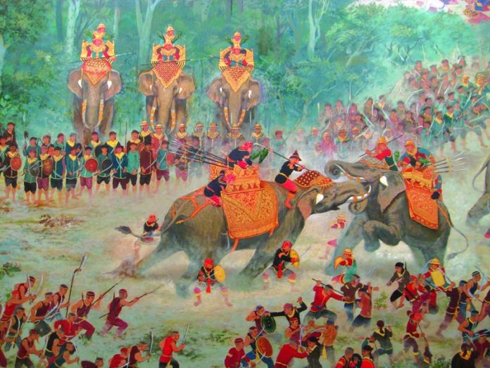

Slide 3
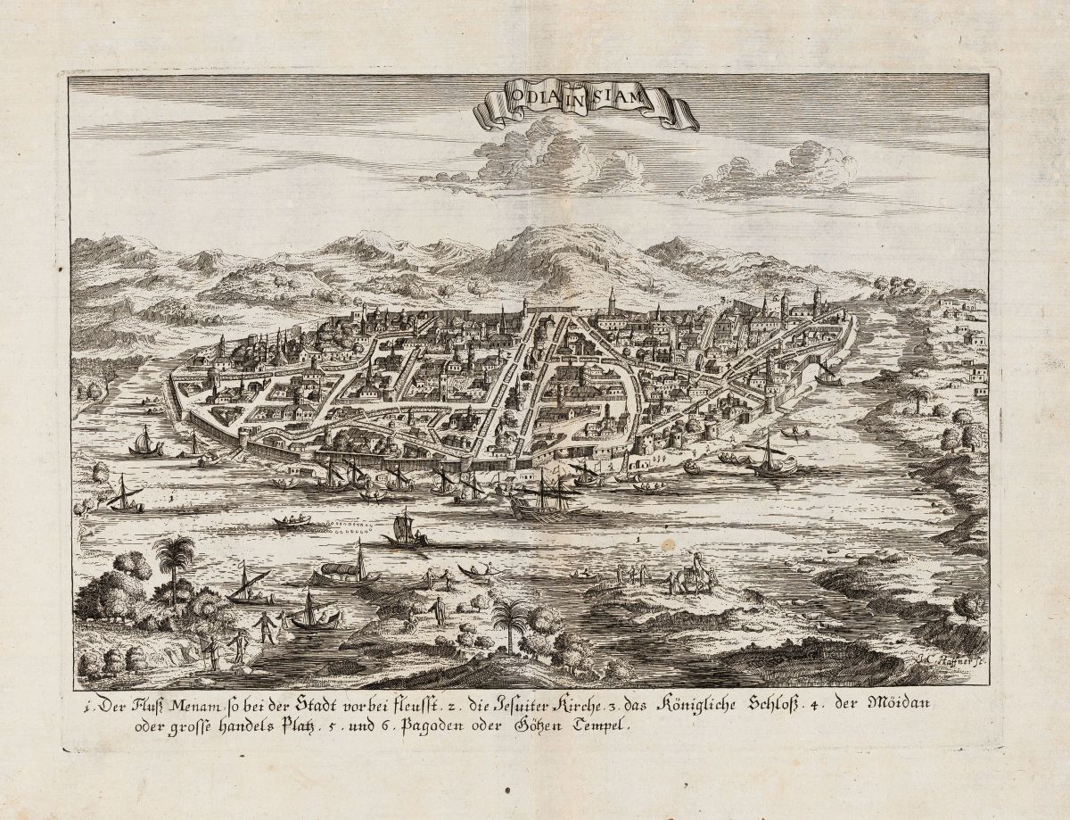

Slide 4
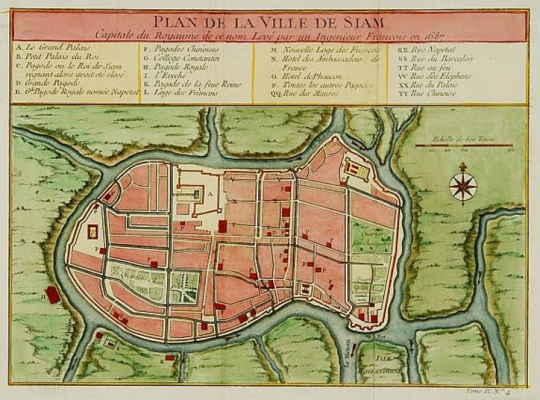
Ayutthaya

Slide 5
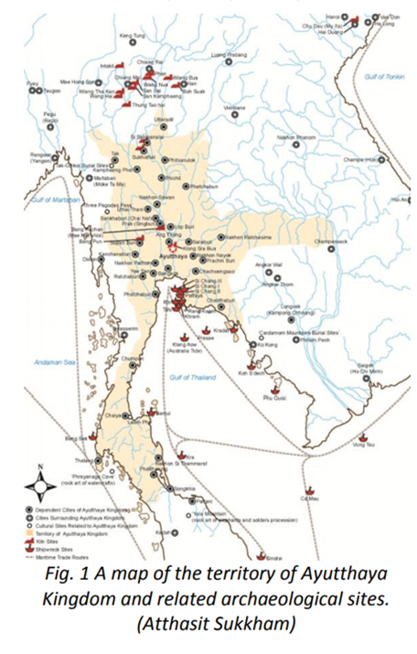
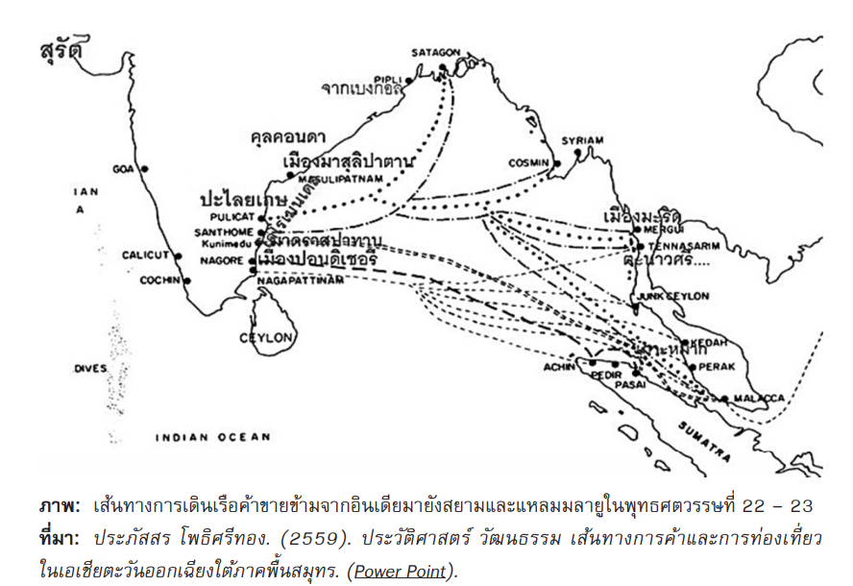

Slide 6
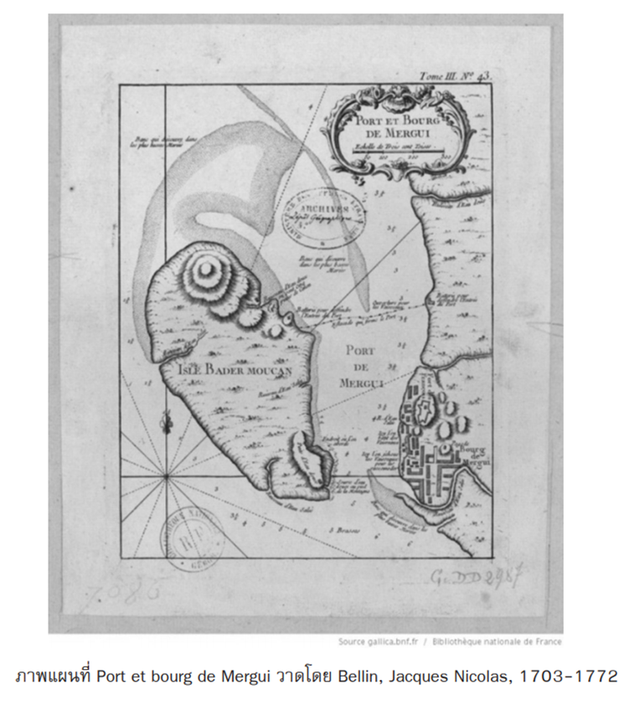

Slide 7
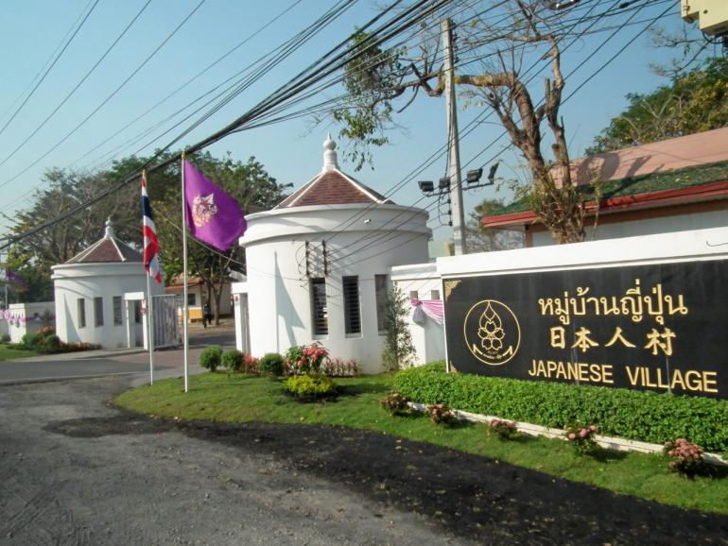
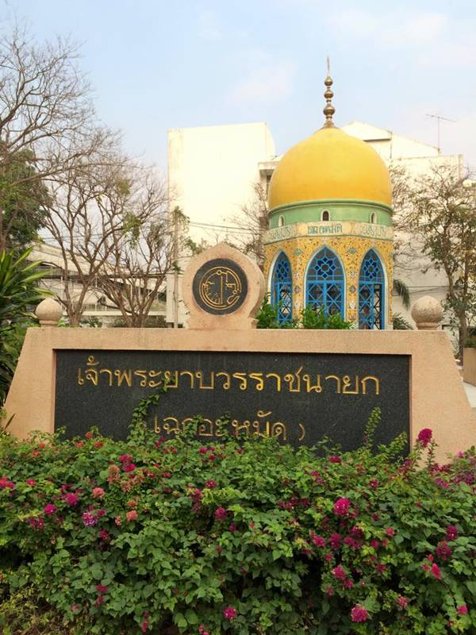
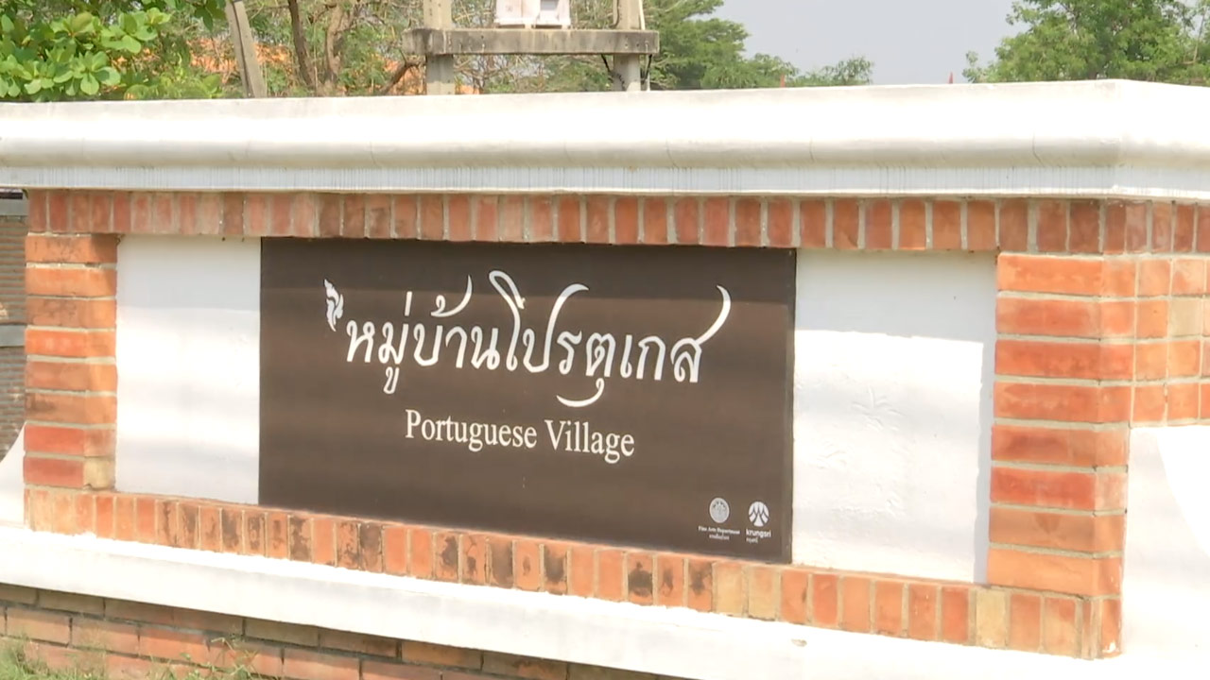
Ayutthaya
“There are few cities in the whole of East where one can see so many different nationalities as in Siam, and more than twenty different languages are spoken there”
Jacques de Bourges, 1669

Slide 8
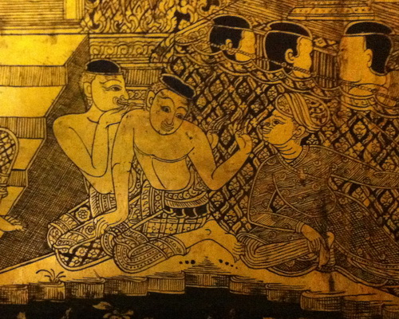

Slide 9
Topics
Ayutthaya as “entrepot”
Ayutthaya’s foreigners
Relationship with other cities
Kings and nobles

Slide 10
Background: From warfare to commerce
From 1600, conflicts and wars in the region subsided
  With peace, Ayutthaya became the center of commerce
    “The entrepot between East and West”
  Kings became trader, nobles grew through patronage

Slide 11
Ayutthaya as Entrepot
Context of trade
  Reestablishing control over portage route
  Earlier contacts with Europeans
  Access of Japanese, Chinese, and Muslims
Trade with China
  Always important but varied due to Emperors' policies
  New competitions from Vietnam's ports

Slide 12
Ayutthaya as Entrepot: factors
European's country trade
  Not direct trade back to Europe
  Participation in trade between Asian ports
  Example: Dutch trading hide (animal skin) from Ayutthaya to Japan
Between East and West
  East: China, Togugawa's Japan, and Spanish Manila
  West: Ottoman Turkey, Safavid Persia (Iran), and Mughal India
  Example: Malays brought forest goods for onward transmission to China, and carried champhor, pepper, and birdnests from Ayutthaya back to Coastal ports

Slide 13
Ayutthaya as Entrepot
Why Ayutthaya?
  Dangers from pirates
  Threats from Europeans intervention

Slide 14
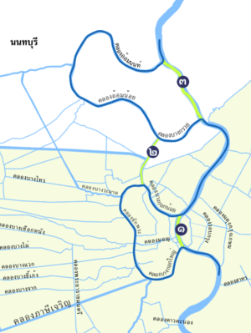
Digging the canals

Slide 15
Ayutthaya's cosmopolitanism
Important features
  Residents of foreigners
  Inseparation between trade and politics
Japanese
  Trade - Shugun and Daimyo's maritime trade with Siam and peninsula
    Exports: saltpeter, deer hides and rayskins
    Imports: copper and silver
  Influx - mercenaries and the fleeing Christians
  Integration: Japanese's village and the story of Yamada Nagamasa

Slide 16
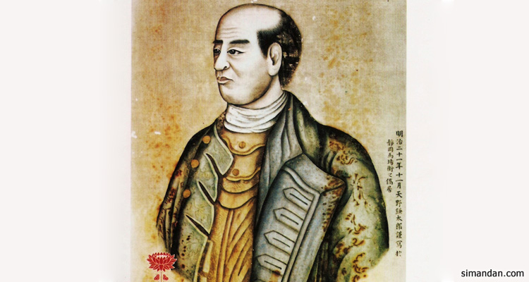
Yamada Nagamasa

Slide 17
Ayutthaya's cosmopolitanism
Moors
  Persian already spread over ports of India
  Integration - Persian strong influences as nobles
    Filled the courts
    Governors along Westward trade routes
  Westward Exports: hides, forest goods, elephants, tin, Japan's copper
  Westward Import: Indian's clothes

Slide 18
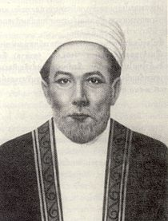
Story of the two Persian brothers
Sheikh Ahmed Qomi - Phra Klang and Mahatthai
Second's son - Aqa Muhammed Astarabadi - Narai's Phraklang
Question: Why choosing foreigners as key nobles?

Slide 19
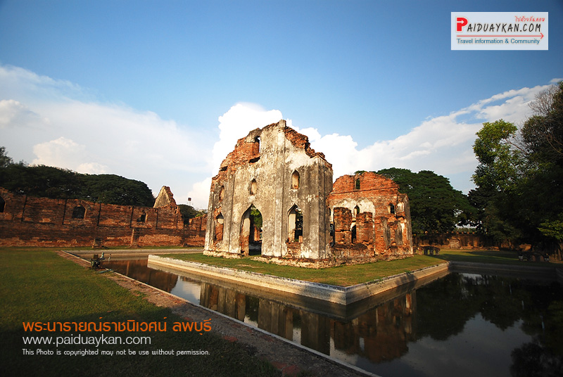
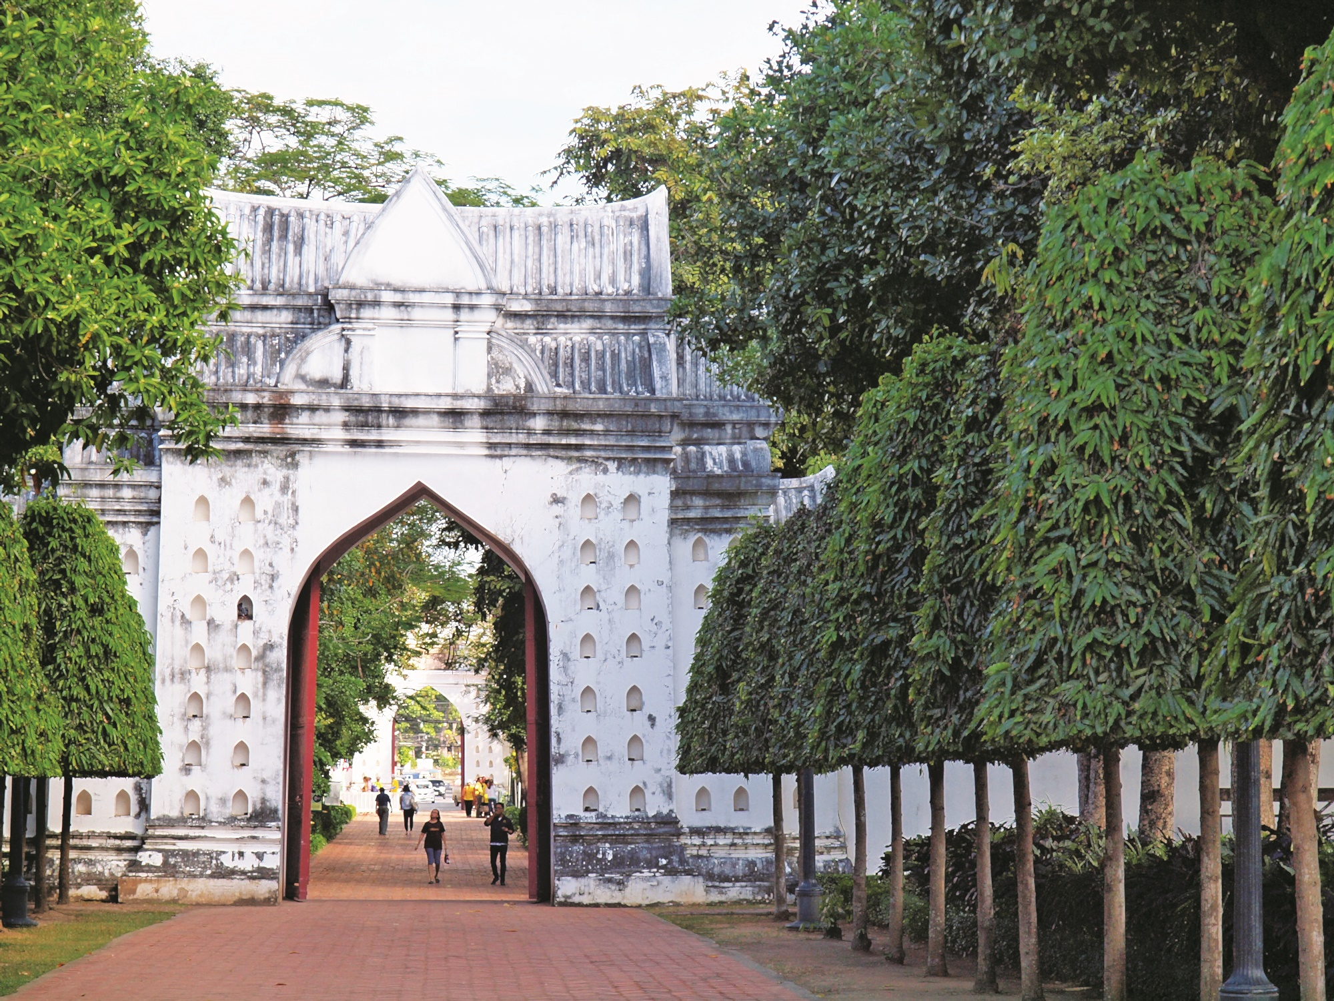
Narai’s Lopburi Palace

Slide 20
Ayutthaya's cosmopolitanism
Dutch
  Looking to export Siam's hides to Japan
  Searching (and failing) for Royal Monopoly
  No integration policy and its implications
Others
  Ayutthaya trade were routed though ports and local communities
  For example: Mon's timber and rice, Lao's gold and forest products, Malays, Portugeses, etc.

Slide 21
Ayutthaya's cosmopolitanism
Siam strategy of balancing foreigners’ influence

Slide 22
Ayuthaya and other cities/towns
With the peninsula's cities: Pattani, Kedah, Ligor, Songklah
The system of tribute
Chinese influence
Local rulers still consider themselves independent
Multiple allegiance
But subsequent rising Malays population and influx of Chinese raise economic importance
  Ayutthaya became more assertive and any defiance became revolt

Slide 23
Ayuthaya and other cities/towns
With the closer provinces - decline of provincial lords
  Attempts to overrule the local lords
  The appointed governors - Okya
  But also the divide and rule strategy - Luang Yokkrabat

Slide 24
Kings and nobles
The King as chief merchants in maritime trading economy
  Trade - owning royal junks, enforcing royal monopolies
  Narai also took part in internal trade
  Wealth of royal treasury

Slide 25
Kings and nobles
Cultural changes introduced by Kings
  Buddhism - expected role as patron
    Songtham's discovery of Pra-Phuttabat, and founding of royal Kathin
  Mystifying the King - Prasartthong's hiding of King's body
    Walling of palace
    Intermarriage
    Khmer revivalism - Ankhor King
  Brahman's as master of court's rituals
  Hunts, displays, poems, and histories

Slide 26
Kings and nobles
Nobles
  The importance of patronage
  Lineage, favour, and ability
  Wealth - self-renumeration
    Fees from ministries' own law-courts
    Controls of Phrai
    Richness from trade
The King's limits on nobles' wealth and the associated dangers

Slide 27
The downfall of wealthy nobles
Prasatthong
  Kalahom --> cut in pieces
  Okya Kamphaeg Pet --> executed and body displayed
Narai
  Chakri --> trampled by an elephant
  Phraklang --> executed
  Kosa-Lek
All were "too" rich and powerful

Slide 28
Succession crises
1610 Death of Ekathotsarot
  First son suicide
  Third son killed second son and became King Songtham
1628-29 Death of Songtham
  Contest between brother and son
  Kalahom with Yamada assisted the son
  Kalahom later took power and became King Prasartthong
1656 Death of Prasartthong
  Nominated son VS brother&another son
  Another son killed King's brother and became King Narai

Slide 29
Succession crises
Why successions were always bloodied?

Slide 30
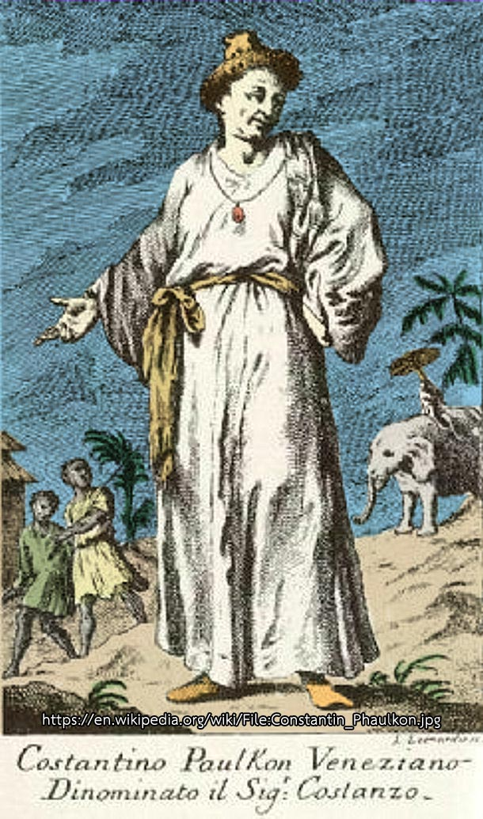
1688: the Death of Narai
Changed Context: rising influence of English and French
  Expansion of English and French country trade, and desire to integrate
Phaulkon
  Rising through the new setting
  Narai's interests in European
  Drawing power from French supports

Slide 31
1688: the Death of Narai
Growing resentment of Europeans
  Europeans came with sense of superiority
  Enraging nobles and locals
  Narai also created resentment within Sangha
Phetracha's coup participated by Sangha, and the mobs

Slide 32
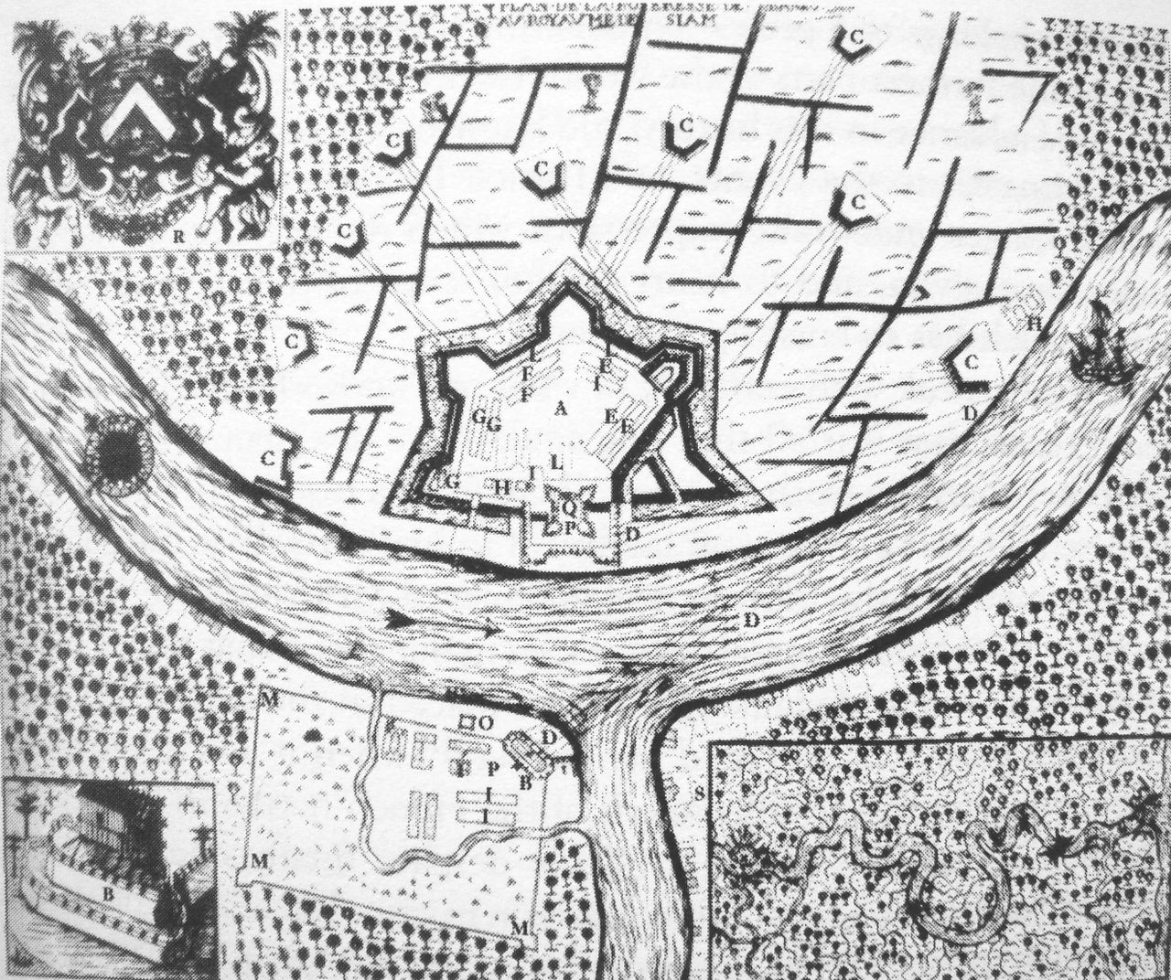
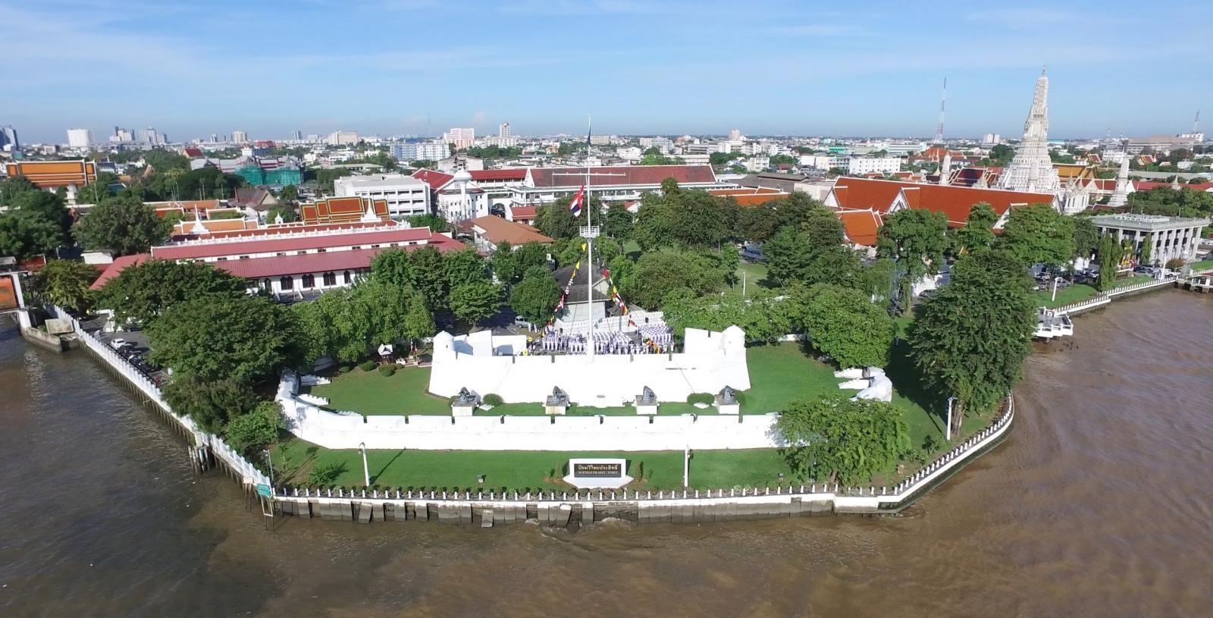
The Siege of French in Bangkok

Slide 33
Key takeaways
1. Importance of trade
  Cosmopolitanism
2. Relationship with other cities
  Loose relations with tribute states
3. King and nobles
  Not absolutism but more as coalition

