Slide 1
QALYs and the equity-efficiency trade-off
Adam Wagstaff
Kewalin Laorsukphaiboon 5504640441
Lalipat Tachapattarawat 5504640607
Nutthawat Srisajjalertwaja 5504640862
Sahawut Aunanant 5504641514
Tanyaporn Simasanti 5504641837

Slide 2
Objective
to point out that QALY approach has overlooked
the inequality issue
to suggest a method for incorporating distributional
concerns and inequality concerns into resource
allocation decision
explore the nature of trade-off between equity
and efficiency in QALY approach

Slide 3
Introduction
As more research on QALY increases, more concern
about equity is expressed
Advocates of the QALY approach in suggest that
there has been a misunderstanding either there has
been a misunderstanding either on the QALY approach
or the part of its advocates

Slide 4
Thus the aim of this paper is to
justify the statement by
exploring the nature of the trade off
between quality and efficiency.

Slide 5
Efficiency as health maximization
QALY(Quality-adjusted life years) measures an
individual's health whereas QALYs measures the sum
of individuals' health as the community's health.
Efficiency in terms of health maximization can be
achieved by reallocating resources to the activity that
generates more health gain for every dollar spent
(Williams, 1985)

Slide 6
Efficiency in terms of health maximization therefore…
explicitly rejects the traditional Pareto doctrine in
health care context ( the view that resource should be
allocated in the way that no one is made worse off)
implicitly rejects the welfarism (social welfare depends
on the utility of the people in the community)

Slide 7
Difference between the QALY approach and welfarism
In QALY approach, the characteristics of people is
use to measure people's health. Thus, two people
with same health state should have the same
level of utility
In welfarism, two people with the same health state
does not need to have the same level of utility since
it depends on the value he gives to his own
health condition.

Slide 8
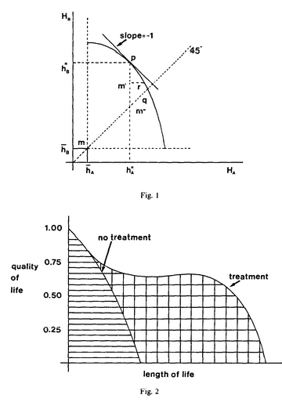
Definition of efficient health maximization
and of Pareto welfare concept of efficiency
in fig 1, the health frontier, without treatment
endowment point is at m.
The health maximization is indicated by
the shaded area.
asymmetry indicates that B can be treated
at lower cost than A
community's health is maximized at point p
where the cost of QALY is the same for both A
and B and the health maximization is indicated
by the sum of shaded area and the
cross-shaded area.

Slide 9
Utilitarianism rediscovered
Utilitarianism and QALY approach
Difference
Similarity
  redeployed away from people who have a low capacity to benefit from treatment
  The treatment of elderly
Utilitarianism | QALY approach
Sought to maximize the sum of utilities | Seek to maximize the sum of QALYs
Resources ought to be distributed away from people who place a relatively low value | Not base on individual’s own valuation of their health which equal value to everybody
 | In a fully employed economy, resource ought to be redeployed toward people whose output is highly valued and who are able to return to work quickly

Slide 10
Equity in the QALY literature
QALY approach
Culyer
  Defense of QALY approach
Pereira
  Arguing the defense of QALY approach
William

Slide 11
I Consideration of definitions of equity:
Can the definition of equity provide a basis for determining an equitable allocation of resource?
If so, is there a conflict between equity and efficiency (in term of health maximization)?
If there is a conflict, can the definition of equity be captured simply by weighting QALYs appropriately in the objective function?

Slide 12
II Equal treatment for need
Lockwood (1988)
  Determined by need
  Justice relates to equality
Broome (economist)
  Equal claims demand equal satisfaction
Both could not defined clear definition of word ‘need’
Culyer (1972)
  Unclear definition
Williams (1974)
  Need for medical treatment; technical judgment and social valuation judgment
  Need cannot be compared
Culyer (1976)
  Society decides

Slide 13
III Equality of access
Le Grand (1982)
  Time and money costs, in utility terms
Mooney (1983)
  ‘Equality of opportunity’
  Equal access for equal need
  Concern with treatment

Slide 14
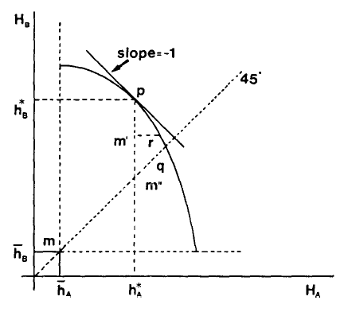
IV Equality of health
Any reduction in inequality is considered as good thing
Equitable distribution of health; capacity and costs
Conflict between equity and efficiency

Slide 15
V Equity and choice
Le Grand (1984,1987)
  Inequality is not necessarily inequitable
  Inequalities are equitable if they reflect differences in tastes; two people facing same constraints but different preferences (different levels of health: smoker vs. non-smoker)
  Both were unconstrained in choices, fully aware of dangers, having own preferences; the result are different and reflects in disparities, so it is not inequitable
  Smoker should be charged a premium but receive the same treatment as non-smoker

Slide 16
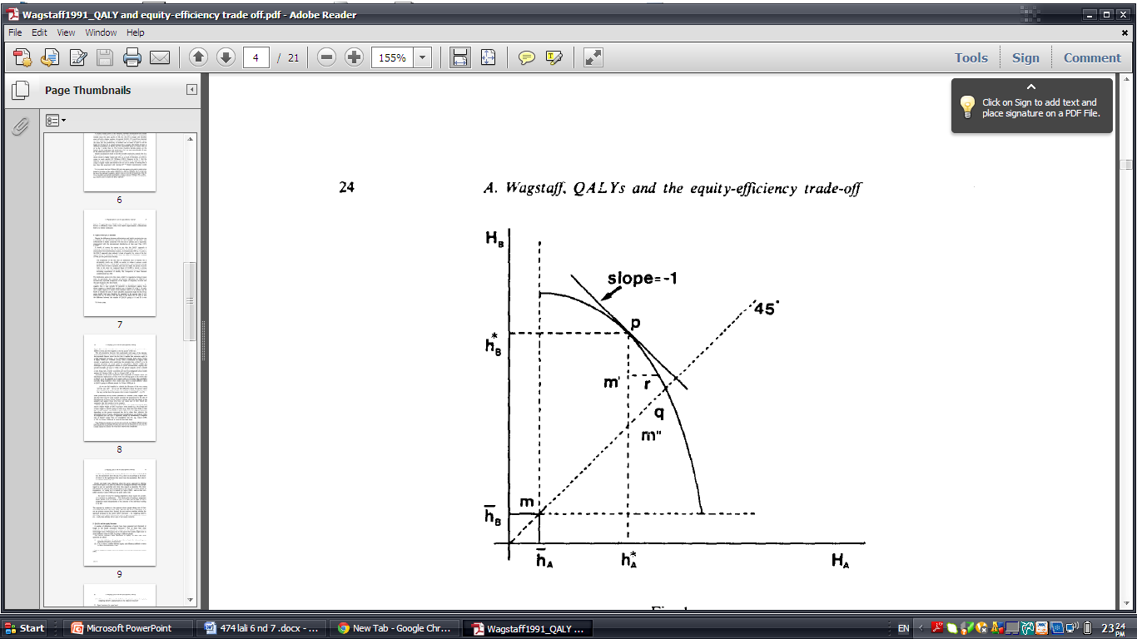
Equality? Or less inequality?
From figure, there is unjust even though both A and B gain better health
Implications of the egalitarian-humanitarian ethic underlying QALY approach. “It is better for many people to get a little than a few people to get a lot”

Slide 17
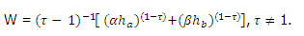
Is a social welfare function the answer?
Isoelastic social welfare function : assumes the case of 2 people or 2 groups of similar individual, A and B
W = level of social welfare associated with the health distribution (HA and HB)
Alpha = weight to be attached to A’s health
Beta = weight to be attached to B’s health
Tau = degree aversion to inequality in health outcomes
Empirical literature on QALY considered ;
Tau = 0 and
Alpha = Beta = 1. Culyer and Williams considered Tau = 0 but Alpha ≠ Beta.

Slide 18
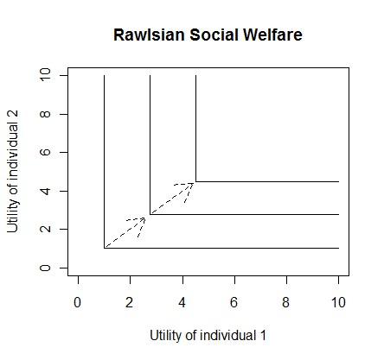
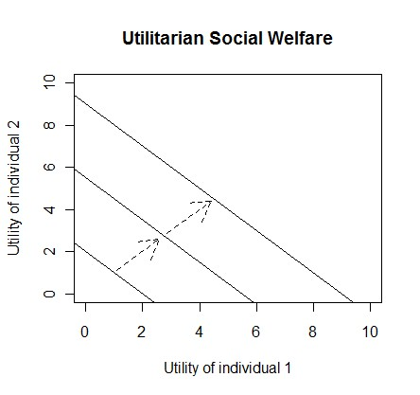
If Tau > 0 and Tau < ∞, the contours of the welfare function are convex to the origin. As Tau → ∞ , the contour becomes L-shape. This is called Rawlsian SWF.
It cannot include egalitarianism , the matter is health distribution not per capita health status, and cannot capture the social welfare contour that is upward-sloping line where some trade-off is permitted.

Slide 19
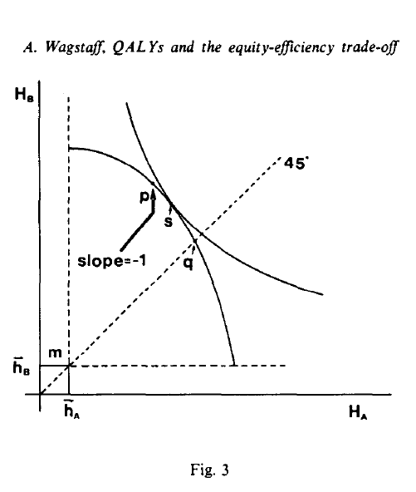
Implication of aversion to inequality for the choice of point on the health frontier.
Health maximization would pick point p.
Equality of health would pick point q.
The non-linear chooses point s.

Slide 20
Social welfare maximization and definitions of equity
SWF approach capture both efficiency and equity considerations by accepting a lower per capita health status and providing the non-technical information to determine needs
The issue raises some conflicts between welfare maximization and the notion of equal treatment for equal need. From example, A and B start off with the same health, have the same capacity to benefit from treatment that can be treated at the same cost
In the case that one person gets more extra QALYs than another, both still require the same amounts of health care resources. Thus, welfare maximization implies that equal treatment for equal need may require differentiation of access costs

Slide 21
Resource allocation: theory
In health maximization method marginal cost per QALY is the same across all type of health care activity
social welfare change this rule and say that slope of the ratio of the marginal costs is equal to the SWF contour
However if there is no concern about the inequality, marginal cost per QALY is equal across programme. So the only concern would be the expected health of a and b in the absence of treatment and the degree to which the society is averse to inequality
Notes:
rule reverts to the original rule that the marginal cost per QALY is to be
equalized across programmes. In this
the expected health of A and B in the absence of treatment and (ii) the
degree to which society is averse to inequality.
8.2.

Slide 22
Resources relocation
For an example we wanted to choose between hip replacement and kidney transplant.
Unless we does not care about the inequality in health so we consider the follow

Slide 23
the cause of diseased for a person with a diseased hip in the absence of a hip replacement
the number of people who could benefit from a hip replacement
the cause of diseased for a person with a diseased kidney in the absence of a kidney transplant
the number of people who could benefit from kidney transplants
society’s aversion to inequalities in health
indications of how the marginal cost of a QALY in each programed changes as the number of cases treated changes.
Notes:
For 1 and 3 the answer were already calculated by williams
for 2 and 4 there are some possible suggestion but not very attractive so use the survey data
for 6 can be obtain for the past experience

Slide 24
Conclusion
negative message health maximization, even in its weighted from, fail to reflect the aversion society toward inequalities in health outcomes
positive message the aversion can be incorporate of resources allocation by using SWF approach.
although SWF is harder to calculated compare to health maximization, it get more detail so it worthwhile to use the method

