Slide 1
TU 122 LAW IN EVERYDAY LIFE
Kongsatja Suwanapech

Slide 2
3. Offences Relating to
Trades
Section 271 Whoever, selling the goods by any fraudulent and deceitful means in order to deceive the buyer as to the origin source, nature, quality or such goods quantity, if such act not constitute cheating and fraud, shall be imprisoned not exceeding three year or fined not exceeding sixty thousand baht, or both. (Fraud / Deception)

Slide 3
3. Offences Relating to
Trades
Section 271
Whoever
selling the goods by any fraudulent and deceitful means
in order to deceive the buyer as to (1) the origin, (2) source, (3) nature, (4) quality or (5) such goods quantity,
if such act not constitute cheating and fraud, shall be imprisoned (Fraud / Deception)

Slide 4

3. Offences Relating to
Trades
Example:

Slide 5
3. Offences Relating to
Trades
Section 272 Whoever:
(1) Uses a name, figure, artificial mark or any wording in the carrying on trade of the other person, or causes the same to appear on a goods, packing, coverings, advertisements, price lists, business letters or the like in order to make the public to believe that it is the goods or trade of such other person;
(2) Imitates a signboard or the like so that the public are likely to believe that his trading premises are those of another person situated nearby;
(3) Circulates or propagates the false statement in order to bring discredit to the trading premises, goods, industry or commerce of any person with a view to obtaining benefit for his trade, shall be punished with imprisonment not exceeding one year or fined not exceeding twenty thousand baht, or both.
The offence under this Section is a compoundable offence.

Slide 6
3. Offences Relating to
Trades
Section 272 Whoever:
(1) Uses a (a) name, (b) figure, (c) artificial mark or any wording in the carrying on trade of the other person, or causes the same to appear on a goods, packing, coverings, advertisements, price lists, business letters or the like in order to make the public to believe that it is the goods or trade of such other person;

Slide 7

3. Offences Relating to
Trades
Example:

Slide 8

3. Offences Relating to
Trades
Example:

Slide 9
3. Offences Relating to
Trades
Section 272 Whoever:
(2) Imitates a signboard or the like so that the public are likely to believe that his trading premises are those of another person situated nearby;

Slide 10
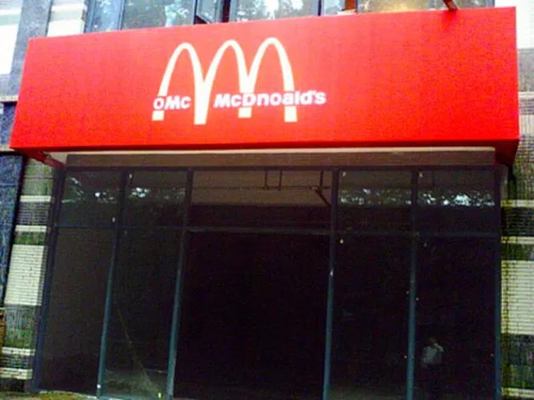
3. Offences Relating to
Trades

Slide 11
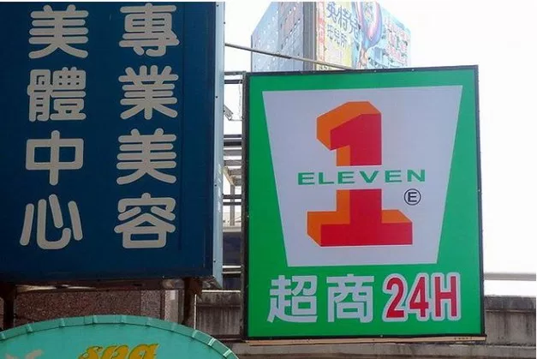
3. Offences Relating to
Trades

Slide 12

3. Offences Relating to
Trades

Slide 13
3. Offences Relating to
Trades
Section 272 Whoever:
(3) Circulates or propagates the false statement in order to bring discredit to the trading premises, goods, industry or commerce of any person with a view to obtaining benefit for his trade, shall be punished…

Slide 14

3. Offences Relating to
Trades

Slide 15
3. Offences Relating to
Trades
Section 273 Whoever, forging the registered trade-mark of other person, whether to be registered inside or outside the Kingdom, shall be imprisoned not out of three years or fined not exceeding sixty thousand baht, or both.

Slide 16
4. Offences of Disclosure
of Private Secrets
Section 322 Whoever, breaking open or taking away the closed letter, telegram or any document belonging to the other person so as to ascertain or to disclose its contents, if such act to be likely to cause injury to any person, shall be imprisoned not exceeding six months or fined not exceeding one thousand baht, or both. (Disclosure of Private Secrets)

Slide 17
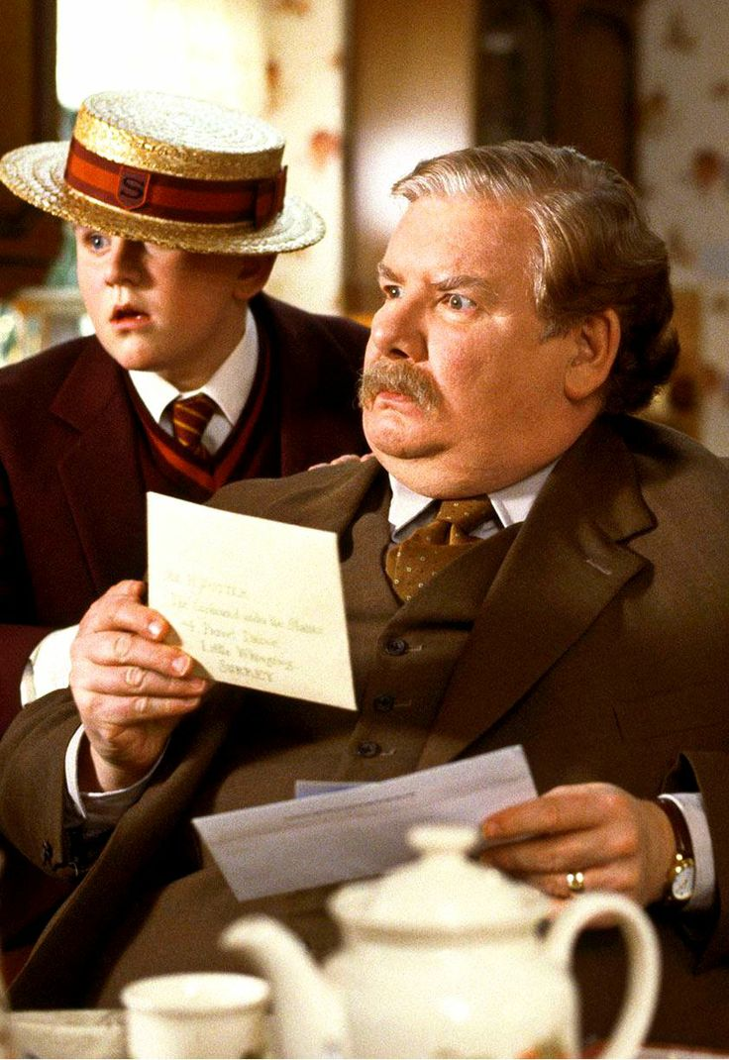
4. Offences of Disclosure
of Private Secrets

Slide 18
4. Offences of Discloser
of Private Secrets
Section 323 Whoever, knows or acquires a private secret of another person by reason of his functions as a competent official or his profession as a medical practitioner, pharmacist, druggist, midwife, nursing attendant, priest, advocate, lawyer or auditor, or by reason of being an assistant in such profession, and then discloses such private secret in a manner likely to cause injury to any person, shall be punished with imprisonment not exceeding six months or fined not exceeding ten thousand baht, or both.

Slide 19
5. Offences of
Defamation
Section 326 Whoever, imputes anything to the other person before a third person in a manner likely to impair the reputation of such other person or to expose such other person to be hated or scorned, is said to commit defamation, and shall be punished with imprisonment not exceeding one year or fined not exceeding twenty thousand baht, or both. (Defamation)

Slide 20
5. Offences of
Defamation
Section 328 If the offence of defamation be committed by means of publication of a document, drawing, painting, cinematography film, picture or letters made visible by any means, gramophone record or an other recording instruments, recording picture or letters, or by broadcasting or spreading picture, or by propagation by any other means, the offender shall be punished with imprisonment not exceeding two years and fined not exceeding two hundred thousand baht.

Slide 21
5. Offences of
Defamation
Section 329 Whoever, in good faith, expresses any opinion or statement:
(1) By way of self justification or defense, or for the protection of a legitimate interest;
(2) In the status of being an official in the exercise of his functions;
(3) By way of fair comment on any person or thing subjected to public criticism; or
(4) By way of fair report of the open proceeding of any Court or meeting, shall not be guilty of defamation.

Slide 22
5. Offences of
Defamation
Section 330 In case of defamation, if the person prosecuted for defamation can prove that the imputation made by him is true, he shall not be punished. But he shall not be allowed to prove if such imputation concerns personal matters, and such proof will not be benefit to the public.

Slide 23
6. Insulting
Section 393 Whoever, insulting the other person in his presence or by publication, shall be imprisoned not exceeding one month or fined not exceeding one thousand baht, or both. (Insulting)

Slide 24
Public Law

Slide 25
Definition of Public Law
2. Public law
Law governs relationships between individuals and the government, and those relationships between individuals which are of direct concern to the society
Notable examples:
Constitutional law defines the relationship of different entities within a state, namely, the executive, the legislature, and the judiciary.
Administrative law governs the activities of administrative agencies of government
Criminal law?
Tax law?

Slide 26
Jurisdiction of
the Constitutional Court
The Constitutional Court’s jurisdiction under the 2007 Constitution:
Constitutionality review of bills of law prior to promulgation;
Constitutionality review of law already in force;
Constitutionality review of the conditions for enacting an Emergency Decree; and
Etc.

Slide 27
Hierarchy of Written Law
Constitution
Acts / Emergency Decrees
Secondary Legislation (Royal Decrees, Ministerial Rules, Ministerial Declaration, etc.)

Slide 28
Emergency Decrees
Section 184 For the purpose of maintaining national
or public safety or national economic security, or averting public
calamity, the King may issue an Emergency Decree which shall
have the force as an Act.
The issuance of an Emergency Decree under paragraph
one shall be made only when the Council of Ministers is of the
opinion that it is the case of emergency and necessary urgency
which is unavoidable.
In the next succeeding sitting of the National Assembly,
the Council of Ministers shall submit the Emergency Decree to the National Assembly [Parliament] for its consideration without delay.
Two conditions must be satisfied
(1) Subject matter
(2) Emergency

Slide 29
Jurisdiction of
the Administrative Court
Legality of an administrative act
Legality of an administrative rule or regulations
Decide disputes over administrative contract
Constitutionality review of administrative rules and regulations

Slide 30
Jurisdiction of
the Administrative Court
A plaintiff shall be aggrieved or injured or may be aggrieved or injured in consequence of an act or omission of an administrative agency or State official or has the dispute in connection with an administrative contract or other cases which fall within the jurisdiction of an Administrative Court. In reality, most aggrieved or injured persons in administrative cases are general people, who are aggrieved or injured by administrative acts. However, administrative agencies or State officials may be aggrieved or injured and have the right to file an administrative case as well.

