Slide 1

Chapter 1: Homework

Slide 2

Group Homework
Group Homework #1: Chapter Presentations
1.Each group will be assigned 2 cases/class
& presented in the following class.
2. You are allowed on more than 3 page ppt slides, and 7 minutes presentation for each case
3. Contents should include :Summary of case and answers, suggestions etc.
4. After each presentation, we will have class discussion therefore everyone should read the cases before coming to class.
Notes:
1

Slide 3
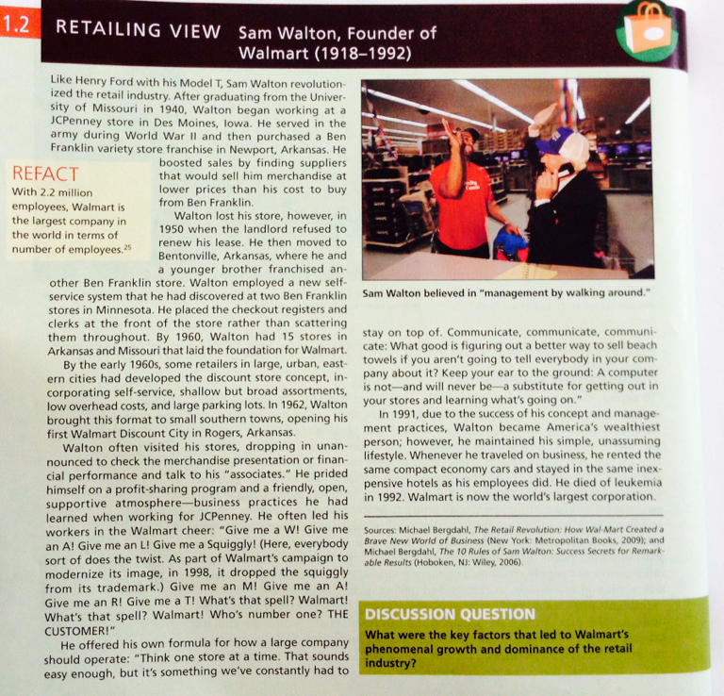
Chapter Presentation 1.1
Page 18
Notes:
1

Slide 4
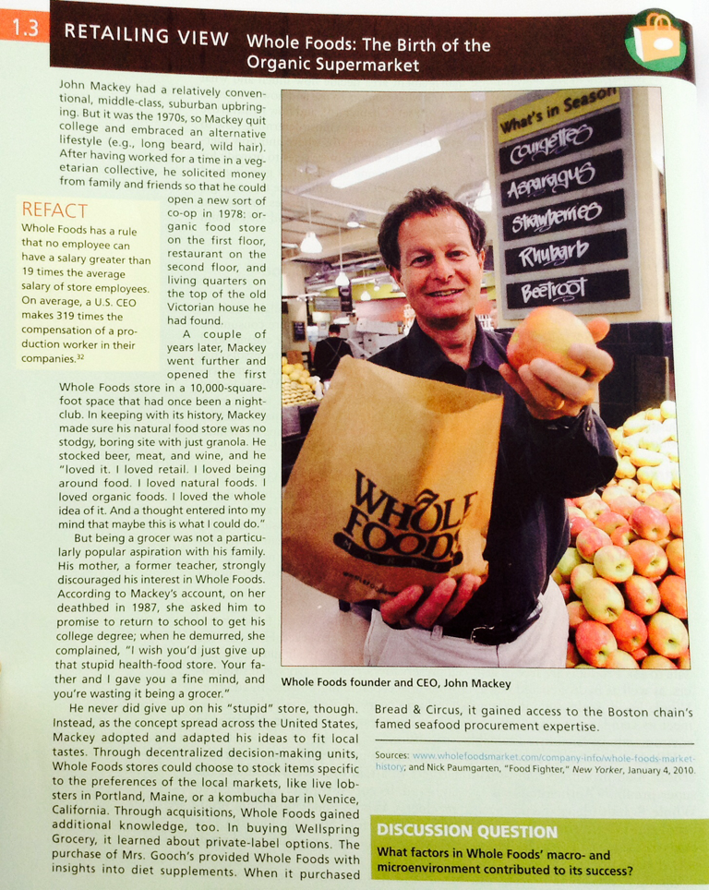
Chapter Presentation 1.1
Page 26
Notes:
1

Slide 5
Group Homework
Group Homework #2: Project Mini-presentation 1
1.Discuss and decide which retail business your team wants to work on.
2. Prepare a 10 minute presentation in the retail business you are interested in…Restaurants, clothing store, supermarkets etc. –
CEO, please re-confirm before leaving class (no duplicates)
- For example, if you choose minimart, you should choose 7-eleven as your ideal retail store and find as much information, including competitors,market situation, IMC, etc.
Notes:
1

Slide 6
Individual Homework
" Retail Experience Delight"
You are to choose one retail place that you love the most in the world and describe your shopping experience associated with the retail. You should write the details of your experience and how you felt ,etc. Then you are to write down how they can be better, improve and explain why.
This is free style so you could include photos,charts, etc, to communicate your experiences. If you have a photo of yourself at that place, feel free to include that in.
Notes:
1

Slide 7
Chapter 2 & 3: Homework

Slide 8
Group Homework
Group Homework : Chapter Presentations
1.Each group will be assigned 2 cases/class
& presented in the following class.
2. You are allowed on more than 3 page ppt slides, and 7 minutes presentation for each case
3. Contents should include :Summary of case and answers, suggestions etc.
4. After each presentation, we will have class discussion therefore everyone should read the cases before coming to class.
Notes:
1

Slide 9
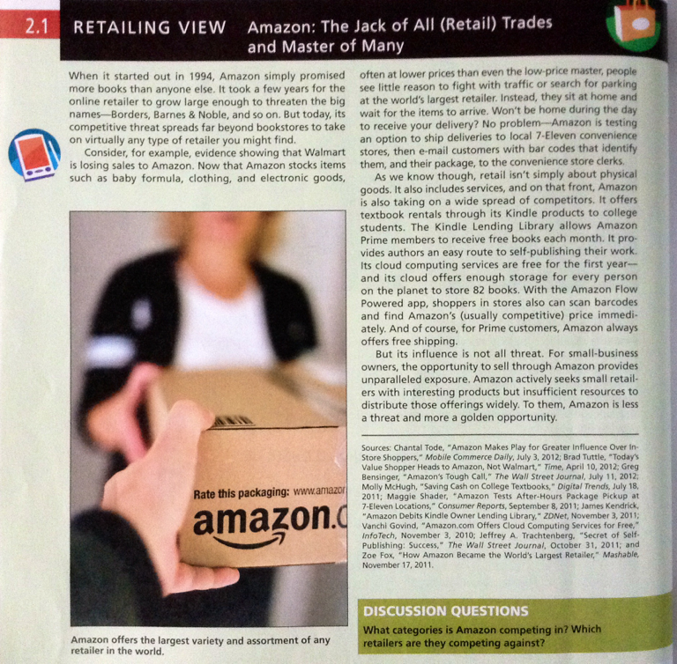
Chapter Presentation 2.1
Page 40
Due Tuesday June 14th
Notes:
1

Slide 10
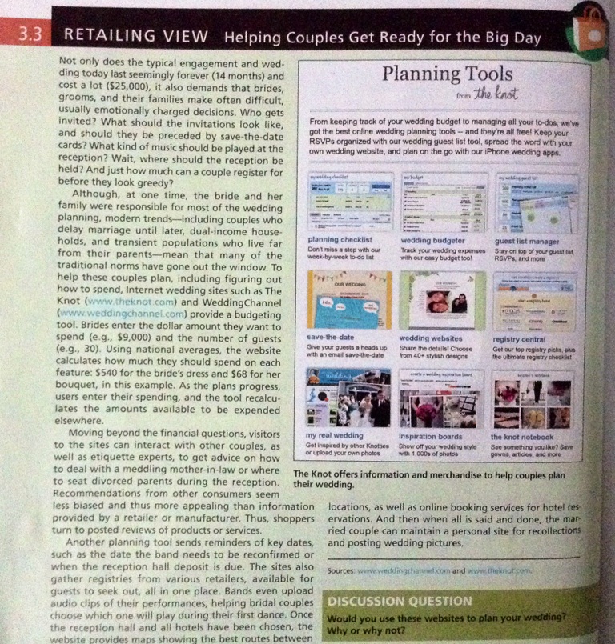
Chapter Presentation 3.3
Page 76
Due Tuesday June 14th
Notes:
1

Slide 11

Individual Homework-
Each Student is to design a namecard to bring to every class with criteria as follows:
First full name
Represent yourself in terms if creativity
Design as if you were branding yourself
Special prize with be awarded to the winner
Notes:
1

Slide 12
Chapter 4: Homework

Slide 13
Group Homework
Group Homework #4: Chapter Presentations
1.Each group will be assigned 2 cases/class
& presented in the following class.
2. You are allowed on more than 3 page ppt slides, and 7 minutes presentation for each case
3. Contents should include :Summary of case and answers, suggestions etc.
4. After each presentation, we will have class discussion therefore everyone should read the cases before coming to class.
Notes:
1

Slide 14
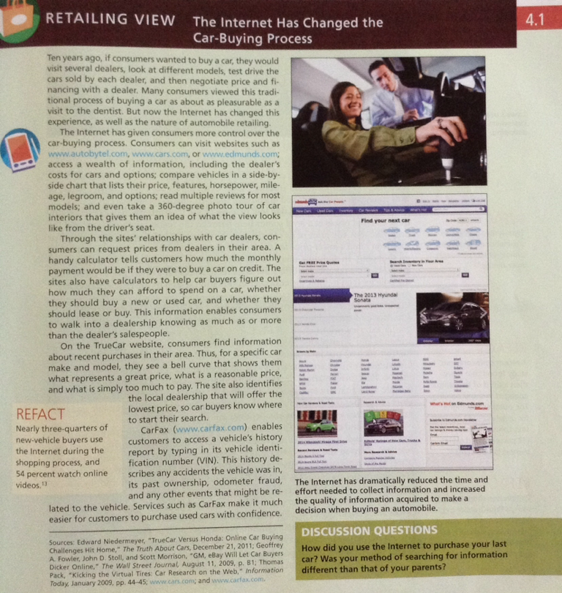
Chapter Presentation 4.1
Page
Notes:
1

Slide 15
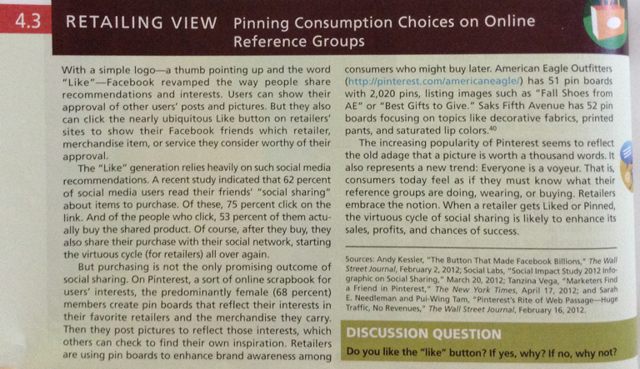
Chapter Presentation 4.3
Page
Notes:
1

Slide 16
Individual Homework
" I-Spy" – CDP Field Observation
You are to choose one consumer ( it could be someone you know but you cannot tell that person what you are doing) Then you are to write down what you observe that person does for 12 hours, like writing a diary - What he/she does, where he buys, how he decides and his interaction. ,etc. You could use the consumer decision process to relate your observations, write down what lifestyle and even what consumer target segment he is in.
This is free style so you could include photos,charts, etc, to communicate your experiences. If you have a photo of your consumer please add him in.
.
Notes:
1

Slide 17
Chapter 5 & 6: Homework

Slide 18
Group Homework
Group Homework #1: Chapter Presentations
1.Each group will be assigned 2 cases/class
& presented in the following class.
2. You are allowed on more than 3 page ppt slides, and 7 minutes presentation for each case
3. Contents should include :Summary of case and answers, suggestions etc.
4. After each presentation, we will have class discussion therefore everyone should read the cases before coming to class.
Notes:
1

Slide 19
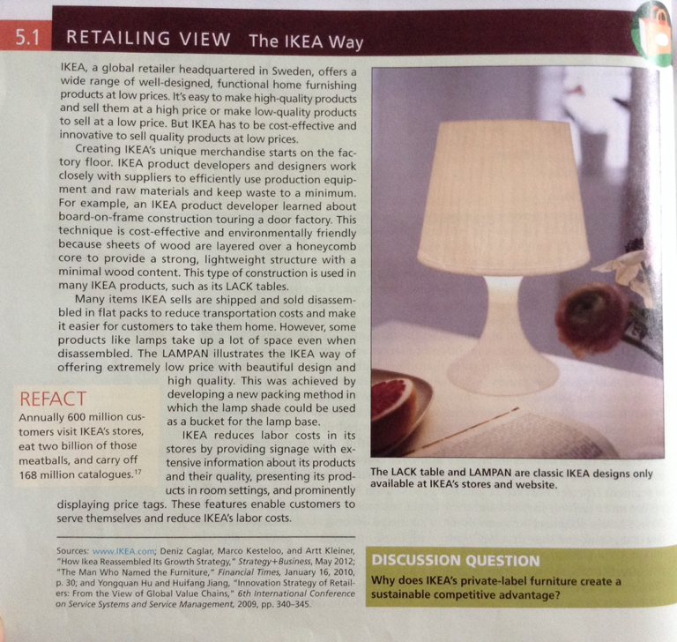
Chapter Presentation 5.1
Page 130
Notes:
1

Slide 20
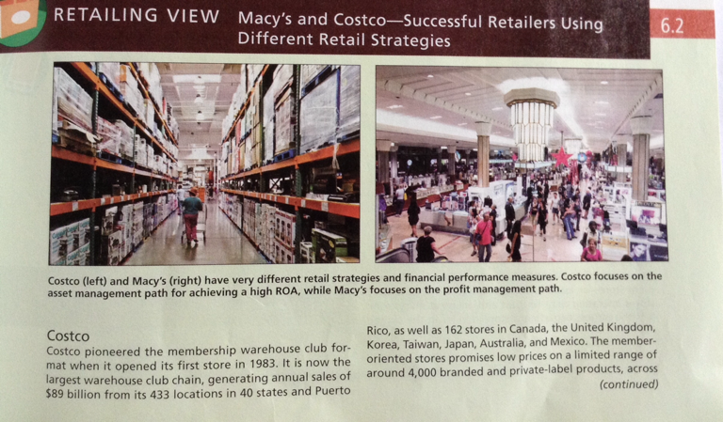
Chapter Presentation 6.2
Page 159-160
Notes:
1

Slide 21
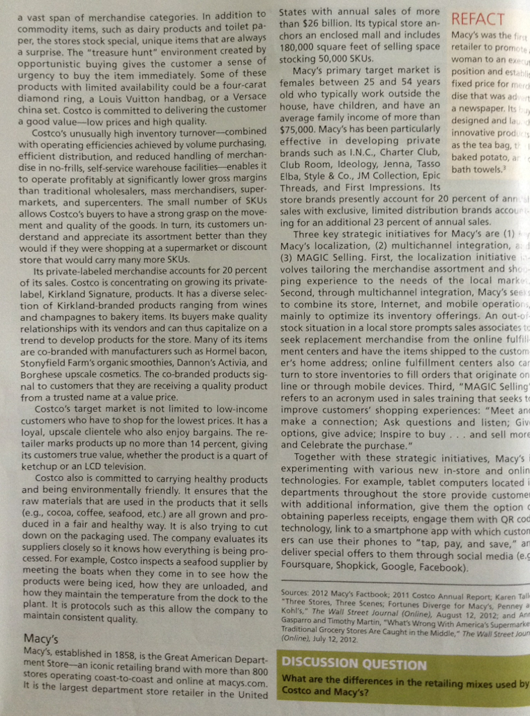
Chapter Presentation 6.2
Page 159-160
Notes:
1

Slide 22
Group Homework-New Retail Strategic Direction
Group Homework #2: Project Mini-presentation 2
1.You are to discuss a new retail business by using the Related Diversification Growth Opportunityto your existing business
2. Prepare a 10 minute presentation about the direction of your new business you are interested in and include the following (at this point research is not required yet)
What is your existing/new business retail format?
Who are your existing/new target group(s)?
What is the existing/new retail positioning?
How does your consumer perceive you/ new business positioning? (for the new one, formulate your own perceptual map as a guideline model since perceptual maps require quantitative data from consumers but for existing you could use current data)
Notes:
1

Slide 23


