Slide 1
Fun question ☺
EE 382

Slide 2
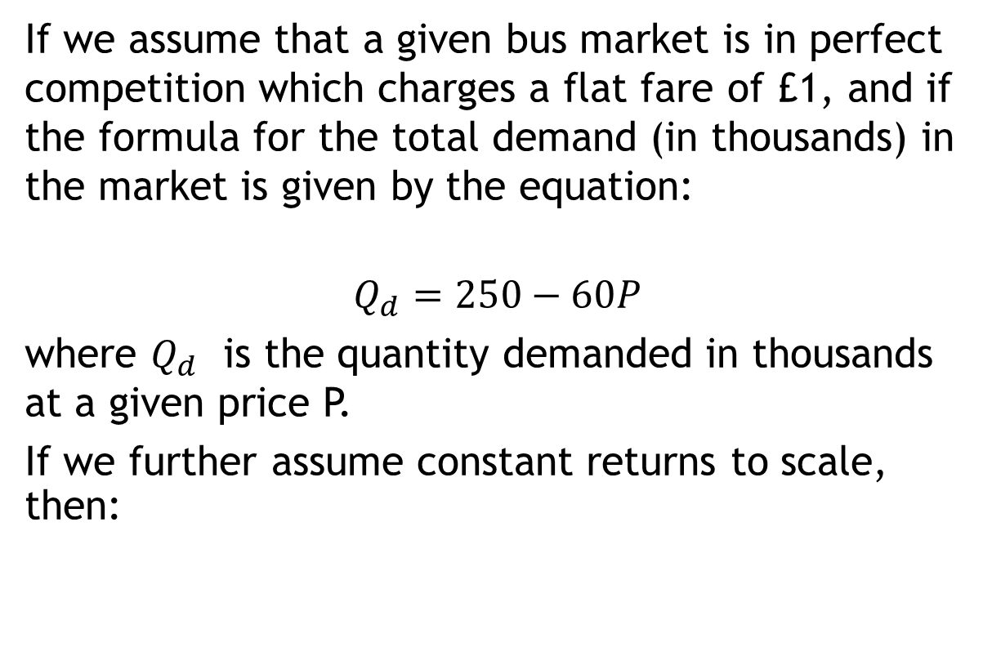
Perfect competition in bus markets
If we assume that a given bus market is in perfect competition which charges a flat fare of £1, and if the formula for the total demand (in thousands) in the market is given by the equation:
$$Q_{d}=250−60P$$
where $Q_{d}$ is the quantity demanded in thousands at a given price P.
If we further assume constant returns to scale, then:

Slide 3
If we further assume constant returns to scale, then:
a) What is total market demand at the £1 flat fare?
b) If the market is shared equally by 4 firms, what is the number of passengers carried by each company?

Slide 4
c) If the cost per vehicle kilometer is £1.60, average utilization 20 passengers per vehicle kilometer and average trip distance 10 kilometers:
What is the level of bus kilometers required to service this market?
What profits are being made?
What type of profit is this, normal or abnormal?
What is the cost per passenger carried (as opposed to the cost per vehicle kilometer)?

Slide 5
As this is perfect competition, new firms may enter the market and compete these profits away. What price therefore will ensure that only normal profits are made?

