Slide 1

MK 322 Retail Management
Chapter 8: Retail Site Location
By Ajarn Suwalya K.

Slide 2
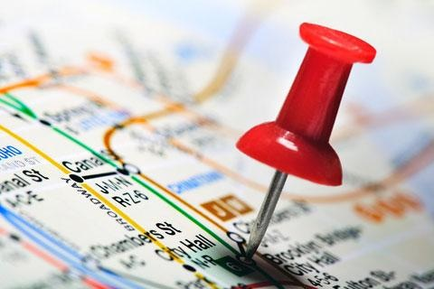
Evaluation Areas for Locations and Determining the Number of Stores in an Area

Slide 3
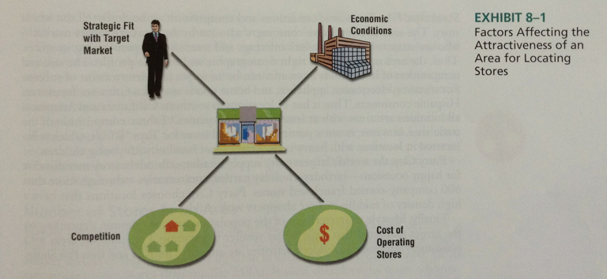
Conditions in Evaluating Store Locations
Notes:
1

Slide 4

Number of stores in an Area
After selecting the area to locate its stores, the next decision is how may stores in the area
Economies of Scale from Multiple Stores
Cannibalization
Notes:
1

Slide 5

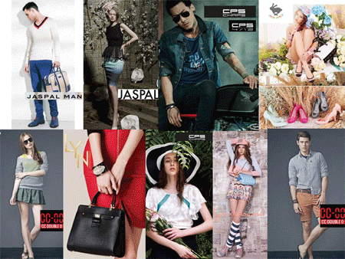
Notes:
1

Slide 6
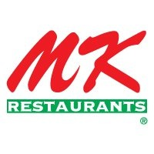
A small Thai restaurant in a one block commercial shop house in Siam Square Soi 3 managed by Aunty Thongkam Mekto was the beginning of MK
The name MK was derived from the former owner of the shop, Makong King Yee, the Hong Kong businessman who relocated to Boston, USA in 1962. Aunty Thongkam has operated the business with service minded and hospitality which have brought the customers back again and again. The famous menus included rice with boiled chicken, goulash beef, Padthai noodles, Korean charcoaled grilled beef, and all sorts of spicy salads. Delightful cakes were also offered in New Year seasons.

Slide 7
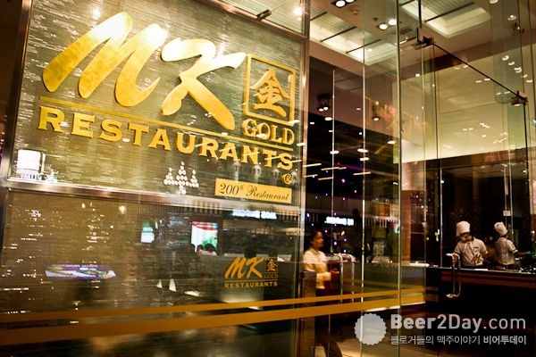
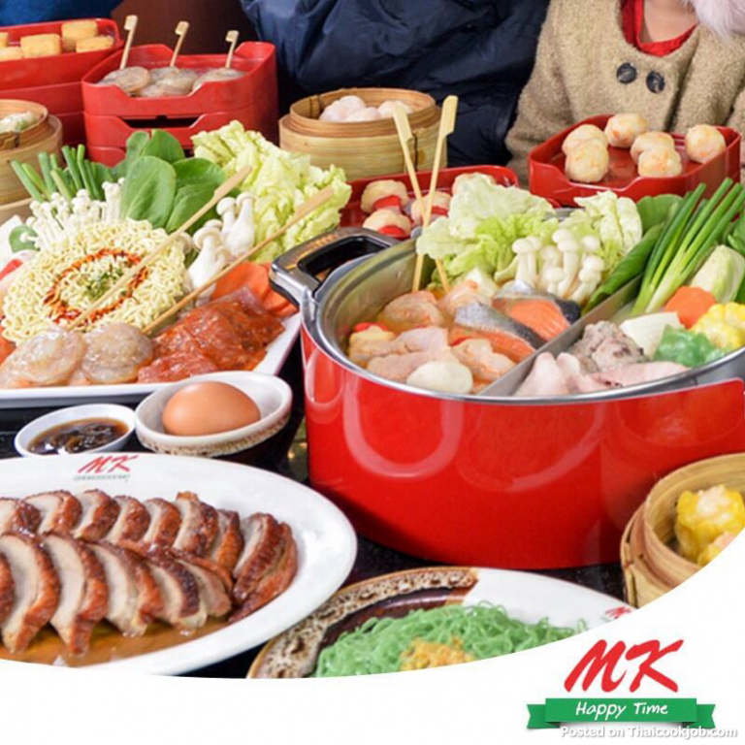
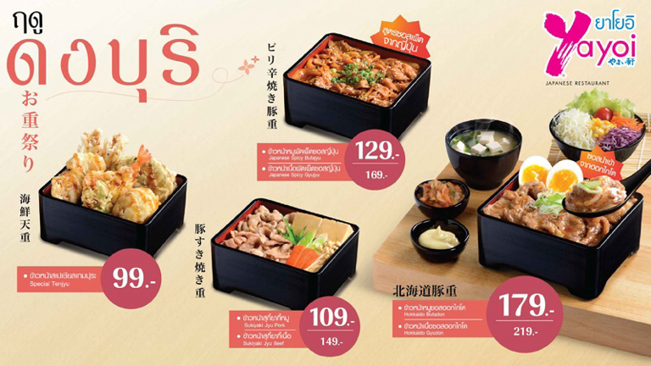

Slide 8
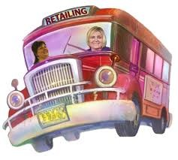
Conditions in Evaluating Store Locations

Slide 9
Site Characteristics
Traffic Flow and accessibility
Parking
Visibility
Adjacent tenants
Restrictions and cost
Notes:
1

Slide 10
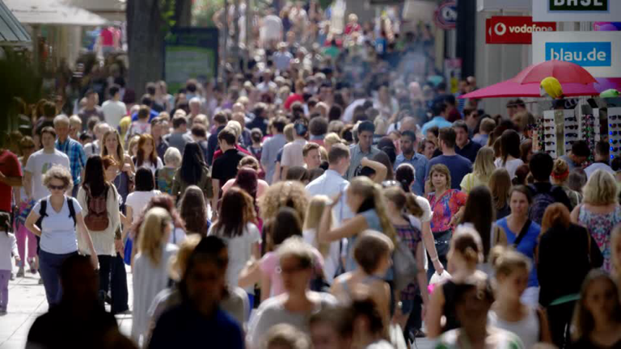
Traffic Flow and Accessibility
Notes:
1

Slide 11

Traffic Flow and Accessibility
One of the most important factor is traffic flow
When traffic is greater,more consumers are likely to stop in and shop at the store.
Thus retailers often use traffic for consumers to stop in and shop at the store, especially those selling convenience goods
Notes:
1

Slide 12
Traffic Flow and Accessibility
The accessibility of the site is the ease with which customers can get into and out of site
As important as traffic
Accessibility is greater for sites located near highways, uncongested highways and streets with traffic lights and lanes, BTS locations
Natural barriers such as rivers and mountains, and artificial barriers such as railroad tracks, divided highways, parks, may affect accessibility
Notes:
1

Slide 13
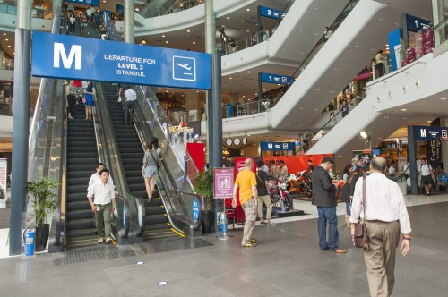
Traffic Flow and Accessibility
Terminal 21 easy accessibility from BTS
Notes:
1

Slide 14
Parking
The amount and quality of the parking facilities are critical for evaluating shopping centers
Risk if there are not enough spaces or spaced too far from the store
Rule of thumb
5.5:1,000 (five and one-half spaces per thousand square feet of retail store space) for shopping center
10 to 15 spaces per 1,000 square feet for supermarket
Notes:
1

Slide 15
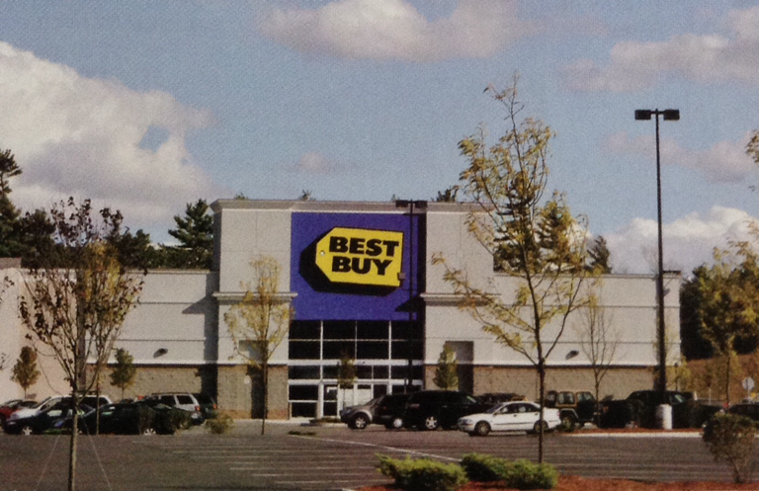
Parking
The parking around this Best Buy store contributes to the quality of this location.
Notes:
1

Slide 16
Visibility
Visibility refers to customers' ability to see the stores from the street
Good visibility is less important for well established loyal customer base stores
Good visibility is important for areas with highly transient population such as a tourist center or large city
Notes:
1

Slide 17
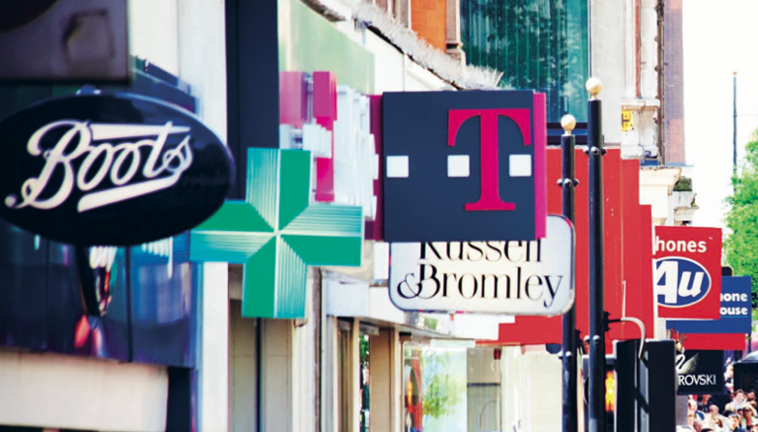
Visibility
Notes:
1

Slide 18
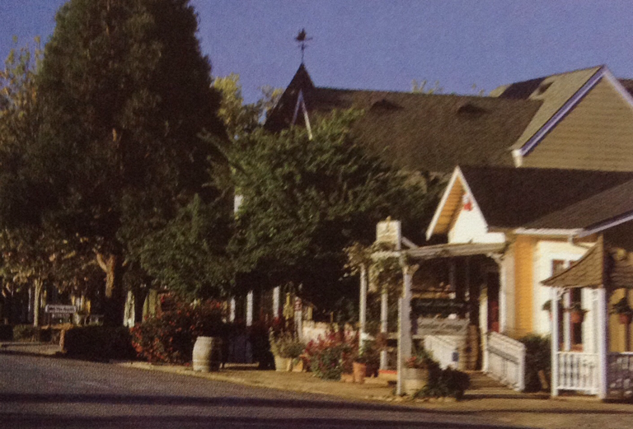
Visibility
The location of this store is poor because the store and its signage are not visible.
Notes:
1

Slide 19
Adjacent Tenants
Locations with complementary, as well as competing, adjacent retailers have the potential to build traffic
Complementary retailers target the same market segment but have different, noncompeting merchandise offering
Convenience or comparison shopping situations are being taken in consideration
Notes:
1

Slide 20
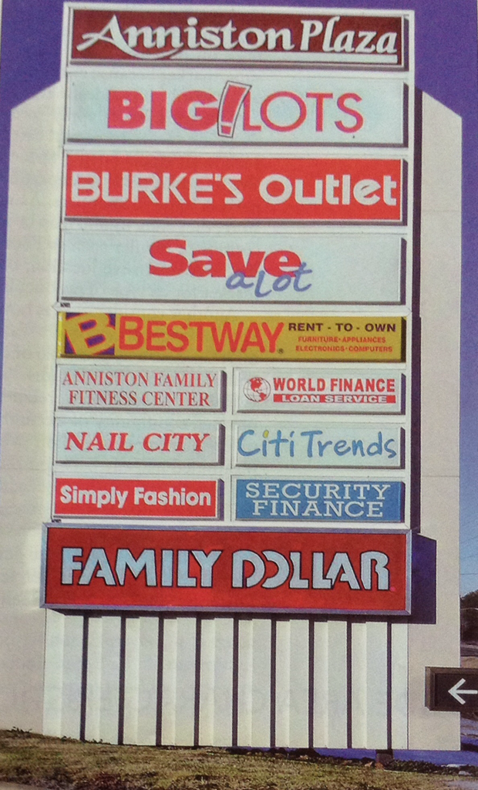
Adjacent Tenants
Save-A-Lot prefers locations next to Big lots or Family Dollar because the presence of the two retailers will attract additional customers
Notes:
1

Slide 21
Restrictions and Cost
Retailers place any restrictions on the type of tenant that are allowed in a shopping center in their lease agreement
Some of these restrictions can make the shopping center more attractive for a retailer
For example, a speciality men's apparel retailer may prefer a lease agreement that precludes other men's speciality apparel retailers locating in the same area
Notes:
1

Slide 22
Locations within a Shopping Center
The location within a shopping center have significant effect on both sales and occupancy costs
The better locations have higher occupancy costs
For example, in a strip shopping center, locations closest to the supermarket are expensive
So flower or sandwich shops may attract impulse buyers
However a shoe repair store could be in lower traffic far away, in other words, a destination store
Notes:
1

Slide 23

Negotiating a Lease

Slide 24
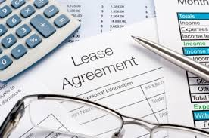
Types of Leases
2 basic types
Percentage
Fixed Rate
Notes:
1

Slide 25
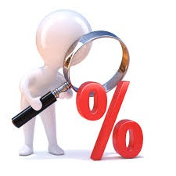
Percentage Leases
Percentage lease is rent based on a percentage of sales
The most common form
In addition percentage of sales, retailers typically pay a common area maintenance(CAM) fee based on a percentage of their gross leasable square footage
Notes:
1

Slide 26
Percentage Leases
A percentage of lease with a specified maximum is a lease that pays the shopping center manager a percentage of sales up to a maximum amount
This rewards good retailer performance by allowing the retailer to hold rent constant above a certain level of sales
Notes:
1

Slide 27
Percentage Leases
A similar variation, the percentage lease with a specified minimum, specifies that the retailer must pay a minimum rent no matter how low sales are
Notes:
1

Slide 28

Fixed-Rate Leases
A fixed-rate lease is when a retailer pays a fixed amount per month over the life of the lease
Most commonly used by community and neighborhood centers
Retailer and shopping manager know exactly how much will be paid
Notes:
1

Slide 29
Fixed-Rate Leases
Graduate lease is a variation of fixed-rate lease in which rent increases by a fixed amount over a specified period of time
For example, rent may be $1,000 per month for the first three years and $1,250 for the next five years
Notes:
1

Slide 30


