Slide 1
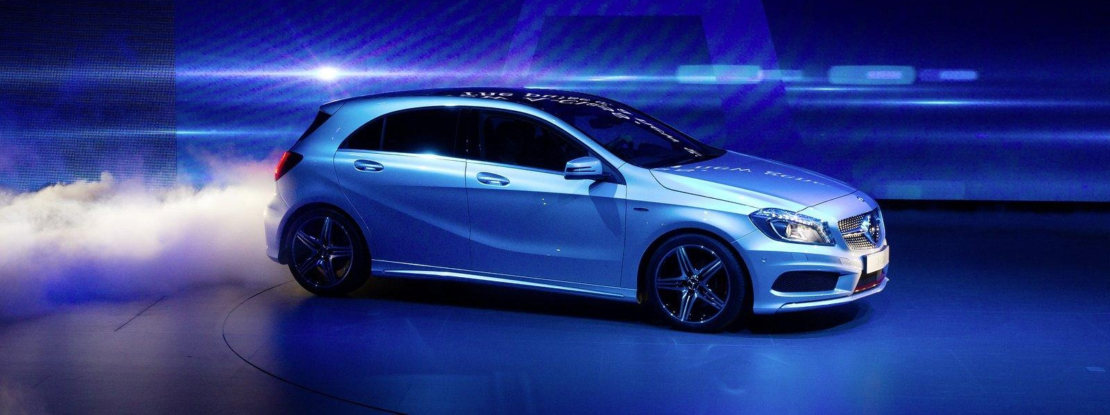
Youth Campaign Thailand
    Marketing Communication / Social Media & Online

Slide 2
Project Background
Mercedes-Benz is perceived as reputable but older brand amongst younger targets
It’s losing ground against other brands in the same segment (BMW, MINI, Audi, VW Scirocco)
There’s an opportunity to leverage those launches to address the brand image issue
2 new models (New Generation Compact Cars) are being introduced in Thailand: New A-Class and New CLA

Slide 3
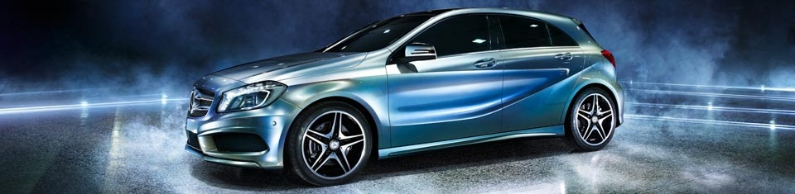

NGCC: Stepping into a younger market
A-CLASS
NEW CLA

Slide 4
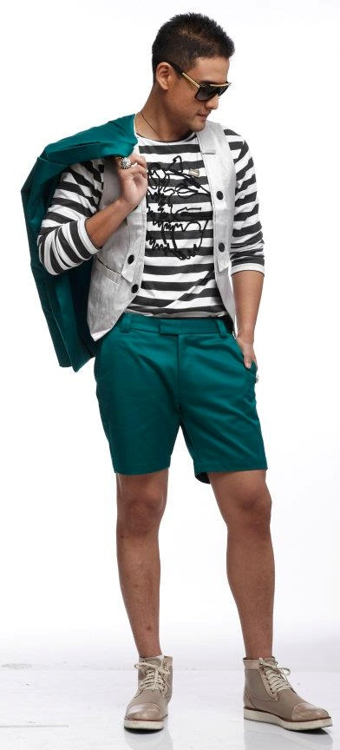
Who are we talking to?
Male 22-35 years old
  First jobbers
  Mid-to-high level corporate employees
  Entrepreneurial start ups
  Family business heir-to-the-thrones.
The ‘Elite’ section of Thai society, the well-to-do affluent, literally ‘A CLASS’
Active, sophisticated, restless, self-conscious, stylish, trend-setting socialite

Slide 5
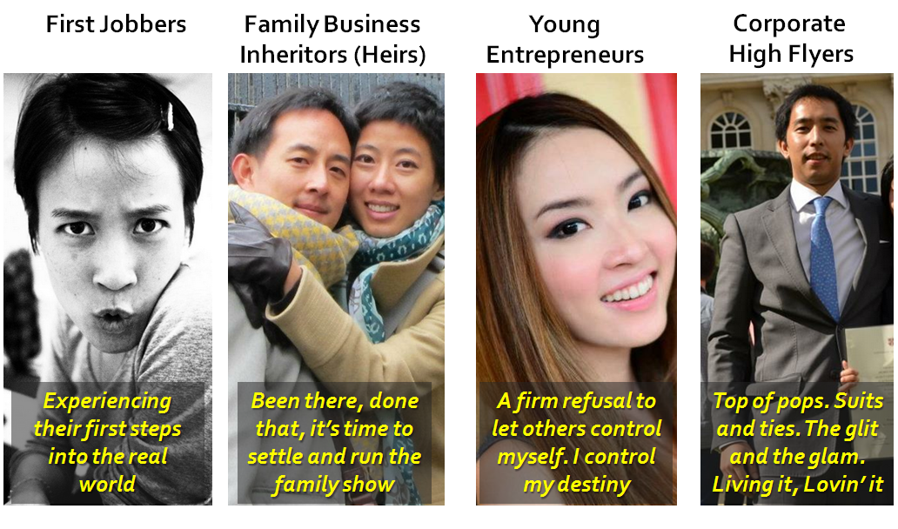
Potential Target(s) by Demographics

Slide 6
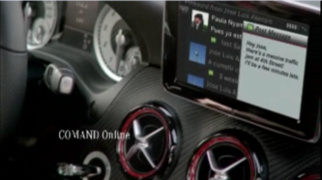
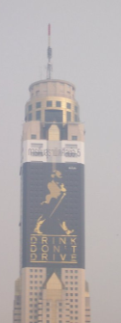

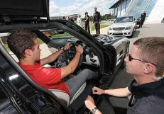
Their media habits
Always Connected
High internet/mobile usage. Feeds, social, online sites (Cool Hunting, Flipboard, Facebook).
  Always moving
  Outdoor, events, activities
Entertainment/News
Cinema, viral, cable, newspapers

Slide 7
Key communication target media consumption

Slide 8







Segmentation by Psychographics
Style/Design
Personalization
Uniqueness
Fashion Accessory
The Thrill Seekers
The Young Go-Getters
The Style Driven
The Pragmatics
Where does MB fit into this scheme of things?
Consciously pragmatic
Practical
Not status conscious
Maintenance conscious
Performance Driven
Adrenalin Rush
Speed Purists
Anti-authority
Rising Stars
On the Rush
Want to part of the elite group
Driven by fame/money/glory

Slide 9

Main Rivals
Individuality
Performance

Slide 10

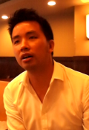
The Consumer Journey: Triggers
LEARNING: Graduation and promotion are the two important
milestones which present an opportunity for premium cars.
Premium
Car / SUV
Get a license start university
Graduate
First Job
Promotion
Pay Hike
Get Married
Premium
Car
Premium
Car
I said to myself that when my salary reached
a certain level I would buy this car.
Meen, 30,
Supply Chain Mg.
When I received my first car at 23 after graduation, I received an E-Class. I removed the star from the bonnet to not make it look like a Benz.
Pahn, 33, Real Estate Developer, D25.

Slide 11
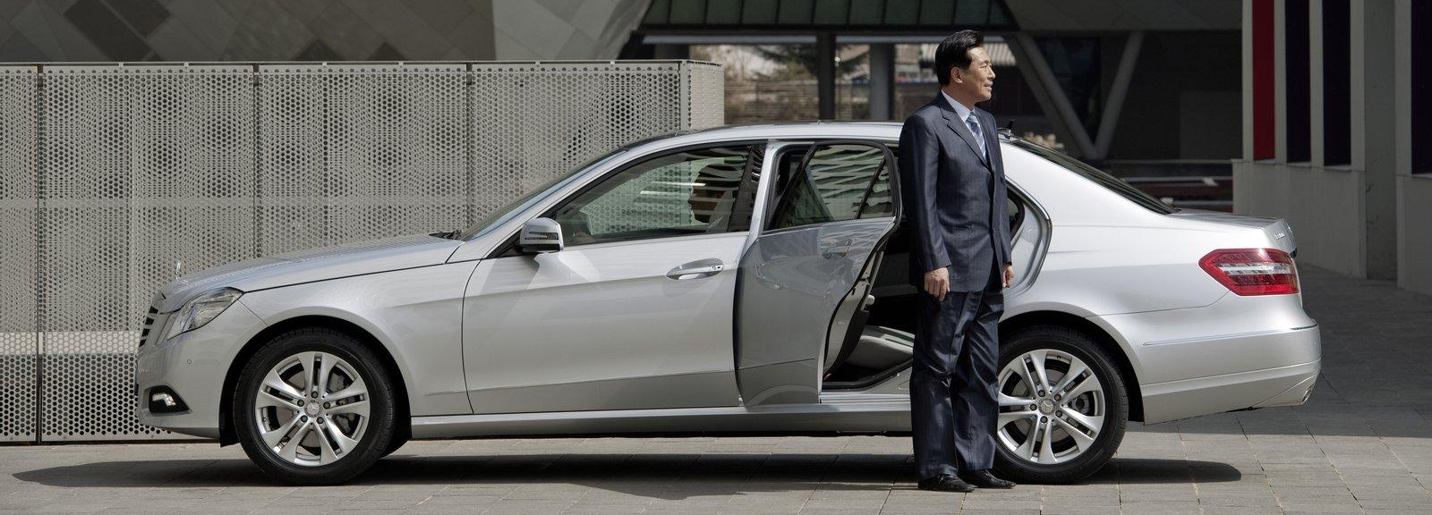
Mercedes Benz: Irrelevance
They consider it as a car for older succesful people
Cliché luxury brand, in the same realm as Rolex
Purely status symbol, not substance

Slide 12
In summary
Mercedes Benz as a brand, is not as relevant to our target group.
Competitors own brand equities that resonate with our consumers’ lifestyle (style, uniqueness, performance).
Individual products (A-Class, CLA, convertible) appeal to our target group, not necessarily the brand Mercedes-Benz itself.(yet)

Slide 13

What do we need to do?
Make this younger generation fall in love
with Mercedes-Benz
Notes:
The values of reliability and safety

Slide 14
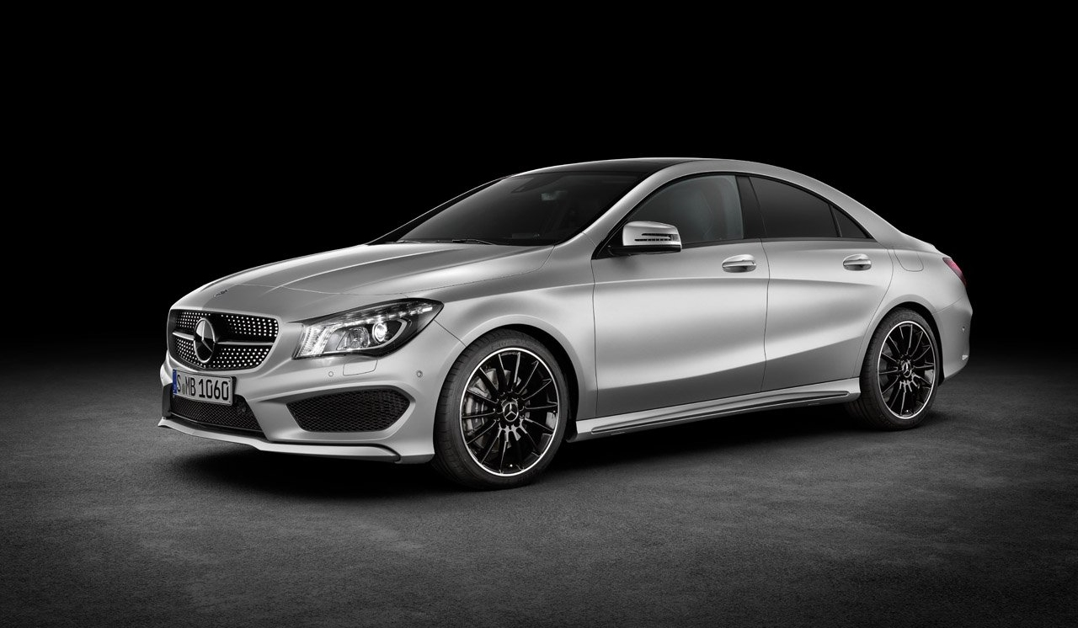
Benz Youth BE Brief
WHAT DO WE EXPECT FROM YOU?

Slide 15
Section 1: INSIGHTs
Consumer Insight
  Why the youth doesn’t fall in love with Mercedes-Benz?
  What are they expecting from a car? Why?
  What’s considered to be a cool car? Why?
  If you go on a party, would you step out of Mercedes-Benz? Why? Why not?
Channel Insight
  What types of media do youngsters like to consume? Why?
  What do youngster do in those channels? Why?
  What are the up-coming media trends?
  What would be your recommendation?

Slide 16
Section 2: Competitive Review
Look at the competitors and try to understand what elements attract the new generation!
How could we adopt certain personality of other car brands?
What fits to Mercedes-Benz, what not?
What are the tone of voice and language of other brands?
Why is it successful? Why not?
What USP of Mercedes-Benz is the right one to promote?

Slide 17
Section 3: Theory Application
Response
Role of communication
Select the most relevant model and give the reason behind

Slide 18
Section 3: Strategy/Campaign Idea
Strategy
Give a summary of your learning from your research (insights, competitors, theories
What are the conclusions of your findings for the campaign?
Selected insights, why?
A title
  A couple of words that summarize the idea
  Sync with the execution ideas you’ll be proposing

Slide 19
Section 4: Creative Executions
Title
Supported insight
Mechanics
Channels
Creative draft/examples

Slide 20




Consideration
Utilize the existing channels:
www.Mercedes-Benz.co.th
www.facebook.com/MercedesBenzThailand
www.youtube.com/MercedesBenzThailand
www.instagram.com/MercedesBenzThailand
www.PulseThailand.com
Allure: YES
Scare: NO
p!
Small budget: NO TVC, no big print campaign
All round campaign: every execution should sync

Slide 21
The time plan
1
1st Presentation – March 23rd
  All teams
  Full scale presentation
  Jugde to decide 2/3 finalists
Finalists to fine-tune their presentation according to feedback
Finalists to present in front of judge panel:
  Present to Agency, client and maybe journalists by end of April
  (date to be confirmed)
  Panel to define winner team
  Ideas may be shown in the MB magazine (+business magazine)
2
3

Slide 22
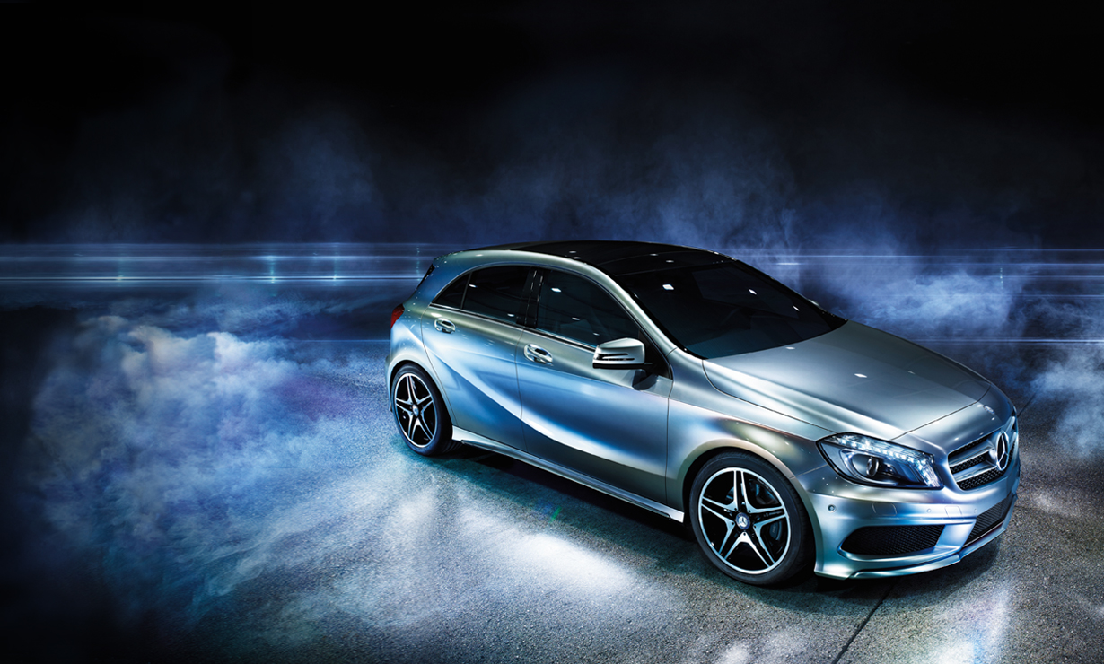
THANK YOU

