Slide 1

Welcome!
YOUR LOGO
EE361 ECONOMIES OF CLMV COUNTRIES
Notes:
© Copyright Showeet.com – Free PowerPoint Templates

Slide 2
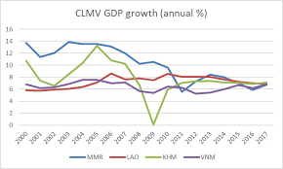
Course Description
Fenomenal growth of CLMV since 1980s
Average economic growth between 5-8% per year since year 2000
One of the world’s best economic performers
Shared experiences: similar, yet different
Geography, history, culture; colonialism, post-independence conflicts
economic reforms in 1980s and 1990s
government policies and strategies
economic development performance

Slide 3
Per capita GDP, 1986-2020

Slide 4

Course description
Development experiences in CLMV
development issues and challenges
sector development: agriculture, health, education, urban development, transport, trade
cross-cutting areas: gender, environment and climate change
International capital flows: foreign aid, foreign direct investment
relationships with Thailand and the world
4

Slide 5
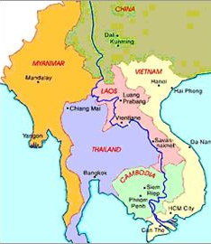
Course objectives
To understand:
development experiences of CLMV following economic reforms (1980s and 1990s
issues, challenges and policy responses in key economic sectors
how regional and international cooperation contributes to economic growth and development
5

Slide 6
Timeline of events
Phase 1
Phase 2
Phase 3
Economic and Political Reforms, 1980s
Political and economic stabilization, 1990s
Foreign aid; regional cooperation, 1990-2000
Gradual shift from central command to free market
Consolidation of power, foundations for foreign aid and investments
Greater Mekong region Programme; emergency assistance, five-year development planning
Phase 5
Phase4
Foreign investments,
sustainable development
Sector development reforms, 2000-2008
Institutional development, further sector reforms
Laws on decentralization, land management, construction, environment, trade and tariffs, health and education, business climate improvements

Slide 7

Format of EE361 class lectures
GMS geographical and historical Context
description of the CLMV countries within the wider Greater Mekong Subregion
understanding of the geographical, historical and cultural features
Economic and political reforms 1980s-1990s
Transition from command-control to market-based economy
Regional cooperation
Foreign assistance and investments
7

Slide 8
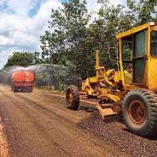
Format of EE361 lectures
Sector development in CLMV
Issues, challenges in key economic sectors: agriculture, health, education, urban development, transport, trade;
Government national policies and strategies
Selected case studies
Cross-cutting issues in CLMV, e.g., gender, environment and climate change
International capital flows
Foreign aid
Foreign direct investments
8

Slide 9
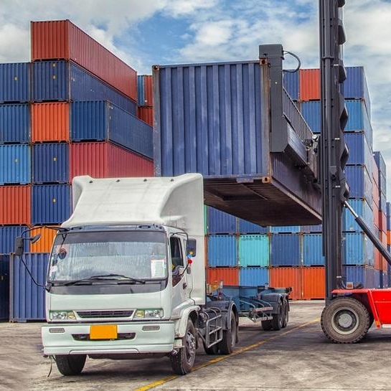
Expected learning outcomes
Students will have a good understanding of:
economic development experiences of CLMV countries
commonalities and variations in CLMV development policies and outcomes
role of key economic development sectors and government policies to address the issues that arise
role of domestic, regional and international actors in economic development
9

Slide 10

Class policy and expectations
Classes in semester 2/2021 will be on-site
Students are expected to read ahead and participate in class activities – this includes at least 70% attendance
Students are expected to be on time for class
Further clarifications or queries: students may either e-mail or set up an appointment with the lecturer
10

Slide 11
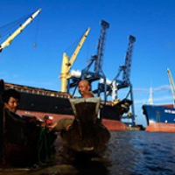
Class time and logistics
Class: Tue and Thu, 9:30-11:00 am
Room 202 Faculty of Economics
Teaching Materials Platform: BE Moodle
Instructor: Januar Hakim, PhD, MURP
E-mail: januar@econ.tu.ac.th
e-mails/queries, all correspondence should include the class section (Subject: EE361)
Main text: Todaro, M., and S. Smith. 2013. Economic Development, 13^{h} ed. Addition-Wesley: NY.
11

Slide 12
Grading
Grading Criteria
Final grade: points accumulated throughout the semester
Course requirements: participation; group presentation on a particular topic learned in class; individual paper; and midterm and final exams
Late submission of assignments/exam: up to 30 minutes a penalty of 10%, up to 60 minutes a penalty of 25%

Slide 13
Grading
Weights of each item:
Participation 15%
Group presentation 15%
Issue paper 15%
Midterm exam 25%
Final exam 30%

Slide 14
Grade conversion
Numerical grades will be converted to letter grades as follows:
>85‒100 A
>80‒85 B+
>70‒80 B
>65‒70 C+
>60‒65 C
>55‒60 D+
>45‒55 D
45 and below F

Slide 15
Announcements
No class on Thursday, 12 January 2023
Reading and slides for 17 January will be available, either through e-mail or BE Moodle
I will be present in class starting 17 January 2023
Please start to form groups of 5 students max to work on group project. Details to follow

Slide 16

Thank You!
Notes:
© Copyright Showeet.com – Free PowerPoint Templates

