Slide 1
The Market for Foreign Exchange
Chapter Five
Notes:
This chapter serves to introduce the student to the institutional framework within which exchange rates are determined and lays the foundation for much of the discussion throughout the remainder of the text. Thus it deserves their careful attention.

Slide 2
Chapter Outline
Function and Structure of the FX Market
  FX Market Participants
  Correspondent Banking Relationships
The Spot Market
  Spot Rate Quotations
  The Bid-Ask Spread
  Spot FX Trading
  Cross Exchange Rate Quotations
  Triangular Arbitrage
  Spot Foreign Exchange Market Microstructure
5-2

Slide 3
Chapter Outline (Continued)
The Forward Market
  Forward Rate Quotations
  Long and Short Forward Positions
  Non-Deliverable Forward Contracts
  Forward Cross-Exchange Rates
  Swap Transactions
  Forward Premium
Exchange-Traded Currency Funds
Summary
5-3

Slide 4
FX Market Participants
The FX market is a two-tiered market:
  Interbank market (wholesale)
    About 100-200 banks worldwide stand ready to make a market in foreign exchange.
    Nonbank dealers account for about 40% of the market.
    There are FX brokers who match buy and sell orders but do not carry inventory and FX specialists.
  Client market (retail)
Market participants include international banks, their customers, nonbank dealers, FX brokers, and central banks.
5-4

Slide 5
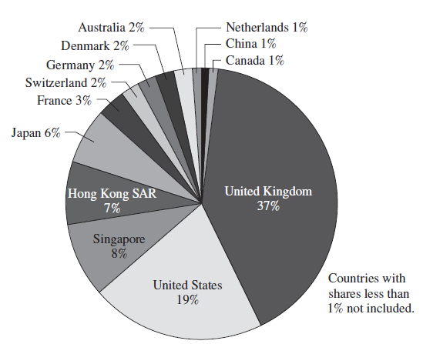
EXHIBIT 5.1 Shares of Reported Global Foreign Exchange Turnover by Country, 2013
5-5

Slide 6
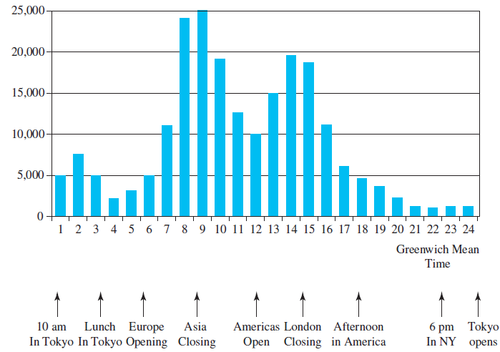
EXHIBIT 5.2 Average Electronic FX Conversations per Hour (Monday–Friday, 2001)
5-6

Slide 7
Correspondent Banking Relationships
Large commercial banks maintain demand deposit accounts with one another, which facilitates the efficient functioning of the FX market.
5-7

Slide 8
Correspondent Banking Relationships: Example 1
Bank A is in London. Bank B is in New York.
The current exchange rate is £1.00 = $1.25.
A currency trader employed at Bank A buys £160m from a currency trader at Bank B for $200 settled using its correspondent relationship.
Bank A
London
$200
Bank B
NYC
£160
5-8
Notes:
$200 = £160 × $1.25/£1.00

Slide 9
Correspondent Banking Relationships:
Example 1 (Bank A’s Balance Sheet Before and After)
Bank A buys £160m from Bank B for $200m
Bank A
London
$200
Bank B
NYC
£160
Bank A (London) 000s
Assets |  |  | Liabilities and Equity
 | OLD | NEW |  |  | OLD | NEW
£ deposit at B | £300 | £460 | B’s $ deposit |  | $580 | $780
$ deposit at B | $800 | $600 | B’s £ deposit |  | £600 | £440
Cash in the Vault | £600 | £600 | Other Liabilities |  | £300 | £300
Other Assets | £400 | £400 | Owners Equity |  | £576 | £576
Total Assets | £1,940 | £1,940 | Total Liabilities & Equity |  | £1,940 | £1,940
5-9
Notes:
€460 = €300 + €160

Slide 10
Correspondent Banking Relationships:
Example 1 (Bank B’s Balance Sheet Before and After)
Bank A buys £160m from Bank B for $200m
Bank A
London
$200
Bank B
NYC
£160
Bank B (NYC) 000s
Assets |  |  | Liabilities and Equity
 | OLD | NEW |  |  | OLD | NEW
$ deposit at A | $580 | $780 | A’s £ deposit |  | £ 300 | £460
£ deposit at A | £600 | £440 | A’s $ deposit |  | $800 | $600
Cash in the Vault | $200 | $200 | Other Liabilities |  | $200 | $200
Other Assets | $600 | $600 | Owners Equity |  | $755 | $755
Total Assets | $2,130 | $2,130 | Total Liabilities & Equity |  | $2,130 | $2,130
5-10

Slide 11
Correspondent Banking Practice Problem
Bank X is in Milan. Bank Y is in London.
The current exchange rate is €1.10 = £1.00.
Show the correct balances in each account if a currency trader employed at Bank X buys £100,000,000 from a currency trader at Bank Y for €110,000,000.
  (The balance sheets are shown on the next slide.)
5-11

Slide 12
Correspondent Banking Practice Problem (conclusion)
Bank X buys £100m from Y for €110m
€1.10 = £1.00
Bank X
Milano
€110m
Bank Y
London
£100m
Bank X
Bank Y
Assets Liabilities
Assets Liabilities
£ deposit at Y
£300m
Y’s deposit
€1,210m
€ deposit at X
€1,210m
X’s deposit
£300m
£400m
€1,320m
€1,320m
£400m
€ deposit at Y
€880m
Y’s deposit
£200m
£ deposit at X
£200m
X’s deposit
€880m
€770m
£100m
£100m
€770m
Other Assets
£600m
Other L&E
£400m
Other Assets
€590m
Other L&E
€810m
Total Assets
£1,700m
Total L&E
£1,700m
Total Assets
€2,020m
Total L&E
€2,020m
5-12

Slide 13
Correspondent Banking Communications
International commercial banks communicate with one another using:
  SWIFT: The Society for Worldwide Interbank Financial Telecommunications.
  CHIPS: Clearing House Interbank Payments System.
  ECHO: Exchange Clearing House Limited, the first global clearinghouse for settling interbank FX transactions.
5-13

Slide 14
Spot Rate Quotations
A direct quotation is:
  The U.S. dollar equivalent.
  E.g., “a Japanese Yen is worth about a penny.”
An indirect quotation is:
  The price of a U.S. dollar in the foreign currency.
  E.g., “you get 100 yen to the dollar.”
See Exhibit 5.4 in the textbook.
5-14

Slide 15
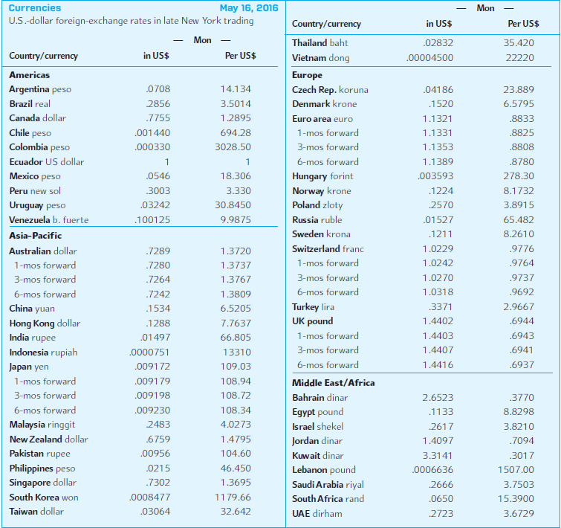
EXHIBIT 5.4 Exchange Rates (May 16, 2016)
5-15

Slide 16
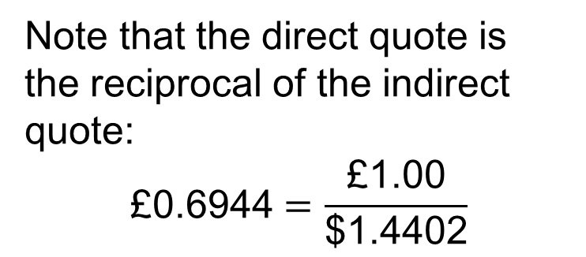
Direct and Indirect Quotes
Currencies
May 16, 2016
 | ------Monday-----
Country/currency | in US$ | per US$
Euro area euro | 1.1321 | 0.8833
1-mos forward | 1.1331 | 0.8825
3-most forward | 1.1353 | 0.8808
6-mos forward | 1.1389 | 0.8780
British pound | 1.4402 | 0.6944
1-mos forward | 1.4403 | 0.6943
3-most forward | 1.4407 | 0.6941
6-mos forward | 1.4416 | 0.6937
The direct spot quote for the pound is: £1 = $1.4402
The indirect spot quote for the pound is: £0.6944 = $1
Note that the direct quote is the reciprocal of the indirect quote:
$$\text{£0.6944}=\frac{\text{£}\text{1.00}}{\text{\$1.4402}}$$
5-16

Slide 17
The Bid-Ask Spread
The bid price is the price a dealer is willing to pay you for something.
The ask price is the amount a dealer wants you to pay for something.
It doesn’t matter if we’re talking used cars or used currencies: the bid-ask spread is the difference between the bid and ask prices.
5-17

Slide 18
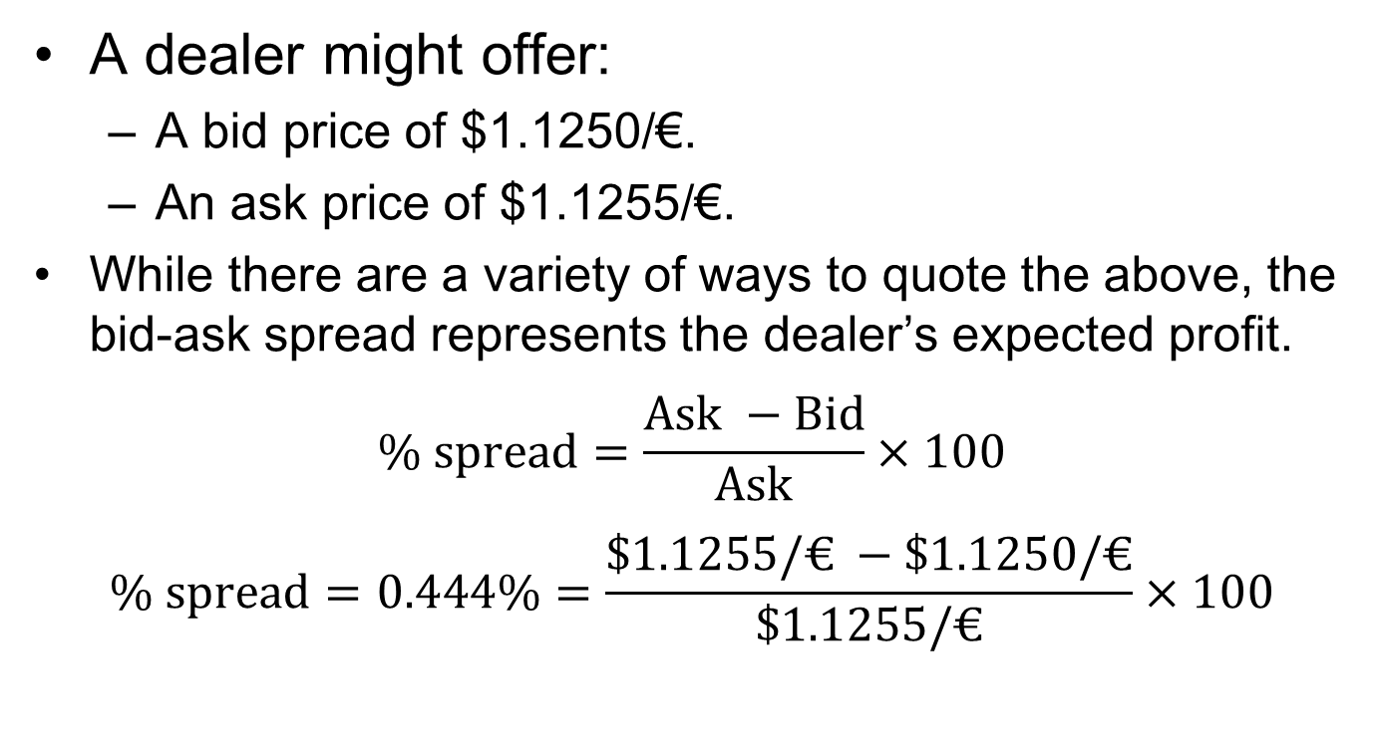
The Bid-Ask Spread as %
A dealer might offer:
  A bid price of $1.1250/€.
  An ask price of $1.1255/€.
While there are a variety of ways to quote the above, the bid-ask spread represents the dealer’s expected profit.
$$\% spread=\frac{Ask −Bid}{Ask}×100$$
$$\% spread=0.444\%=\frac{\$1.1255/€ −\$1.1250/€}{\$1.1255/€}×100$$
5-18

Slide 19
The Bid-Ask Spread:
Quoted “Big Fig” versus “Small Fig”
A dealer pricing pounds in terms of dollars would likely quote these prices as 50–55.
Anyone trading $10m knows the “big figure.”
USD Bank Quotations | American Terms |  | European Terms
 | Bid | Ask | Bid | Ask
Euro | $1.1250/€ | $1.1255/€ | €0.8885/$ | €0.8889/$
“big fig”→
“big fig”→
“small fig”→
“small fig”→
5-19

Slide 20
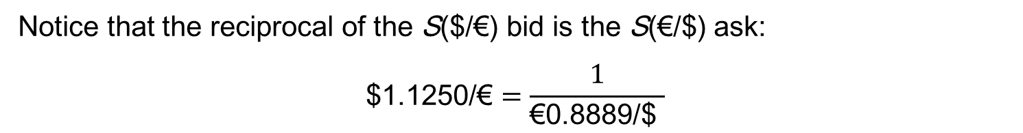



The Bid-Ask Spread:
Indirect Ask as reciprocal of Direct Bid
USD Bank Quotations | American Terms |  | European Terms
 | Bid | Ask | Bid | Ask
Euro | $1.1250/€ | $1.1255/€ | €0.8885/$ | €0.8889/$
Notice that the reciprocal of the S($/$\text{€}$) bid is the S($\text{€}$/$) ask:
$$\text{\$1.1250/€}=\frac{1}{\text{€0.8889/\$ }}$$
$$\$1,1250 =€1,000×\frac{\$1.1250}{€1.00}$$
$1,125
Customer
Dealer
Dealer
Customer
$$€1,000=\$1,1250 ×\frac{€0.8889}{\$1.00}$$
$\text{€}$1,000
Customer buys $1,125 from dealer at indirect ask
Customer sells €1,000 to dealer at direct bid
5-20

Slide 21
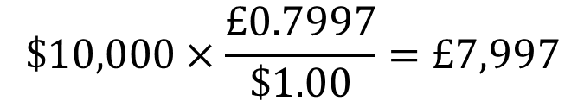
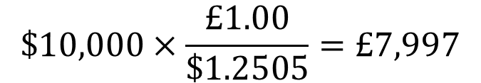
Currency Conversion with Bid-Ask Spreads
A speculator in New York wants to take a $10,000 position in the pound. He faces these bid-ask prices:
After his trade, what will be his position?
Bid Ask
Dealer will pay $1.2500 for 1 GBP; he is asking $1.2505/£.
He will pay £0.7997 for $1 and will charge £0.8000 for $1
S($/£)
1.2500 – 05
S(£/$)
.7997– 03
Investor selling USD at the indirect bid:
Investor buying GBP at the direct ask:
$$\$10,000×\frac{£0.7997}{\$1.00}=£7,997$$
$$\$10,000×\frac{£1.00}{\$1.2505}=£7,997$$
5-21
Notes:
The easiest way to keep bid and ask prices straight is to take the position of the retail customer and anticipate getting the “worst” price every time.

Slide 22
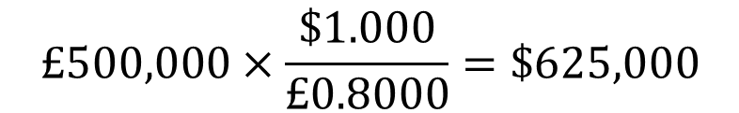
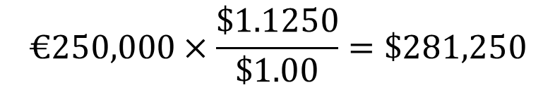
Sample Currency Conversion Problem
A businessman has just completed transactions in Italy and England. He is now holding €250,000 and £500,000 and wants to convert to U.S. dollars.
His currency dealer provides this quotation:
  GBP/USD 0.7997– 03
  USD/EUR 1.1250 – 55
  What are his proceeds from conversion?
He sells €250,000 at the dealer’s bid price:
$$€250,000×\frac{\$1.1250}{\$1.00}=\$281,250$$
He buys £500,000 worth of USD
at the dealer’s ask price:
$$£500,000×\frac{\$1.000}{£0.8000}=\$625,000$$
$906,250
5-22
Notes:
$1,353,502.58

Slide 23
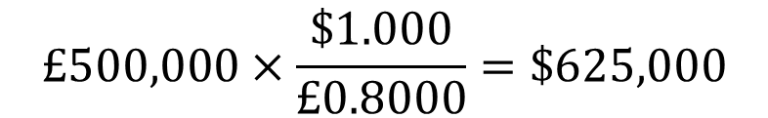
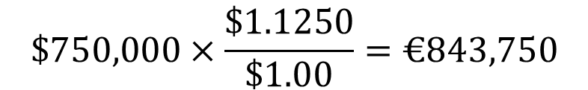
Second Sample Currency Conversion Problem
An Italian has just completed transactions in America and England.
He is now holding $125,000 and £500,000, and wants to convert both amounts to euro.
His currency dealer provides this quotation:
  GBP/USD 0.7997– 03
  USD/EUR 1.1250 – 55
  What are his proceeds from conversion?
$$£500,000×\frac{\$1.000}{£0.8000}=\$625,000$$
↓
$$\$750,000×\frac{\$1.1250}{\$1.00}=€843,750$$
Notes:
$1,353,502.58

Slide 24
Spot FX Trading
In the interbank market, the standard size trade is about U.S. $10 million.
A bank trading room is a noisy, active place.
The stakes are high.
The “long term” is about 10 minutes.
5-24

Slide 25
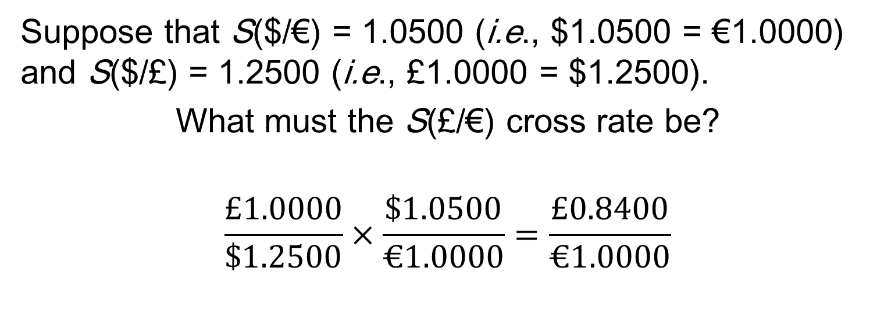
Spot Cross Rates
Suppose that S($/€) = 1.0500 (i.e., $1.0500 = €1.0000) and S($/£) = 1.2500 (i.e., £1.0000 = $1.2500).
What must the S(£/€) cross rate be?
$$\frac{£1.0000}{\$1.2500}×\frac{\$1.0500}{€1.0000}=\frac{£0.8400}{€1.0000}$$
Pay attention to your “currency algebra”!
5-25

Slide 26
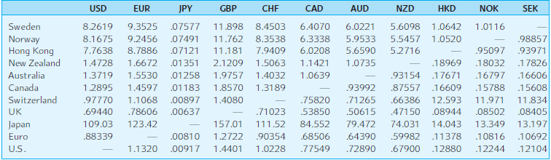
EXHIBIT 5.6 Key Cross-Currency Rates
5-26

Slide 27
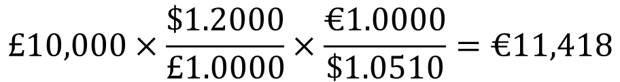
Cross Bid Rates with Bid-Ask Spreads
£10,000
sell £ at bid
$12,000
buy € at ask
€11,418
USD Bank Quotations | American Terms |  | European Terms
 | Bid | Ask | Bid | Ask
Pounds | 1.2000 | 1.2500 | .8000 | .8333
Euros | 1.0500 | 1.0510 | .9515 | .9524
€/£ | €1.1418 |  |  | £0.8758
To find the €/£ cross bid rate, consider a retail customer who:
Starts with £10,000, sells £ for $, and buys €:
$$£10,000×\frac{\$1.2000}{£1.0000}×\frac{€1.0000}{\$1.0510}=€11,418$$
1
€1.1418/£
He has effectively sold £ at a €/£ bid price of €1.1418/£.
5-27

Slide 28
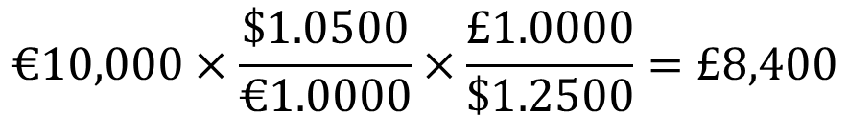
Cross Ask Rates with Bid-Ask Spreads
€10,000
sell € at bid
$10,500
buy £ at ask
£8,400
USD Bank Quotations | American Terms |  | European Terms
 | Bid | Ask | Bid | Ask
Pounds | 1.2000 | 1.2500 | .8000 | .8333
Euros | 1.0500 | 1.0510 | .9515 | .9524
€/£ | €1.1418 | €1.1905 | £0.8400 | £0.8758
To find the €/£ cross ask rate, consider a retail customer who starts with €10,000, sells € for $, and buys £:
$$€10,000×\frac{\$1.0500}{€1.0000}×\frac{£1.0000}{\$1.2500}=£8,400$$
1
€1/£0.8400
= €1.1905/£
He has effectively sold € at a £/€ bid price of £0.8400/€.
He has effectively bought £ at a €/£ ask price of €1.1905/£.
5-28

Slide 29
Cross Rates with Bid-Ask Spreads
direct
indirect
Bank Quotations | American Terms |  | European Terms
 | Bid | Ask | Bid | Ask
£:$ | 1.2000 | 1.2500 | .8000 | .8333
€:$ | 1.0500 | 1.0510 | .9515 | .9524
€/£ | €1.1418/£ | €1.1905/£ | £0.8400/€ | £0.8758/€
Recall that the reciprocal of the S(£/€) bid is the S(€/£) ask.
€1.1905
€1.000
=
£1.00
£0.8400
He has bought £ at a €/£ ask price of €1.1905/£
Bid-ask quote would be €/£: 1.1418-487
5-29

Slide 30
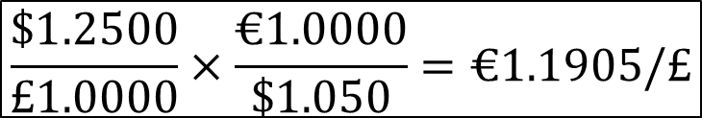
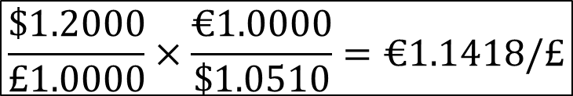
Triangular Arbitrage Example
 | Bid | Ask
Deutsche Bank $:£ | $1.2000/£ | $1.2500/£
Credit Lyonnais $:€ | $1.0500/€ | $1.0510/€
Credit Agricole €/£ | €1.1400/£ | €1.1800/£
“No Arbitrage” €/£ | €1.1418/£ | €1.1905/£
Suppose we observe these banks posting these exchange rates. As we have calculated the “no arbitrage” €/£ cross bid and ask rates, we can see that there is an arbitrage opportunity: Credit Agricole’s ask is too low.
$$\frac{\$1.2000}{£1.0000}×\frac{€1.0000}{\$1.0510}=€1.1418/£$$
$$\frac{\$1.2500}{£1.0000}×\frac{€1.0000}{\$1.050}=€1.1905/£$$
5-30

Slide 31
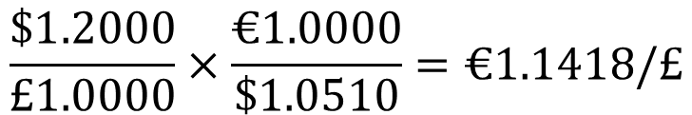
Triangular Arbitrage Example (continued)
Bank Quotations | Bid | Ask
Deutsche Bank $:£ | $1.2000/£ | $1.2500/£
Credit Lyonnais $:€ | $1.0500/€ | $1.0510/€
Credit Agricole €/£ | €1.1400/£ | €1.1400/£
“No Arbitrage” €/£ | €1.1418/£ | €1.1905/£
By going through Deutsche Bank and Credit Lyonnais, we can sell pounds for €1.1418.
$$\frac{\$1.2000}{£1.0000}×\frac{€1.0000}{\$1.0510}=€1.1418/£$$
The arbitrage is to buy the pounds from Credit Agricole for €1.1400/£.
5-31

Slide 32



Triangular Arbitrage Example (concluded)
 | Bid | Ask
Deutsche Bank £:$ | $1.2000/£ | $1.2500/£
Credit Lyonnais €:$ | $1.0500/€ | $1.0510/€
Credit Agricole £:€ | €1.1400/£ | €1.1400/£
Start with £1m. Sell £ to Deutsche Bank for $1,200,000:
$$£1,000,000×\frac{\$1.2000}{£1.0000}=\$1,200,000$$
Buy € from Credit Lyonnais, receive €1,141,769.74:
$$\$1,200,000×\frac{€1.000}{\$1.0510}=€1,141,769.74$$
Buy £ from Credit Agricole, receive £1,001,552.41.
$$€1,141,769.74×\frac{£1.0000}{€1.1400}=£1,001,552.41$$
5-32

Slide 33
Spot Foreign Exchange Microstructure
Market microstructure refers to the mechanics of how a marketplace operates.
The bid-ask spreads in the spot FX market:
  Increase with FX exchange rate volatility.
  Decrease with dealer competition.
Private information is an important determinant of spot exchange rates.
5-33

Slide 34
The Forward Market
Forward Rate Quotations
Long and Short Forward Positions
Non-Deliverable Forward Contracts
Forward Cross Exchange Rates
Forward Premium
Swap Transactions
5-34

Slide 35
Forward Rate Quotations
The forward market for FX involves agreements to buy and sell foreign currencies in the future at prices agreed upon today.
Bank quotes for 1, 3, 6, 9, and 12 month maturities are readily available for forward contracts.
Longer-term swaps are available.
5-35

Slide 36
Forward Rate Quotation Example
Consider the exchange rates shown to the right. For British pounds, the spot exchange rate is
$1.4402 = £1.00 while the 180-day forward rate is $1.4416 = £1.00
What’s up with that?
Country/currency | in US$ | per US$
U.K./British pound | 1.4402 | 0.6944
1-mos forward | 1.4403 | 0.6943
3-most forward | 1.4407 | 0.6941
6-mos forward | 1.4416 | 0.6937
Clearly market participants expect that the pound will be worth more (in dollars) in six months.
5-36

Slide 37
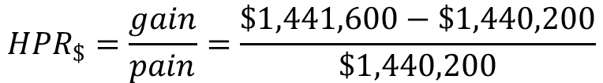
Forward Rate Quotation: Dollar-Based Holding Period Return
Consider the (dollar) holding period return of a dollar-based investor who buys £1 million at the spot exchange rate and sells them forward:
$${HPR}_{\$}=\frac{gain}{pain}=\frac{\$1,441,600−\$1,440,200}{\$1,440,200}$$
HPR$ = 0.0010
Annualized dollar HPR = 0.1944% = –0.0972% × 2
5-37

Slide 38
Forward Premium
The interest rate differential implied by forward premium or discount.
For example, suppose the € is appreciating from S($/€) = 1.1321 to F₁₈₀($/€) = 1.1389.
The 180-day forward premium is given by:
F₁₈₀($/€) – S($/€)
360
1.1389 – 1.1321
f_{180,€v$}
=
×
=
× 2
S($/€)
180
1.1321
= 0.0120, or 1.20%
5-38

Slide 39
Long and Short Forward Positions
If you have agreed to sell anything (spot or forward), you are “short.”
If you have agreed to buy anything (forward or spot), you are “long.”
So, if you have agreed to sell an FX forward, you are short, and if you have agreed to buy an FX forward, you are long.
5-39

Slide 40
Forward Contract Payoff Profiles
Payoff from long position in £10,000
Consider the payoffs at maturity to a long position in a six month forward contract on £10,000 purchased at $1.4416/£.
profit
$584
Spot exchange in 6 months $/£
$1.40/£
−$416
$1.50/£
Country/currency | in US$ | per US$
UK/pound | 1.4402 | 0.6944
1-mos forward | 1.4403 | 0.6943
3-most forward | 1.4407 | 0.6941
6-mos forward | 1.4416 | 0.6937
$1.4416/£
loss
5-40

Slide 41
Non-Deliverable Forward Contracts
Due to government-initiated capital controls, the currencies of some emerging market countries not freely traded.
For many of these currencies, trading in non-deliverable forward contracts exists.
A non-deliverable forward contract is settled in cash, usually U.S. dollars.
  Settlement is calculated by the difference between the forward price agreed to in the contract and the spot price at maturity of the contract multiplied by the contract size.
5-41

Slide 42
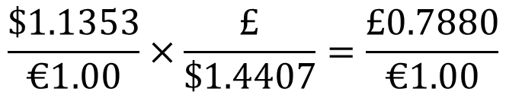
Forward Cross Rates
Currencies
May 16, 2016
 | ------Monday-----
Country/currency | in US$ | per US$
Euro area euro | 1.1321 | 0.8833
1-mos forward | 1.1331 | 0.8825
3-most forward | 1.1353 | 0.8808
6-mos forward | 1.1389 | 0.8780
British pound | 1.4402 | 0.6944
1-mos forward | 1.4403 | 0.6943
3-most forward | 1.4407 | 0.6941
6-mos forward | 1.4416 | 0.6937
The 3-month forward €/£ cross rate is:
$$\frac{\$1.1353}{€1.00}×\frac{£}{\$1.4407}=\frac{£0.7880}{€1.00}$$
5-42

Slide 43
Currency Symbols
In addition to the familiar currency symbols (£, ¥, €, $) there are three-letter codes for all currencies.
It is a long list, but selected codes include:
CHF Swiss francs
GBP British pound
ZAR South African rand
CAD Canadian dollar
JPY Japanese yen
5-43

Slide 44
Swaps
A swap is an agreement to provide a counterparty with something he or she wants in exchange for something that you want.
  Often on a recurring basis, e.g., every six months for five years.
Swap transactions account for approximately 56 percent of interbank FX trading, whereas outright trades are 11 percent.
Swaps are covered fully in Chapter 14.
5-44

Slide 45
Exchange-Traded Currency Funds
Individual shares are denominated in the U.S. dollar and trade on the New York Stock Exchange.
  Consider an ETF where each share represents 100 euros. The price of one share at any point in time will reflect the spot dollar value of 100 euros plus accumulated interest minus expenses.
Six additional currency trusts exist on the Australian dollar, British pound sterling, Canadian dollar, Mexican peso, Swedish krona, and the Swiss franc.
Currency is now recognized as a distinct asset class, like stocks and bonds. Currency ETFs facilitate investing in these currencies.
5-45

Slide 46
Summary
Spot rate quotations
  Direct and indirect quotes
  Bid and ask prices
Cross Rates
  Triangular arbitrage
Forward Rate Quotations
  Forward premium (discount)
  Forward points
5-46

Slide 47
Summary (continued)
The FX market is the largest and most active financial market in the world. It is open somewhere in the world 24 hours a day, 365 days a year.
The FX market is divided into two tiers: the retail or client market and the wholesale or interbank market.
The FX market participants include international banks, bank customers, nonbank FX dealers, FX brokers, and central banks.
Additionally, the concept of a cross-exchange rate was developed. Non-dollar currency transactions must satisfy the bid-ask spread determined from the cross-rate formula or a triangular arbitrage opportunity exists
5-47

