Slide 1
Risk Management Products
1.Anongpat U. 5204640030
2.Kunlanat A. 5204640410
3.Natcha V. 5204640451
4.Natchana P. 5204640469
5.Pornpicha E. 5204640873
6.Ravisara H. 5204640907

Slide 2
What is Risk Management products?
A RMP is a financial product, which allows a client to transform the financial risk characteristics of its obligation under a loan or other instrument without renegotiating or amending the terms of the original instrument.

Slide 3
Purpose of offering risk management products
The Bank offers RMPs to its clients in order to enable them to hedge their exposure to market risks including interest rate, currency exchange and commodity price risks, thus allowing them to engage in debt management. RMPs will be available to clients at the time of loan signature or at any time during the life of the loan.

Slide 4
Risk management products offered
Thai Bank may offer the following RMPs, or combinations thereof, to eligible Clients:
Interest risk management
  Interest rate swaps
    This is an exchange of cash flows between two parties, which generally transforms floating rate obligations in a particular currency into a fixed rate obligation in that same currency or vice versa.
Foreign exchange risk management
  FX Forward
    Agreement to purchase or sell a set amount of a foreign currency at a specified price for settlement at a predetermined future date.
  FX Option
    FX Options can help to assure the minimum profit margin of customer’s international trade deals while allowing customer to benefit from favorable market exchange rate movements.
  Currency swaps
    This is an exchange of cash flows denominated in different currencies.

Slide 5

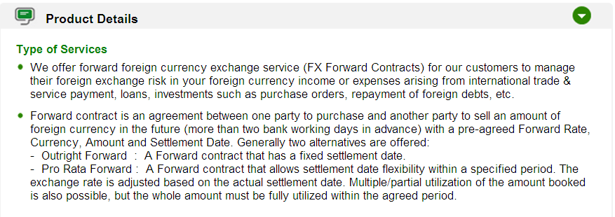
Realistic example of RMP in Thailand

