Slide 1

Chapter 1: Homework

Slide 2

Group Homework
Group Homework #1: Chapter Presentations
1.Each group will be assigned 2 cases/class
& presented in the following class.
2. You are allowed on more than 3 page ppt slides, and 7 minutes presentation for each case
3. Contents should include :Summary of case and answers, suggestions etc.
4. After each presentation, we will have class discussion therefore everyone should read the cases before coming to class.
Notes:
1

Slide 3
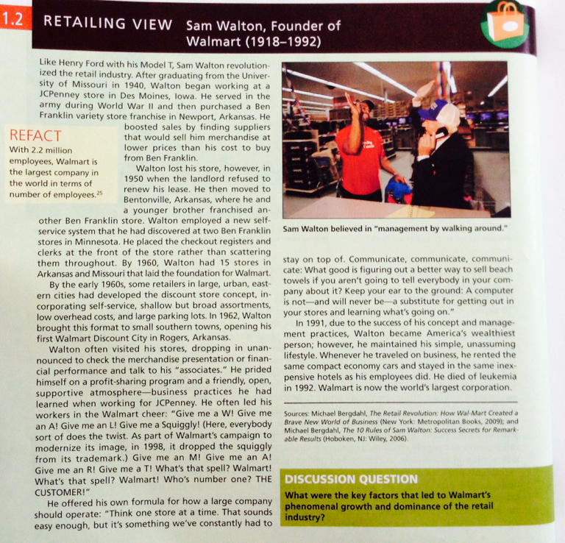
Chapter Presentation 1.1
Page 18
Notes:
1

Slide 4
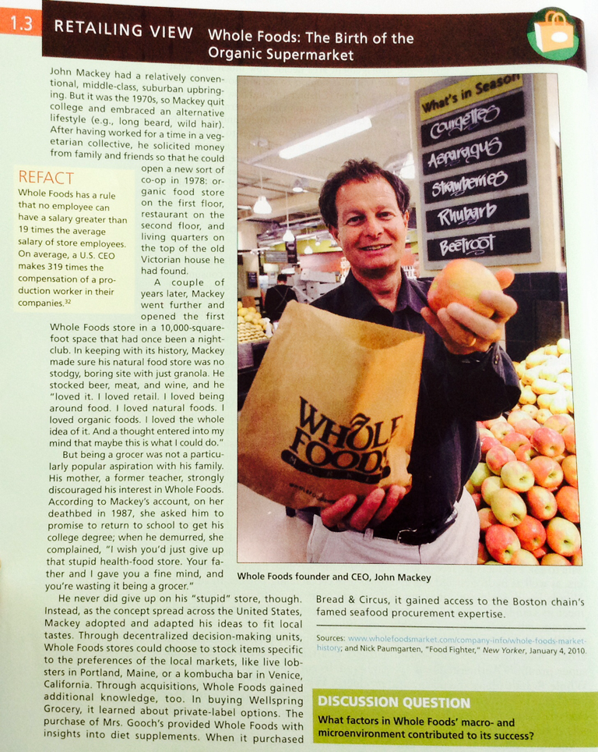
Chapter Presentation 1.1
Page 26
Notes:
1

Slide 5
Group Homework
Group Homework #2: Project Mini-presentation 1
1.Discuss and decide which retail business your team wants to work on.
2. Prepare a 10 minute presentation in the retail business you are interested in…Restaurants, clothing store, supermarkets etc. –
CEO, please re-confirm before leaving class (no duplicates)
- For example, if you choose minimart, you should choose 7-eleven as your ideal retail store and find as much information, including competitors,market situation, IMC, etc.
3. Presentation due Monday January 15
Notes:
1

Slide 6
Individual Homework
" Retail Experience Delight"
You are to choose one retail place that you love the most in the world and describe your shopping experience associated with the retail. You should write the details of your experience and how you felt ,etc. Then you are to write down how they can be better, improve and explain why.
This is free style so you could include photos,charts, etc, to communicate your experiences. If you have a photo of yourself at that place, feel free to include that in.
The assignment should be no more than 1 A4 page and is due Monday January 15
Notes:
1

Slide 7


