Slide 1
Chapter 9: Multifactor Models of
Risk and Return
Analysis of Investments &
Management of Portfolios
10TH EDITION
Reilly & Brown

Slide 2
Arbitrage Pricing Theory
CAPM is criticized because of
  The many unrealistic assumptions
  The difficulties in selecting a proxy for the market portfolio as a benchmark
An alternative pricing theory with fewer assumptions was developed: Arbitrage Pricing Theory (APT)

Slide 3
Arbitrage Pricing Theory
Three Major Assumptions:
  Capital markets are perfectly competitive
  Investors always prefer more wealth to less wealth with certainty
  The stochastic process generating asset returns can be expressed as a linear function of a set of K factors or indexes
In contrast to CAPM, APT doesn’t assume
  Normally distributed security returns
  Quadratic utility function
  A mean-variance efficient market portfolio
Notes:
15

Slide 4
Arbitrage Pricing Theory
The APT Model
E(R_{i})=λ₀+ λ₁b_{i1}+ λ₂b_{i2}+…+ λ_{k}b_{ik}
where:
λ₀=the expected return on an asset with zero systematic risk
λ_{j}=the risk premium related to the j th common risk factor
b_{ij}=the pricing relationship between the risk premium and the asset; that is, how responsive asset i is to the j th common factor
Notes:
15

Slide 5
Arbitrage Pricing Theory
A Comparison with CAPM
  In CAPM, the relationship is as follows:
E(R_{i})=RFR + β_{i}[(E(R_{M}-RFR)]
  Comparing CAPM and APT (Exhibit 9.1)
  CAPM APT
  Form of Equation Linear Linear
  Number of Risk Factors 1 K (≥ 1)
  Factor Risk Premium [E(RM) – RFR] {λ_{j}}
  Factor Risk Sensitivity β_{i} {b_{ij}}
  “Zero-Beta” Return RFR λ₀
Notes:
15

Slide 6
Arbitrage Pricing Theory
More Discussions on APT
  Unlike CAPM that is a one-factor model, APT is a multifactor pricing model
  However, unlike CAPM that identifies the market portfolio return as the factor, APT model does not specifically identify these risk factors in application
  These multiple factors include
    Inflation
    Growth in GNP
    Major political upheavals
    Changes in interest rates
Notes:
15

Slide 7
Using the APT
Selecting Risk Factors
  As discussed earlier, the primary challenge with using the APT in security valuation is identifying the risk factors
  For this illustration, assume that there are two common factors
    First risk factor: Unanticipated changes in the rate of inflation
    Second risk factor: Unexpected changes in the growth rate of real GDP

Slide 8
Using the APT
Determining the Risk Premium
  λ₁: The risk premium related to the first risk factor is 2 percent for every 1 percent change in the rate (λ₁=0.02)
  λ₂: The average risk premium related to the second risk factor is 3 percent for every 1 percent change in the rate of growth (λ₂=0.03)
  λ₀: The rate of return on a zero-systematic risk asset (i.e., zero beta) is 4 percent (λ₀=0.04)

Slide 9
Using the APT
Determining the Sensitivities for Asset X and Asset Y
  b_{x1} = The response of asset x to changes in the inflation factor is 0.50 (bx1 0.50)
  b_{x2} = The response of asset x to changes in the GDP factor is 1.50 (bx2 1.50)
  b_{y1} = The response of asset y to changes in the inflation factor is 2.00 (by1 2.00)
  b_{y2} = The response of asset y to changes in the GDP factor is 1.75 (by2 1.75)

Slide 10
Using the APT
Estimating the Expected Return
  The APT Model
= .04 + (.02)b_{i1} + (.03)b_{i2}
  Asset X
E(R_{x}) = .04 + (.02)(0.50) + (.03)(1.50)
= .095 = 9.5%
  Asset Y
E(R_{y}) = .04 + (.02)(2.00) + (.03)(1.75)
= .1325 = 13.25%

Slide 11
Security Valuation with the APT:
An Example
Three stocks (A, B, C) and two common systematic risk factors have the following relationship (Assume λ₀=0 )
  E(R_{A})=(0.8) λ₁ + (0.9) λ₂
  E(R_{B})=(-0.2) λ₁ + (1.3) λ₂
  E(R_{C})=(1.8) λ₁ + (0.5) λ₂
If λ₁=4% and λ₂=5%, then it is easy to compute the expected returns for the stocks:
  E(R_{A})=7.7%
  E(R_{B})=5.7%
  E(R_{C})=9.7%

Slide 12
Security Valuation with the APT:
An Example
Expected Prices One Year Later
  Assume that all three stocks are currently priced at $35 and do not pay a dividend
  Estimate the price
  E(P_{A})=$35(1+7.7%)=$37.70
  E(P_{B})=$35(1+5.7%)=$37.00
  E(P_{C})=$35(1+9.7%)=$38.40

Slide 13
Security Valuation with the APT:
An Example
Arbitrage Opportunity
  If one “knows” actual future prices for these stocks are different from those previously estimated, then these stocks are either undervalued or overvalued
  Arbitrage trading (by buying undervalued stocks and short overvalued stocks) will continues until arbitrage opportunity disappears
  Assume the actual prices of stocks A, B, and C will be $37.20, $37.80, and $38.50 one year later, then arbitrage trading will lead to new current prices:
      E(P_{A})=$37.20 / (1+7.7%)=$34.54
      E(P_{B})=$37.80 / (1+5.7%)=$35.76
      E(P_{C})=$38.50 / (1+9.7%)=$35.10

Slide 14
Empirical Tests of the APT
Roll-Ross Study (1980)
  The methodology used in the study is as follows
    Estimate the expected returns and the factor coefficients from time-series data on individual asset returns
    Use these estimates to test the basic cross-sectional pricing conclusion implied by the APT
  The authors concluded that the evidence generally supported the APT, but acknowledged that their tests were not conclusive

Slide 15
Empirical Tests of the APT
Extensions of the Roll-Ross Study
  Cho, Elton, and Gruber (1984) examined the number of factors in the return-generating process that were priced
  Dhrymes, Friend, and Gultekin (1984) reexamined techniques and their limitations and found the number of factors varies with the size of the portfolio
  Roll and Ross (1984) pointed out the number of factors is a secondary issue compared to how well the model can explain the expected return

Slide 16
Empirical Tests of the APT
Extensions of the Roll-Ross Study
  Dhrymes, Friend, and Gultekin (1985) repeated the prior tests with large samples and found that the unique risk can be used to predict future return.
  Connor and Korajczyk (1993) developed a test that identifies the number of factors in a model that does allow the unsystematic components of risk to be correlated across assets
  Harding (2008) also showed the connection between systematic and unsystematic risk factors

Slide 17
Empirical Tests of the APT
The APT and Stock Market Anomalies
  Small-firm Effect
    Reinganum: Results inconsistent with the APT
    Chen: Supported the APT model over CAPM
  January Anomaly
    Gultekin and Gultekin: APT not better than CAPM
    Burmeister and McElroy: Effect not captured by model, but still rejected CAPM in favor of APT

Slide 18
Empirical Tests of the APT
Shanken’s Challenge to Testability of the APT
  APT has no advantage because the factors need not be observable, so equivalent sets may conform to different factor structures
  Empirical formulation of the APT may yield different implications regarding the expected returns for a given set of securities
  Thus, the theory cannot explain differential returns between securities because it cannot identify the relevant factor structure that explains the differential returns

Slide 19
Empirical Tests of the APT
Alternative Testing Techniques
  Jobson (1982) proposes APT testing with a multivariate linear regression model
  Brown and Weinstein (1983) propose using a bilinear paradigm
  Geweke and Zhou (1996) produce an exact Bayesian framework for testing the APT
  Others propose new methodologies

Slide 20
Multifactor Models & Risk Estimation
The Multifactor Model in Theory
  In a multifactor model, the investor chooses the exact number and identity of risk factors, while the APT model doesn’t specify either of them
  The Equation
  R_{it} = a_{i} + [b_{i1}F_{1t} + b_{i2} F_{2t} + . . . + b_{iK} F_{Kt}] + e_{it}
where:
F_{it}=Period t return to the jth designated risk factor
R_{it} =Security i’s return that can be measured as either a nominal or excess return to

Slide 21
Multifactor Models & Risk Estimation
The Multifactor Model in Practice
  Macroeconomic-Based Risk Factor Models: Risk factors are viewed as macroeconomic in nature
  Microeconomic-Based Risk Factor Models: Risk factors are viewed at a microeconomic level by focusing on relevant characteristics of the securities themselves,
  Extensions of Characteristic-Based Risk Factor Models

Slide 22
Macroeconomic-Based Risk Factor Models
Security return are governed by a set of broad economic influences in the following fashion by Chen, Roll, and Ross in 1986 (Exhibit 9.3)
R
=
a
+
[
b
R
+
b
MP
+
b
DEI
+
b
UI
+
b
UPR
+
b
UTS
]
+
e
it
i
i
1
mt
i
2
t
i
3
t
i
4
t
i
5
t
i
6
t
it
where:
R_{m}= the return on a value weighted index of NYSE-listed stocks
MP=the monthly growth rate in US industrial production
DEI=the change in inflation, measured by the US consumer price index
UI=the difference between actual and expected levels of inflation
UPR=the unanticipated change in the bond credit spread
UTS= the unanticipated term structure shift (long term less short term RFR)

Slide 23
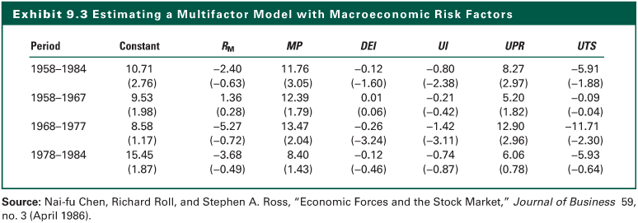
Exhibit 9.3

Slide 24
Macroeconomic-Based Risk Factor Models
Burmeister, Roll, and Ross (1994) analyzed the predictive ability of a model based on the following set of macroeconomic factors.
  Confidence risk
  Time horizon risk
  Inflation risk
  Business cycle risk
  Market timing risk

Slide 25
Microeconomic-Based Risk Factor Models
Fama and French (1993) developed a multifactor model specifying the risk factors in microeconomic terms using the characteristics of the underlying securities (See Exhibit 9.5)
  SMB (i.e. small minus big) is the return to a portfolio of small capitalization stocks less the return to a portfolio of large capitalization stocks
  HML (i.e. high minus low) is the return to a portfolio of stocks with high ratios of book-to-market values less the return to a portfolio of low book-to-market value stocks
(
R
−
RFR
)
=
a
+
b
(
R
−
RFR
)
+
b
SMB
+
b
HML
+
e
it
t
i
i
1
mt
t
i
2
t
i
3
t
it

Slide 26
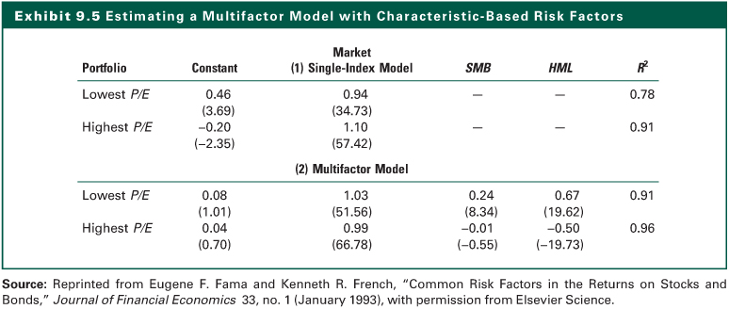
Exhibit 9.5

Slide 27
Microeconomic-Based Risk Factor Models
Carhart (1997), based on the Fama-French three factor model, developed a four-factor model by including a risk factor that accounts for the tendency for firms with positive past return to produce positive future return
  where, MOM_{t} = the momentum factor
(
R
−
RFR
)
=
a
+
b
(
R
−
RFR
)
+
b
SMB
+
b
HML
+
b
MOM
+
e
it
t
i
i
1
mt
t
i
2
t
i
3
t
i
4
t
it

Slide 28
Extensions of Characteristic-Based Risk Factor Models
One type of security characteristic-based method for defining systematic risk exposures involves the use of index portfolios (e.g. S&P 500, Wilshire 5000) as common risk factors such as the one by Elton, Gruber, and Blake (1996), who rely on four indexes:
  The S&P 500
  The Barclays Capital aggregate bond index
  The Prudential Bache index of the difference between large- and small-cap stocks
  The Prudential Bache index of the difference between value and growth stocks

Slide 29
Extensions of Characteristic-Based Risk Factor Models
The MSCI Barra Model: Use the following Characteristic-based the risk factors
  Volatility (VOL)
  Momentum (MOM)
  Size (SIZ)
  Size Nonlinearity (SNL)
  Trading Activity (TRA)
  Growth (GRO)
  Earnings Yield (EYL)
  Value (VAL)
  Earnings Variability (EVR)
  Leverage (LEV)
  Currency Sensitivity (CUR)
  Dividend Yield (YLD)
  Nonestimation Indicator (NEU)

Slide 30
Estimating Risk in a Multifactor Setting
Estimating Expected Returns for Individual Stocks
  A specific set of K common risk factors must be identified
  The risk premia for the factors must be estimated
  Sensitivities of the ith stock to each of those K factors must be estimated
  The expected returns can be calculated by combining the results of the previous steps in the appropriate way

Slide 31
The Internet Investments Online
http://www.barra.com
http://www.kellogg.northwestern.edu/faculty/korajczy/htm/aptlist.htm
http://www.mba.tuck.dartmouth.edu/pages/faculty/ken.french

