Slide 1
National Income and Product Account
2

Slide 2
2.1 The component of Macroeconomy
Macroeconomics focuses on five groups:

Slide 3
2.2 Circular flow diagram
Circular flow: A diagram showing the income received and payments made by each sector of the economy.

Slide 4
Injection
Withdrawal
Foreign Sector
Firms
Financial Institutions
Households
Government

Slide 5
2.3 National Income and Product Account
National income and product accounts:
Data collected and published by the government describing the various components of national income and output in the economy.
Office of the National Economics Development Board (NESDB)
  www.nesdb.go.th

Slide 6
Gross Domestic Product
Gross Domestic Product (GDP): The total market value of all final goods and services produced within a given period by factors of production located within a
country.

Slide 7
Concept of final goods and services
Final goods and services: Goods and services produced for final use.
Intermediate goods: Goods that are produced by one firm for use in further processing by another firm.
Value added: The difference between the value of goods as they leave a stage of production and the cost of the goods as they entered that stage.

Slide 8
2.4 GDP versus GNP
Gross Domestic Product (GDP):
Look at output that use factor of production within the country to produce goods and services
Gross National product (GNP)
The total market value of all final goods and services produced within a given period by factors of production owned by a country’s citizens, regardless of where the output is produced.

Slide 9
2.4 GDP versus GNP
Example
  Income from factory located in other country
  Maid and labor work in other country
  GNP = GDP + Net Factor Income from Abroad
  Net factor income from abroad = Income from Thai factor of
  production used to produce G&S abroad – Income from foreign
  factor of production used to produce G&S in Thailand

Slide 10
2.5 Measurement of GDP
Production Approach
Expenditure Approach
Income Approach

Slide 11
2.5.1 Product Approach
Calculated from value of final goods and services
Calculated using value added method

Slide 12

Production Approach: using final G&S values
  Calculate total value of final goods and service: suppose there are 400 apples and 300 oranges in the economy
B 10
B 5
GDP = (price of apples × amount of apples)
+ (price of oranges × amount of oranges)
=
GDP =

Slide 13
Production Approach: using value-added values
Value added The difference between the value of goods as they leave a stage of production and the cost of the goods as they entered that stage.

Slide 14
Production Approach: using value-added values
Value added in production of bottle orange juice
Stage of production |  | Sales |  |  | Value Added
(1) | Orange |  | 500
(2) | Orange juice |  | 650
(3) | Orange juice in bottle (factory level) |  | 900
(4) | Retail sale (Supermarket level) |  | 1200
 | Total value added

Slide 15
Some concerns: measuring GDP
EXCLUSION OF USED GOODS AND PAPER TRANSACTIONS
GDP is concerned only with new, or current, production.
GDP ignores all transactions in which money or goods change hands and in which no new goods and services are produced.
Example:
A house build 3 years ago, should it be counted in GDP this year ?
How about commission fee for the commissioner who sell the house?

Slide 16
2.5.2 Expenditure Approach
Expenditure approach: A method of computing GDP that measures the amount spent on all final goods during a given period.

Slide 17
THE EXPENDITURE APPROACH
There are four main categories of expenditure:
Expenditure Categories:
■ Personal consumption expenditures (C): household spending on consumer goods
■ Gross private domestic investment (I): spending by firms and households on new capital, i.e., plant, equipment, inventory, and new residential structures
■ Government consumption and investment (G)
■ Net exports (X - M): net spending by the rest of the world, or exports (EX) minus imports (IM)
GDP = C + I + G + (X - M)

Slide 18
THE EXPENDITURE APPROACH (C)
Personal Consumption Expenditures (C)
personal consumption expenditures (C): expenditures by consumers on goods and services.
There are three main categories of consumer expenditures: durable goods, nondurable goods, and services.

Slide 19
THE EXPENDITURE APPROACH (C)
Durable goods: Goods that last a relatively long time, such as cars and household appliances.
Nondurable goods: Goods that are used up fairly quickly, such as food and clothing.
Services: The things we buy that do not involve the production of physical things, such as legal and medical services and education.

Slide 20
THE EXPENDITURE APPROACH (I)
Gross Private Domestic Investment (I)
Gross private domestic investment (I): Total investment in capital—that is, the purchase of new housing, plants, equipment, and inventory by the private (or nongovernment) sector.
There are three main categories of investment expenditures: nonresidential investment, residential investment, and changes in inventories

Slide 21
THE EXPENDITURE APPROACH (I)
Nonresidential investment: Expenditures by firms for machines, tools, plants, and so on.
Residential investment : Expenditures by households and firms on new houses and apartment buildings.
Change in business inventories: The amount by which firms’ inventories change during a period. Inventories are the goods that firms produce now but intend to sell later.
= inventory end of period – inventory beginning of period
GDP = final sales + change in business inventories
GDP = final sales + inventory end of period
- inventory beginning of period

Slide 22
THE EXPENDITURE APPROACH (I)
Gross Investment versus Net Investment
Depreciation: The amount by which an asset’s value falls in a given period.
Gross investment: The total value of all newly produced capital goods (plant, equipment, housing, and inventory) produced in a given period.
Net investment = Gross investment - Depreciation.
capital_{end} _{of period} = capital_{beginning} _{of period} + net investment
capital_{end} _{of period} = capital_{beginning} _{of period} + Gross investment
- Depreciation

Slide 23
THE EXPENDITURE APPROACH (G)
Government Consumption and Investment (G)
Government consumption (purchases) and investment (G): Expenditures by federal, state, and local governments
For goods and services that government consumes in providing public services
For investment.

Slide 24
THE EXPENDITURE APPROACH (X - M)
Net Exports (EX - IM)
Net exports (EX - IM): The difference between exports (sales to foreigners of Thai produced goods and services) and imports (Thai purchases of goods and services from abroad).
The figure can be positive or negative.

Slide 25
THE EXPENDITURE APPROACH (X - M)
Conclusion
Gross Domestic Product
GDP = C + I + G + (X - M)
Net
Domestic Product
NDP =
NDP =
NDP =
NDP =
Net
National Product
NNP =

Slide 26
Expenditure on Gross Domestic Product at Current Market Prices (Original),2015 (Millions of Baht)
Private Consumption expenditure (C)
6,974,351
Expenditure on GDP
14,104,337
+
-
General Consumption Government Expenditure (G)
2,334,149
Statistical Discrepancy
566,852
+
Gross Fixed Capital Formation (I)
3,375,475
Gross Domestic Product
+
13,537,485
Chang in Inventory (I)
(108,626)
+
Consumption = 51.52%
Exports of Goods and Services (X)
Government = 17.24%
9,340,694
-
Investment = 24.13%
Imports of Goods and Services (M)
Exports = 69%
7,811,706
Imports = 57.70%
Expenditure on Gross Domestic Product
GDP =100.00%
14,104,337
data source: NESDB

Slide 27
Expenditure on Gross Domestic Product at Current Market Prices (Original), 2009-2015, (Millions of Baht)
 | Private | General | Gross | Change | Exports of | Imports of | Expenditure | Statistical | Gross
 | Consumption | Government | Fixed | in | Goods | Goods | on Gross | Discrepancy | Domestic
 | Expenditure | Consumption | Capital | Inventories | and | and | Domestic |  | Product
 |  | Expenditure | Formation |  | Services | Services | Product
 | C | G | I | I | X | M
2009 | 4,993,302 | 1,213,928 | 2,181,821 | -261,315 | 6,180,052 | 5,226,526 | 9,081,262 | -39,711 | 9,041,551
 | 55.23% | 13.43% | 24.13% | -2.89% | 68.35% | 57.81% | 100.44% | -0.44% | 100.00%
2010 | 5,429,683 | 1,310,027 | 2,499,311 | 121,382 | 7,203,299 | 6,452,512 | 10,111,190 | -6,369 | 10,104,821
 | 53.73% | 12.96% | 24.73% | 1.20% | 71.29% | 63.86% | 100.10% | 0.06% | 100.00%
2011 | 5,742,852 | 1,397,530 | 2,769,018 | 37,451 | 8,109,950 | 7,631,792 | 10,425,009 | 115,125 | 10,540,134
 | 54.49% | 13.26% | 26.27% | 0.36% | 76.94% | 72.41% | 98.91% | 1.09% | 100.00%
2012 | 6,293,508 | 1,544,330 | 3,245,925 | 137,205 | 8,529,212 | 8,400,223 | 11,349,957 | 25,392 | 11,375,349
 | 55.33% | 13.58% | 28.53% | 1.21% | 74.98% | 73.85% | 99.78% | 0.22% | 100.00%
2013 | 6,475,849 | 1,643,464 | 3,180,865 | 298,352 | 8,753,512 | 8,362,555 | 11,989,487 | -90,777 | 11,898,710
 | 54.42% | 13.81% | 26.73% | 2.51% | 73.57% | 70.28% | 100.76% | -0.76% | 100.00%
2014 | 6,644,632 | 1,729,869 | 3,146,155 | -37,252 | 9,111,735 | 8,217,427 | 12,377,712 | -236,616 | 12,141,096
 | 54.73% | 14.25% | 25.91% | -0.31% | 75.05% | 67.68% | 101.95% | -1.95% | 100.00%
2015 | 6,974,351 | 2,334,149 | 3,375,475 | -108,626 | 9,340,694 | 7,811,706 | 14,104,337 | -566,852 | 13,537,485
 | 51.52% | 17.24% | 24.93% | -0.8% | 69% | 57.7% | 104.19% | -4.19% | 100.00%
data source: NESDB

Slide 28
THE INCOME APPROACH
Income approach for GDP or GNP
Factor Incomes: the total income earned by factors of production owned by a country’s citizens
GNP
Factor Incomes: the total income earned by factors of production within a country
GDP
Factor Incomes
= compensation of employees
+ proprietors’ income
+ corporate profits
+ net interest
+ rental income

Slide 29
THE INCOME APPROACH
Composition of Factor Incomes
Compensation of employees: Includes wages, salaries, and various supplements—employer contributions to social insurance and pension funds, for example—paid to households by firms and by the government.
Proprietors’ income: The income of unincorporated businesses
Corporate profits: The income of corporate businesses.
Net interest: The interest paid by business
Rental income: The income received by property owners in the form of rent

Slide 30
THE INCOME APPROACH
GDP or GNP (depends on factor income that we consider)
= factor incomes
+ depreciation
+ (indirect taxes – subsidies)
+ others
Depreciation: The amount by which an asset’s value falls in a given period.
Indirect taxes: eg. sales taxes, custom duties, and license fees
Subsidies: government payments to firms or households for which it receives nothing in return.

Slide 31
THE INCOME APPROACH
GDP or GNP (depends on factor income that we consider)
= factor incomes
+ depreciation
+ (indirect taxes – subsidies)
+ others
Others: such as net business transfer payments, surplus of government enterprises and statistical discrepancy
Business transfer payments: Net transfer payments by businesses to others.
Surplus of government enterprises: Net income of government enterprises
Statistical discrepancy: Data measurement error

Slide 32
THE INCOME APPROACH
Relationship between GDP, GNP, NNP, and NI
  GNP = GDP + Net Factor Income from Abroad
  Net factor income from abroad = Income from Thai factor of
  production used to produce G&S abroad – Income from foreign
  factor of production used to produce G&S in Thailand
  NNP = GNP – Depreciation
  National Income = NNP – Statistical Discrepancy

Slide 33
THE INCOME APPROACH
Relationship between National Income (NI), personal income (PI), and Disposable Income (DI)
  Personal Income = NI – Amount of national income not going to households
  Example of Amount of national income not going to households is Retained earnings of corporation
  Retained earnings of corporation =
  Corporate profits - Dividends
  Personal Income = NI
  – (Corporate profits – Dividends)
  – Other parts of NI not going to households

Slide 34
THE INCOME APPROACH
Relationship between National Income (NI), personal income (PI), and Disposable Personal Income (DI)
Disposable personal Income (DI) =
Personal Income (PI) – Personal income taxes
People spends Disposable Personal Income (DI) for
  Personal consumption expenditures (C)
  Personal interest payment
  Transfer payments made by households
  Personal saving (S)
If there is no “Personal interest payment” and “Transfer payments made by households” DI = C+S

Slide 35
GDP, GNP, NNP, NI, PI and DI
  Net factor income from abroad (NFIEA)= Income from Thai factor of
  production used to produce G&S abroad – Income from foreign factor of production used to produce G&S in Thailand
+ NFIEA
GNP
- Depreciation
GDP
- Statistical discrepancy
NNP
NI
(Corporate profits – Dividends)
Other parts of national income not going
to household
PI
- Personal income tax
DI
C
-Personal interest payment
Transfer payments made by
households
S

Slide 36
Measurement of GDP by Income Approach,
2009-2014, (Millions of Baht)
 | GDP | GNP | NNP | NI | PI | DI
2009 | 9,654,016 | 9,322,692 | 7,835,953 | 6,925,342 |  | 5,612,949
2010 | 10,802,402 | 10,326,084 | 8,735,308 | 7,623,833 |  | 6,130,171
2011 | 11,300,485 | 11,052,339 | 9,313,813 | 8,206,172 |  | 6,497,536
2012 | 12,349,026 | 11,819,474 | 9,861,316 | 8,576,808 |  | 7,025,459
2013 | 12,901,498 | 12,102,248 | 10,016,723 | 8,675,600 |  | 7,200,719
2014 | 13,132,234 | 12,481,046 | 10,246,647 | 8,970,142 |  | 7,434,419
data source: NESDB, NSO

Slide 37
2.6 NOMINAL GDP vs. REAL GDP and GDP Deflator
Nominal GDP: Gross domestic product measured in current prices
= (P_{1 current}× Q₁) + (P_{2 current}× Q₂) + ……..+ (P_{n current}× Q_{n})
Real GDP: Gross domestic product measured in constant prices
= (P_{1 base year} × Q₁) + (P_{2 base year}× Q₂) + ……..+ (P_{n base year}× Q_{n})

Slide 38
2.6 NOMINAL GDP vs. REAL GDP and GDP Deflator
GDP deflator = Nominal GDP = Σ (P_{current} × Q_{current})
Real GDP
Σ (P_{base year} × Q_{current} )
The GDP deflator is one measure of the overall price level.
Overall price increases can be sensitive to the choice of the base year.

Slide 39
Example: NOMINAL GDP vs. REAL GDP calculation
Three Goods Economy: Books (B), Rulers (R), Erasers (E)
ปี | P_{B} | Q_{B} | P_{R} | Q_{R} | P_{E} | Q_{E}
Year 1 | 100 | 80 | 20 | 300 | 5 | 250
Year 2 | 120 | 60 | 30 | 250 | 6 | 150
Year 3 | 130 | 90 | 35 | 400 | 7 | 450

Slide 40
Example: NOMINAL GDP vs. REAL GDP calculation
Using year 1 as a base year, Find
Nominal GDP for year 1 =
Nominal GDP for year 2 =
Nominal GDP for year 3 =
Real GDP for year 1 =
Real GDP for year 2 =
Real GDP for year 3 =

Slide 41
Example: NOMINAL GDP vs. REAL GDP calculation
Using year 1 as a base year, Find
GDP deflator for year 1 =
GDP deflator for year 2 =
GDP deflator for year 3 =
Inflation rate for year 2 (from year 1) =
Inflation rate for year 3 (from year 2) =

Slide 42
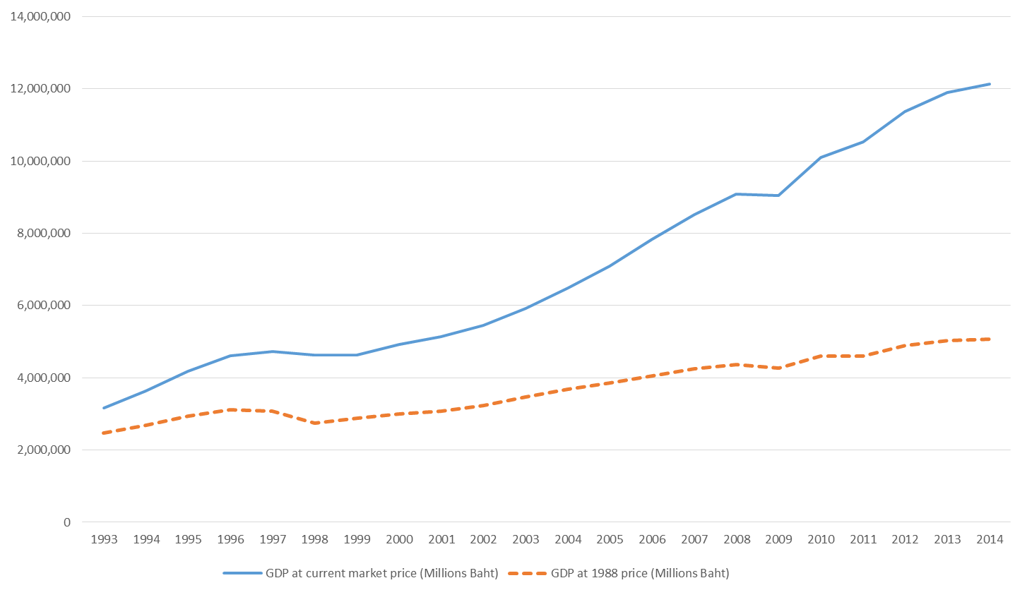
Level of GDP 1993 – 2014 (unit millions of Baht)
Source: Draw using data from www.nesdb.go.th
21 of 38

Slide 43
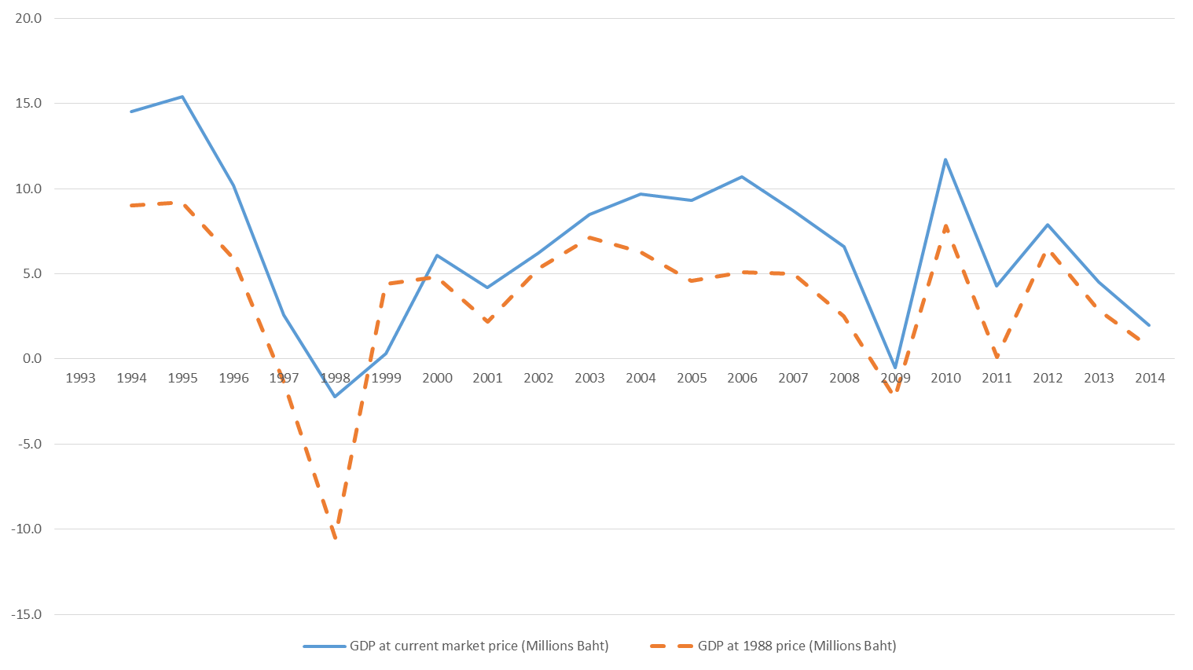
Level of growth GDP 1993 – 2014 (unit percent)
Source: Draw using data from www.nesdb.go.th
22 of 38

Slide 44
2.7 LIMITATIONS OF THE GDP CONCEPT
GDP and SOCIAL WELFARE
GDP and MEASUREMENT

Slide 45
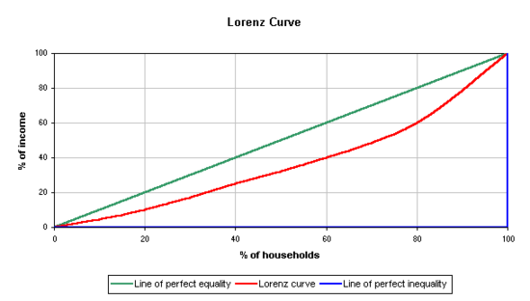
1.5.6 Income distribution (Lorenz Curve and Gini-coefficient)
A
X
B
Y
Z

Slide 46
1.5.6 Income distribution (Lorenz Curve and Gini-coefficient)
At point X
20% of household receives
At point Y
20% of household receives
At point Z
20% of household receives
Point X is on the “Perfect Equality Line”
Point Y is on the “Lorenz Curve”
Point Z is on the “Perfect Inequality Line”
Gini-coefficient
=
area A
area A + area B
Gini-coefficient
Unequal income distribution

Slide 47
Gini-Coefficient of Income,
Thailand, 1988-2013
Bad
Good
data source: NESDB

Slide 48
Gini-Coefficient of Income,
Thailand and other countries, 2002-2012
Bad
Good
Data source: NESDB, OECD(The Organization for Economic Co-operation and Development)
World bank,

Slide 49
Poverty Headcount Ratio at National Poverty Line,
Thailand, 2002-2014, (% of population)
Bad
Good
Data source: World Bank

