Slide 1

INTEGRATED BRAND COMMUNICATION
Massimiliano La Franca
Lesson 6
YAWP

Slide 2
Developing IMC

Slide 3
Stakeholders: who plays in this game

Slide 4
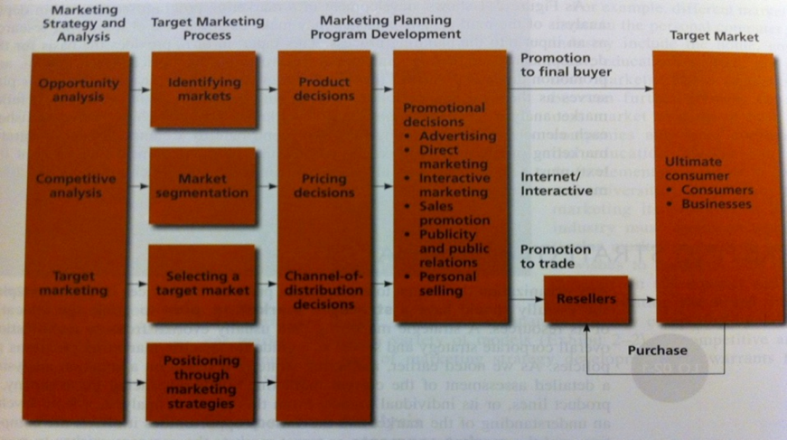
people
marketers
agencies

Slide 5
people
marketers
agencies

Slide 6
The client’s side
MD
Production
Marketing
Sales
Finance
R&D
HR
Brand manager
Trade marketing
Market Researches: Trends, Needs and Motivations, Market segmentation
Marketing mix development
Innovation
Communication
Pricing strategies
Positioning
Pack design
Agency management
Support to sales
Brand manager (…)
Mktg services

Slide 7
people
marketers
agencies
Deliver specific services according to the nature of the agency:
Researches
Advertising
Media planning and buying
Web solutions
PR and influence plans
Packaging design

Slide 8
The ad agency side
President
Client services
Planning
Creative
Digital
Production
Finance
HR
Manage clients and supervise the projects
Responsible for actual production (ex. shooting)
The boring things Finance and HR do
Define communication strategies and researches
Develop actual executions
Develop web solutions and integrate

Slide 9
The phases

Slide 10
The phases of IMC development
Brief
Develop creativity
Executions
Planning strategy
Evaluation of effectiveness

Slide 11
The phases of IMC development
Brief
Develop creativity
Executions
Planning strategy
Evaluation of effectiveness
Brief from marketing to client services (C.S.)
Planners to understand the brief and develop creative brief
Planners and C.S. to brief creative team.
Creative team to develop executions – Planners to work on strategy
Agency presents to client
Client and Planners to evaluate and understand

Slide 12
The phases of IMC development
Brief
Develop creativity
Executions
Planning strategy
Evaluation of effectiveness
Brief from marketing to client services (C.S.)
Planners to understand the brief and develop creative brief
Planners and C.S. to brief creative team.
Creative team to develop executions – Planners to work on strategy
Agency presents to client
Client and Planners to evaluate and understand

Slide 13

Everything starts with the brief

Slide 14
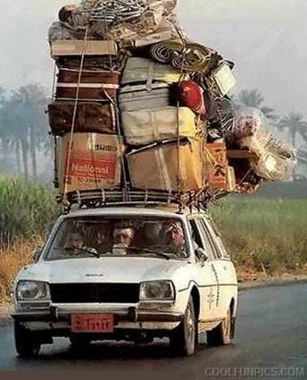
Now, imagine I were to tell you that we are about to leave tomorrow…

Slide 15
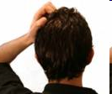
Where are we going?
Why are we going there?
How are we going there?
Who is coming? When?

Slide 16


That’s the magic of the brief, it transforms…

Slide 17
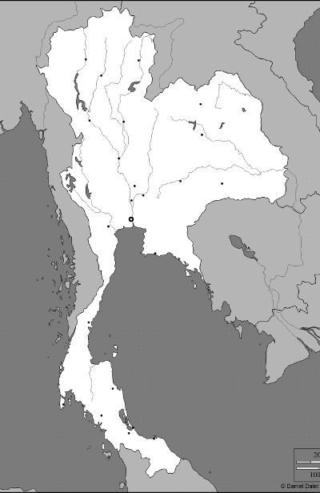
…this…

Slide 18
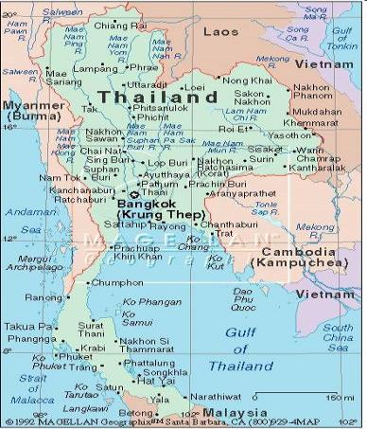
…into this

Slide 19
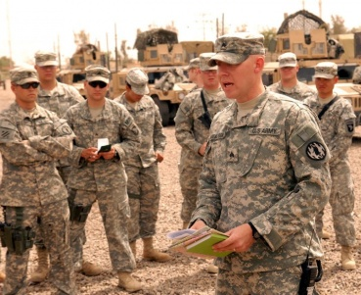
The basics
What is a brief?
Is a document to start a project
Contains the basic information
It is written in a way that engages people
Why do we write a brief?
It defines the scope of the work
It clarifies our thinking
Is the benchmark to judge the work against

Slide 20
What’s in the brief then?

Slide 21
Lots of info…but I would like you to remember a brief must contain
4 key information
1. Where
2. Why
3. What
4. Who

Slide 22
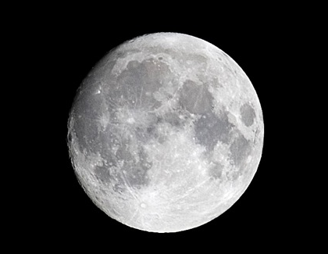
1. Where…
…ARE WE NOW ?
…DO WE WANT TO GO?

Slide 23
Where?
Where are we now?
  Insightful description of where is the brand now
  What is the situation on the market? How are market share performing? How do people perceive the brand? Etc
  Relevant and key information, no need to write an essay!
Where do we want to be as consequence of the communication?
  Where will the brand will be if the communication is successful?
  What sort of behavior are we trying to influence and change?
  How does success looks like?
  Set SMART objectives, they will be useful to know when we have arrived

Slide 24

2. Why?

Slide 25
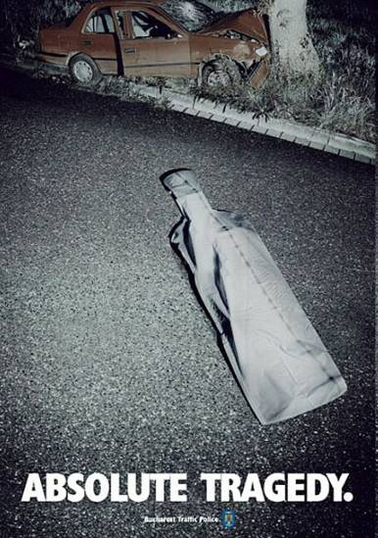
Why are we doing this?
What’s the key issue that the brand is facing right now?
Be clear, Make choice, Be single minded
It needs reading researches but more importantly knowing the business
Think behavior, what are we trying to change? Incidence of car accidents amongst young people is particularly high at night and weekends because they drink and drive

Slide 26

3. What do we want to SAY?

Slide 27
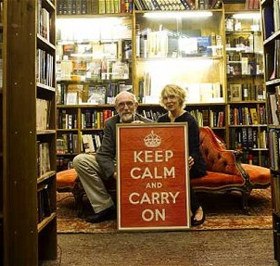
What do we want to say?
What is the key message the communication has to deliver?
  Advertising can carry one message, one!
  If there’s an “and”, “or”, “also”…think again!
  Must be relevant, unique and interesting
  Comes from the communication concept: is usually the discriminating benefit but it depends on the Communication objectives
  Don’t overpromise
What are the supporting evidences that will make this believable?
  Emotional or rational (see concept development)

Slide 28
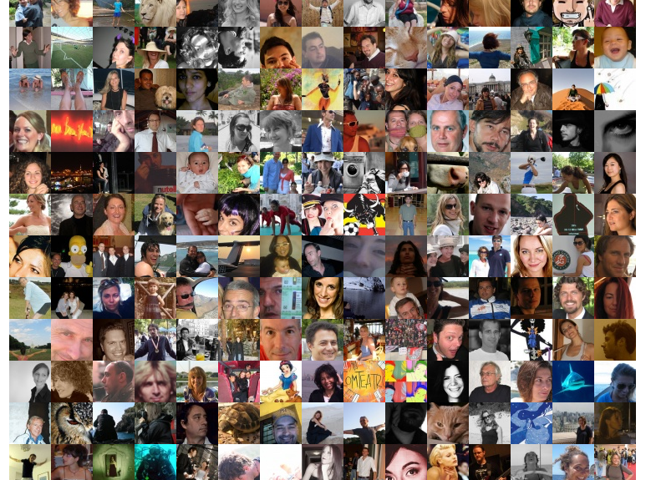
4. Who?

Slide 29

Who are we talking to?
Different message, in different ways to different people. Do you speak in the same way with your friends and your grandma?
How could you describe them in a meaningful way?
What insight do we know about them?
Focus

Slide 30
Into the details of the standard brief

Slide 31
A. What is the Job-to-be-Done and resulting marketing objective? ▲ B. What is the measurable communication objective for this Job to be Done? ▲ Note: if briefing for an Execution, please specify the JtbD & Objectives for that Execution.
What insight drives this brief? ▲
Who is our target audience? ▲
A. If Briefing for a Campaign Idea: Initial recommendation on required channels to reach and engage our target and why: ▲ B. If Briefing for an Execution: What is the role of this execution within the Channel Strategy?
What do they think and do now? (in relation to our brand and its product category) ▲
What would we like them to think and do in response to the communication? ▲
What is the single most important point to communicate? ▲ Why should they believe it? ▲
Practical requirements: Timings: ▲ Budget: ▲ Geographical Scope (highlight any key regional/local differences): Assets: ▲ Mandatories (if required, maximum of three): ▲ Legal & Other considerations: ▲ Agency Next Step: ▲
IBC Leader: Unilever & Agency ▲ Team Members: Roles, Remuneration and Rights*:
Business Card Summary: ▲

Slide 32
Today we will focus on:
A. What is the Job-to-be-Done (Brand Task) and resulting marketing objective? ▲ B. What is the measurable communication objective for this Job to be Done? ▲
What insight drives this brief? ▲
Who is our target audience? ▲
A. If Briefing for a Campaign Idea: Initial recommendation on required channels to reach and engage our target and why: ▲ B. If Briefing for an Execution: What is the role of this execution within the Channel Strategy?
What do they think and do now? (in relation to our brand and its product category) ▲
What would we like them to think and do in response to the communication? ▲
What is the single most important point to communicate? ▲ Why should they believe it? ▲
Section 1: Objectives
Section 2: Insight
Section 3: Target
Section 4: Channels
Section 5: Key point

Slide 33
SECTION 1: DEFINE OBJECTIVES – WHY DO YOU NEED COMMUNICATION ?
Brand Task JTBD
Mktg Objectives
Comms Objectives

Slide 34
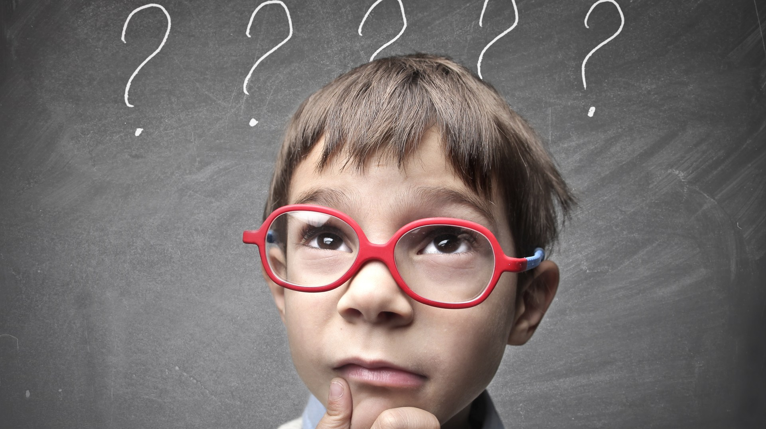
why are we doing this?
What is the problem we are trying to solve?
What is the opportunity we are trying to grab?
The key most important thing to understand before starting developing strategies

Slide 35

Where do I start to identify the right problem?
Path to purchase
Hierarchy of effects
Researches
Market data
Intuition
…

Slide 36
Once I understand the problem I need to state it in a way that will also suggest an immediate direction to be solved.
This thing we call Job to be done or Brand Task.

Slide 37
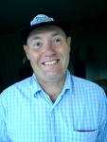

What is a Job to be Done (Brand task)?
get WHO to do WHAT
Change
Behaviour/
Change
Perception
by OVERCOMING barrier x
(if the barrier is specific and obvious)
Get older men to use deodorant rather than aftershave
37
Notes:
37

Slide 38
The behavior change
What do we want them to do in the future?
What do they do now?
Why are thy doing this? (insight)
clarify what’s the key reason behind current behavior
define what’s the new behavior
think on how to influence the behavior by tackling the key reason behind current behavior

Slide 39
Why is JTBD (brand task) important?
1. What are people
doing now?
2. Why are
they doing it?
It directs everyone towards the behavioural change we want to achieve.
5. (Check) Are people
behaving differently?
3. What do we want them to do instead?
4. How can we influence them?

Slide 40
To frame your Job to be Done identify the desired outcome using Target Audience Task Map
Who are the target audience?
Current
Desired
What are they doing now?
What do you want them to do?
DO
THINK,
FEEL,
BELIEVE
How do you want them to think & feel ?
What do they think & feel?
40
Notes:
Who is the target audience?

Slide 41
Try together: convince Thai university students to stop for breakfast at Mc Cafe
Who are the target audience?
Current
Desired
What are they doing now?
What do you want them to do?
DO
THINK,
FEEL,
BELIEVE
How do you want them to think & feel ?
What do they think & feel?
41
Notes:
Who is the target audience?

Slide 42
JTBD
Mktg Objectives
Comms Objectives

Slide 43
Marketing objectives
A statement of what the brand wants to achieve with some specific element of its marketing mix(pack, price, promotion, place)
Most of the times it is related to a behavior change
Usually we use the path to purchase to inform the Job to Be done; mktg objectives are defined in the first section of it (get who to do what)
Usually stated in the marketing plan
Has to be measurable

Slide 44
Communication objectives
A statement of what the brand wants to achieve with the communication (i.e. how communication will influence a specific behavior
Usually we use the hierarchy of effects to inform the Job to Be done; communication objectives are defined in the second section of it (by doing xxx)
Refers to what can be influenced by communication: awareness, knowledge, attitudes
Usually stated in the marketing plan
Has to be measurable
Think the hierarchy of effects:
  Where is the problem/opportunity? What is the key thing that the communication can influence?

Slide 45
Marketing objectives vs. Communication objectives
Don’t confuse the 2
Mktg activities and their objectives come from JTBD. They can include communication or not. Frequency, Penetration, Loyalty…
Communication objectives are related to what can be influenced by communication: awareness, behaviors, perception, affinity. Use BHC image profiles to measure them

Slide 46
JTBD
Mktg Objectives
Comms Objectives
The JTBD
Sets the task – what are we trying to do. What kind of change are we looking for the brand that will have a strong impact on the business
Marketing Objectives
A measurable quantification of the behavior changes we intend to achieve: frequency of usage, trial of a new product, buy more, switch brand etc.
Communication
Objectives
A measurable quantification of how our communication will influence our target and induce the behavior change in marketing objective : create awareness, change attitude towards the brand, convince, communicate a specific feature etc.

Slide 47
GET WHO TO DO WHAT
A behavioral change that defines the marketing objective. Example: get wives to buy male shampoo for their husband – Mktg objective: increase penetration amongst wives
BY DOING XXX
A change in their attitudes that comes from the communication activities of the brand. This defines the communication objective. Example: by convincing them that their husband need a shampoo for men to maintain their healthy hair – Communication objective: drive awareness

Slide 48
JTBD
Mktg Objectives
Comms Objectives
The JTBD
Get university students to visit the pizza restaurant once more every month by creating a friendly environment where they can hang out
Marketing Objectives
Improve frequency of visit of the pizza restaurant from 1 time every 3 months into 2 times every 3 months
Communication
Objectives
To create awareness of the new afternoon happy hour and wi-fii free

Slide 49
Your turn
groups, 20 min to discuss + 10 min presentation:
- Who’s the target
- Task map
- JTBD
- Marketing and communication objectives
1. Wear motorcycle helmets and teenagers
2. Convince young adults to quit smoking
3. Convince university students to floss teeth
4. Convince mothers to exercise more

Slide 50
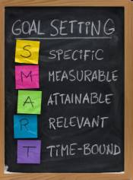
SMART OBJECTIVES
Specific: “I will lose weight”
Measurable "I will lose 3Kg”
Attainable: “I will lose 50Kg (will I???)”
Relevant: “I will look like Madonna after having lost 3Kg”
Time Bound: “I will lose 3Kg by the end of the month”

