Slide 1
Ayutthaya: Production and Society
EC301/EE301
Thorn Pitidol

Slide 2
Topics
Population
Agricultural Production
An Urban Society
Family, Religion and Identity

Slide 3
Questions
How many people lived in Siam during 17th Century Ayutthaya?
Was Ayutthaya a peasant society?
What drove Ayutthaya's culture?

Slide 4
Population
La Loubere account from 1687-88 estimated Siam population to be around 1.9 millions
  Most likely only covered Chaophraya plain
Later estimates
  1718: 3 millions, 1820: 2.8 millions, 1900s, 3 millions
Siam - "mountainous, woody, and mourish"

Slide 5
Population
Why low population density in mainland Southeast Asia?
  Not because of scarcity of food, not low birth rates
  Most likely due to high death rates
What caused death?
  Ancient endemics: Smallpox and cholera
      https://www.youtube.com/watch?v=xT8vz1p2utk
    Cities destroyed: Chiangsaen, Nakorn Sri Thammarat, Lamphun
Dangers of tropical forests
  “Muang" VS “Pa"
  High chance of death when travelling through forests, especially during wars
  Late history of forest clearance in Siam
    No open plains to live away from forests

Slide 6
Agricultural Production
Puzzle: assumptions of early Siam as agrarian society actually hard to find in historical sources
  Laws paid little attention to land, livestock, irrigation
  Peasants and villages missing from literacy works
Why?
  Likely because there was no need for agricultural surplus to be created from having agrarian society

Slide 7
Agricultural Production
Easy cultivation
  Garvaise: "The country is very fertile and, without needing great labour for cultivation, anything that one may plant fouishes"
  Only period of intense labour was harvesting
  Yield per unit of land low, but yield per unit of labour was high
  And plenty supplies of food from hunting, fishing, and gathering

Slide 8
Agricultural Production
With high availability of food, there was no need for settlements dedicated to agriculture
  People could live in urban area and travel to "thung" (rice growing plain).
  Rice growing tract stretched along rivers
Although laws stated land belong to the king, practices could be different
  Clauses for selling of land, and for managing disputes
  Yet, taxes from land were not important, likely indicates…

Slide 9
Agricultural Production
In sum, together with low population density, Ayutthaya was urban society
  No need for majority of population to engage in agriculture,
  Land abundance close to city
  Dangers from forest encourage close clustering in urban area
Question: What present view would this perspective directly challenge?

Slide 10
An Urban society
Cities and their population
  Ayutthaya - 150,000 to 200,000 (A.Reid)
  But likely too low, ignored some occupied areas outside the island
  Also did not count people living on the water (boats)
  More likely, 250,000
Other towns- mueang of 1st, 2nd, and 3rd class
  Pitsanulok, Kampheangphet, Lopburi, Korat, Nakornsawan, Bangkok, etc.
  Est population of 50,000 each

Slide 11
An Urban society
Then small towns, and settlements along waterways, account for the rest of population.
  Heeck - strech from Ayutthaya and Bangkok lined with "many large and small villages, hamlets, and other settlements“
Ayutthaya society is “not semi subsistent rice growing villages of peasant society, but riverside ribbon urbanism”

Slide 12
An Urban society
What did people do in the cities?
  Van Vliet "the people earn their living by trade, court services, navigating with the junks, barges, and prauws, fishery and industries, and handicrafts…"
  La Loubere "the most general Professions at Siam are Fishing for the common people, and Marchandize for those that have wherewith to follow it"
Productions
  Fishery equipment, potteries, stuffs for royal and religion ceremonies
  And everyday goods such as house components, furniture, baskets, etc.
  Productions reflected from neighborhoods' names

Slide 13
Servitude (Phrai) in Ayutthaya
Intertwined with a system of military recruitments
  Possibly originated from China
With the decline of wars after 1600, the conscription system continued, and became general servitude
  Common people divided under quartermasters.
  All male registered at 16. Counted every year.

Slide 14
Servitude (Phrai) in Ayutthaya
Phrai luang required to work for King on alternate months
  Constructions, manning of ships, facilities, warehouses, collection of goods for exports.
Phrai-som under control of nobles.
  Also a system providing protections
Slaves (That) - include war captives, those failing to pay debts, or face punishments
  Could be way to escape Phrai and to raise capitals to enter business
  La Loubere "liberty often times more burdensome than servitude"

Slide 15
Servitude (Phrai) in Ayutthaya
Kings and nobles were "man-lords" not "land-lords", and the struggle to control labour was crucial

Slide 16
Family, Religion, and Identity
Two worlds of gender
For commoners: female families and loose males
  Women are at the center of families. Women not only progenitors, care-givers, and but also managers of property and providers of income
    "All affairs are managed by wives"
  Culture of open sexuality on women side.
  Men not tightly attached to family, they travel away, and later became monks, soldiers, traders, and bandits.
  As men mobile and highly unreliable, female sustained the family

Slide 17
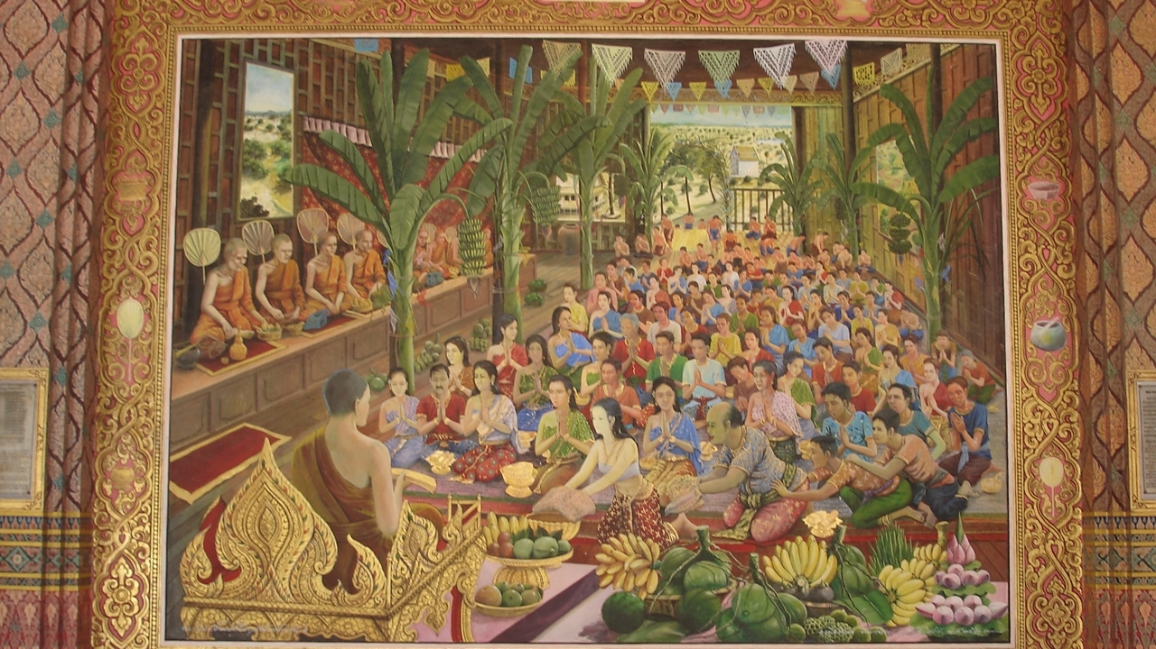
Khun Chang Khun Phaen

Slide 18
Family, Religion, and Identity
Two worlds of gender
For nobles: male dominance and women submission
  Going up the social scale, different picture of patriarchy, privilege male, and constraints on women
  Men with absolute rights over wives and children, and also can have many wives
  Unrestrained female sexuality seen as a source of chaos

Slide 19

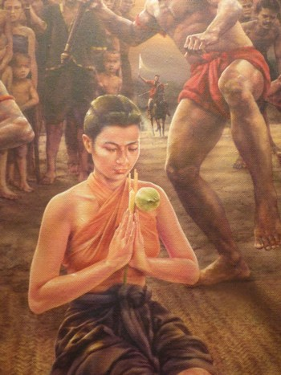
Khun Chang Khun Phaen

Slide 20
Family, Religion, and Identity
Buddhism
  Theravada Buddhism. Buddhism co-existed with other beliefs (Hindu and supernatural)
  Buddhism embedded in everyday living.
    Many attended ceremonies, large festivals
    Beliefs: happiness in the present is a reward for virtue in the past --> hence merit makings
  Temples also served as school and dispensary (pharmacy)

Slide 21
Family, Religion, and Identity
Identity
  Cosmopolitanism had crucial impact
    Portugese, Japanese, Moors, Chinese, Indian, Spanish, Malays, Lao, Khmer, Mon
  Languages
    At least three medium languages: Malay, Persian, and Portugese
    Many people would have been knowledgeable in more than one languages

Slide 22
Family, Religion, and Identity
How identity differed from the present
  People were defined by where they come from and what they spoke, and not membership of a nation
  No stress on Siam being uniquely Thai.
  Celebrating inclusion, not exclusion. For example: multi-languages chanting by monks.

