Slide 1
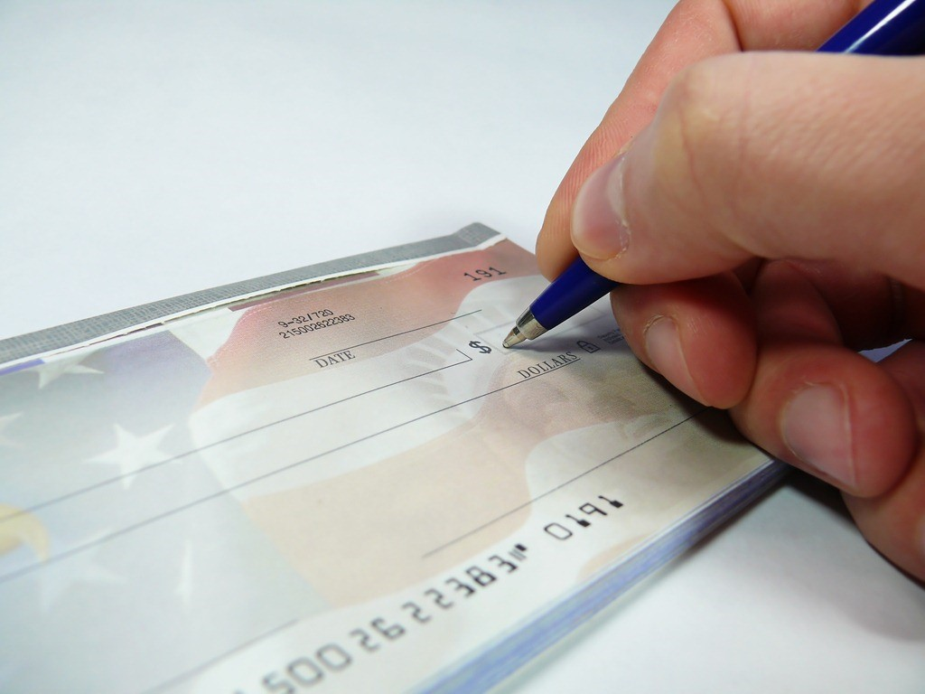
Cheque Clearing Process
Thanon Korapinsuwan 5504641951
Jinnawat Laohapiengsak 5404640285
Supakit Trabchuagallapa 5504641720
Komjak Likhitluecha 504640482
Krit Phankitnirundon 5504640532
Phonthanat Uruhamanon 5504641092

Slide 2

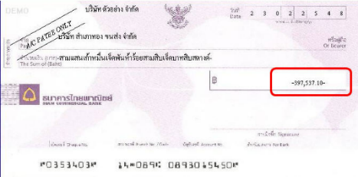

Check clearing is …
Bank A
Bank B
Deposit
(Account Credit)
Withdrawal
(Account Debit)
Clearing Process
Overview
ICAS
Regulation
Notes:
Cheque clearing (or check clearing in American English) is the process of moving a cheque from the bank in which it was deposited to the bank on which it was drawn, and the movement of the money in the opposite direction. This process is called the clearing cycle and normally results in a credit to the account at the bank of deposit, and an equivalent debit to the account at the bank on which it was drawn

Slide 3

Evolution of cheque clearing system in Thailand
Electronic Cheque Clearing System (ECS)
ICAS
Provincial Cheque Clearing System
Imaged Cheque Clearing
and Archive System
Bill for Collection
Overview
ICAS
Regulation

Slide 4
What is ICAS?
Electronic Cheque Clearing System (ECS)
Provincial Cheque Clearing System (PCS)
Bill for Collection System
(B/C)
Imaged Cheque Clearing and Archive System (ICAS)
Image Cheque Clearing System (ICS)
Image Archive System
(IAS)
Time Efficiency and Reducing Transaction cost
Storage of electronic data and image
Overview
ICAS
Regulation
Notes:
Script: ICAS or Imaged Cheque Clearing and Archive System is the integration of the previous three systems as ICAS is aimed to be one clearing system. ICAS consists of ICS and IAS.
ICS is responsible for image based cheque clearing which can reduce clearing cycle under one clearing business day, so it improves time efficiency. Moreover, the system will reduce transaction cost and loss since image cheque can be transferred between banks.
IAS is responsible for storage of electronic data and image as the system allows image cheque to be legal evidence

Slide 5



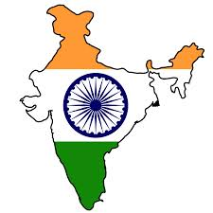
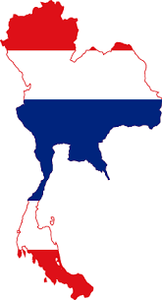


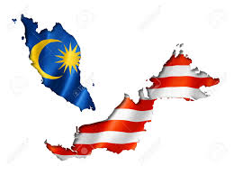
Where is ICAS used?
Several thousand banks with high overall degree of technical sophistication
Laws related to electronic documents to be represented as evidence in court
2001
2003
2004
2008
2012
U.S.A.
Hong Kong
India
Germany
Thailand
Singapore
South Korea
Malaysia
Overview
ICAS
Regulation
Notes:
Although ICAS help to support economic activities a lot, the country can used ICAS if it has several thousand banks with high overall degree of technical sophistication and Laws related to electronic documents to be represented as evidence in court.
This timeline shows which country uses ICAS in what year.

Slide 6



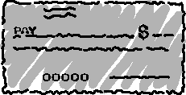



How ICAS works
The Sending Bank
Electronic Clearing House
The Paying Bank
Customer
Overview
ICAS
Regulation

Slide 7
How ICAS works
Customer
The Sending Bank
Electronic Clearing House
The Paying Bank
Overview
ICAS
Regulation

Slide 8



Benefits of the ICAS
Business Sector & Cheque Depositors
Banking Sector
The Economy
time in process shortened
Can deposit cheque until bank closed
Transportation cost eliminated
Risk of the loss of cheques eliminated
Storing data and physical cheques is reduced
  MV=PY→ higher GDP
Overview
ICAS
Regulation

Slide 9
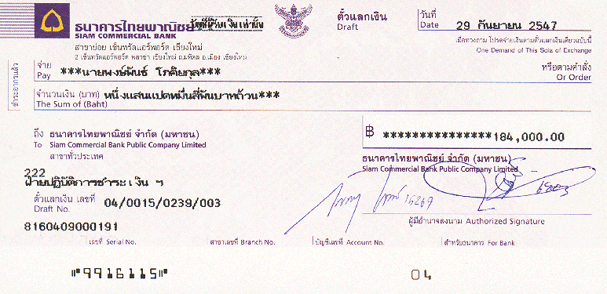


Old System VS ICAS
Old System
ICAS
Legal Evidence
Time Process
3-5 days
1 days
Cheque deposit time
14.00
Bank closed
Cheque Transport
Overview
ICAS
Regulation

Slide 10

Image Cheque and Clearing and Archive System
ICAS(ECH)
Imaged Cheque Clearing System
Image Archive System
Overview
ICAS
Regulation

Slide 11
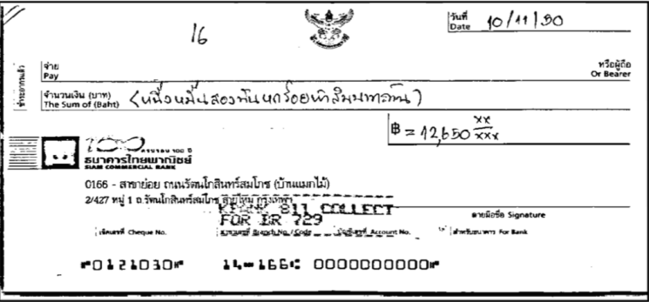
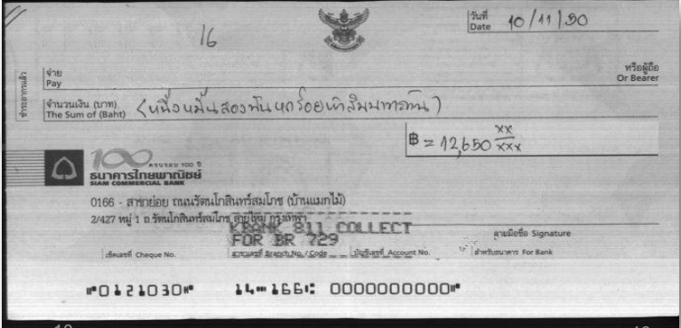
Regulation for ICAS
Black & White, Front and back, 200dpi, TIFF
Grayscale, Front, 100dpi, JPEG
Validation
Commercial Code Book 3
Civil punishments
fraudulent cheques
Use of Cheque Act B.E. 2534
Criminal Punishment
Electronic Transactions
Electronic Translations Act (No. 2)
accepted as evidence in legal
Overview
ICAS
Regulation

Slide 12
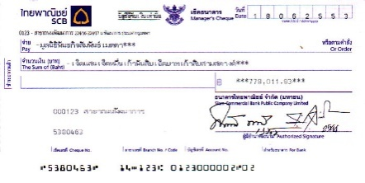


Cheque Redemption Fee
Same district
Different district
No fee
Fee 0.2% and minimum 20 Baht
Cheque Fee
:
Bank Cheque
20 Baht/Cheque
or
Gift cheque , Occasional Gift Cheque Set ฿ 20/Cheque, ฿ 150/set
Overview
ICAS
Regulation

Slide 13
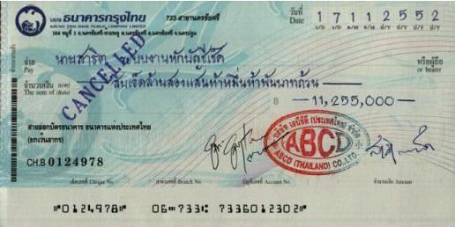
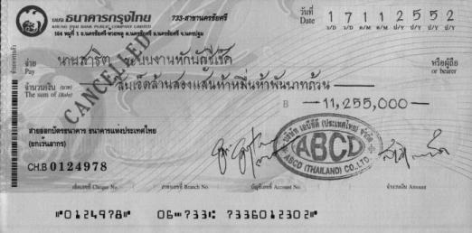
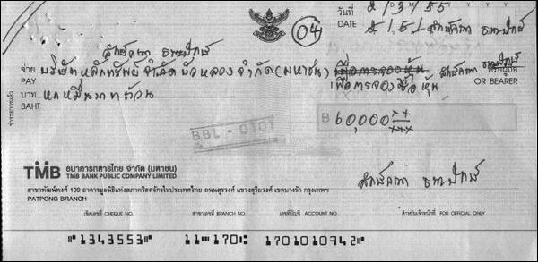
Cheque with stamp or correction
Cheque with stamp
Original
ICAS
Cheque
with correction
Overview
ICAS
Regulation

Slide 14
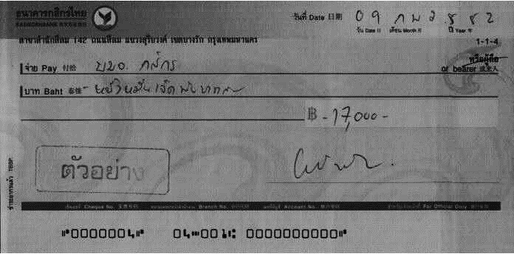
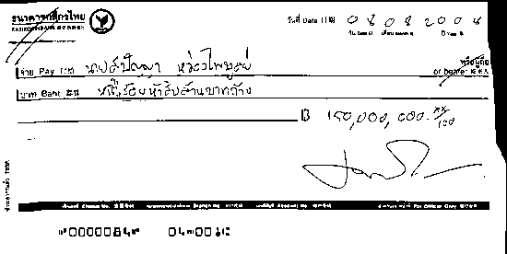
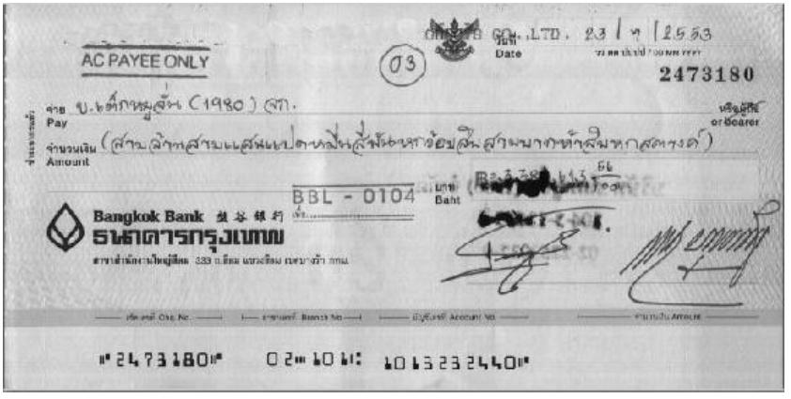
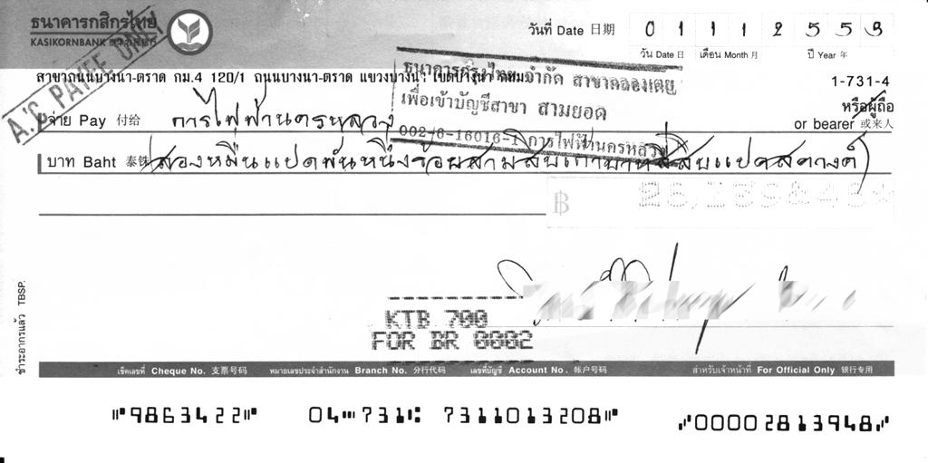
Uncommon Cheque
Dark Background
Torn
Wet
Perforated amount
Overview
ICAS
Regulation

Slide 15
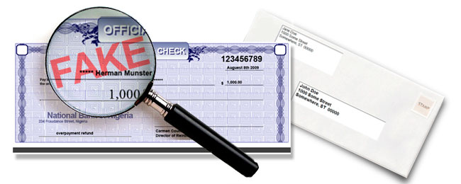
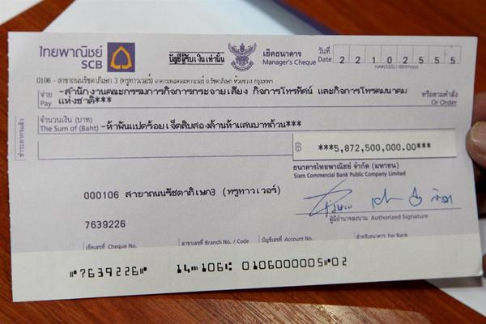
Uncommon Cheque (2)
Cheque with possibility of fake
High value cheque
(not less than 10 million Bath)
Overview
ICAS
Regulation

Slide 16


