Slide 1
Research Methods in Economics:
Application for EE 362 Term Paper and Presentation
Monthien Satimanon

Slide 2
Rules of the Game
7-8 members per group
20-25 minutes Presentation
15-20 pages excluding references
Spacing: Double Space
Font: Time New Roman 12

Slide 3
Presentation/Paper
Introduction
Statement of Problem
(Literature Review)
Theory
(Methodology)
Data
Analyze
Result, Interpretation → Answer the question
Conclusion
References
PLAGIARISM will lead to zero point.

Slide 4
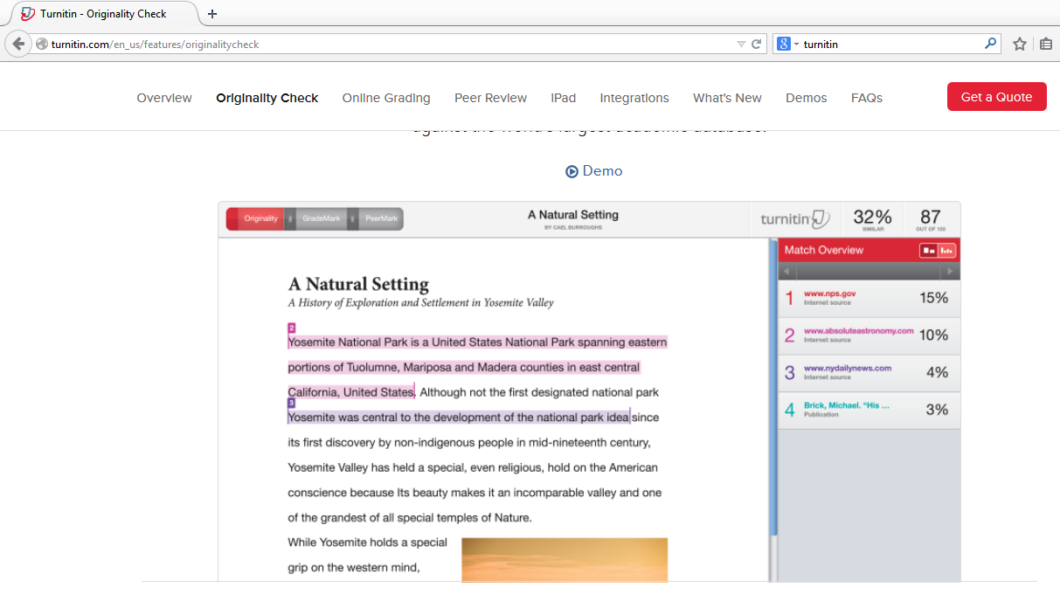
http://turnitin.com/en_us/features/originalitycheck

Slide 5
Introduction
  Why do you choose this topic?
  Motivations
  Important of the topic
    Statistic numbers
    New regulation, new agreement, etc.
  The gap of the literature

Slide 6
Statement of Problem/ Objectives
What do you want to know?
What do you want to answer?
Questions/ Objective
Scope of the study***
Examples:
  Which industries in East Asia?
  Which economic issues in East Asia?
  Which countries in East Asia?

Slide 7
Statement of Problem/ Objectives (cont.)
A good research question/statement of problem…
Is interesting and/or important from an economic perspective
Is clearly stated
Has a logical rationale and is tied to (international) economic theory
Is doable

Slide 8
Statement of Problem/ Objectives (cont.)
Doable?
  Not too broad
  Not more work than you can do
  Data needed are available or can be acquired
  Example 1:
  How can liberal trade reduce pressure of illegal immigration to rich countries?
  Medical Service Sector in Thailand and Philippines After the Opening of AEC
Too broad
√

Slide 9
Statement of Problem/ Objectives (cont.)
  Example 2:
  Examination of Tariff and non-tariff barriers of trade
  Does Multi Fabre Arrangement(MFA) Benefits Bangladesh’s Textile Export?
Too broad
√

Slide 10
(Literature Review)
Who else have ever studied this topic?
  Which theories do they use?
  Which methodologies do they use?
  Which kind of data do they use?
  What are their results and conclusions?
  Sources
  http://scholar.google.co.th/

Slide 11
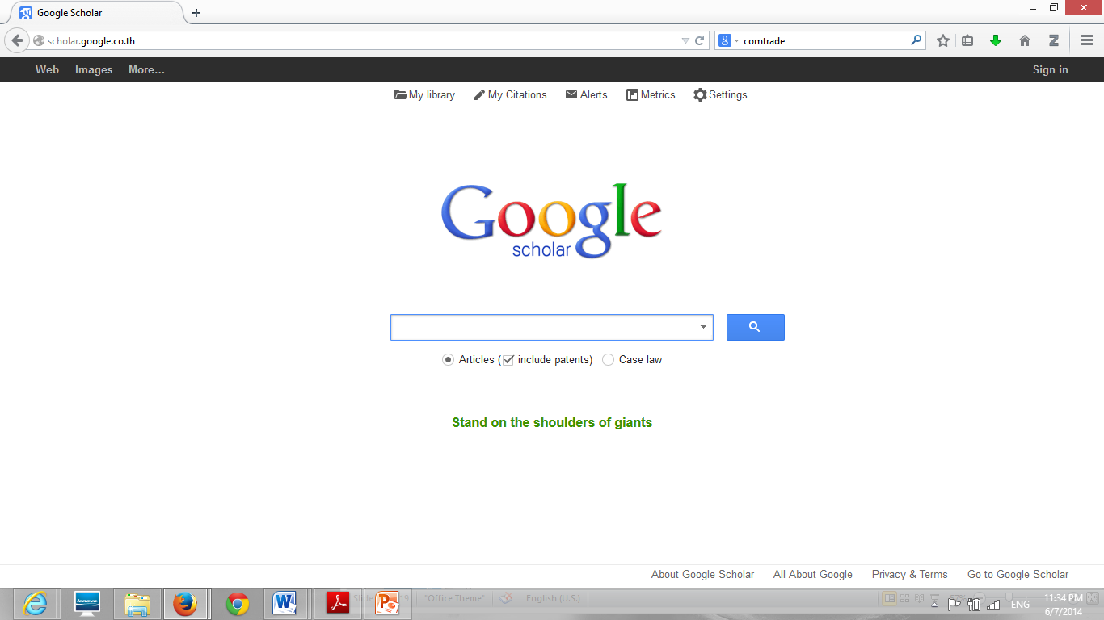
  http://scholar.google.co.th/

Slide 12
Theory/ Theoretical Framework
Your problems/questions are under which conditions/situations/regulations?
That conditions are similar to assumptions of which theory.
Apply a theory to derive a hypothesis (prediction) about the problem or question.
  The hypothesis should be testable. → You have the way to answer!!!!!!!!!

Slide 13
Methodology
Select the model/the way to answer the question.
  Theoretical Method
  Empirical Method
    Statistical Tools
      Descriptive Statistic
        Example:
        Plot the graph to predict the trend.
        Find the area of gain/loss by using the real figures.
      Econometrics
      Test the hypothesis by comparing its predictions to evidence from the real world.

Slide 14
Data
Types of data
  Primary data
  → Collect data by yourself (i.e., interview)
  Secondary data
  → Use other people/organizations’ data
Sources of data
  http://comtrade.un.org/
  http://data.un.org/browse.aspx?d=ComTrade
  http://databank.worldbank.org/data/home.aspx
  http://www.bot.or.th/ENGLISH/STATISTICS/Pages/index1.aspx

Slide 15
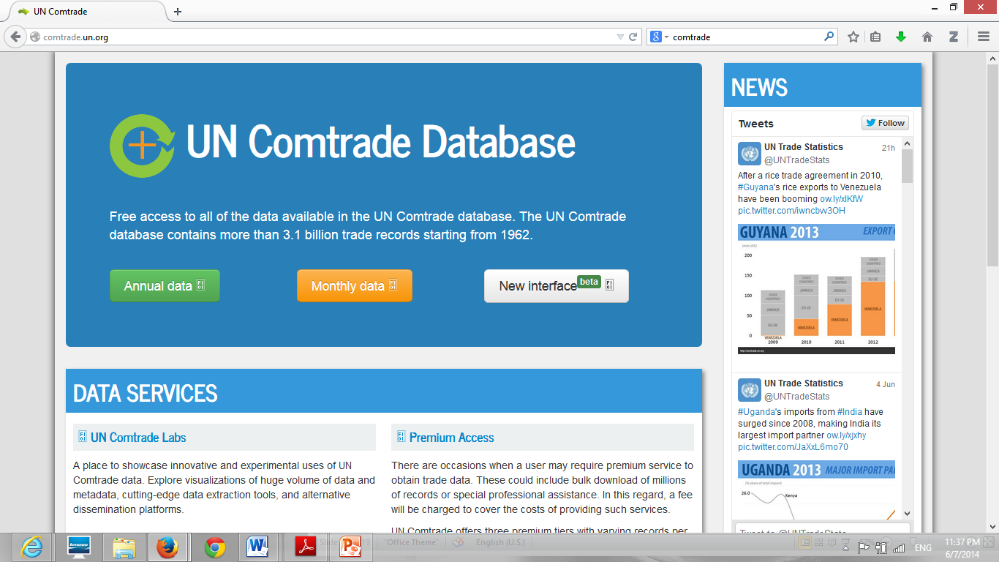
  http://comtrade.un.org/

Slide 16
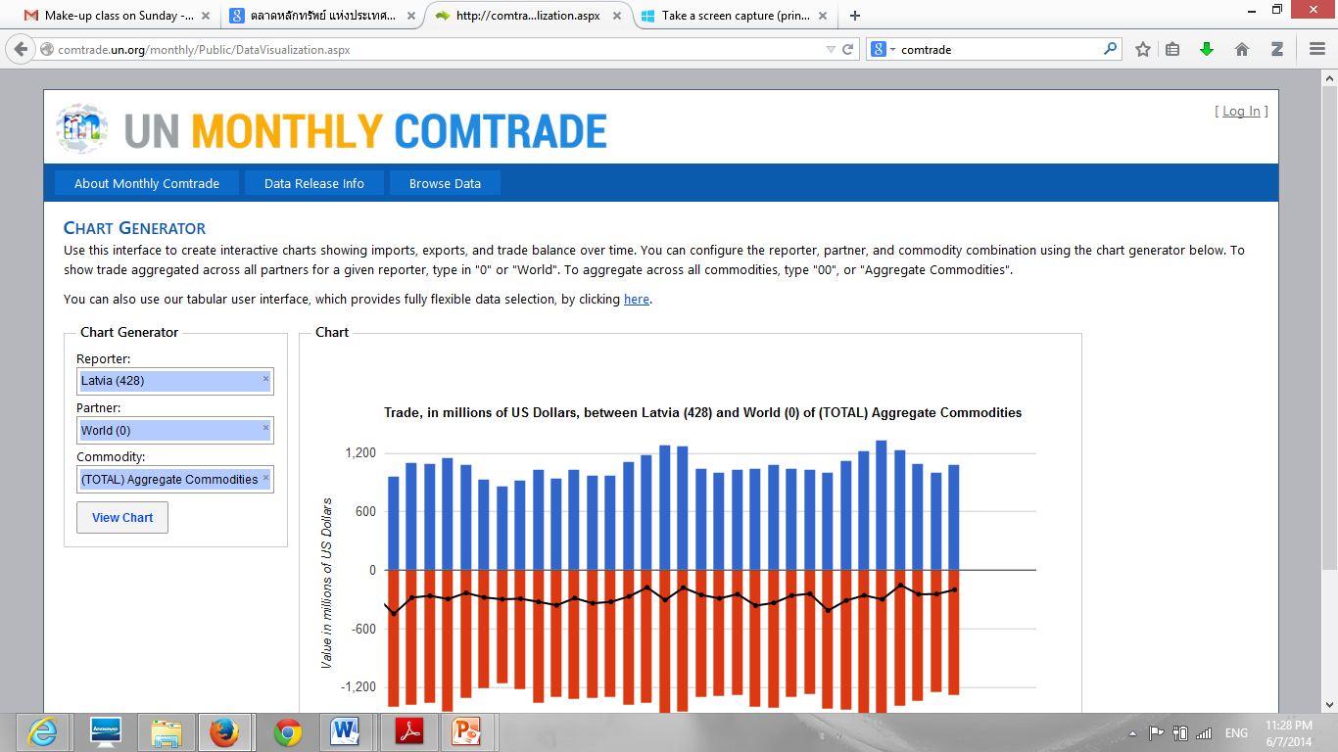

Slide 17
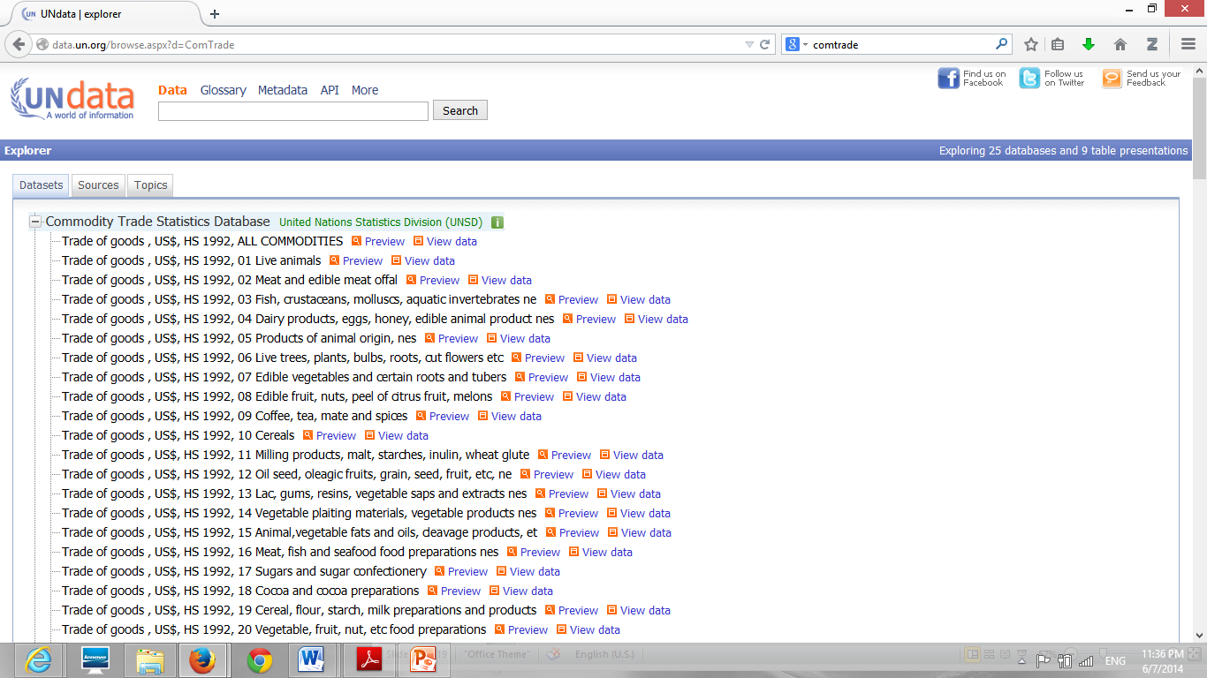
  http://data.un.org/browse.aspx?d=ComTrade

Slide 18
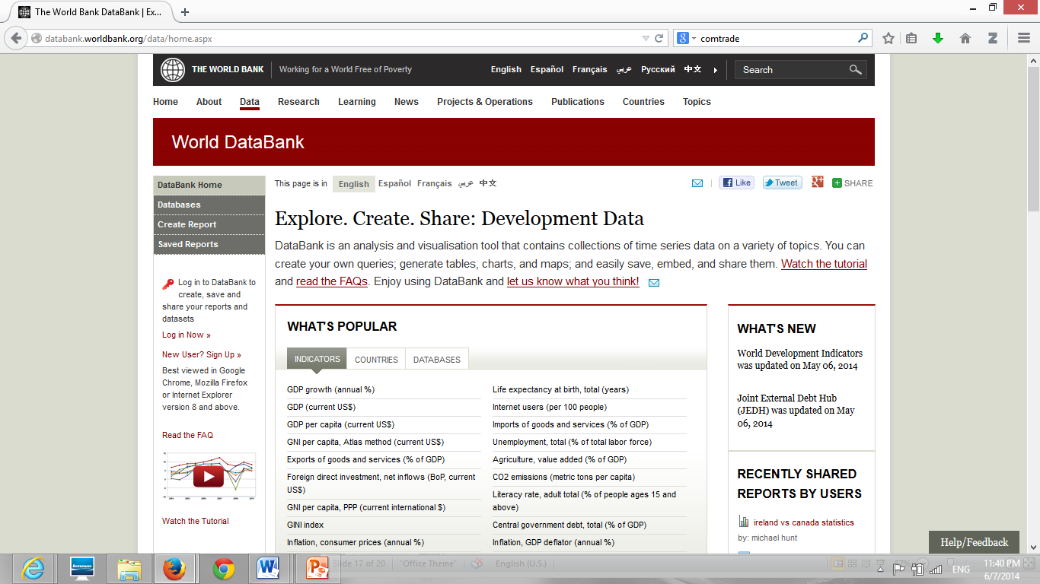
  http://databank.worldbank.org/data/home.aspx

Slide 19
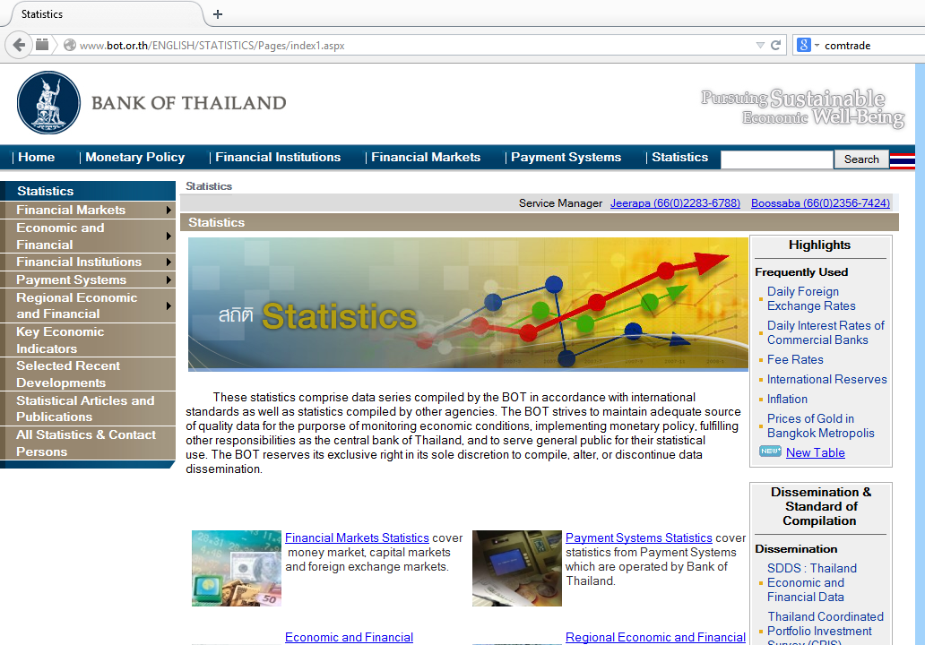
  http://www.bot.or.th/ENGLISH/STATISTICS/Pages/index1.aspx

Slide 20
Analysis and Result Interpretation
→ Answer the question
Use the theories, data, and the selected method to find the answer of your question(s).
Write the results from your analysis.
Do not write the result base on your guess which do not come from the theories and data.

Slide 21
Conclusion
Summarize the story again.
Focus on your finding and the new contribution.
Tell the reader about the limitation of the study and the future research related to your topic.

Slide 22
References
Easy for the readers to study more.
Follow the international format.
  Chicago
  APA
  MLA
  Your helper
  Endnote
  Zotero

Slide 23
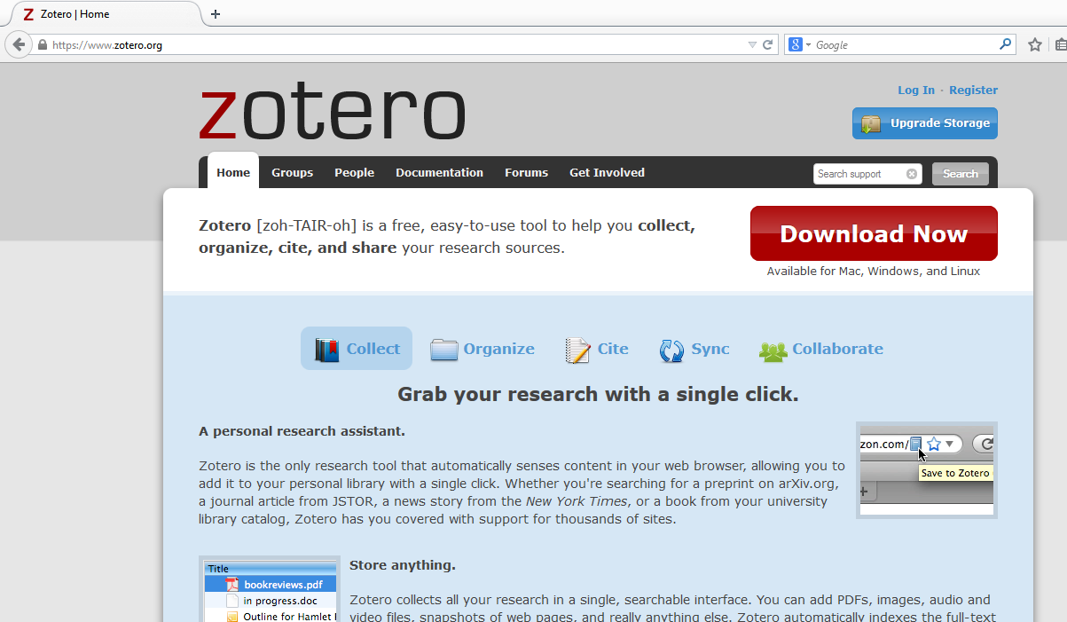
https://www.zotero.org/

Slide 24
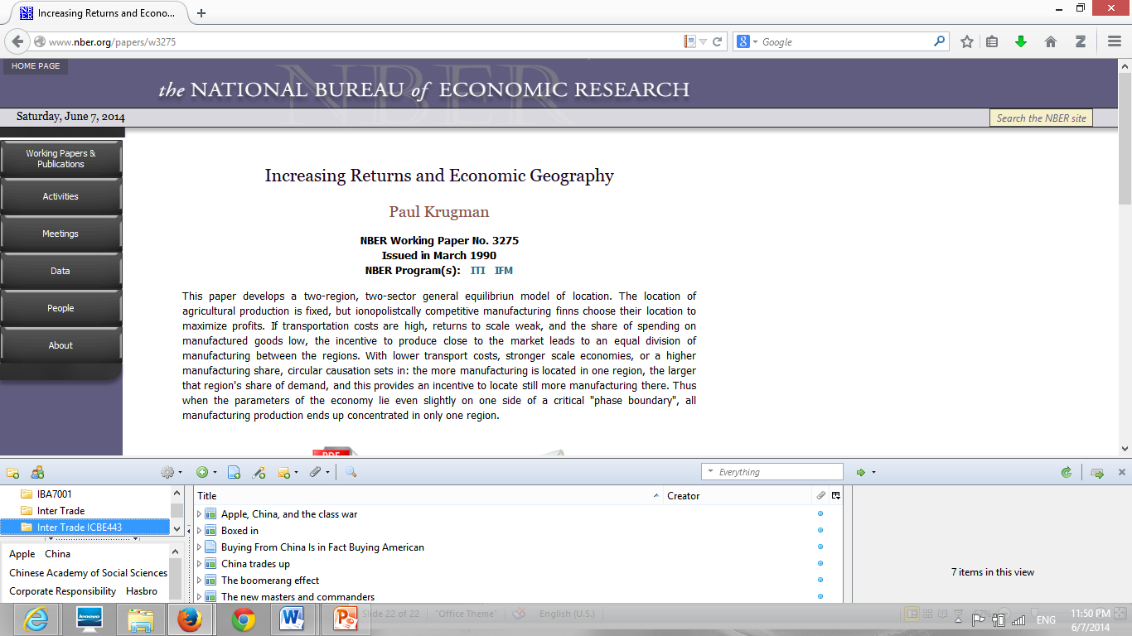

Slide 25


