Slide 1

Arnakorn Sangadej 5604640085
Thanawan Bunsiri 5604641851

Slide 2
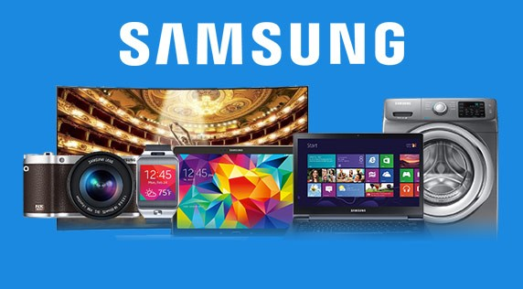
SAMSUNG
A South Korean multinational conglomerate company headquartered in Samsung Town, Seoul.
It comprises numerous subsidiaries and affiliated businesses, most of them united under the Samsung brand, and is the largest South Korean chaebol

Slide 3
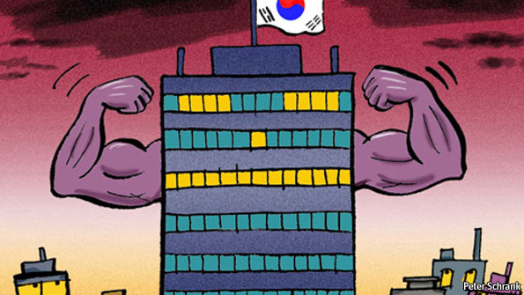
CHAEBOL
Business conglomerate structure that originated in South Korea in the 1960s
Creating global multinationals with huge international operations
Can encompass a single large company or several groups of companies
Each chaebol is owned, controlled or managed by the same family dynasty. Samsung, Hyundai and LG Group are among the biggest and most prominent chaebol.

Slide 4
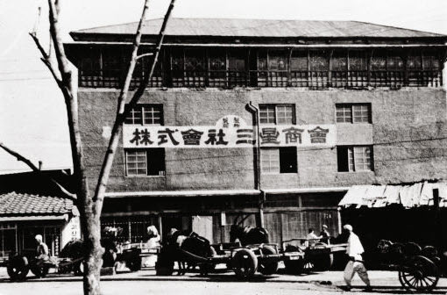
History
Lee Byung chull
Dealt in locally-grown groceries and made noodles
CHAEBOL
1920
started a sugar refinery in Busan named Cheil Jedang.
built the plant in Chimsan-dong, Daegu. It was the largest woollen mill ever in the country
SAMSUNG
1938

Slide 5
Samsung moved into lines of business such as insurance, securities and retail.
In the late 1960s, Samsung Group entered the electronics industry
1970
In 1980s, Samsung entered telecommunications hardware
Became the center of Samsung's mobile phone manufacturing
Invest heavily in research and development
In 1987, Samsung Group was separated into four business groups:Samsung Group, Shinsegae Group, CJ Group and the Hansol Group
Started to rise as an international corporation in the 1990s
In 1993, Lee Kun-hee sold off ten of Samsung Group's subsidiaries, downsized the company, and merged other operations to concentrate on three industries: electronics, engineering and chemicals.
1990
1997
Asian Financial Crisis

Slide 6
2000
In 2012, Samsung Electronics became the world's largest mobile phone maker by unit sales.
In 2015, Samsung has been granted more U.S. patents than any other company - including IBM, Google, Sony, Microsoft and Apple.
Many Subsidiaries and affiliates
NOW

Slide 7
1950-1970
Benefited from the import-substitution policy and also acquired control of several commercial banks and insurance companies.
Samsung would be allowed to remain in business but it would have to be the vehicle for carrying out the development projects that Park wanted.
When American government officials thought that the Communists had taken control of South Korea.
Park had a fondness for collectivist-type slogans such as "Enrich the Nation and Strengthen the Army!" and "Steel is National Power."
Lee offered to donate most of his wealth to the government and accept expropriation of his bank shares. Also he agreed to gain the cooperation of other businessmen in promoting Park's development projects.

Slide 8
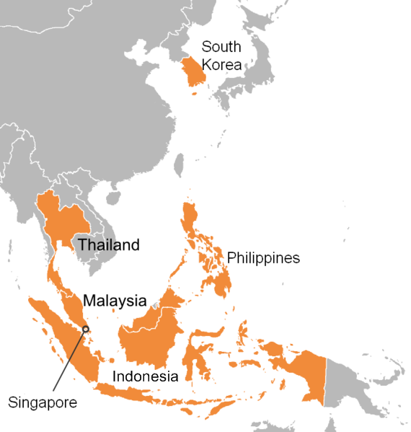
The Asian financial crisis
A period of financial crisis that gripped much of East Asia beginning in July 1997 and raised fears of a worldwide economic meltdown due to financial contagion

Slide 9

The Asian financial crisis VS Samsung
11 of the 30 largest chaebol collapsed but Samsung survived

Slide 10

How Samsung survive?
Engaging the business of North American and western European markets
Reduce its work force
Government support

Slide 11

The Chaebol reform
Corporate restructuring consisted of the following measures to be implemented:
Drastic reduction of corporate debt
Improvement in transparency
End of cross-debt guarantees by conglomerates
Chaebols to concentrate on core businesses
Greater managerial accountability to shareholders

Slide 12

References
https://en.wikipedia.org/wiki/Samsung
http://www.antiessays.com/free-essays/Samsung-s-Survival-Of-The-Asian-Financial-522093.html
http://www.sjsu.edu/faculty/watkins/chaebol.htm#45
https://en.wikipedia.org/wiki/1997_Asian_financial_crisis

Slide 13


