Slide 1
Social and Political Aspects of a Middle Income Trap: Thailand’s Challenges and Opportunities for Policy Reform
Asst. Prof. Dr. Pornthep Benyaapikul
EE460

Slide 2
Thailand Past Development and Inequality
Notes:
I would like to begin by quickly summarising the result of Thailand past development strategy

Slide 3
The success story
Export promotion industrialization policy
  High and uninterrupted growth: Average GDP growth
    1960-1995 = 7.9%
    1960-2011 = 6.2%
    Gained upper-middle income status in 2011
Notes:
Thailand has adopted export orientation industrialization policy some 4 decades and it had been very successful. Average GDP growth between 1960-1995 was about 8%
Lower-middle income 1,036-4,085
Upper-middle income 4,086-12,615

Slide 4
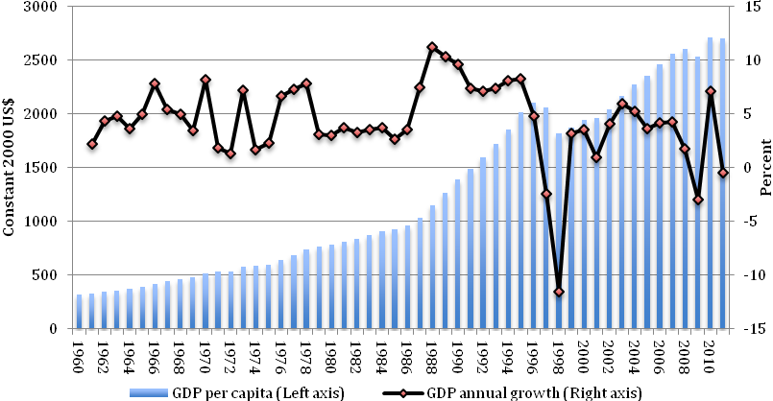
GDP per capita and growth
Notes:
Economic growth had been high and uninterrupted and as Prof.Pasuk and Dr.Chris mentioned yesterday, per capita income has tripled in just less than 30 years.
Despite economic crisis in 1997, the country was upgraded to upper middle income status in 2011

Slide 5
The success story
Export promotion industrialization policy
  High and uninterrupted growth: Average GDP growth
    1960-1995 = 7.9%
    1960-2011 = 6.2%
    Gained upper-middle income status in 2011
  Successfully improved the standard of living
Notes:
Also, the standard of living of Thai people has improved significantly

Slide 6
Successful poverty reduction
Notes:
The most important success could be the marked reduction of poverty. 40% of the population were pulled out of poverty. Real gross domestic product (GDP) per capita rose 256 percent from 20,215 baht (US$ 815 at year 2000 price) in 1981 to 71,949 baht (US$ 2,713 at year 2000 price) in 2010
2,304 at PPP equivalent (constant 2005 international dollar).

Slide 7
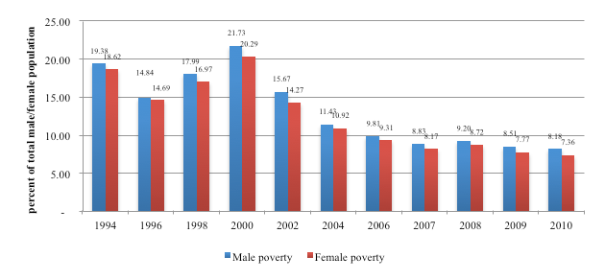
Poverty incident by gender

Slide 8
Middle income trap?
Since the economic crisis in 1997, growth rate has slowed down markedly
  Average growth rate 1998-2012 is 3.3%
  11 years moving-average annual growth
    1998-2011 = 4%
    1963-1993 = 7%
Notes:
There have also been speculations that Thailand might have fallen into the middle income trap.
Undoubtedly, Thailand’s economic structure has changed significantly after the crisis.
After the 1997 crisis, it’s been widely accepted that low-wage export orientation development model will not take Thailand any further.
Thailand’s medium-term growth since 1997 has been about 4 percent compared with more than 7% during 1963-1993.

Slide 9
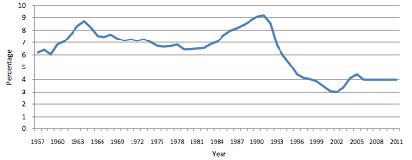
11 years moving average GDP growth (Jitsuchon,2012)
Notes:
According to a TDRI economist, Dr Somchai jitsuchon
The 11 years moving-average annual growth which show the medium to long-run growth trend also suggest this structural shift.
1998-2011 = 4%
1963-1993 = 7%

Slide 10
Slowing down growth and investment
Notes:
Also, as shown in this figure, investment rate did not really recover after the economic crisis.

Slide 11
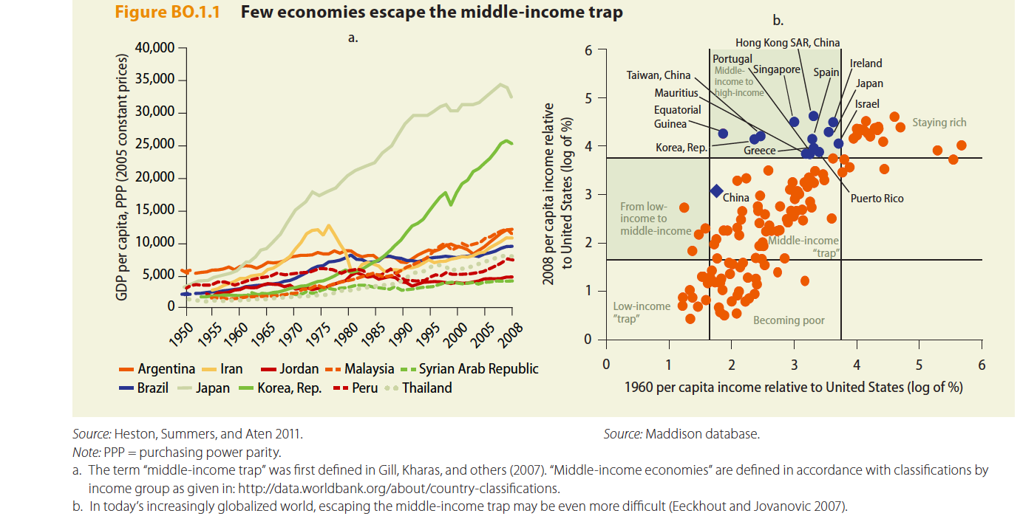
International comparison
Notes:
One way to see if we are in the trap is to compare the long term growth trend with other countries.
We can see that Japan and the Republic of Korea were successful in raising their per capita income steadily during the period 1950-2008, leaving behind many other countries that had a similar income in 1950.

Slide 12
International comparison
Notes:
This figure show countries’ per capita income relative to the US in 1960 and 2008. Only 13 countries managed to move from middle-income country to high-income country compared to the US between 1960-2008 (the blue dot). Many more countries remained in a relative middle-income position throughout the period (those in the middle box), including Thailand.

Slide 13
What restricts growth?
Notes:
So what restrict growth? This question has been asked many times and this seems like a problem with known solutions.
Industrial policies such as technology upgrade and increase R&D spending have been suggested for long time to lift the country growth path. But why is this not happening?
Many economists believe that the social and political dimensions are equally important to growth but these received relatively less attention.

Slide 14
Well-known factors
Low R&D: spending 0.2 % of GDP on R&D (global average ~ 1%).
Labor shortage and lacking skill (Cheap labor, import technology, loss competitiveness).
Inefficient use of natural resources.
Corruption and rent-seeking (misallocation of resources)
Notes:
These factors are well-known and policy recommendations have been on the table for quite long-time

Slide 15
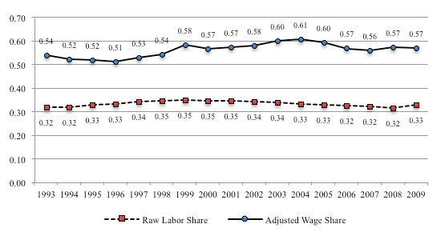
Low labor share

Slide 16
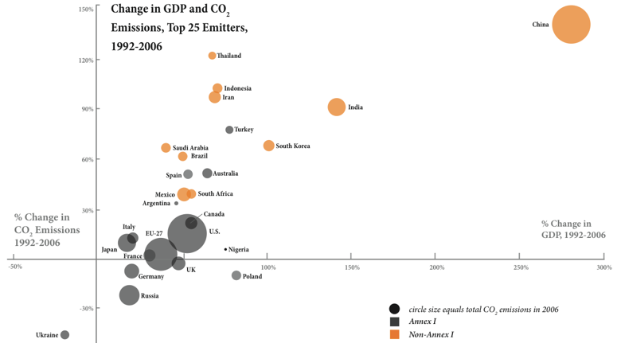

Slide 17
Socio-economic dimension and economic growth
What can we learn from international evidence?
Notes:
We identify socio-economic and political issues of Thailand that are potentially restricting growth.
I will start by exploring some of the recent but well established findings about factors that important to long run growth.

Slide 18
1.Inequality
Thailand’s inequality problem has not been much improved
More equality improves resource allocation and efficiency when credit market are imperfect (Aghion and Bolton, 1997)
International evidence (Berg et al., 2008) shows that better income distribution greatly increases growth spell duration
Notes:
The first factor important to growth but received relatively less attention is inequality.
Thailand inequality has increased during the early episode of development but until now it has not been much improved.
There are convincing evidence that better income distribution could improve growth.

Slide 19
Income distribution greatly increases growth spell duration
Berg et al. (2008)
Notes:
Income distribution is very important to long term growth.
Relationship between growth and equality is complementary especially when country income reach certain level.
This graph which from a work done by Berg et al. from IMF show that income distribution has the largest effect on growth duration.

Slide 20
unimproved inequality
Notes:
This figure show Thailand GINI coefficient between 1988-2010. Inequality has not improve much over the past 3 decades.

Slide 21
Gini
Thailand
Malaysia
Philippines
Cambodia
Vietnam
Indonesia
Laos
Year
Notes:
Compared with our neighboring countries, we are one of the most unequal.

Slide 22
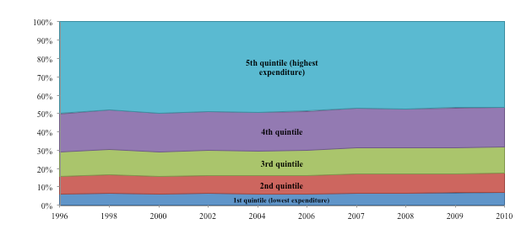
Expenditure quintiles

Slide 23
Wage inequality
Wages have been kept low to support export-driven growth based on cheap labor.
Share of total wage income (percent)
 | 2006 | 2007 | 2008 | 2009 | 2010
Poorest 10% | 1.85 | 1.96 | 2.02 | 2.02 | 2.22
Richest 10% | 35.11 | 35.43 | 37.01 | 36.50 | 36.96
Ratio Richest/Poorest | 18.97 | 18.09 | 18.28 | 18.04 | 16.66
Notes:
One of the reason behind the persistence of inequality is that wage structure has been very dispersed.
Wages have been persistently kept low to support export-driven growth based on cheap labor.
Persistently low wage rates among low-skilled workers have also resulted in large wage dispersion. It’s been improve over the years, but again, only very slightly.

Slide 24
Real minimum wage and Real GDP per capita
Notes:
The most vulnerable group depends on minimum wage but because of the low wage policy approach, the minimum wage has not been adjusted enough to keep up with inflation.
As we can see from this figure, the blue line is Real Minimum wage for bangkok. (Real Min wage is the minimum wage after correcting the effect of inflation.). The red line is national average real minimum wage. It was on the rising trend until the financial crisis in 1997. After 1997, it ‘s been in a steady decline.
Note that real GDP per capita (the dotted line in the figure) also declined sharply after the crisis but it rose back to the precrisis level after 5 years and continue to grow.
Minimum wage is set by tripartite system (gov, employer, employee). Workers participations of wage setting are very limited

Slide 25
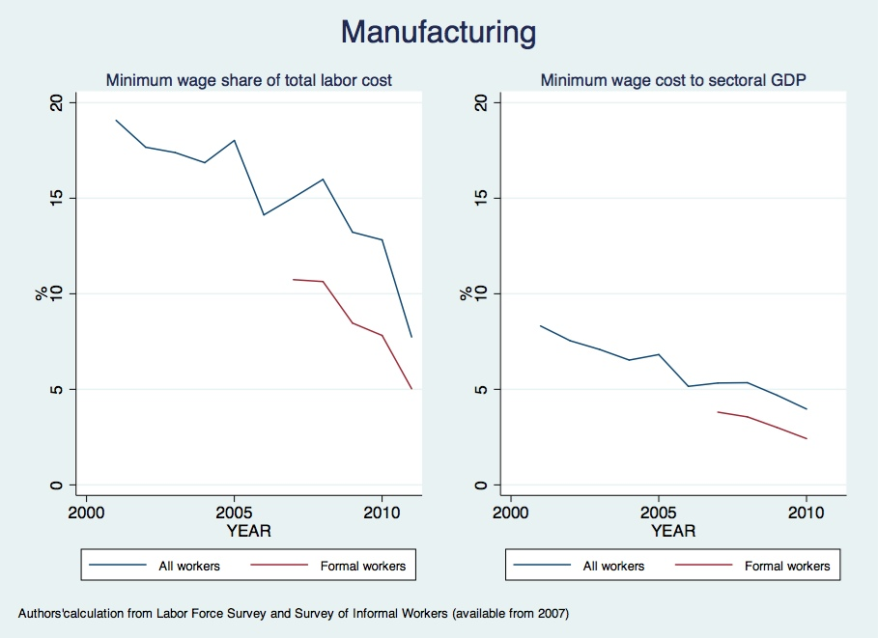
Notes:
In this graph, I calculate minimum wage share to total labor cost for manufacturing sector. It shows a decreasing trend of minimum wage share. In fact, similar trend can be observed in other sectors too.
The sharp drop of this statistic suggests that minimum wage has been increasingly irrelevant. Fewer and fewer workers receive minimum wage. It also indicates the larger and larger wage disparity between unskilled workers living on minimum wage and the high earners.

Slide 26
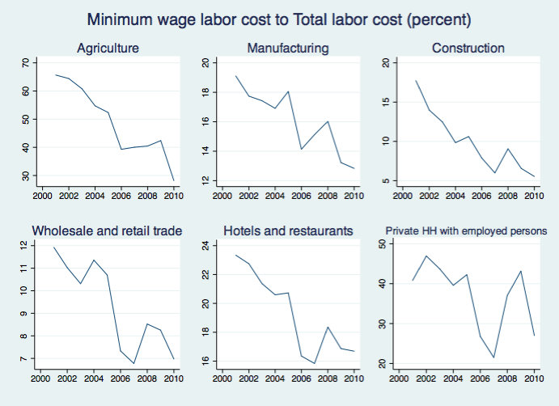

Slide 27
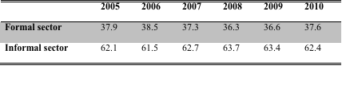
Majority of workers is in informal sector
Notes:
Majority of labor forces is in informal sector with limited old-age pension and social security scheme

Slide 28
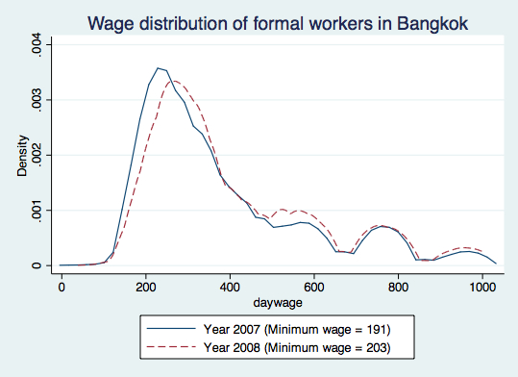

Slide 29
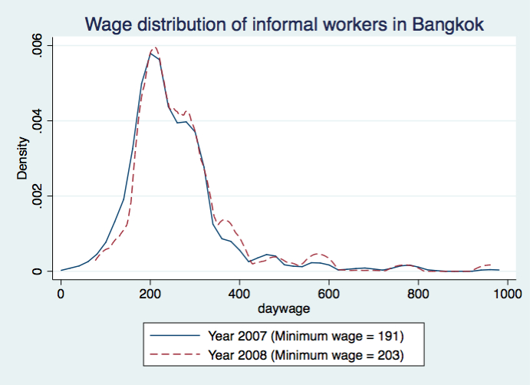
Notes:
Minimum wage change have little effect in informal wage distribution

Slide 30
Persistent inequality: The rich spends much more on children education
Private education expenditure by household income in 2009
Notes:
One thing about inequality is that if not fixed it will persist and get worst
As this graph shows, the rich spend much more on children education than the poor.

Slide 31
Persistent inequality: Better educated parents spend much more on children education
Education expenditure per household in 2009 by education of the household head
Notes:
And better educated parents spend more on children education
It is common for students from rich family in Bangkok to have private tutor now. They spend most of their weekend time on extra tutorial classes.
If inequality restricts growth, persistent inequality will restrict long-run growth.

Slide 32
2. Education
Thailand public education has been improved… only quantitatively
International evidence (Hanushek and Wößmann,2007; Hanushek and Kimko ,2000) show that education is important for growth…but it is quality not quantity
Also, higher public expenditure on education does not necessarily improves quality (Hanushek and Wößmann,2007)
Notes:
The next socio-economic factor that I would like to mention is education.
Increasing evidence show that education quality, not quantity is important to growth.
Also, higher public expenditure on education does not necessarily improve quality.
No relationship between education spending per student and PISA score (standardized test score). This of course doesn't that spending is not important. It’s necessary but not sufficient

Slide 33
Education quantity and growth
Hanushek and Wößmann (2007), Hanushek and Kimko (2000)
Notes:
Education quantity has no significant effect on growth once quality is controlled for.
The graph shows the relationship between growth and years of education when quality is controlled. The coefficient is insignificant.

Slide 34
Education quality and growth
Hanushek and Wößmann (2007)
Notes:
But there is a strong relationship between quality of education and growth.

Slide 35
Thailand:
Increased education budget
Notes:
As you can see from the graph, education budget increases overtime
In 2011, education spending was 4% of GDP

Slide 36
The problem is not insufficient budget…
Public spending on education in 2011 (% of GDP)
Thailand: 4%
Malaysia: 5.1% (in 2010)
Singapore: 3.3%
Japan: 3.8%
East Asian and the pacific average: 3.8%
Global average: 5%
Notes:
Budget is comparable with neighboring countries.
We are not spending as much as malaysia but more than singapore, japan and more than regional average.
So, spending is not low but why quality is low?
I don’t have complete answer but some Thai economists give some insight on this.

Slide 37
Thailand:
High gross enrollment rate…
Notes:
Minimum education policy has been successful.
Gross enrollment increased steadily

Slide 38
…low quality
PISA score 2009
Notes:
But in term of quality, not very high compared with international benchmark. Much lower than Japan and Singapore. Lower than international average

Slide 39
Misaligned teacher’s incentive
(Tangkitvanit et al., 2012)
Teachers’ pay rise evaluation weight
  Teaching skill: 33%
  Proper behavior: 33%
  Academic output: 13%
  Students’ GPA: 7%
  Standardized test score: 3%
Notes:
One of the reasons would be incentive misalignment.
In Thailand, school teachers are evaluated for pay rise annually.
Standardized test score which is the best available reference for student quality receive only 3% of weight.
Teachers has less incentive to improve student academic ability.

Slide 40
Centralized System
Decision to hire/fire teachers not at schools
Centralized teacher’s performance evaluation system
Notes:
Another reason would be that schools does not have autonomy.
The system is highly centralised. Schools cannot hire teachers they want and fire bad teachers.
Teacher evaluation system is also centralized. Pay rise determined by Minister of Education. Parents cant hold teacher accountable for their teaching performance.

Slide 41
3. Public good provision
Regressive tax structure
  The major sources are indirect taxes → regressive → the incidence falls disproportionately to the poor.
  In 2010, indirect taxes accounted for 58.6% of total tax revenue (around 50% in OECD).
Low tax effort
  small personal income tax base (around 2 millions out of 38 millions labor force)
  long-list of exemptions benefitting high earners
  high prevalence of tax evasion especially by the rich
The ratio of Thailand’s taxation income to GDP at 16%
  Developed economies: around 30%-50%
  Developing economy average: 18%
Notes:
The next factor concerns the provision of public goods.
As we all know that the government have a very important role in improving economic equality using tools such as progressive tax policy and providing more public good to the poor.
In Thailand, the major sources of revenue are indirect taxes (VAT, excise tax, and custom duties) which are regressive and the incidence falls disproportionately to the poor
In 2010, revenue from indirect taxes accounted for 58.6% of total tax revenue while in developed countries, OECD countries for example, the ratio is about 50%
Thailand also have a very small tax base (2 million workers pay personal income tax) and long-list of exemption and high prevalence of tax evasion.
Overall, the ratio of tax income to GDP is about 16%, lower than global average.

Slide 42
Fiscal Policy: Public good provision heavily biased towards Bangkok
Regional Comparisons: Public Expenditure, GDP, and Population in 2010 (World Bank, 2012)
Notes:
Now, turning to the expenditure side of the fiscal policy.
This remarkable graph shows distribution of GDP, Population and public expenditure by region in 2010. Spending is heavily biased in bangkok (72% of annual public goods are there) while it produced only 26% of GDP with only 17% of population live there.
Bangkok has 17% of population, create 26% of GDP but receive 72% of total public expenditure.
Two reasons were identified as the major reasons for concentration.
Firstly, as economic activities are mostly concentrated in Bangkok and the central region, investments on infrastructure have been concentrated in these regions. The need to maintain and extend this infrastructure creates a momentum that crowds out other expenditure.
Secondly, the equalization component of intergovernmental transfer is very small; out of 174 billion baht fund from the central government in 2011, only 3.7 billion were designated for equalization purpose (World Bank, 2012).
Public good provision could be an instrument that correct inequality but they are heavily concentrated in Bangkok where people are already rich.

Slide 43
4. Oligarchic Structure of Politics
The oligarchic structures consist of several distinct but overlapping and interlocking groups of powerful people.
The present oligarchy has evolved from an earlier incarnation under the absolute monarchy, in which the participants were aristocrats, senior bureaucrats and a few big merchant families (mostly Sino-Thai).
Notes:
Provide characteristic of Thai political oligarchic structure

Slide 44
The bureaucratic elite that developed in the early twentieth century under the absolute monarchy had since become entrenched.
Although noble families and old money figured strongly in this oligarchy, this has never been a closed elite. Indeed its resilience has come partly from its openness and flexibility.

Slide 45
During 1930s - 1980s, a military elite became absolutely dominant.
Economic boom during 1980s – 1990s has helped expanding and cementing the structure.
Politically connected rent-seekers enjoyed economic rents from monopoly positions and concessions in tightly regulated sectors. They become hugely rich.

Slide 46
“Oligarchy”
Ben Anderson has described the politics of Indonesia, the Philippines, Malaysia and Thailand as “oligarchy,” rule by the few, in some form or another.
This oligarchy consists of family groups, their children going to the same school, investing together in related businesses, married within and among themselves, as well as sharing similar value systems and mutual benefits.
This does not mean that members of the oligarchy do not compete with one another. Neither does it mean they are completely cut off from other groups. They are flexible to bring in outsiders, but it must be under the terms they set

Slide 47
The oligarchy was challenged in a big way following the economic crisis and new constitution of 1997. The crisis undermined the reputation and legitimacy of the old power elites.
The constitution allowed new forces to emerge. A new power center, led by the Shinawatra family, affected changes by enhancing the role of parliament.

Slide 48
top
bureaucrats
palace
top
military
big
business
senior
judges
select
civil
society
provincial
business

Slide 49
New mechanisms for sustaining the oligarchic structures
Some of the biggest companies are semi-public, semi-private organisation enjoying best of both worlds.
  Monopolistic structure and privileges from being public organisation. Board of director are senior officials or elite bureaucrats who supposed to regulate them.
  The Finance Ministry as their loan guarantor
  The Attorney-General as their representative in the Administrative Court
  The Council of State as legal advisor.
  Free to maximise profit without competition.
  Enjoy many of the advantages of a private enterprise, such as investment incentives, as well as exemptions from Finance Ministry’s rules and regulations on executives’ salaries, net profit allocations, and the duty to return the profits to the government
Notes:
Provide characteristic of Thai political oligarchic structure

Slide 50
New mechanisms for sustaining the oligarchic structures
This creates a huge problem of governance, involving multiple conflicts of decision making with adverse consequences on fairness and public welfare.
Thailand's oligarchic politics is the main obstacle hindering reforms of inequality.
  Example: the case of pollution control in Maptaphut Industrial Estate. a bureaucratic network in the energy sector has allowed some big private businesses to go ahead with their investment plans without having to undergo the environmental and social impact assessments required by law, and despite the fact the residents surrounding the industrial estate secured a court verdict mandating these studies.
According to The economist’s crony-capitalism index, Thailand is ranked 14th as the country where politically connected businessmen are most likely to prosper
Notes:
Provide characteristic of Thai political oligarchic structure

Slide 51
New mechanisms for sustaining the oligarchic structures
Short-courses for executives and alumni associations as links to the oligarchic political structure at the national level
Many decades ago, the army began offering courses to officials, businessmen, and others to increase understanding of the military’s role, and to build networks of contacts.
Now, there are courses organized by the stock exchange, Chamber of Commerce University, judiciary, and the parliament, among other.
Notes:
new networks deliberately created by the invention of quasi-academic institutions and associated alumni networks in order to link new players in the public and private sectors into Thailand’s oligarchic politics

Slide 52
Elite executive courses
Pattern of the course
part-time courses lasting up to a year.
Besides the classroom work (which is not so onerous, and not the real point), these institutes orchestrate many bonding activities:
  dinners, karaoke sessions, golf outings, and overseas study trips.
  Most importantly, they have an alumni club that maintains the bonds and builds links across classes of different years.

Slide 53
Elite executive courses
They seed the classes by inviting influential figures from different areas of influence — permanent secretaries, generals, judges, and executives of top companies.
Other people then press to get accepted into the class in order to build contacts in this celestial arena.
The class lists show that many people have attended classes in several of these institutes. According to the model established by the military’s model version of this scheme, alumni are bound to help one another

Slide 54
Elite executive courses
These quasi-academic institutions have been invented as conscious attempts to facilitate networking across constituent parts of the elite, established and emerging.
These new institutions are the only spaces where the established and emerging elites from different segments of the public and private sectors are able to build alliances. Several people attend many of these courses precisely because each attendance widens their network.

Slide 55
Elite executive courses
They provide a framework through which powerful groups from the security sector, politics, business, the judiciary, and selected segments of civil society can cooperate to set policies and divide the spoils.
The strength of these networks helps to insulate the oligarchy from popular pressures in favor of redistribution or other reform policies.

Slide 56
Income from assets by percentile, 2009
income from rent
income from interest and dividend

Slide 57
Landownership by decile, 2012
Source: Duangmanee Laowakul, 2013

Slide 58
Landownership by politicians (MPs, senators), 2010
Party | N landowners | Total land (rai) | Value (Mil. Baht)
Pheu Thai | 173 | 21,079 | 4,795.5
Democrat | 160 | 15,181 | 5,829.6
Phumjai Thai | 31 | 3,853 | 733.8
Pheu Phaendin | 29 | 5,323 | 1,299.4
Chat Thai Phatthana | 21 | 2,541 | 483.6
Ruam Jai Thai CP | 8 | 819 | 681.1
Other | 15 | 4,164 | 552.9
Senators | 145 | 19,311 | 10,429.4
Total | 582 | 72,274 | 24,805.3
Source: Asset declarations, NCCC | . | Average = 20 ha

