Slide 1

MK 322 Retail Management
Chapter 7: Retail Locations Part I
By Ajarn Suwalya K.

Slide 2
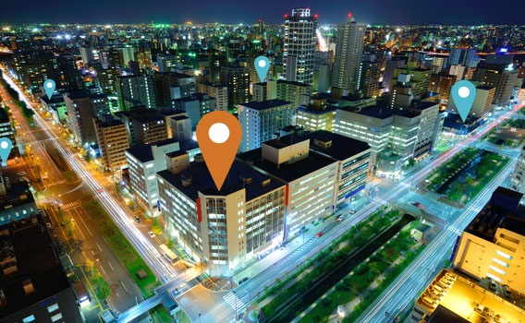
Types of Retail Locations

Slide 3
Types of Retail Locations
Many types of locations are available for retail stores, each type with its benefits and limitations
Two basic types of location are unplanned(free standing and urban sites) and planned (shopping centers)
Unplanned locations do not have centralized management that determines what stores will be in a development
In planned locations, the shopping developer and/or manager makes and enforces policies that govern store operations such as the hours that a store must be opened
Notes:
1

Slide 4
Types of Retail Locations
The shopping center management also maintains the common facility such as parking area- an arrangement referred to as common area maintenance (CAM)
And responsible for providing security, parking lot lighting, outdoor signage for the center, advertising, special events to attract consumers and so on.
Notes:
1

Slide 5
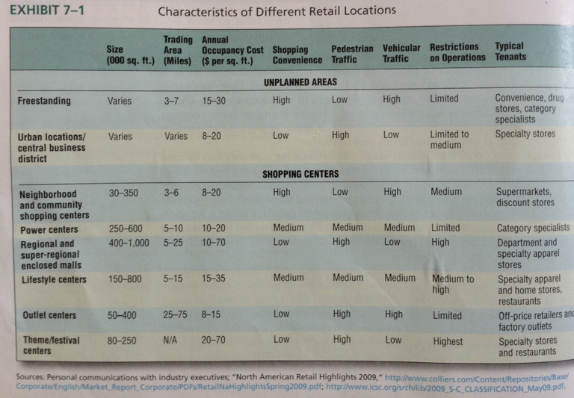
Types of Retail Locations
Notes:
1

Slide 6

Unplanned Locations

Slide 7
Types of Unplanned Retail Locations
The three types of unplanned retail locations are freestanding sites, urban locations, mainstreet locations
Notes:
1

Slide 8
Freestanding Sites
Freestanding sites are retail locations for an individual isolated store unconnected to other stores
Advantages are convenience for customers(easy access and parking); visibility to attract customers while driving; fewer restrictions on sign, and hours
Disadvantages are limited trade area; higher occupancy cost than shopping centers, do not share CAM costs;little pedestrian traffic
Notes:
1

Slide 9
Freestanding Sites
Outparcels are freestanding stores that are not connected to other stores in the shopping area, but located on the premises of a shopping center typically in the shopping area
Advantages compared to other freestanding location is convenience of a drive through window, extensive parking and clear visibility from the street.
Popular for fastfoods restaurants and banks
Notes:
1

Slide 10
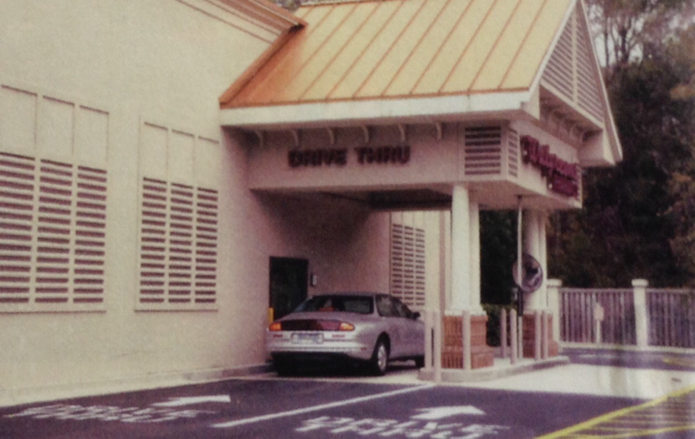
Freestanding Sites
Drugstore chains use freestanding locations for their stores with drive-through windows to make it easy for customers to pick up prescriptiom pharmaceuticals
Notes:
1

Slide 11

Urban Locations
Urban areas in large cities offer three types of locations: the central business district, inner city, and gentrified residential sites
Notes:
1

Slide 12
Urban Locations - Central Business District
The central business district (CBD) is traditionally downtown financial and business area in a city or town
Due to its daily activities, it draws many people and employees in the area during business hours
High level of pedestrian traffic, but shopping flow on evenings and weekends is slow
Vehicle traffic is limited, parking problems
Evening and weekdays special events to attract pedestrian taffic
Notes:
1

Slide 13
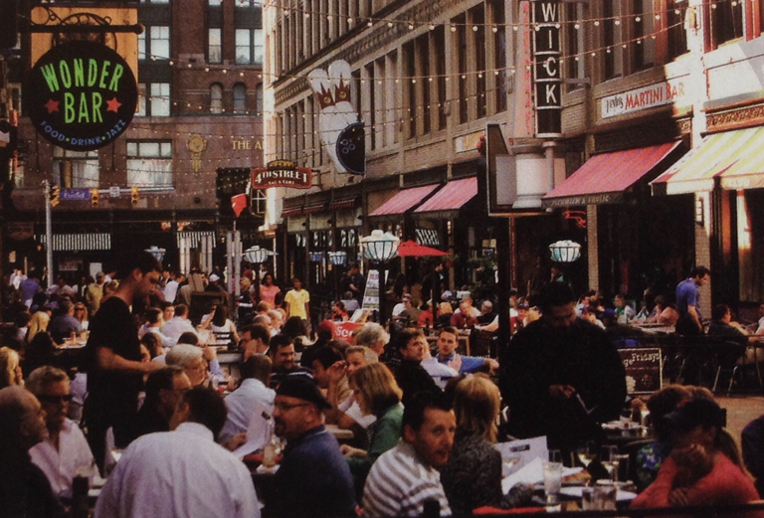
Urban Locations - Central Business District
Cleveland's East Fourth Street development attracts consumers to the CBD.
Notes:
1

Slide 14
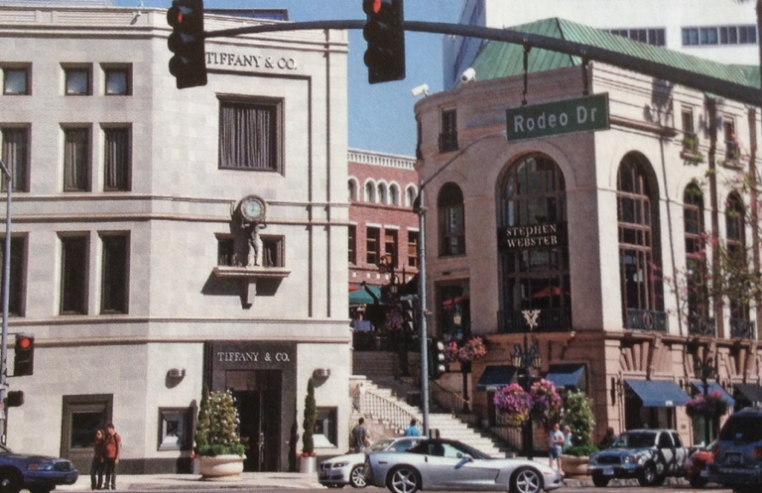
Urban Locations - Central Business District
Rodeo Drive is an CBD location that is one of the most highly regarded
locations by retailers of high-fashion merchandise.
Notes:
1

Slide 15
Urban Locations – Inner City
During 1970s and 1980s, many U.S. And some European cities experienced urban decay.
Urban decay is a process of a previously functioning city, or part of the city
The inner city is a low income residential area within a large city
Retailing can play an important role in inner-city development activities by providing needed services and jobs for the residents
Notes:
1

Slide 16
Urban Locations – Gentrified Residential Areas
Many inner-city are going through a process of gentrification- the renewel and rebuilding of offices, housing, and retailers in deteriorating areas
Young professionals and retired empty noisers are moving into these areas to enjoy the convenience of shopping, restaurants, and entertainment near where they live
Big-box retailers like Target, Walmart, Office Depot, Home Depot and Costco are opening outlets in cities, typically with smaller stores
Notes:
1

Slide 17
Main Street
Main Street refers to the traditional downtown shopping area in smaller towns and secondary shopping areas in large cities and their suburbs
To attract consumers and retailers, Main Street development efforts focus on providing better shopping experience than big box retailers
They develop pedestrian walkways, ie. Receive grants for new signage, attractive entrances
Town administration work to improve downtown aesthetics with landscaping, repaved sidewalks, updated street lights, etc.
Notes:
1

Slide 18
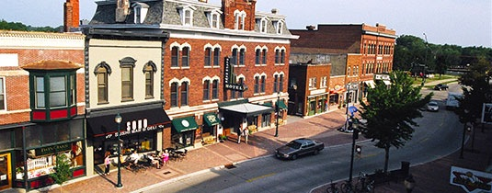
Main Street
Notes:
1

Slide 19
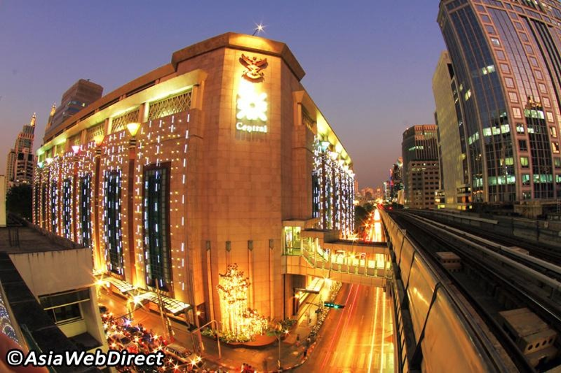
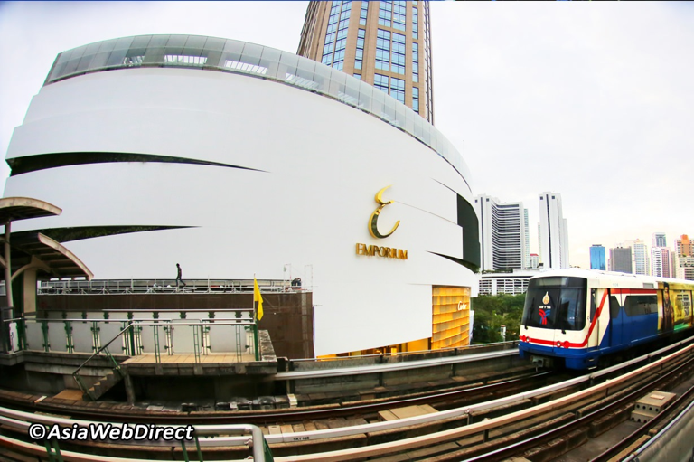
Shopping Centers and Planned Retail Locations

Slide 20
Shopping Center
Shopping Center is a group of retail and other commercial establishments that are planned, developed, owned, and managed as a single property
Attract customers due to many stores
Shopping center management carefully select a set of retailers that are complementary to provide consumers with a comprehensive shopping experience at one, convenient location
Notes:
1

Slide 21
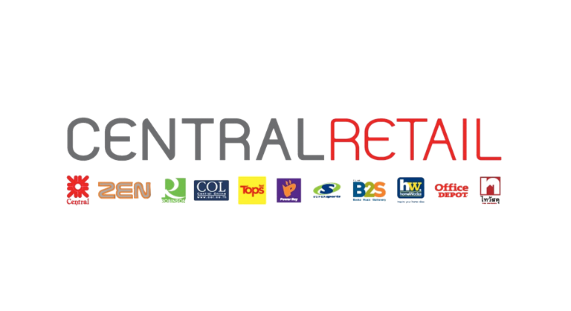
Shopping Center
Lease agreements require retailers to pay for CAM, according to size of their store space and/or sales volume and a retail fee based on sales
Notes:
1

Slide 22
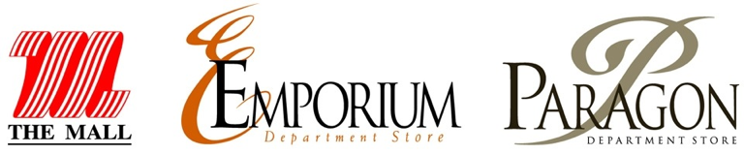
Shopping Center
Most shopping centers have at least one or two major retailers, referred to as anchors such as Macy's, Walmart or Kroger
Managed by shopping center property management firm.
Notes:
1

Slide 23
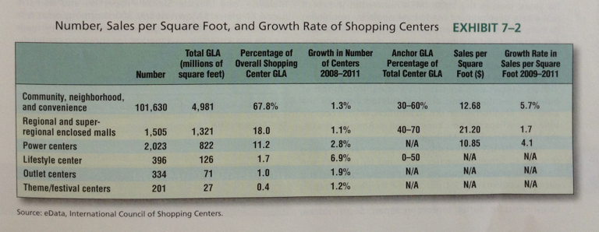
Shopping Center
Notes:
1

Slide 24
Convenience, Neighborhood, and Community Shopping Centers
Convenience, Neighborhood, and Community Shopping Centers also called strip shopping centers are attached rows of open-air stores with onsite parking usually located in front of the stores
Usually smaller centers are 10,000 to 60,000 sq.feet
They offer customers convenient locations and easy parking
They lack limited trade area, lack of entertainment and restaurants due to their size
Notes:
1

Slide 25
Power Centers
Power centers are shopping centers that consist primarily of collections of big box retailers, such as full-line discount stores (Target), off-line price stores (Marshalls), warehouse clubs(Costco), category specialist (Toys"R" Us)
Power center offers low occupany cost, modest levels of consumer convenience, and vehicular and pedestrian traffic
Notes:
1

Slide 26
Enclosed Shopping Malls
Shopping malls are enclosed, climate controlled, lighted shopping centers with retail stores on one or both sides of the enclosed walkway
Parking is provided within the perimeter
Shopping malls are classified as either regional malls( less than 800,000 sq.feet) or super-regional malls (more than 800,000 sq.feet)
Notes:
1

Slide 27
Enclosed Shopping Malls
Advantage over several locations
Large trade area
In expensive form of Entertainment
Hang out with friends, older citizens exercise
Generate pedestrian traffic within mall
No need to worry about weather
Uniform open and closing hours
Disadvantage: high occupancy costs, retailer selling similar merchandise, parking in front not feasible
Notes:
1

Slide 28
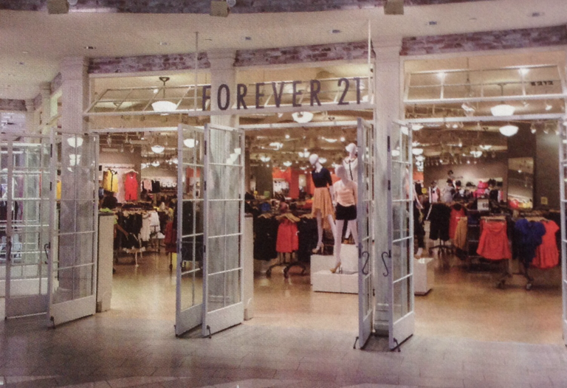
Enclosed Shopping Malls
An increasing number of malls are using exciting stores like Forever 21 to
attract younger customers
Notes:
1

Slide 29
Lifestyle Centers
Lifestyle centers are shopping centers that have an open-air configuration of speciality stores, entertainment, restaurants, with design, ambience and amenities such as fountains and street furniture, ice cream carts, events, concerts
People enjoy the ambience, shops
Occupancy cost lower than enclosed mall
Ease of parking, very convenient for shoppers
Notes:
1

Slide 30
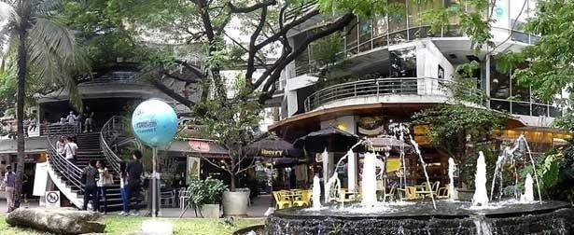
Lifestyle Centers
Located near high income areas, part of mixed-use development
Disadvantage: bad weather
Notes:
1

Slide 31
Mixed-Use Developments
Mixed-use developments(MXDs) combine several different uses into one complex including retail, office,residential, hotel,recreation, or other function
They are pedestrian oriented and therefore facilitate live-work-play environment
They appeal to people who have enough of long commutes to work and looking for a lifestyle that gives them more time for things they enjoy
Notes:
1

Slide 32
Mixed-Use Developments
MXDs are popular with retailers since they attract additional shoppers to their stores
And popular with urban planners, developers and environmentalists because they provide a pleasant, pedestrian environment and efficient use of space
Notes:
1

Slide 33
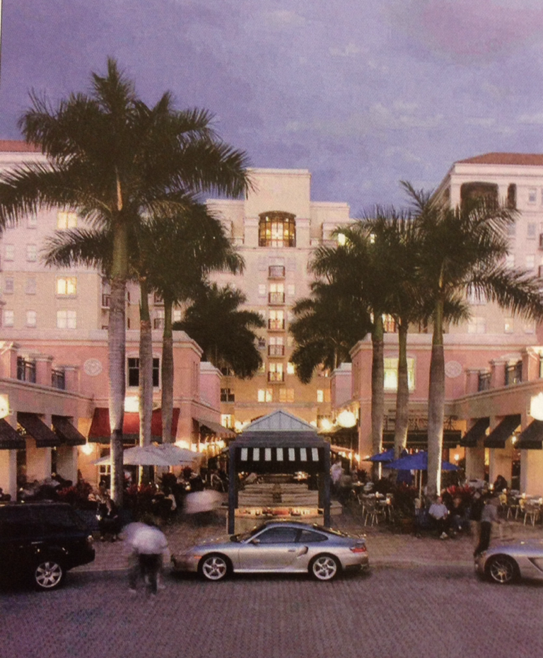
Mixed-Use Developments
Mizner Park in Boca Raton, Florida, combines retail, residential, and entertainment offerings in one location with unique boutiques, eateries, music, movies, and art galleries conveniently located close to ocean-front apartments and condos
Notes:
1

Slide 34
Outlet Centers
Outlet centers are shopping centers that contain mostly manufacturers' and retailers'outlet stores.
Some outlet centers have a strong entertainment component, including movie theaters and restaurants to keep customers on the premises longer.
Typically outlet centers are in remote locations. These remote locations offer lower costs and reduce competition between outlet stores and department and speciality stores offering branded merchandise at full price.
Notes:
1

Slide 35
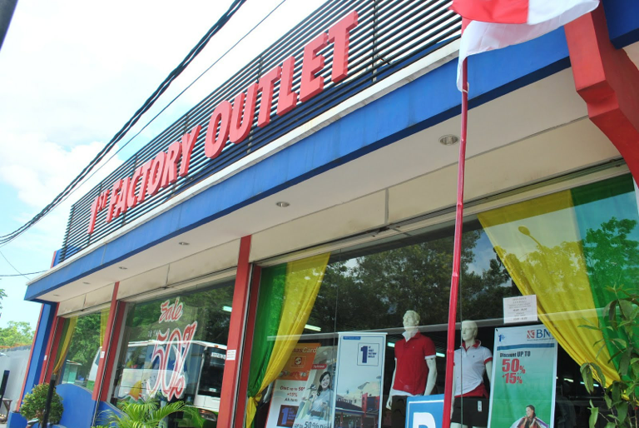
Outlet Centers
Notes:
1

Slide 36
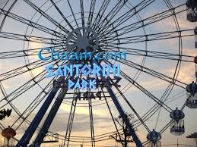
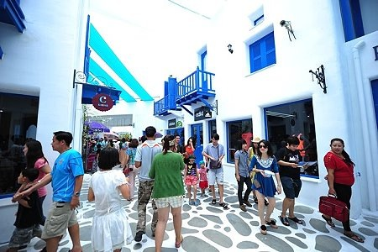
Themes/Festival Centers
In theme/festival centers, a unifying theme is generally reflected in each individual store, both in their architecture and merchandise they sell,
Notes:
1

Slide 37
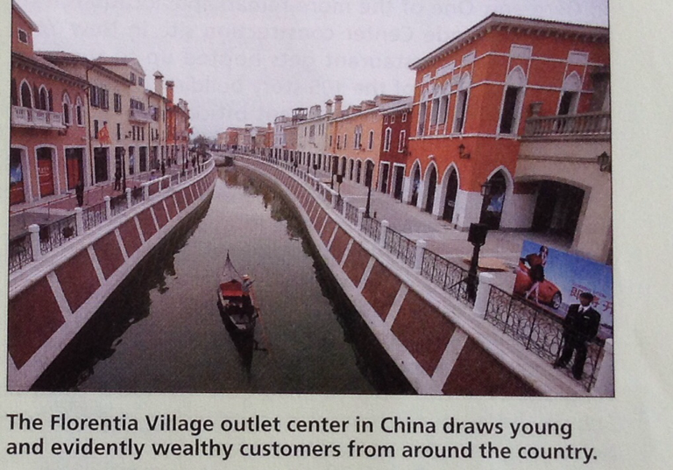
Themes/Festival Centers
Notes:
1

Slide 38
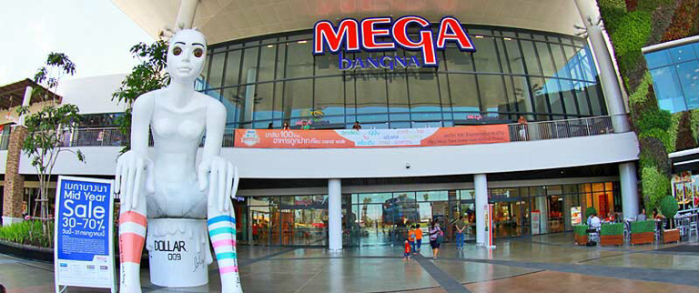
Larger, Multiformat Developments-Omnicenters
Omnicenters are new shopping center developments are combining enclosed malls, lifestyle centers, and power centers.
They reflect the growing tendency of consumers to cross-shop, which is a pattern of buying both premium and low-priced merchandise.
Notes:
1

Slide 39


