Slide 1


Mk 201 Midterm Exam Guidelines
Date: Friday July 2, 2021
Time: 9:00-11:00 am ( 2 hours)
By Ajarn Suwalya K.
Summer 2020

Slide 2
Grading
Group Assignments 35%
Midterm Examination 25%
Final Examination 25%
Participation & Discussion 15%
Total 100%

Slide 3

Grading – Midterm and Final Exam
Midterm Exam 25% - On Friday July 2, 2020
What is expected on the exam
Handouts – textbook material
VDO material
Individual/Group Assignments
Project Presentations
Class Discussions
Proctored in Zoom

Slide 4
What types of questions on midterm?
(100 points -> 25% of your grade)
Short Answers
True or False and justify why?
Case Questions

Slide 5
What to prepare?
Pens and Colored markers only, no pencils
White writing paper ( bring a lot in case)
Closed book
Cover Lesson 1 to 5 ( up to chapter objective 2)
Memorize concepts then will need to apply to questions and case
Justify why? = means that you need to give reason with supporting evidence/facts

Slide 6
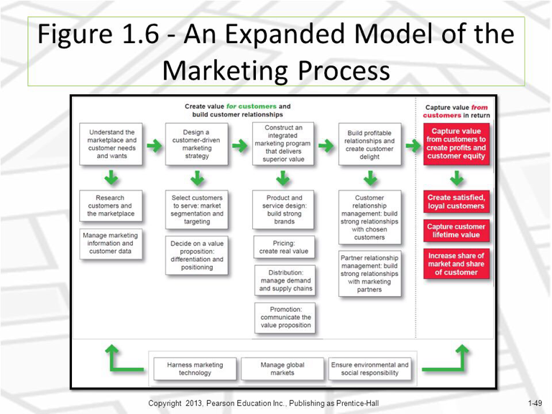
Important Chart: Need to understand
(plus other charts in handouts as well)

Slide 7

Any questions or concerns,
Please feel free to contact me
FB Messenger: Suwalya Ja

