Slide 1
Personal Finance
Class 2: Planning Your Personal Finances
Money management strategy.
Planning your tax strategy.
Please do not reproduce or distribute. Please refer to Ch.3 and Ch.4 of the main textbook.

Slide 2
Successful Money Management
MONEY MANAGEMENT is the day-to-day financial activities needed to manage personal economic resources, while working toward long-term financial security
Daily spending and saving decisions are the center of financial planning
Decisions must be coordinated with needs, goals, and personal situations
3-2

Slide 3
Successful Money Management
OPPORTUNITY COST AND MONEY MANAGEMENT
Spending money on current living expenses reduces the amount you can save and invest
Saving and investing for the future reduces the amount you can spend now
Buying on credit ties up future income
Using savings for purchases results in lost interest and depletes savings
Comparison shopping can save money but takes valuable time
3-3

Slide 4
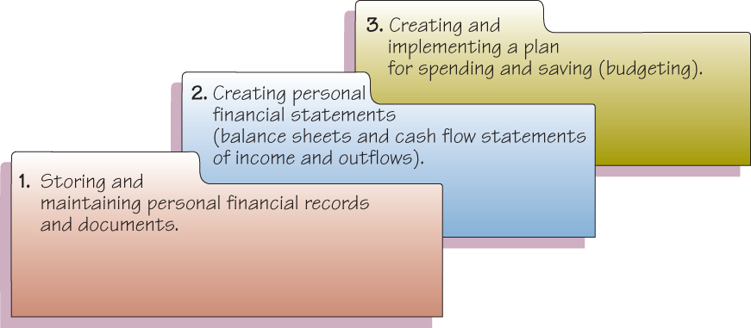
Successful Money Management
COMPONENTS OF MONEY MANAGEMENT
3-4

Slide 5
Successful Money Management
A PERSONAL FINANCIAL RECORDS SYSTEM
Benefits of an Organized System of Financial Records
  Handling daily business affairs, including payment of bills on time
  Planning and measuring financial progress
  Completing required tax reports
  Making effective investment decisions
  Determining available resources for current and future spending
3-5

Slide 6
Successful Money Management
Items in Your Home File
  Personal and employment records
  Money management records
  Tax records
  Financial services records
  Credit records
  Consumer purchase & auto records
  Housing records
  Insurance records
  Investment records
  Estate planning and retirement records
3-6

Slide 7
Successful Money Management
Items in the safe deposit box
Records that would be difficult-to-replace
  Birth, marriage and death certificates, copy of will
  Citizenship and military papers
  Adoption and custody papers
  Serial numbers and photos of valuables
  CDs and credit and banking account numbers
  Mortgage papers and titles
  List of insurance policies
  Annual stock investment statements
  Rare coins and stamps
3-7

Slide 8
Successful Money Management
Records on your personal computer
  Current and past budgets
  Summary of checks written and other banking transactions
  Past income tax returns prepared with tax preparation software
  Account summaries and performance results of
  investments
  Computerized versions of wills,
  estate plans, and other documents
3-8

Slide 9
Successful Money Management
How long should records be kept?
Birth certificates, wills, and Social Security information should be kept permanently
Keep records on personal property and investments as long as you own them
Keep documents related to the purchase and sale of real estate indefinitely
Copies of tax returns and supporting data should be kept seven years
3-9

Slide 10
Personal Financial Statements
Develop a personal balance sheet and cash flow statement.
PURPOSE OF PERSONAL FINANCIAL STATEMENTS
Report your current financial position in relation to the value of the items you own and the amounts you owe
Measure your progress toward your financial goals
Maintain information on your financial activities
Provide data you can use when preparing tax forms or applying for credit
3-10

Slide 11
Personal Financial Statements
BALANCE SHEET: WHERE ARE YOU NOW?
Also called the Net Worth Statement or Statement of Financial Position
Preparation of Balance Sheet requires using three Steps
STEP 1: LIST ITEMS OF VALUE
Assets - what you own
Liquid assets
  Real estate
  Personal possessions
  Investment assets
3-11

Slide 12
Personal Financial Statements
STEP 2: DETERMINE AMOUNTS OWED
Liabilities - what you owe
  Current liabilities (< 1 year)
  Long-term liabilities
STEP 3: COMPUTE NET WORTH
Net Worth = Assets – Liabilities
Assets = Liabilities + Net Worth
Insolvency is the inability to pay debts when they are due
3-12

Slide 13

Personal Financial Statements
Net Worth is an indication of the financial position at any given date
Ways to increase Net Worth
Increasing your savings
Reducing spending
Increasing the value of investments and other possessions
Reducing the amounts you owe
3-13

Slide 14

Personal Financial Statements
THE CASH FLOW STATEMENT
Cash Flow is the actual inflow and outflow for a given time period
The Cash Flow statement is also called
Personal Income and Expenditure Statement
3-14

Slide 15
Personal Financial Statements
Preparation of The Cash Flow Statement requires using three Steps
STEP 1: RECORD INCOME
  Wages, salaries, and commissions
  Self-employment business income
  Savings and investment income
  Gifts, grants, and scholarships
  Government payments, such as Social Security, public assistance, and unemployment benefits
  Amounts received from pension and retirement programs
  Alimony and child support payments
3-15

Slide 16
Personal Financial Statements
STEP 2: RECORD CASH OUTFLOWS
  Fixed Expenses
  Variable expenses
STEP 3: DETERMINE NET CASH FLOWS
  The difference between income and outflows can either be positive (surplus) or negative (deficit)
  Cash flow statement provides the foundation for preparing and implementing a spending, saving, and investment plan
3-16

Slide 17
Budgeting for
Skilled Money Management
Learning Objective 3-3:
Create and implement a budget.
A budget is a spending plan
The main purposes of a budget are to help you
  Live within your income
  Spend your money wisely
  Reach your financial goals
  Prepare for financial emergencies
  Develop wise financial management habits
3-17

Slide 18
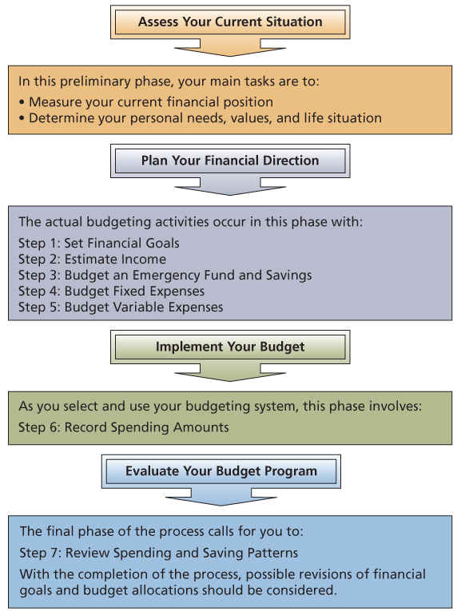
Budgeting for
Skilled Money Management
3-18

Slide 19
Budgeting for
Skilled Money Management
THE BUDGETING PROCESS
Step 1: Set Financial Goals
Step 2: Estimate Income
Step 3: Budget An Emergency Fund
and Savings
Step 4: Budget Fixed Expenses
Step 5: Budget Variable Expenses
Step 6: Record Spending Amounts
Step 7: Review Spending and
Saving Patterns
Step 8: Revise Your Goals and
Budget Allocations

Slide 20
Budgeting for
Skilled Money Management
CHARACTERISTICS OF SUCCESSFUL BUDGETING
  Well planned
  Realistic
  Flexible
  Clearly communicated
3-20

Slide 21
Budgeting for
Skilled Money Management
TYPES OF BUDGETING SYSTEMS
Which one works for you?
Mental budget: it is all in your head
Physical budget: use envelopes for your expenses such as food, rent, etc.
Written budget: use spreadsheets
Computerized budgeting system: use software such as Quicken (http://www.quicken.com/)
Online budget: (http://www.mint.com/)
Budget App: using your phone to track expenses
3-21

Slide 22
Money Management and Achieving Financial Goals
Relate money management and savings activities to achieve financial goals.
IDENTIFYING SAVING GOALS
  To create an emergency fund for irregular and unexpected expenses
  To pay for the replacement of expensive items, such as cars or a down payment on a house
  To buy special items like recreational equipment or to pay for a vacation
  To provide for long-term expenses such as retirement or the education of children
  To earn income from the interest on savings for use in paying living expenses
3-22

Slide 23
Money Management and Achieving Financial Goals
SELECTING A SAVING TECHNIQUE
Payroll deductions into savings accounts
Automatic payments from checking into savings accounts or mutual funds
Saving regularly in 401(k) plans
Also save coins, make periodic deposits
Write a check each payday as a % of income and deposit into savings
3-23

Slide 24
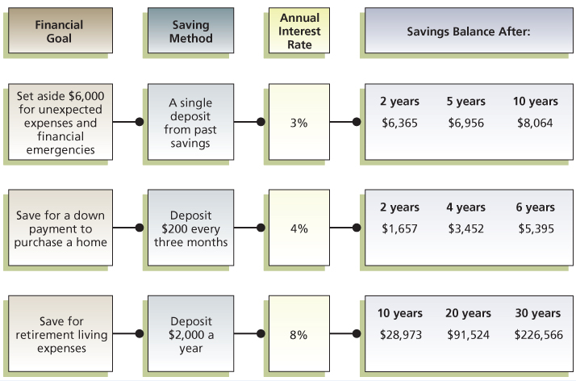
Money Management and Achieving Financial Goals
CALCULATE SAVINGS AMOUNTS

Slide 25

Taxes and Financial Planning
An effective tax strategy is vital for successful financial planning
Understanding tax rules and regulations can help you reduce your tax liability
4-25

Slide 26
Taxes and Financial Planning
About one-third of each dollar you earn goes to pay taxes
Tax Freedom Day came in Mid-April and represents the portion of the year that people had to work to pay their taxes for the year
4-26

Slide 27
Taxes and Financial Planning
To help you cope with the many types of taxes you should:
  Know current tax laws and regulations that affect you
  Maintain complete tax records
  Plan purchases and investments to reduce your tax liability
  Take advantage of tax benefits while paying your fair share of taxes
4-27

Slide 28
Taxes and Financial Planning
FOUR TYPES OF TAXES
1. Taxes on Purchases
Sales tax and Excise tax
2. Taxes on Property
Real Estate Property tax
Personal Property tax
3. Taxes on Wealth
Federal Estate tax and State Inheritance tax
4. Taxes on Earnings
Income tax and Social Security tax
4-28

Slide 29

Income Tax Fundamentals
Calculate taxable income and the amount owed for federal income tax.
Step 1: Determining Adjusted Gross Income
  Identify Taxable Income, which is
  net income, after deductions, on which income tax is computed
4-29

Slide 30
Income Tax Fundamentals
Determining adjusted gross income
  TYPES OF INCOME INCLUDED IN GROSS INCOME
    Earned income includes wages, salary, commissions, fees, tips or bonuses
    Investment income (also known as portfolio income) is money from dividends, interest, or rent from investments
    Passive income is from business activities where you do not directly participate - limited partnership
    Other income includes alimony, awards, lottery winnings, and prizes
4-30

Slide 31
Income Tax Fundamentals
  TYPES OF INCOME EXCLUDED FROM GROSS INCOME
    Exclusions are amounts not included in gross income; for example, a portion of foreign earned income
    Exclusions can also be tax-exempt income, which is income not subject to federal income tax; for example, interest on most state and city bonds
  TYPES OF INCOME TAXED LATER
  Total income is also affected by tax-deferred income, which is income that will be taxed at a later date; for example, earnings from a traditional individual retirement account (IRA).
4-31

Slide 32
Income Tax Fundamentals
  ADJUSTMENTS TO INCOME
  Adjusted gross income (AGI) is gross income after certain reductions have been made. These reductions are called adjustments to income and include the following:
    Contributions to an IRA or Keogh retirement plan
    Penalties for early withdrawal of savings
    Alimony payments
    Student loan interest, tuition & fee deductions
    Tax-deferred retirement plans, such as a 401(k)or a 403(b)(7) are a type of tax shelter
4-32

Slide 33
Income Tax Fundamentals
Step 2: Computing Taxable Income
DEDUCTIONS
A tax deduction is an amount subtracted from adjusted gross income (AGI) to arrive at taxable income
4-33

Slide 34
Income Tax Fundamentals
  You can subtract the standard deduction
  “or” you can subtract your total itemized deductions from AGI
  Itemized deductions includes items such as:
    Medical, dental expenses > 10% of AGI
    Taxes (state/local income tax, real estate prop. tax)
    Interest (mortgage interest, home equity loan interest)
    Contributions to charities
    Casualty and theft losses
    Moving expenses
    Miscellaneous expenses > 2% of AGI
4-34

Slide 35
Income Tax Fundamentals
  Next subtract exemptions from AGI
    An exemption is a deduction for yourself, your spouse and qualified dependents
    The amount of the exemption increases each year
  After deducting exemptions you
  arrive at your taxable income
4-35

Slide 36
Income Tax Fundamentals
Step 3: Calculating Taxes Owed
  TAX RATES
  Use your taxable income with the appropriate tax table or tax schedule
  The percent tax rates are the marginal tax rates on the last dollars of taxable income
    For example, after deductions and exemptions, a person in the 28% tax bracket pays 28 cents in taxes for every dollar of taxable income in that bracket
4-36

Slide 37
Income Tax Fundamentals
  CALCULATING YOUR TAX
  A person’s average tax rate is based on the total tax due divided by taxable income. This rate is less than a person’s marginal tax rate
    For example, if a person with a taxable income of $30,000 has a total tax bill of $3,000, their average tax rate is 10%, ($3,000 / $30,000)
4-37

Slide 38
Income Tax Fundamentals
  TAX CREDITS
  A tax credit is an amount subtracted directly from the amount of taxes owed. An example is the earned income tax credit
  Tax Credit vs. Tax Deduction
  $100 Tax Credit reduces your taxes by $100
  $100 Tax Deduction reduces taxes by $28 if you are in the 28% bracket
4-38

Slide 39
Income Tax Fundamentals
Recent Tax Credits
Foreign tax
Child and dependent care expenses
Retirement savings
Adoption expenses
American opportunity/Lifetime learning
Mortgage interest
Energy-savings
Elderly and disabled
4-39

Slide 40
Income Tax Fundamentals
Making Tax Payments
Withholding
Estimated Payments
Deadlines and Penalties
Most people are required to file their federal tax return each April 15
Form 4868 allows an automatic 6-month extension to file the federal return

Slide 41
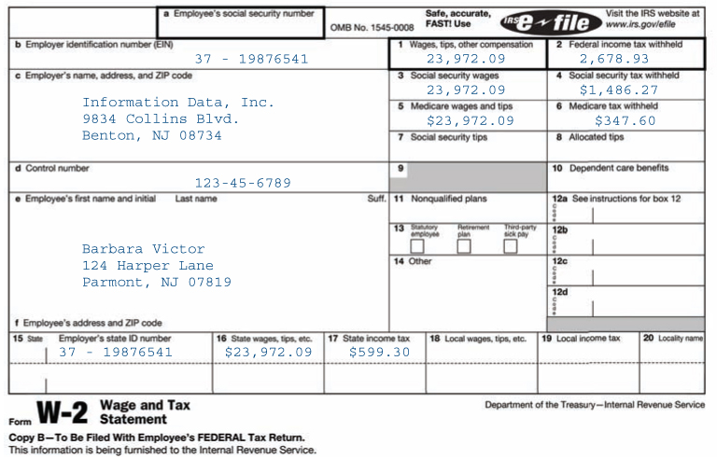
W-2 Form
Income Tax Fundamentals
4-41

Slide 42
Filing Your Federal
Income Tax Return
Prepare a federal income tax return.
Who Must File?
There are five filing status categories
  Single or legally separated
  Married, filing jointly
  Married, filing separately
  Head of household
    Unmarried individual who maintains a household for a child or dependent relative
  Qualifying widow or widower (2 years)
4-42

Slide 43
Filing Your Federal
Income Tax Return
Which Tax Form Should You Use?
Form 1040EZ
Least complicated; quick and easy to file
Single or married filing jointly, under age 65 and with no dependents
Income consisted of wages, salaries, and tips, and no more than $1,500 of taxable interest
Your taxable income is less than $100,000
You do not itemize deductions or claim any adjustments to income or tax credits
4-43

Slide 44
Filing Your Federal
Income Tax Return
Form 1040A
Taxable income less than $100,000
Adjustments to income are allowed
Tax credits for child care and dependent care are allowed
Form 1040
Required to use this form if income is over $100,000; use if you itemize deductions
Form 1040X
Used to amend a previously filed return
4-44

Slide 45
Filing Your Federal
Income Tax Return
Completing the Federal Income Tax Return
  Filing status and exemptions
  Income
  Adjustments to income
  Tax computation
  Tax credits
4-45

Slide 46

Filing Your Federal
Income Tax Return
  Other taxes
    (such as from self-employment)
  Payments
    (total withholding, estimated payments, etc.)
  Refund or Amount You Owe
    (Refunds can be sent directly to your bank account)
  Sign your return
4-46

Slide 47
Tax Assistance and the Audit Process
Identify tax assistance sources.
Tax Information Sources
The IRS has methods of assistance
  Publications and forms 1-800-TAX-FORM www.irs.gov
  Recorded messages 1-800-829-4477
  Phone hot line 1-800-829-1040
  Walk-in service at an IRS office
  Interactive tax assistant
  DVD: sold by IRS; contains forms and pubs
Tax publications: The Ernst and Young Tax Guide
The Internet
Kiplinger’s Personal Finance and Money
Tax preparation software companies
4-47

Slide 48
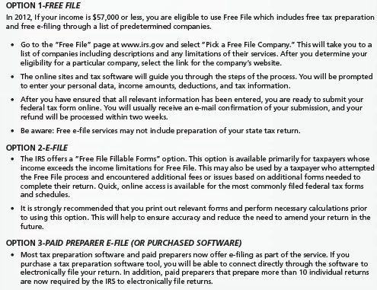
Tax Assistance and the Audit Process
How to File Your Taxes Online
4-48

Slide 49
Tax Assistance and the Audit Process
Tax preparation services
  Range from a one-person office to large firms such as H&R Block
  Enrolled Agents: Government-approved tax experts
  Accountants
  Attorneys
  If your professional tax preparer makes a mistake, you are still responsible for paying the correct amount, plus any interest and penalties
4-49

Slide 50
Tax Assistance and the Audit Process
What if Your Return is Audited?
About 1% of all returns are audited
If you claim large or unusual deductions you are more likely to be audited
There are three types of audits
  Correspondence Audit for minor questions
  Office Audit takes place at an IRS office
  Field Audit is the most complex, with an IRS agent visiting you at home, business or your accountant’s office
You have audit rights, including time to prepare for the audit, and clarification
4-50

Slide 51
Tax Planning Strategies
Select appropriate tax strategies for different financial and personal situations.
Legal: Practice Tax Avoidance
  Legitimate methods to reduce your tax obligation to your fair share but no more
  Financial decisions related to purchasing, investing, and retirement planning are the most heavily affected by tax laws
Illegal: Do not practice Tax Evasion
  Illegally not paying all the taxes you owe, such as not reporting all income
4-51

Slide 52
Tax Planning Strategies
To minimize taxes owed:
Accelerate deductions
If you expect to have the same or a lower tax rate next year.
Delay the receipt of income
If you expect to have the same or a lower tax rate next year.
Delay deductions
If you expect to have a higher tax rate next year.
Accelerate the receipt of income
If you expect to have a higher tax rate next year.
4-52

Slide 53
Tax Planning Strategies
Consumer Purchasing
Homeowners—mortgage interest and property taxes are deductible when you itemize. This reduces your taxable income
Use your home equity line of credit to buy a car or consolidate debt. Interest can be deductible when you itemize
Job-related expenses may be allowed as itemized deductions
Health Care Expenses: Flexible spending accounts (FSA) allow you to reduce your taxable income when paying for medical expenses or child care costs
4-53

Slide 54
Tax Planning Strategies
Investment Decisions
Tax-Exempt Investments
  Interest income from municipal bonds is not subject to federal income taxes
  Series EE U.S. Treasury bonds interest is exempt if used for tuition
Tax-Deferred Investments
  Tax-deferred annuities
  Section 529 savings plans for a child’s education
  Retirement plans such as IRA, 401(k) plans
  Capital gains on sale of stocks, bonds & real estate
4-54

Slide 55
Tax Planning Strategies
Self-Employment
  Owning your own business may allow you to deduct health and life insurance as business costs; However, have to pay self-employment tax (social security) in addition to regular tax rate
Children’s Investments (Income Shifting)
  A child under 18 with investment income of more than $1,900 is taxed at parent’s top tax rate
  A child under 18 with investment income of less than $1,900 receives a $950 deduction and the next $950 is taxed at his or her own rate
4-55

Slide 56

Tax Planning Strategies
Retirement and Education Plans
  Traditional IRA
  Roth IRA
  Coverdell Education Savings Account
  529 Plan
  Keogh Plan
  401(K) Plan
4-56

