Slide 1
General Equilibrium Models
Pawin Siriprapanukul
CW Ch.3

Slide 2
Outline
General Market Equilibrium
Equilibrium in National-Income Analysis

Slide 3
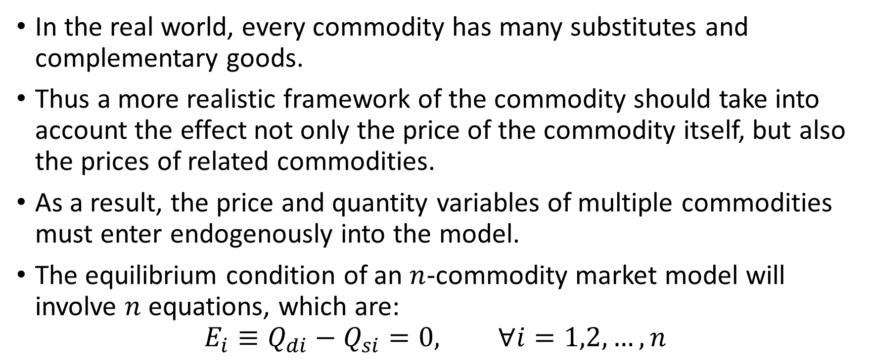
General Market Equilibrium
In the real world, every commodity has many substitutes and complementary goods.
Thus a more realistic framework of the commodity should take into account the effect not only the price of the commodity itself, but also the prices of related commodities.
As a result, the price and quantity variables of multiple commodities must enter endogenously into the model.
The equilibrium condition of an $n$-commodity market model will involve $n$ equations, which are:
$$E_{i}≡Q_{di}−Q_{si}=0, ∀i=1,2,…,n$$

Slide 4
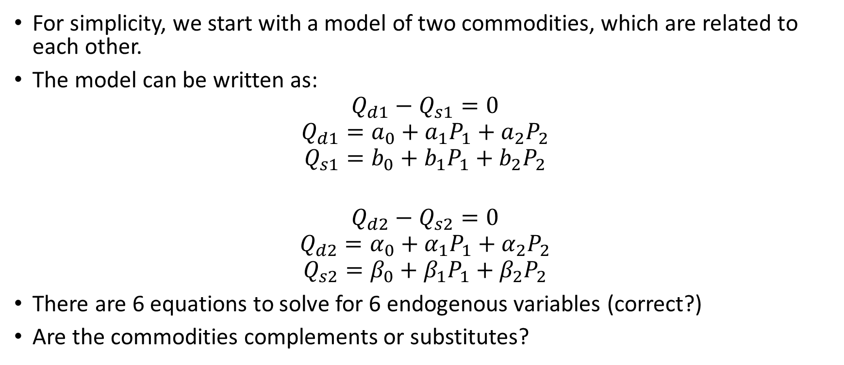
Two-Commodity Market Model
For simplicity, we start with a model of two commodities, which are related to each other.
The model can be written as:
$$Q_{d1}−Q_{s1}=0$$
$$Q_{d1}=a_{0}+a_{1}P_{1}+a_{2}P_{2}$$
$$Q_{s1}=b_{0}+b_{1}P_{1}+b_{2}P_{2}$$
$$Q_{d2}−Q_{s2}=0$$
$$Q_{d2}=α_{0}+α_{1}P_{1}+α_{2}P_{2}$$
$$Q_{s2}=β_{0}+β_{1}P_{1}+β_{2}P_{2}$$
There are 6 equations to solve for 6 endogenous variables (correct?)
Are the commodities complements or substitutes?

Slide 5
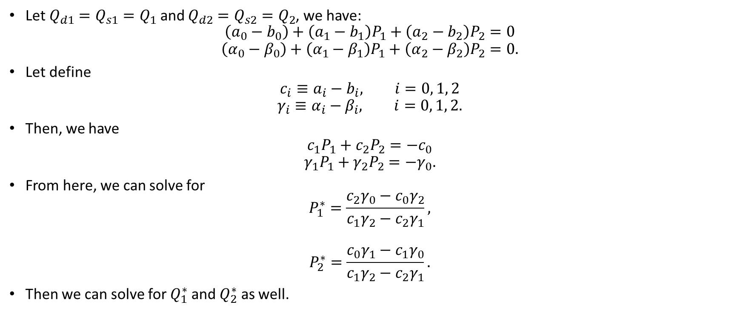
Solving by Elimination of Variables
Let $Q_{d1}=Q_{s1}=Q_{1}$ and $Q_{d2}=Q_{s2}=Q_{2}$, we have:
$$\left(a_{0}−b_{0}\right)+\left(a_{1}−b_{1}\right)P_{1}+\left(a_{2}−b_{2}\right)P_{2}=0$$
$$\left(α_{0}−β_{0}\right)+\left(α_{1}−β_{1}\right)P_{1}+\left(α_{2}−β_{2}\right)P_{2}=0.$$
Let define
$$c_{i}≡a_{i}−b_{i}, i=0, 1, 2$$
$$γ_{i}≡α_{i}−β_{i}, i=0, 1, 2.$$
Then, we have
$$c_{1}P_{1}+c_{2}P_{2}=−c_{0}$$
$$γ_{1}P_{1}+γ_{2}P_{2}=−γ_{0}.$$
From here, we can solve for
$$P_{1}^{∗}=\frac{c_{2}γ_{0}−c_{0}γ_{2}}{c_{1}γ_{2}−c_{2}γ_{1}},$$
$$P_{2}^{∗}=\frac{c_{0}γ_{1}−c_{1}γ_{0}}{c_{1}γ_{2}−c_{2}γ_{1}}.$$
Then we can solve for $Q_{1}^{∗}$ and $Q_{2}^{∗}$ as well.

Slide 6
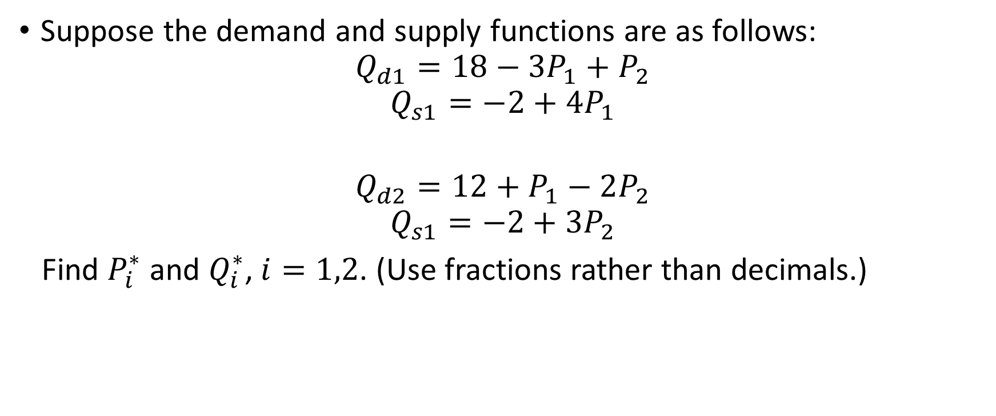
Numerical Example
Suppose the demand and supply functions are as follows:
$$Q_{d1}=18−3P_{1}+P_{2}$$
$$Q_{s1}=−2+4P_{1}$$
$$Q_{d2}=12+P_{1}−2P_{2}$$
$$Q_{s1}=−2+3P_{2}$$
Find $P_{i}^{∗}$ and $Q_{i}^{∗}$, $i=1,2$. (Use fractions rather than decimals.)

Slide 7
Try it here!

Slide 8
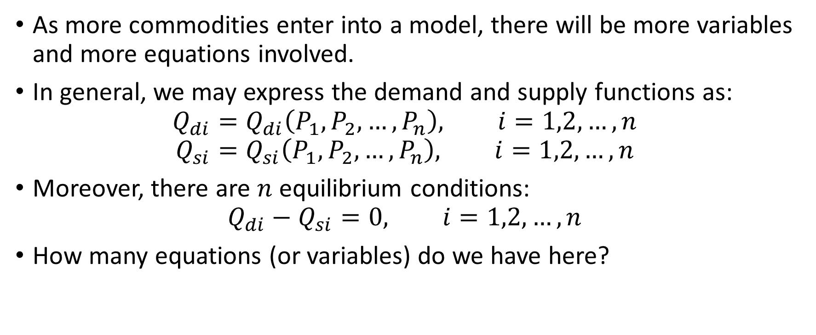
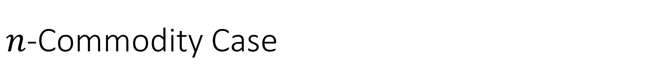
$n$-Commodity Case
As more commodities enter into a model, there will be more variables and more equations involved.
In general, we may express the demand and supply functions as:
$$Q_{di}=Q_{di}\left(P_{1},P_{2},…,P_{n}\right), i=1,2,…,n$$
$$Q_{si}=Q_{si}\left(P_{1},P_{2},…,P_{n}\right), i=1,2,…,n$$
Moreover, there are $n$ equilibrium conditions:
$$Q_{di}−Q_{si}=0, i=1,2,…,n$$
How many equations (or variables) do we have here?

Slide 9
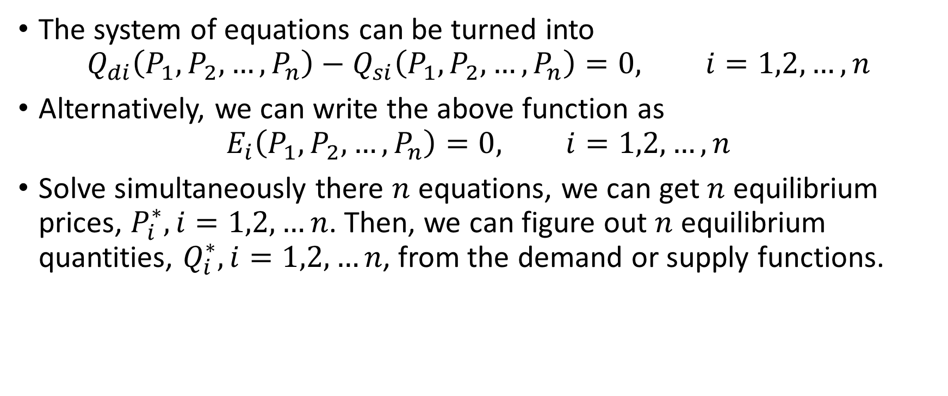
Solving by Elimination of Variables (Idea)
The system of equations can be turned into
$$Q_{di}\left(P_{1},P_{2},…,P_{n}\right)−Q_{si}\left(P_{1},P_{2},…,P_{n}\right)=0, i=1,2,…,n$$
Alternatively, we can write the above function as
$$E_{i}\left(P_{1},P_{2},…,P_{n}\right)=0, i=1,2,…,n$$
Solve simultaneously there $n$ equations, we can get $n$ equilibrium prices, $P_{i}^{∗}, i=1,2,…n$. Then, we can figure out $n$ equilibrium quantities, $Q_{i}^{∗}, i=1,2,…n$, from the demand or supply functions.

Slide 10
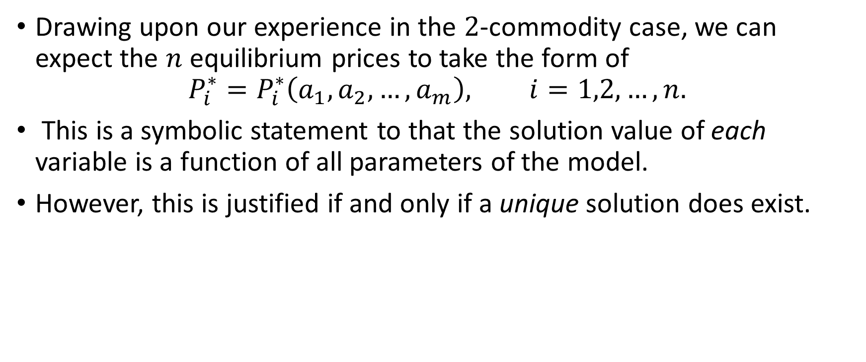
Solution of a General-Equation System
Drawing upon our experience in the $2$-commodity case, we can expect the $n$ equilibrium prices to take the form of
$$P_{i}^{∗}=P_{i}^{∗}\left(a_{1},a_{2},…,a_{m}\right), i=1,2,…,n.$$
This is a symbolic statement to that the solution value of each variable is a function of all parameters of the model.
However, this is justified if and only if a unique solution does exist.

Slide 11
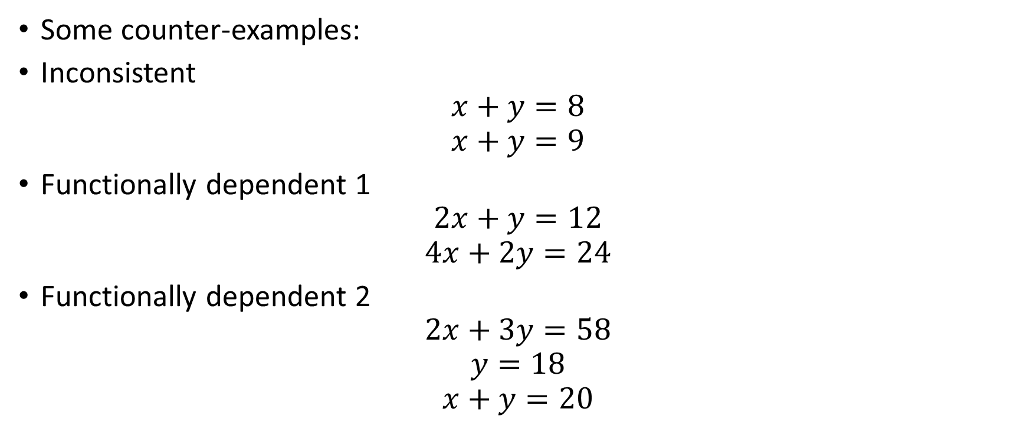
“Counting equations and unknowns”
Some counter-examples:
Inconsistent
$$x+y=8$$
$$x+y=9$$
Functionally dependent 1
$$2x+y=12$$
$$4x+2y=24$$
Functionally dependent 2
$$2x+3y=58$$
$$y=18$$
$$x+y=20$$

Slide 12
Prerequisites for “Counting Equations and Unknowns”
Consistency
  The satisfaction of any one equation in the model will not preclude the satisfaction of another
Functionally Independent
  No equation is redundant
For simultaneous-equation models, there exists systematic methods for testing the existence of a unique solution, called the Jacobian determinant. We will discuss about it later.

Slide 13
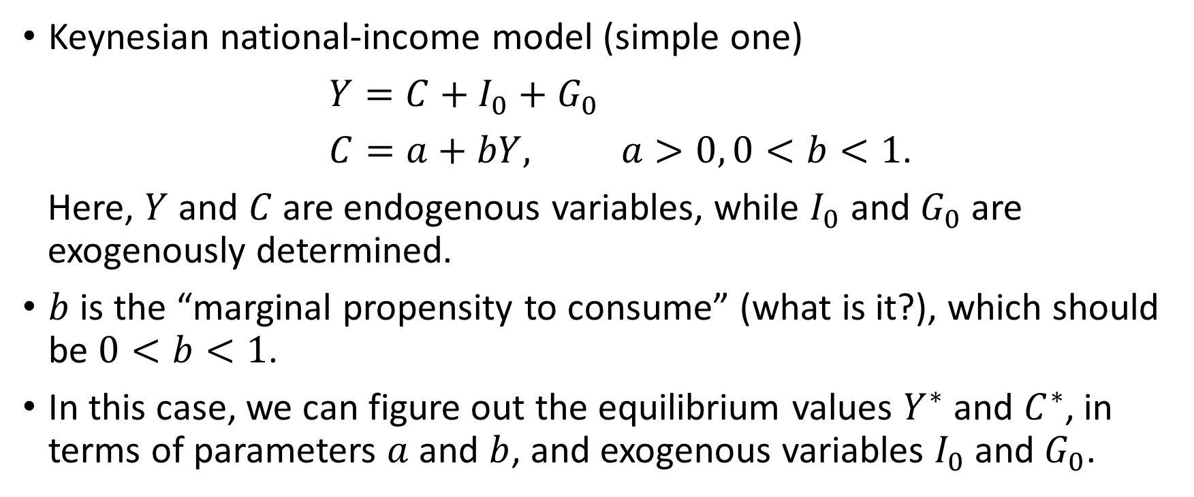
Equilibrium in National-Income Analysis
Keynesian national-income model (simple one)
$Y=C+I_{0}+G_{0}$
$C=a+bY, a>0, 0<b<1$.
Here, $Y$ and $C$ are endogenous variables, while $I_{0}$ and $G_{0}$ are exogenously determined.
$b$ is the “marginal propensity to consume” (what is it?), which should be $0<b<1$.
In this case, we can figure out the equilibrium values $Y^{∗}$ and $C^{∗}$, in terms of parameters $a$ and $b$, and exogenous variables $I_{0}$ and $G_{0}$.

Slide 14
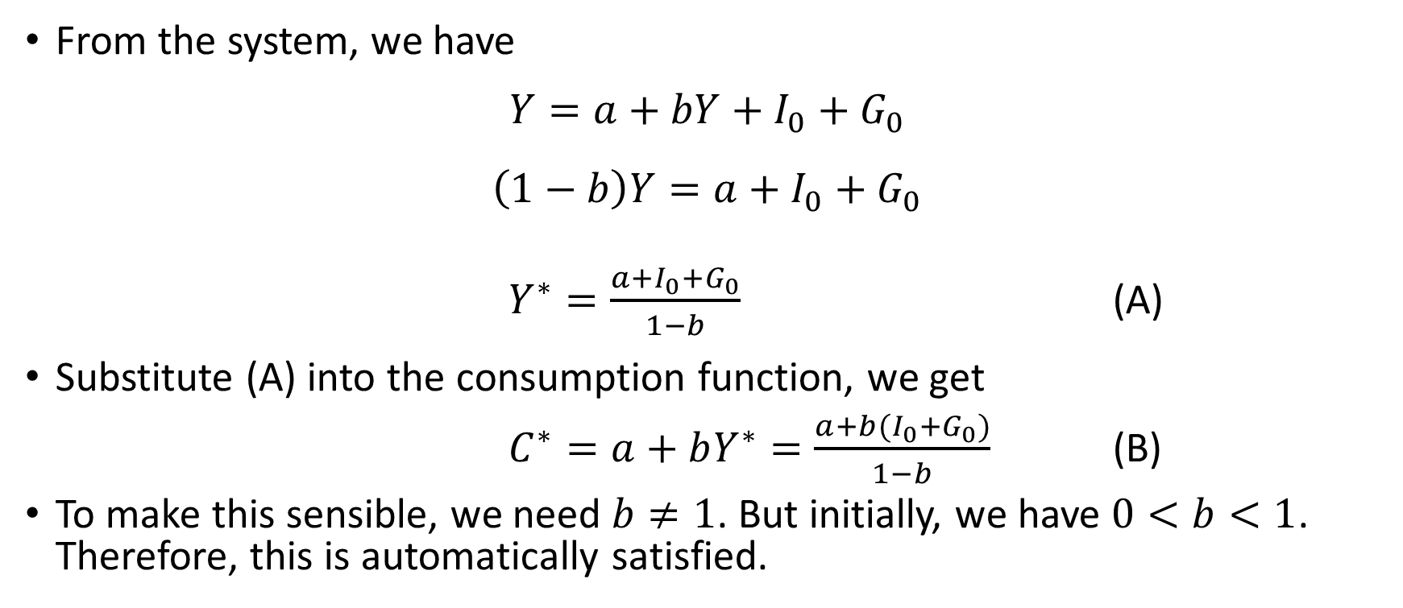
Solution
From the system, we have
$$Y=a+bY+I_{0}+G_{0}$$
$$\left(1−b\right)Y=a+I_{0}+G_{0}$$
$Y^{∗}=\frac{a+I_{0}+G_{0}}{1−b}$ (A)
Substitute (A) into the consumption function, we get
$C^{∗}=a+bY^{∗}=\frac{a+b(I_{0}+G_{0})}{1−b}$ (B)
To make this sensible, we need $b≠1$. But initially, we have $0<b<1$. Therefore, this is automatically satisfied.

Slide 15
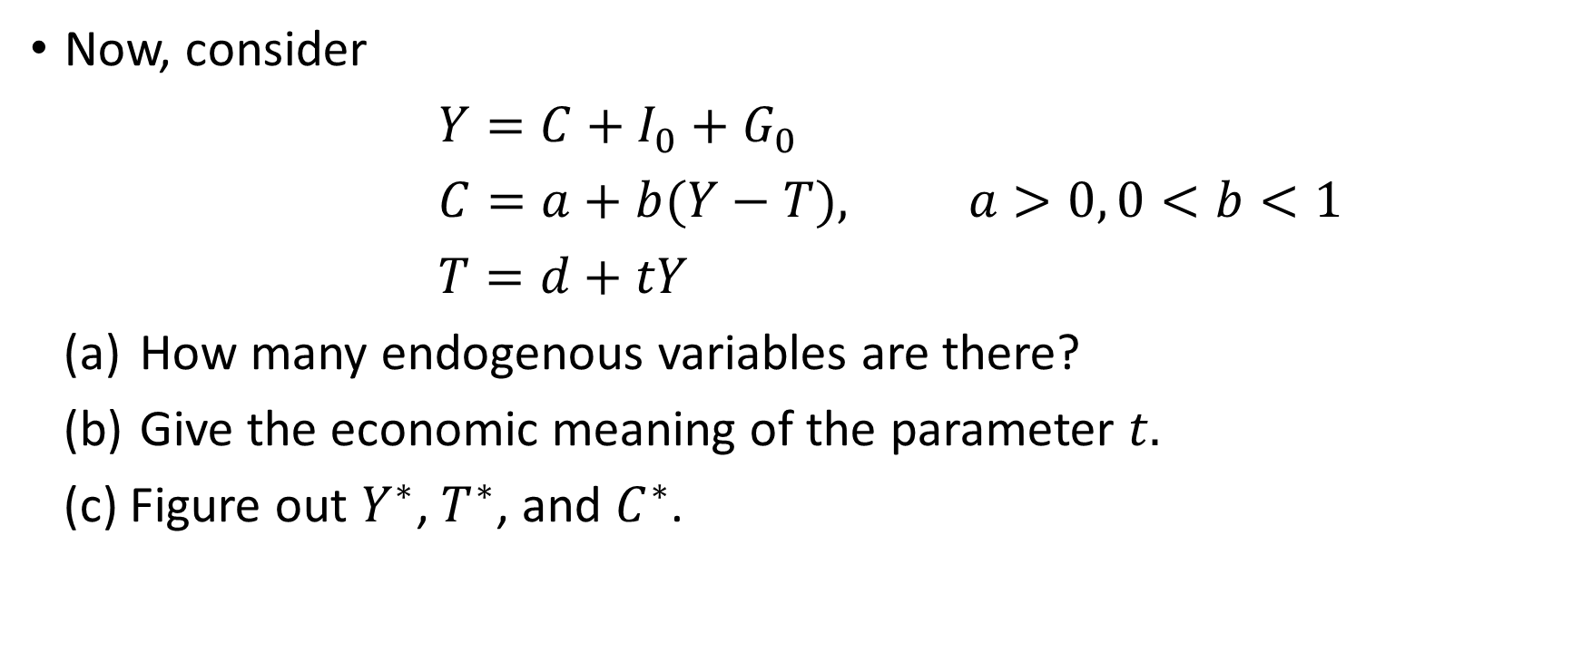
A More Complicated Model
Now, consider
$Y=C+I_{0}+G_{0}$
$C=a+b(Y−T), a>0, 0<b<1$
$T=d+tY$
How many endogenous variables are there?
Give the economic meaning of the parameter $t.$
(c) Figure out $Y^{∗}$, $T^{∗}$, and $C^{∗}$.

Slide 16
Try it here!

Slide 17
Assignment #2
Exercise 3.3 No. 5, 6
Exercise 3.5 No. 3

